Slide 1
Disruptive Innovations and Systems Thinking
MIS5801: Singapore
Bruce Hohne (Bruce.Hohne@temple.edu)
Adapted from material by Munir Mandviwalla and Steven L. Johnson

Slide 2
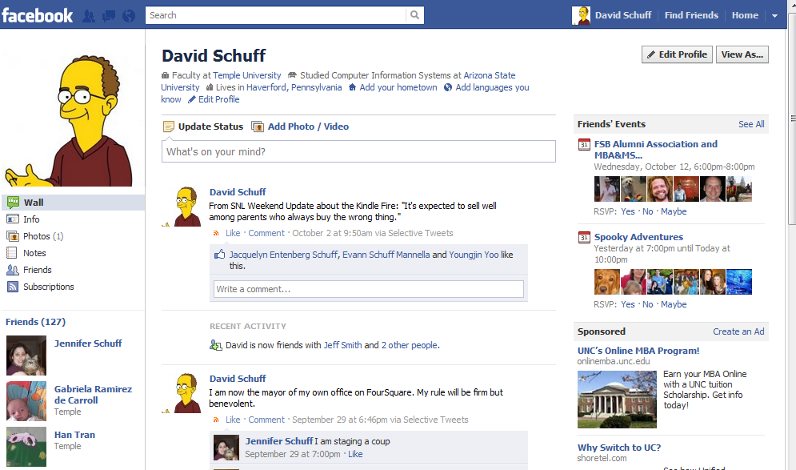
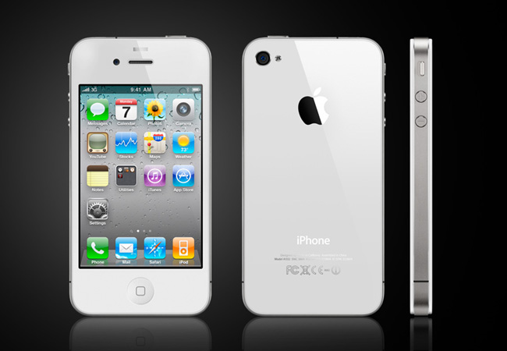
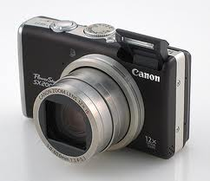
What do these have in common?

Slide 3
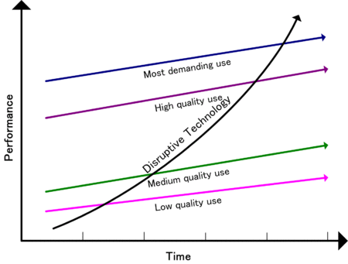
Disruptive Innovation Theory
Low-end
Quality increasing faster than need
Opportunity for low-cost entrant
New-market
Fits an emerging segment with an unmet need
Low-end disruption
http://en.wikipedia.org/wiki/Disruptive_technology

Slide 4
Responding to Disruptive Innovations
Your existing position
What’s going on in the environment
What to do
Options
Compete directly
Serve a different market
Create a new market

Slide 5
So how do companies innovate?
New products for high-margin customers
Cheap alternatives to existing products
New products for “nonconsumers”

Slide 6
Resources, Processes, Values
Resources
Assets
Processes
Way of working
Values
Criteria used to make decisions
People, cash, products
Hiring, budgeting, product development
Customer demands, ethics, cost structure
Determines whether a company embraces or ignores a disruptive innovation.
Source: Christensen, C., Anthony, S., and Roth, E. “Seeing What’s Next: Using the Theories of Innovation to Predict Industry Change.” Harvard Business School Press, 2006, p.6.

Slide 7
Understanding Signals of Change
Undershot Customers
Overshot Customers
Nonconsumers
Nonmarket Contexts
When companies are filling up-market need
When companies are filling down-market need
When new markets are being created
Barriers to innovation are changing
i.e., Government regulation
i.e., Facebook, iPad
i.e., Netbooks, Kindle Fire
i.e., new data analytics software to handle “big data”
Source: Christensen, C., Anthony, S., and Roth, E. “Seeing What’s Next: Using the Theories of Innovation to Predict Industry Change.” Harvard Business School Press, 2006, p.2.

Slide 8
Systems Thinking Versus Process Thinking
Process Thinking
Considering the system as a collection of independent processes
Decompose and optimize
Systems Thinking
Considering the system as a collection of integrated processes
Synthesize and optimize
For what types of problems is each best suited?

Slide 9
Connecting Systems Thinking to Disruptive Innovation
The Kindle as a disruptive innovation…
What processes did it directly affect?
How did it affect the publishing industry?
What were the secondary effects on society?

