Slide 1
Enterprise Applications
MIS5801: Singapore
Bruce Hohne (Bruce.Hohne @temple.edu)
Adapted from material by Munir Mandviwalla and Steven L. Johnson

Slide 2
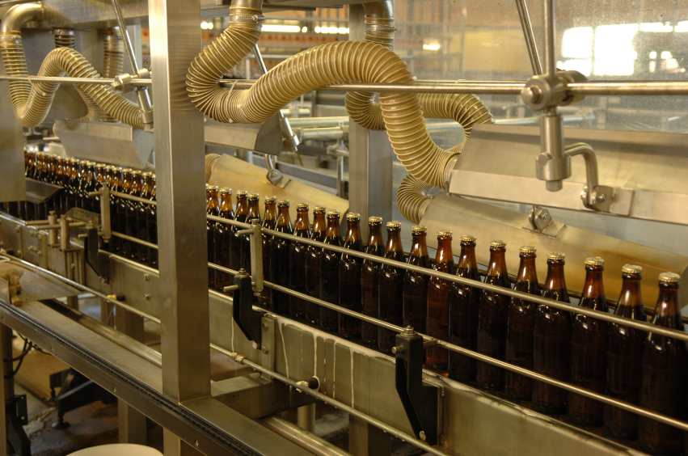
The Business Process
What is it?
Why is it important?
How does it relate to information technology?

Slide 3
Systems Thinking Versus Process Thinking
Process Thinking
Considering the system as a collection of independent processes
Decompose and optimize
Systems Thinking
Considering the system as a collection of integrated processes
Synthesize and optimize
The role of the business process in each?

Slide 4
Two Competing Models
Enterprise Approach
Distributed Approach
Organization
Accounting
Finance
Human Resources
Marketing
Manufacturing
Information Technology
Enterprise System (ERP/CRM)
Accounting
Finance
Human Resources
Marketing
Manufacturing
Information Technology
Organization

Slide 5
Enterprise Systems
Enterprise Resource Planning (ERP)
Customer Relationship Management (CRM)
What are the key goals?
What are the benefits?
What are the problems?

Slide 6
Enterprise Systems and Innovation
Do enterprise systems encourage or discourage innovation?
Are they compatible with an “agile” organization?

Slide 7
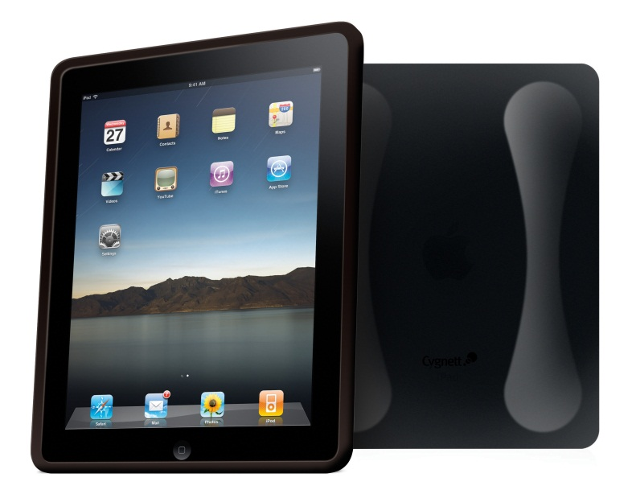
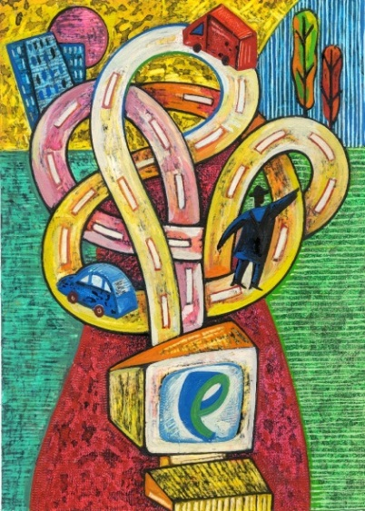
Enterprise Systems and the Modern Organization
Are enterprise systems consistent with changes in...
Mobile technology?
Social media?
A “flat” world?

Slide 8
The Future?
How do you think enterprise systems will evolve?

