Slide 1
Business Intelligence and Knowledge Management
MIS5801: Singapore
Bruce Hohne (Bruce.Hohne@temple.edu)
Adapted from material by Munir Mandviwalla, Steven L. Johnson, and Sunil Wattal

Slide 2
By the numbers
40%
61%
Say this is because there is “no good data”
72%
Want to increase their organization’s use of business intelligence
Of decisions by managers are made by using their “gut”
Source: http://advice.cio.com/thomas_wailgum/to_hell_with_business_intelligence_40_percent_of_execs_trust_gut

Slide 3
It all starts with data
Data
Gathering
Storing
Retrieving
Interpreting
Almost every business action requires at least one of these!

Slide 4
Business Intelligence Examples
Memphis Police
Used historical crime data
Place police where and when crime was likely to occur
Elie Tahari
Used real-time sales data “from the floor”
Efficiently source and distribute their inventory
Air shipments fell from 80% to 50%
http://www.ibm.com/smarterplanet/us/en/business_analytics/examples

Slide 5
When you don’t pay attention to your data…
The 2008 Housing Bubble
Careless record keeping and complex bundling led to unclear mortgage ownership.
http://www.cbsnews.com/8301-504803_162-20049744-10391709.html
Medicaid/Medicare Fraud Detection
Federal systems underused because of missing Medicaid data, disconnected systems.
http://www.cbsnews.com/stories/2011/07/12/national/main20078688.shtml

Slide 6
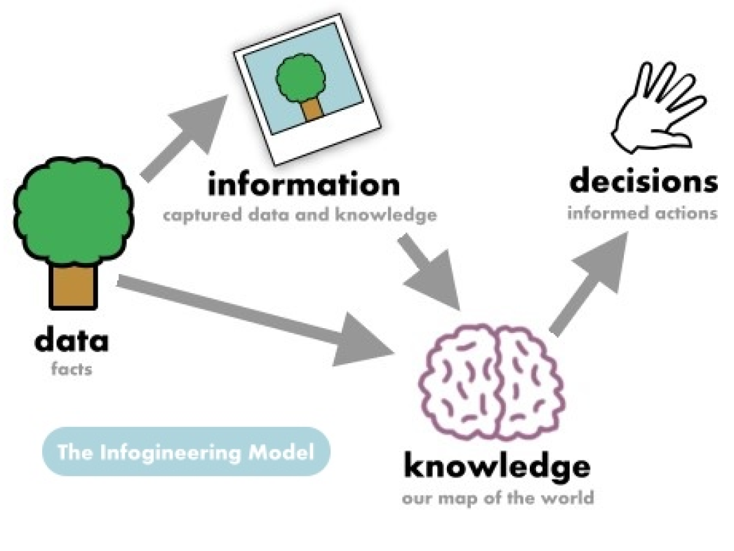
Data, Information, and Knowledge
Implication: data is always right, but information can be wrong
So in this view of the world, what is a “database”?
from http://www.infogineering.net/data-information-knowledge.htm
Definitions for these conflict, overlap, and are ambiguous. So don’t panic!

Slide 7
So according to this framework, what is…
The fact that I’m 5’10” tall?
My height printed on a piece of paper?
Everyone’s height stored in an Excel spreadsheet?
The statement “kids are generally shorter than adults?”
The understanding that height and weight are correlated?

Slide 8
This is all very philosophical. In practical terms…
Data
Information
Raw, unorganized facts
Summarized, analyzed data
Knowledge
Map of the world; beliefs and explanations
Aids interpretation
“Information into instructions” (Ackoff)

Slide 9
So then what is wisdom?
?
Who knows?
Who cares?
Is it even a useful construct?

Slide 10
Communities of Practice
What do they deal in?
Data, information, or knowledge
Structured or unstructured

