Slide 1
Evaluating Emerging Technology Trends
MIS5801: Singapore
Bruce Hohne (Bruce.Hohne@temple.edu)
Adapted from material by Munir Mandviwalla, Steven L. Johnson, Sunil Wattal, and Paul Weinberg

Slide 2
Why bother?
Defense of business
Significant potential return
These technologies can be disruptive
To you
To your competition

Slide 3
Key Concepts
Firm position
Incumbent
New entrant
Technology
Evolutionary
Discontinuous
Response
Aggressive Stance
Passive Stance

Slide 4
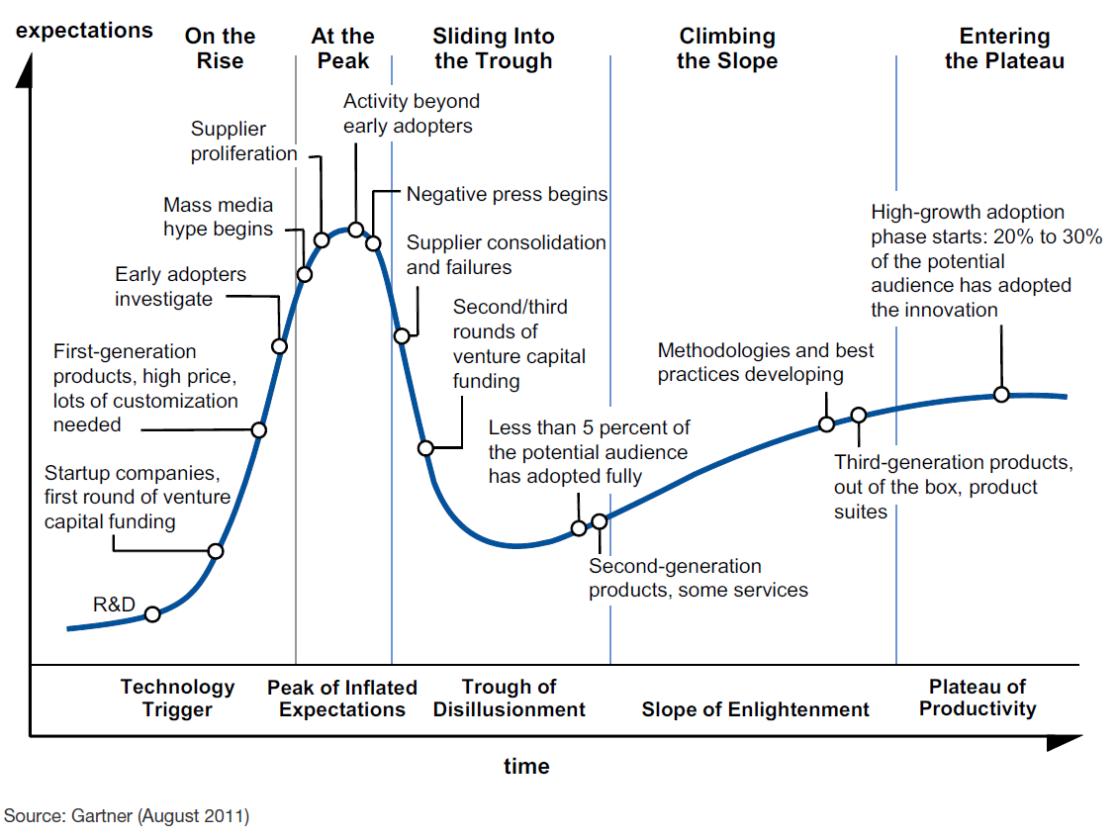
The Gartner Hype Cycle

Slide 5
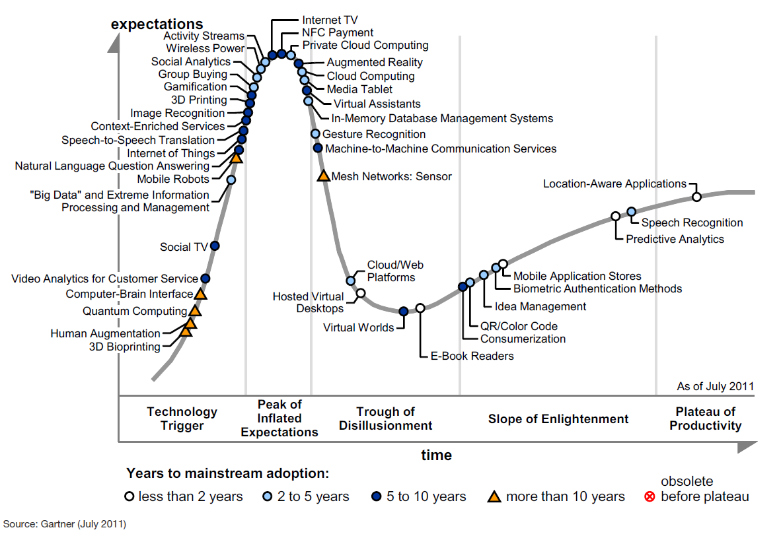
Hype Cycle for 2011

Slide 6
Mistakes Incumbents Make
Affected by an organization’s
Delayed Participation
Sticking with the Familiar
Reluctance to Fully Commit
Lack of Persistence
Resources
Processes
Values
Source: Day, G. and Schoemaker, P. (2000). Avoiding the Pitfalls of Emerging Technologies. California Management Review. (42)2. pp. 8-33.

Slide 7
Things You Can Do
Attend to signals from the periphery
Invest in a learning capability
Maintain flexibility through an options perspective
Maintain organizational separation
Would these actions be more effective when the innovation is…
Low-end?
New-market?
Source: Day, G. and Schoemaker, P. (2000). Avoiding the Pitfalls of Emerging Technologies. California Management Review. (42)2. pp. 8-33.

