Slide 1
I.T. DOESN’T MATTER or DOES IT?
Group 6
Dominik
Santosh
Austin
Notes:
I.T. in Organizations: Risk, Strategy and Costs
Potential Pitfalls
Commoditizing IT Solutions
Common Pitfalls
IT as a knowledge distributor
Paul Strassman

Slide 2
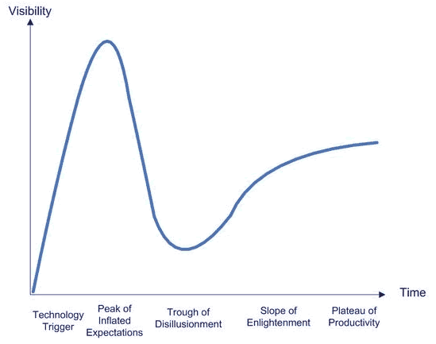
Using Information Technology in Organizations
Risk
Strategy
Cost
As of today it has already matured and is commercially available

Slide 3
Potential Pitfalls
Strategic alignment – commodity, infrastructure, utility
Is it key technology? Or just a tool?
What matters most about IT is the people running it (competitive advantage comes form the people)
Overspending: IT is not the core business but (sometimes requires huge sums to run effectively)

Slide 4
IT solutions have commoditized and standardized
IT is developed as an open solution – everyone can take advantage of it
Internal development must be very carefully considered
It is arriving a natural end of growth cycle
Might have too much focus on IT related issues and methods
How you fit your business to IT rather than how IT fits your business

Slide 5
Common pitfalls
Delayed participations
Late start can create competitive disadvantage as IT becomes commodity
Sticking with the familiar
Systems are available and installed but people are not using them
Reluctance to fully commit
Traditional technology still used for subsystems
Lack of persistence
IT still seen as support group and not business partner

Slide 6
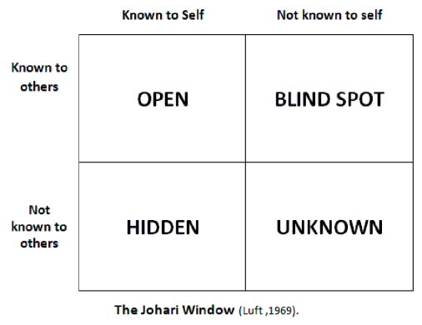
IT as a knowledge distributor
Management must have sufficient attention to the IT risks (confidentiality vs innovation)

Slide 7
Enter Paul Strassman
CIO General Foods, Kraft, Xerox
Executive Advisor NASA
Department of Defense
Carr’s Assertions:
IT has lost strategic value
IT is a commodity that does not offer…competitive advantage
IT will be macroeconomic & not competitive differentiation
IT is a transport technology, open to all & offers no advantage
Notes:
Any proof that rests entirely on analogies is flawed
Competitive Advantage Is not the result of PC’s, but effective management
The proposition that IT benefits will flow to consumers and not to businesses is a contradiction…value for customers & companies
This is a misunderstanding of IT. Message transport is not the reason IT is deployed. It is for the management of information intelligence & collaboration.

