Slide 1
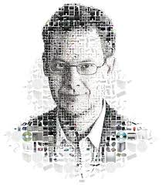
IT Doesn’t Matter
What opportunities exist for companies now….
By
Talwinder Singh
Logu Subramaniam
Terrance Burns

Slide 2
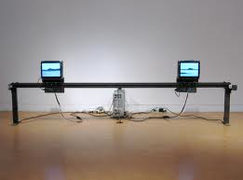
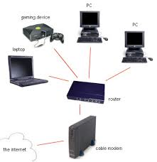
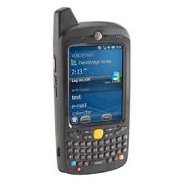
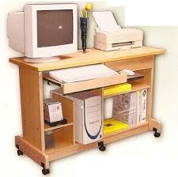
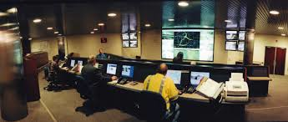
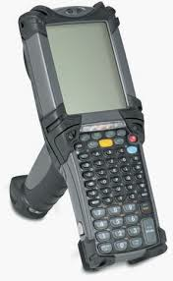
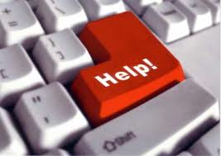
IT of the past …..2003
It’s about supporting a product/business for efficiency, productivity, networking and cost reduction

Slide 3
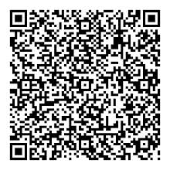
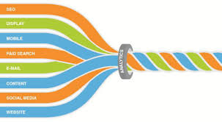
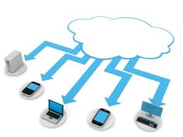
IT of Today
Manage your key business in single integration system

Slide 4
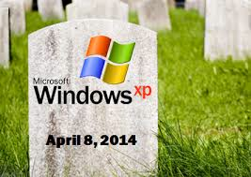
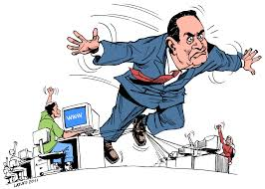
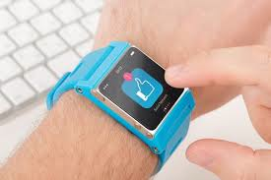
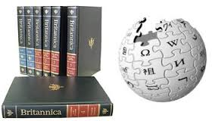
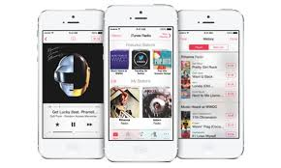
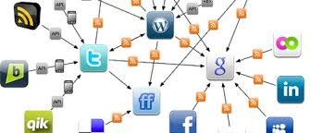
IT of Today……
IT is the product & service!!!!

Slide 5
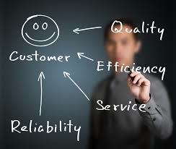
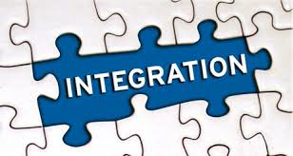
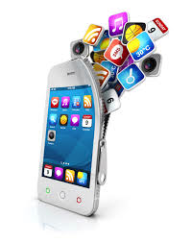
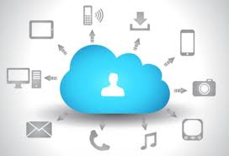
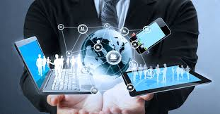
IT is all about…
Support on fundamentals – The end customer
IT integrate people, process & technology – partnership
Smart phone application – customer experience thru mobile application
Manage Personal Cloud - is about service and not the device
Develop IT service via web – re-invent IT service & delivery method
Green technology – Efficient & Clean Energy

Slide 6
IT is all about…
Finance
Social Network
eBusiness
Corporation
Delivery
Transporatation

Slide 7
Opportunities for the Future
Continuous improvements in increasingly shorter time spans as IT becomes more personalized, more customized and more customizable
Chief Information Officer ---- Chief Innovation Officer.
Focus on being agile and adaptive.
Shift focus from growing or updating the IT department, to instead integrating IT throughout the business
Turning information systems from a underutilized fixed asset to a variable low cost expense.
Technical roles will be increasingly outsourced to third-party suppliers, as organisations use the cloud to simplify their applications and IT infrastructure

Slide 8
IT of The Future
The integration of technologies will continue to expand
communications, computing, audio, video
Will become smaller and more powerful.
Improved interfaces
Handwriting and speech recognition, facial recognition, virtual keyboards and virtual screens
Cloud Computing – whatever, wherever, whenever
Bandwidth – Expanding globally
Automation and 3D Technology will continue to decrease the cost of products and services, making it possible to reduce prices while improving profits

Slide 9
IT DOES MATTER
Business is becoming connected, intelligent, real time, customizable, multi-platform

