Slide 1
Mainer Herrera
Kenneth Sumbuk
Pravin Nehete
Ong Han Boon

Slide 2
What opportunities exist for companies?
Integral to all businesses and people
Larger global market
Increasing Speed of IT
Lowering Cost of IT
Greater connectivity
New technologies developed
Intelligent and innovative applications to help solve business problems and opportunities

Slide 3
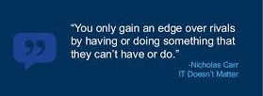
What opportunities exist for companies?
More companies can have access to technology ,as IT becomes a commodity.
Companies will be able to spend their money on other areas that will provide them a true competitive advantage.
Standardizing processes and utilizing IT systems will be the norm, this will also provide a workforce that is trained on these systems, this will be beneficial for companies as more skilled people will be available.

Slide 4
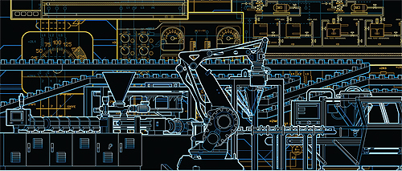
IT & Allied Industrial Automation
Manufacturing Plant Automations to reduce production cycle time.
Replacing human operators in tasks that involve hard physical or monotonous work & Replacing humans in tasks done in dangerous environments (i.e. fire, space, volcanoes, nuclear facilities, underwater, etc.)
Performing tasks that are beyond human capabilities of size, weight, speed, endurance, higher degree of accuracy
Reduces operation time and work handling time significantly with Distributed Control System (DCS), Supervisory Control & Data Acquisition System (SCADA) & Programmable Logic Controllers (PLC)..

Slide 5
IT & Allied Industrial Automation
Provides higher level jobs in the development, deployment, maintenance and running of the automated processes.
Wide application in almost all sort of industries including aerospace, Oil & gas (Upstream & Downstream), Power (Smart Grids), Chemical (Wireless field devices), Railways, buildings, Home - smart Appliances, Artificial Neural Networks & intelligence system, Telecommunication, Health care Industries.
Changing workplace rules (Globalization).
ERP & CRM system.

Slide 6
What opportunities existed for the companies
Invest more on the human capital of the enterprise. Since the IT will now be easily accessible and much cheaper, the massive financial investment of the companies now can be diverted to the human capital, after all, IT is only a tool for enhanced productivity.
It is the human face of the enterprise that ensures the proper and effective use of the IT that is now easily and cheaply available
Increase competition. With the easily and cheaply availability and accessibility of IT, the dynamics of competition changes for the better. Increase competition is beneficial to customer and in the long term the continued improvement of the IT.

