Slide 1
Volkswagen of America: Managing IT Priorities
Managing IT Priorities
Mainer Herrera
Kenneth Sumbuk
Pravin Nehete
Ong Han Boon

Slide 2
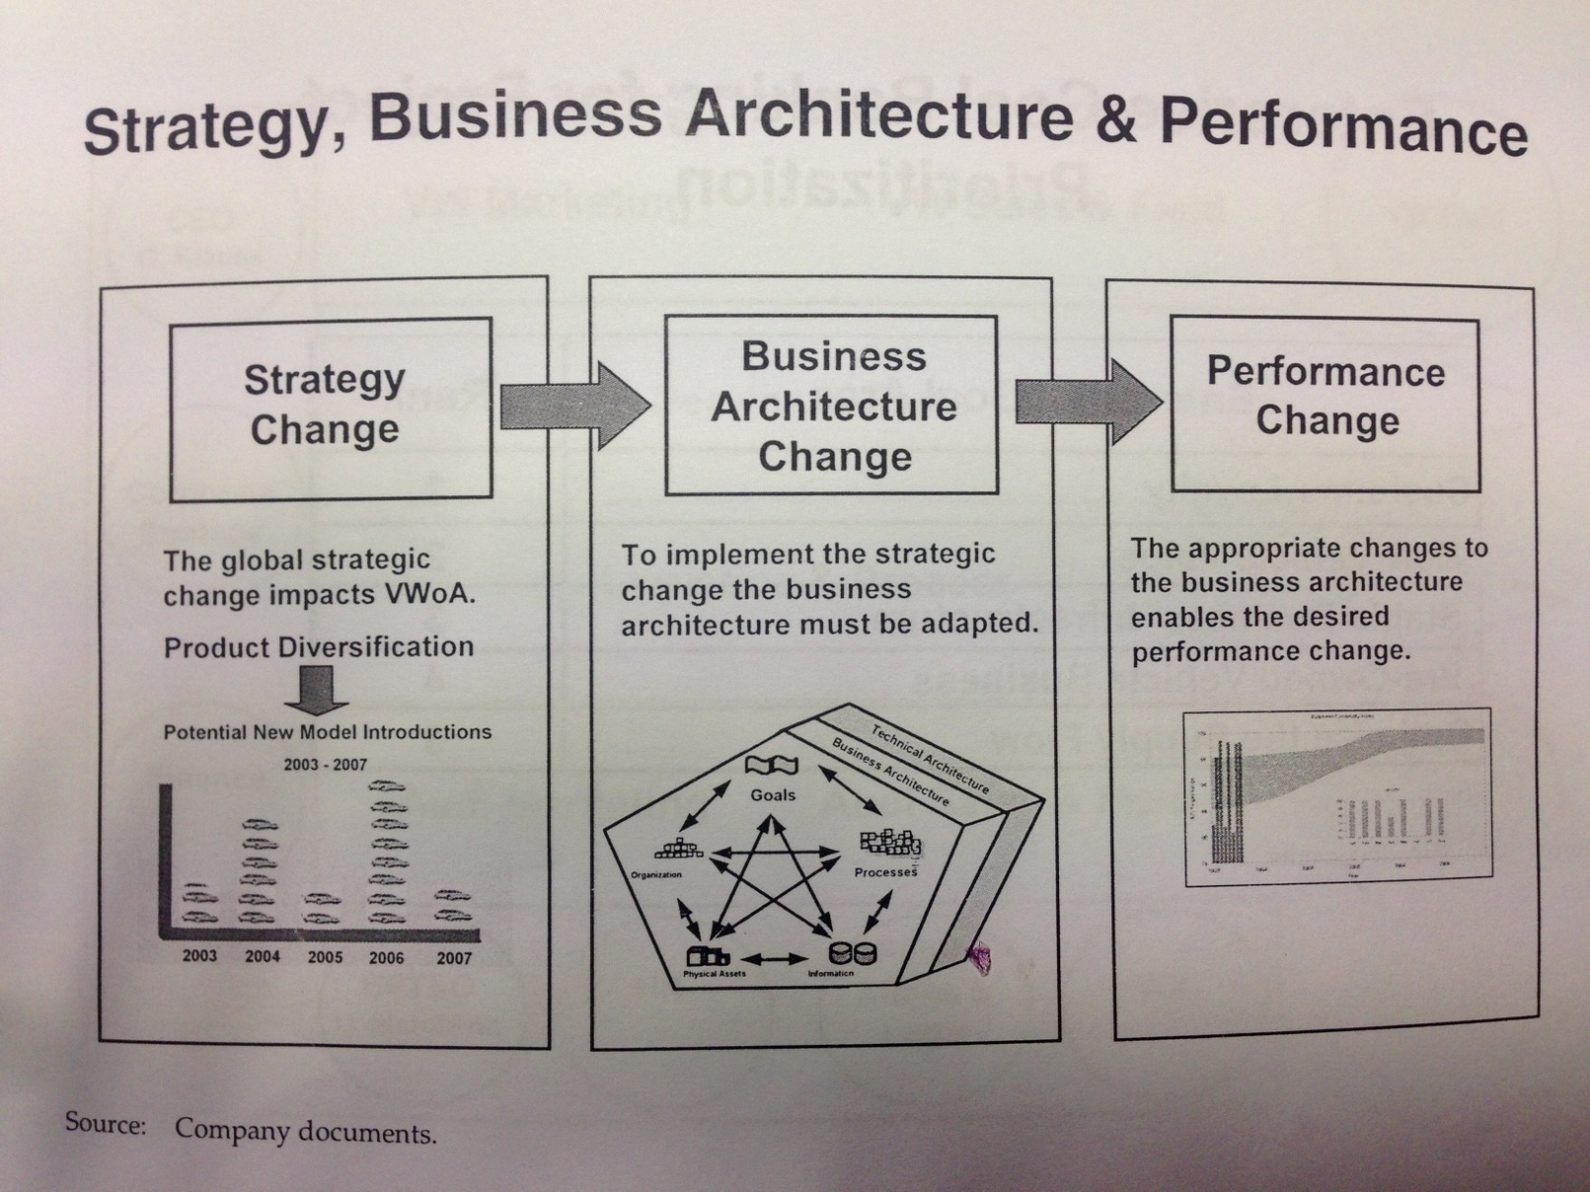
What VWoA did Right

Slide 3
What VWoA did Right
New process & architecture of prioritizing IT Projects-
Structured around core processes (sales & marketing, logistics, after-sales service)
Supported Next Round of Growths (NRG) & high level of business goals to “build brand customer loyalty” & “Improve vehicle value”.
Created digital marketing assets & interacting with customers in new ways.
Formation of Business Process, Technology & Organization (BPTO) to avoid schedule & cost overruns of IT projects.

Slide 4
IT governance processes implementation & formation of IT steering committee (ITSC).
PMO with qualified project managers & Project management standards
Three phases of selecting & categorizing projects:
Calling for projects, communicating process & identifying dependencies
Formal project request from business units.
Transforming business unit request into enterprise Goal portfolio.

Slide 5
How it enabled innovation?
Innovation: the discovery of better solutions that meet Business requirements & needs of existing market.
Divided into two broad categories: Evolutionary innovations (continuous or dynamic evolutionary innovation) that are brought about by many incremental advances in technology or processes and revolutionary innovations (also called discontinuous innovations) which are often disruptive and new.

Slide 6
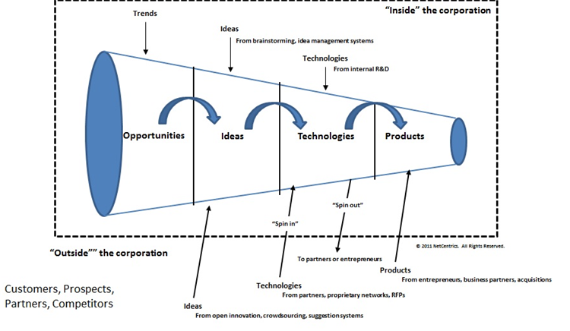
Source of Diagram: http://4.bp.blogspot.com/-bCWBIOcRew4/TZOTUmxvl6I/AAAAAAAAAE8/rjTjm8tb6I4/s1600/Innovation+Funnel+3.jpg

Slide 7
Innovation is enabled by:
Obtain feedback to be able to adjust strategies and come up with new ideas to improve their portfolios.
Align IT project selection process with corporate strategy and business goals
Identify dependencies among projects, grouped similar projects and maximize coordination and performance with a limited budget.
Categorization in the project investments:
Stay in Business (SIB)
Return on Investment (ROI)
Option Creating Investment (OCI) similar to ROI

