Slide 1
NEW AIR
ENTERTAINMENT
Stephanie Cheng, Tyler Gaber, Kevin Santoni, & Dario Trabucco

Slide 2

Problem
Airlines always looking for ways to differentiate themselves
Struggle to implement mobile technology in processes
Removing television screens
Struggle to provide a quality customer experience

Slide 3

Notes:
According to SkyTrax (airline and airport review website), 4,500+ passengers reviewed the in-flight experience of the top four airlines in the U.S. based on revenue
Delta, Southwest, American, United
Passengers gave the airlines a 2 out of 5 stars

Slide 4
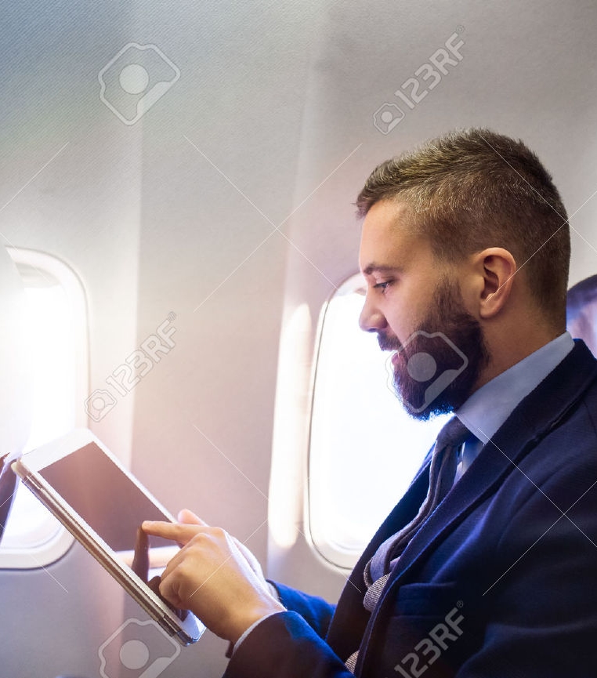
Solution
Mobile gaming app
Selection of games like chess, connect four, etc.
Compete against other passengers on same flight

Slide 5
88% of passengers bring their smartphone on the flight;
51% bring their tablet
42% of passengers pay for Wi-Fi on the airplane for entertainment purposes
In 2015, the U.S. gaming marketing had a total of $23.5 billion in sales with a 4% growth rate YoY

Slide 6
“We firmly believe that giving people access to in-flight entertainment when they’re captive for an hour or two will make us a fortune.”
Michael O’Leary, CEO of Ryanair

Slide 7
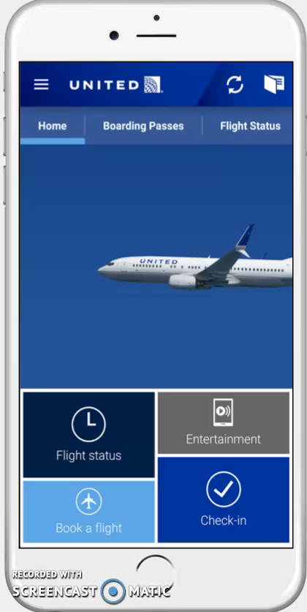
Business Strategy
Implemented into existing application
Free to access; purchase additional plays
Short-term vs. frequent flyer profiles
Incentives; Free plays & prizes
Notes:
Hit play before you start speaking

Slide 8

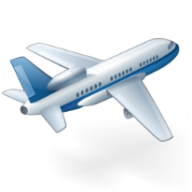


New Air Entertainment
Games are accessed through organization app
User
Airplane’s Wi-Fi connection will give access to the games
Airplanes
Games will be hosted on the cloud
Amazon Cloud Services

Slide 9
Financial Overview

Slide 10


Future Plan
Notes:
Global expansion into China
China has the largest and fastest growing gaming market in the world
Expand client base (other transportation industries; trains and buses)
Amtrak, Greyhound, Peter Pan
Both transportation options are in need of additional sources of revenue and providing customer entertainment is an area neither has explored before

Slide 11
NEW AIR
ENTERTAINMENT
Notes:
Our solution will help support our clients’ need to improve customer experience and will generate additional source of revenue to also differentiate themselves from competitors.

Slide 12
References
http://www.lonelyplanet.com/news/2016/02/17/survey-air-passengers-bring-two-to-three-electronic-devices-on-flights/
https://newzoo.com/insights/articles/global-games-market-reaches-99-6-billion-2016-mobile-generating-37/
http://www.businessinsider.com/these-are-the-7-biggest-us-airlines-2016-4/
http://www.airlinequality.com/
http://airtravel.about.com/od/traveltools/fl/Report-Airlines-Struggle-to-Offer-Personalized-Customer-Experience.htm
https://newzoo.com/insights/articles/global-games-market-reaches-99-6-billion-2016-mobile-generating-37/
http://www.bigfishgames.com/blog/2016-video-game-statistics-and-trends/
http://www.lonelyplanet.com/news/2016/02/17/survey-air-passengers-bring-two-to-three-electronic-devices-on-flights/

