Slide 1
License Key Sentry
Mike, Andrew, Jack, Kellen
Notes:
Kellen

Slide 2
The Data: Software License Audit Costs are Too High
Companies Need A Way To Prepare and Prevent...
Over ⅓ of enterprises reported 200K settlement
63% of enterprises audited yearly
13 out of 20 top IT vendors actively audit customers
Violating firms pay on average 34% of contract value
Notes:
Kellen

Slide 3
Business Problem: License Audits Waste...
TIME
MONEY
RESOURCES
Software audits and compliance violations waste time and money
Businesses lack tools to track license utilization
Software audits are inevitable; wasting time and money on them is not
Notes:
Kellen

Slide 4
Solution: License Key Sentry Product and Service
Exportable Utilization Log
Cost-saving license allocation Strategies
Overuse Notifications
Expert Consultation
Notes:
Andrew
We have the ideal balance of features
The reason we are unique is because we do license auditing with other features
Software utilization metrics
Keeping track of receipts; alerting when company is using software without a receipt
Reduce the likelihood and occurence of penalties
Find more research on penalty prices

Slide 5
licensekeysentry.com
License Key Sentry
Platform
Notes:
Jack
Tell the crowd to follow along if they have their laptops

Slide 6
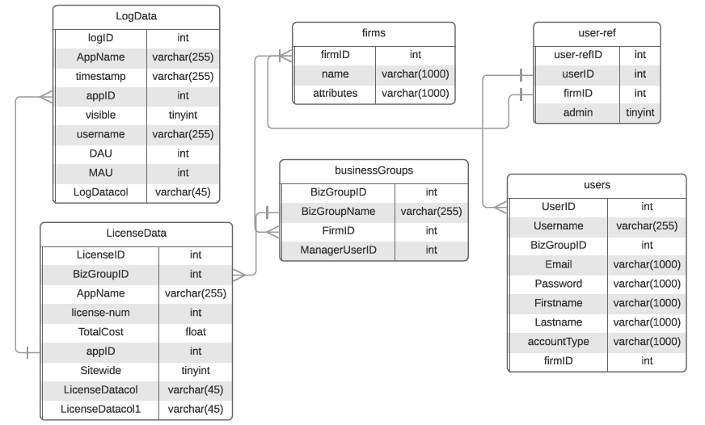
Data Model Overview
Notes:
Jack

Slide 7
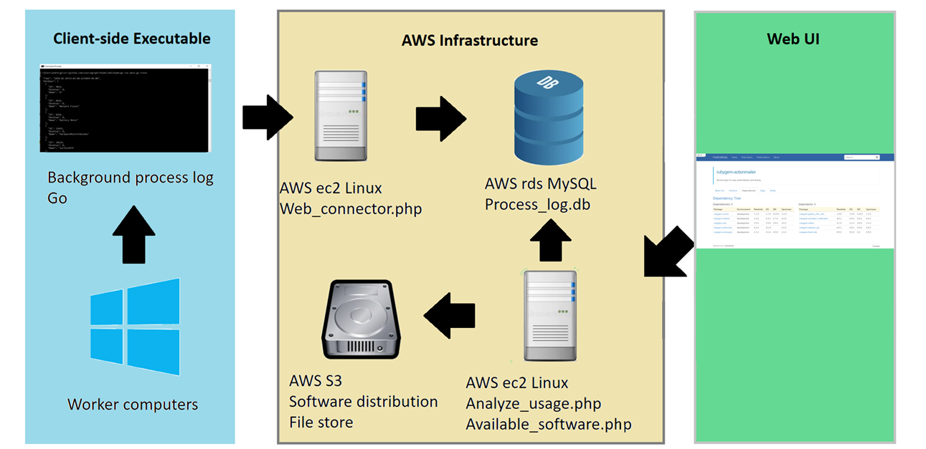
Systems Architecture
What is the overall architecture? (MIS 2501)
Notes:
Andrew

Slide 8
Competitive Market Analysis
Product: → | Manage Engine | SNOW | Reprise Software | Intelex | License Key Sentry
Cloud-Based |  | X | O |  | X
Software Discovery | X | X |  | X | X
Utilization Metrics | X |  | X | X | X
Exportable Audit Reports | X | X |  | X | X
Consultation |  |  |  |  | X
** O = Self-managed cloud solution
SaaS (Software as a service) Firms → Products make more work for companies that buy them!
Notes:
Kellen
This needs to be made pretty

Slide 9
Subscription-based cost structure
$900 / Month
Support and maintenance fees
10 percent of software platform revenue
$5,000 ad revenue per customer
Advertising
Bill hourly for consulting services
Quarterly engagement per customer
Notes:
Hello everyone, now I am going to take you through our revenue model.We are currently estimating four sources of revenue, with consulting services as our main source of revenue.
First off, on the first point of our slide, our software platform is going to have a subscription-based cost structure. Each company that purchases our software will pay $900 per month for unlimited use of our license audit platform. This will come out to $10,800 per year for each company that uses our software platform.
The second source of revenue on the slide, support and maintenance fees, is directly correlated to the use of our software platform. When companies use our platform, they will need support and maintenance with troubleshooting and errors or upgrades. Companies will want to tailor our software to their own specifications, and we are estimating that this will generate revenue of about 10 percent of the software subscription.
For my third point, and the largest portion of our revenue, these are our consulting services. This pricing structure will follow a typical consulting services model. We will charge $150 per hour for our services, and as a part of our terms and agreements of our product and service package, we will perform a yearly review of the customer’s license audit strategy and use of our platform.
And for the last source of revenue, we are going to allow companies to advertise on our platform. This will be at a price of $5,000 per company.
https://pixabay.com/en/skyscraper-glass-facade-offices-418189

Slide 10
Gross Income | Year 1 | Year 2 | Year 3
Software license management system (SLMS) customer subscriptions ($900 per month) | $108,000 | $324,000 | $540,000
Annual support and maintenance fees | $10,800 | $32,400 | $54,000
Consulting services | $480,000 | $1,440,000 | $2,400,000
Advertising | $- | $150,000 | $200,000
Total Income | $598,800 | $1,946,400 | $3,194,000
Expenses
Marketing & advertising | $341,000 | $316,000 | $316,000
Salaries & wages | $741,430 | $1,350,680 | $1,950,680
Rent costs | $73,200 | $96,000 | $132,000
Hosting & Server Costs | $30,002 | $45,004 | $75,006
Total Expenses | $1,185,632 | $1,807,684 | $2,473,686
Net Income | -$586,832 | $138,716 | $720,314
Projected 3-year Budget
Notes:
Now, on the slide here is our projected 3-year budget.
Starting with revenue, these are the actual numbers that we are projecting for our revenue sources. These are year-end numbers, so at the end of year 1 we are projecting XXX, in year 2 we are projecting XXX, and in year 3 we are projecting to gain XXX.
For our expenses, we are going to spend money on marketing & advertising, salaries & wages for our employees, rent costs, and hosting & server costs for computer equipment.
In year 1 we are expecting total expenses of XXX and net income of XXX. In year 2 we are expecting total expense of XXX and net income of XXX, and in year 3 we are expecting total expenses of XXX and net income of XXX.
We will breakeven in year 2, and from year 3 and on we will keep aiming to increase profit every year.

Slide 11
Implementation plan
Implement key platform upgrades
Market to customers and clients
Hire sales team and begin collecting revenue!
Get Cash
Hire Great People/Hiring
Protect Against Roadblocks: Unexpected
Months
1
3
4
8
9
12
Notes:
Mike or Andrew?
https://www.entrepreneur.com/article/236499

Slide 12
Questions for the Founders?
Thank you for your time!
Jack Perrotta, CTO
Andrew Kondelin, CIO
Kellen O’Connor, COO
Mike Doyle, CFO
Notes:
Survey Source: “White Paper: Flextera and IDC Research Survey - Software License Audits and Costs & Risks to Enterprises.”

Slide 13
