Slide 1
Along The Way
What do you want to do today?

Slide 2
The Team
“Why are we the ones to solve the problem we identified?”
Michael Seagraves
Justin Klaugh
James Dantonio
Theo Wilks
Justinmind SME
Business Analyst
Documentation Specialist
Project Manager

Slide 3
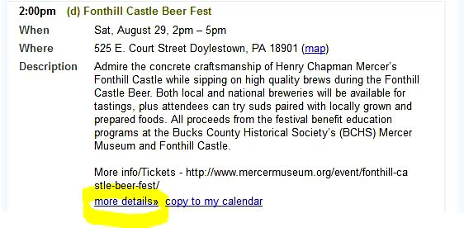
The Problem
People can’t find smaller events in one centralized resource
Small businesses and events have trouble getting exposure
Advertising in newspapers and commercials is expensive
Increasing dependency on mobile devices

Slide 4
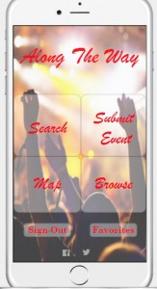
The Solution
Mobile application that consolidates lesser known events
Search events within a certain radius and time frame
Satellite-view of all events in a designated viewing area
Browse all nearby events
Submit upcoming events

Slide 5
Competitive Analysis & Market
Clients:
Event promoters
Marketing Agencies
App Users (Event seekers)
Competitors:
TripAdvisor
Craigslist
Facebook
Newspaper ads
Market:
Advertising
Event Planning/Finding

Slide 6
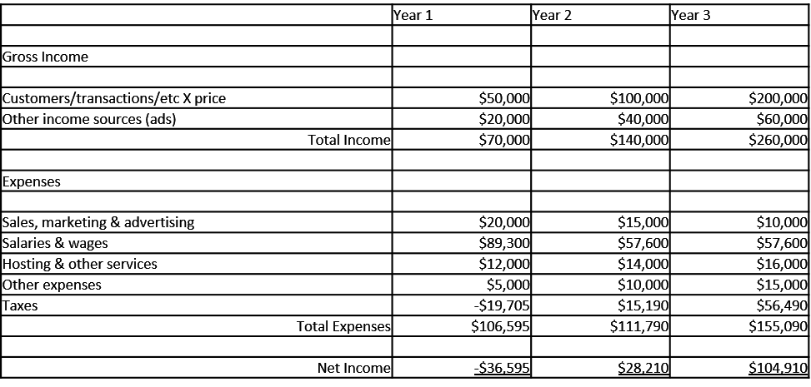
Financials

Slide 7
Risks
How to minimize?
Self adverstisement
User friendly interface
Diverse selection of events
Submission reviewal process
Users do not download app
Promoters do not submit events
Select demographic
Only popular in certain geographic areas
Accuracy of events

Slide 8
Implementation Plan
Step 3
Step 2
Step 1
Revised application and finalized project deliverables
Updated Status reports biweekly and designed application
Formulated Project Charter and planned design of application

Slide 9
Find project sponsor and application developers
Partner with event promoters and small agencies
Launch app to market (Apple app Store & Google Play)
6 months
10 months
12 months
18 months
24 months
Purchase server and employ administrator
Promote ‘Along The Way’ app to event seekers

Slide 10
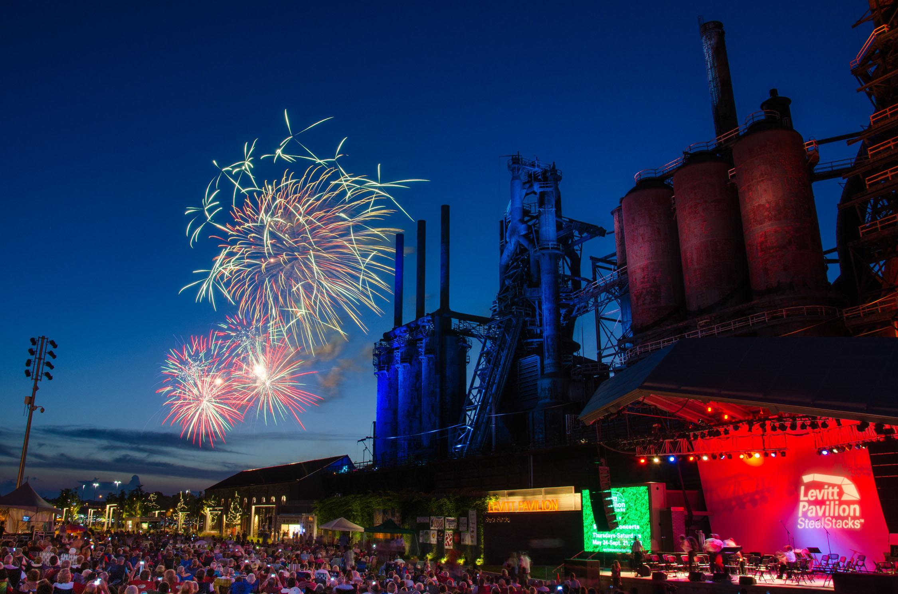
Questions?

Slide 11
Appendix

Slide 12
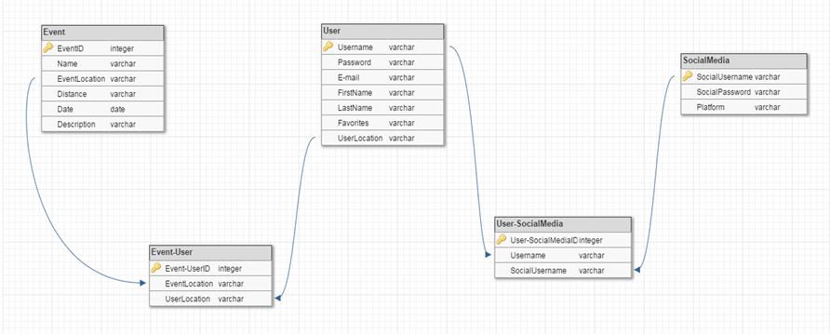
Data Model Overview

Slide 13
Process Model Overview
Create an account

Slide 14
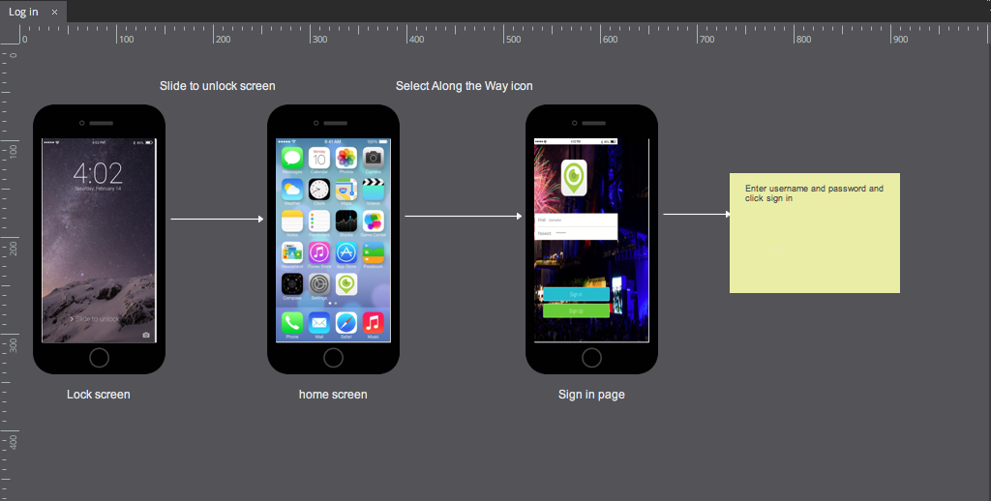
Process Model Overview
Log-in

Slide 15
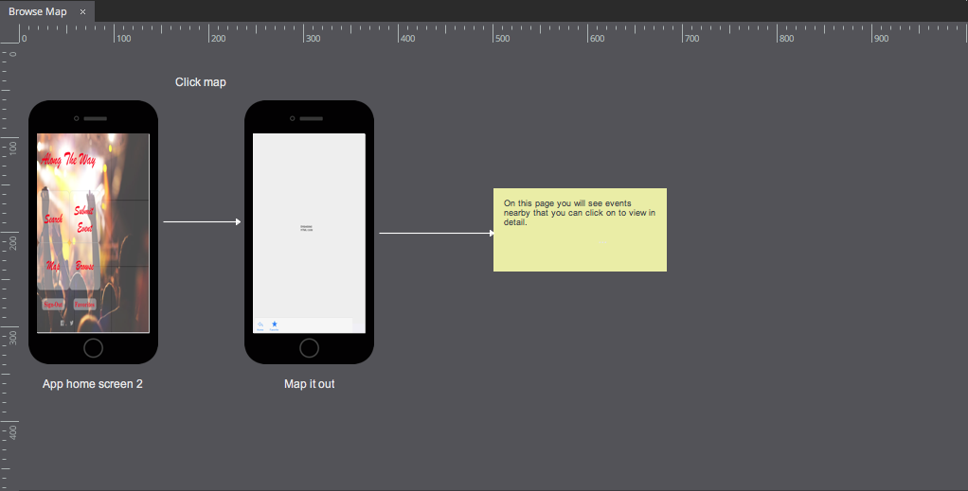
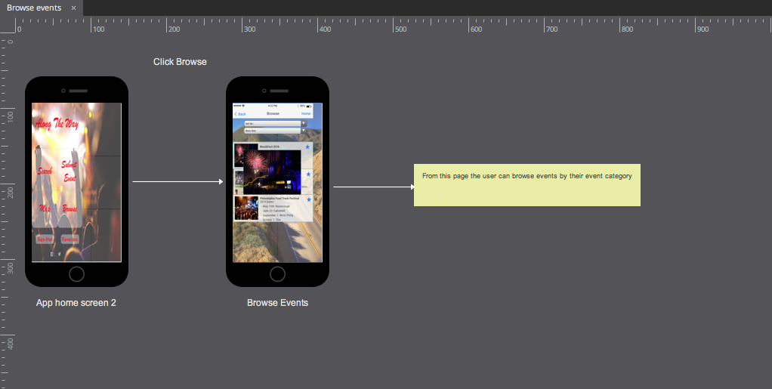
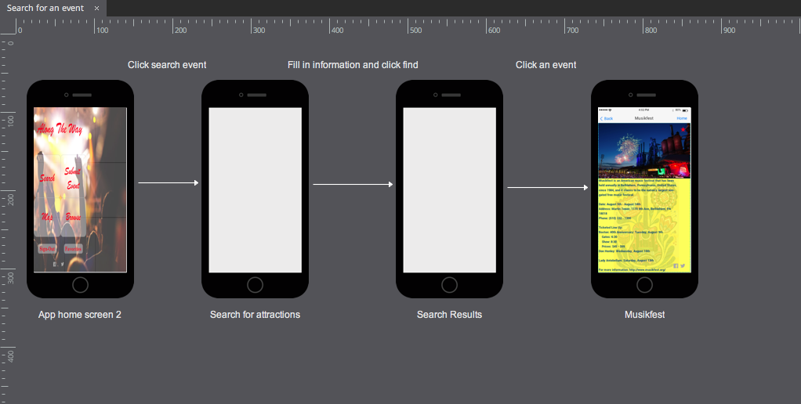
Process Model Overview
Search for an event

Slide 16
Process Model Overview
Browse Events

Slide 17
Process Model Overview
Browse Map

Slide 18
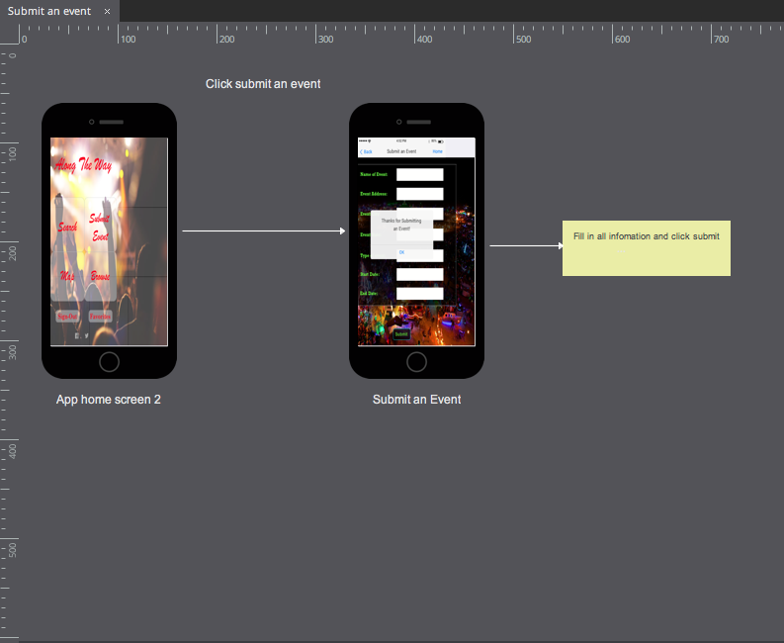
Process Model Overview
Submit an event

Slide 19
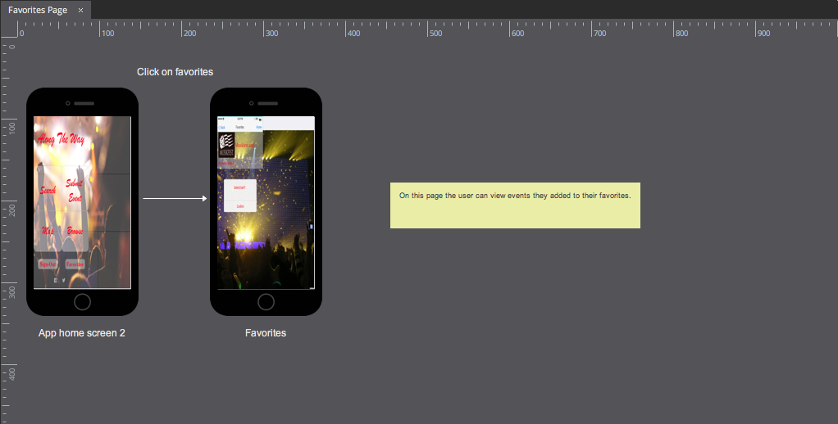
Process Model Overview
Favorites Page

Slide 20
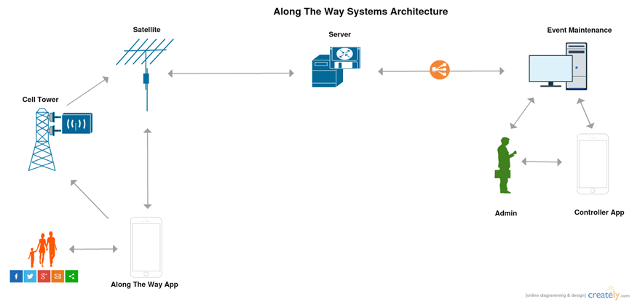
Systems Architecture Overview

