Slide 1
Process model overview
Create an account

Slide 2
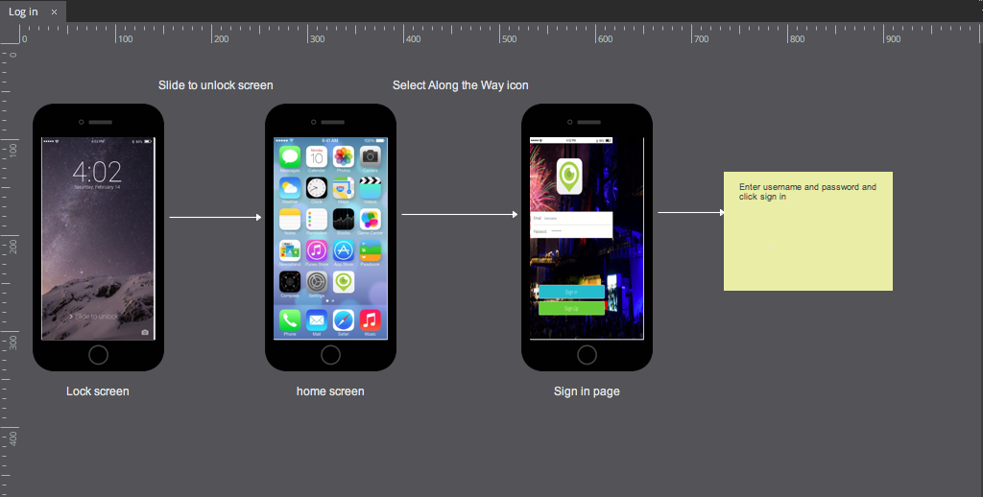
Process model overview
Log-in

Slide 3
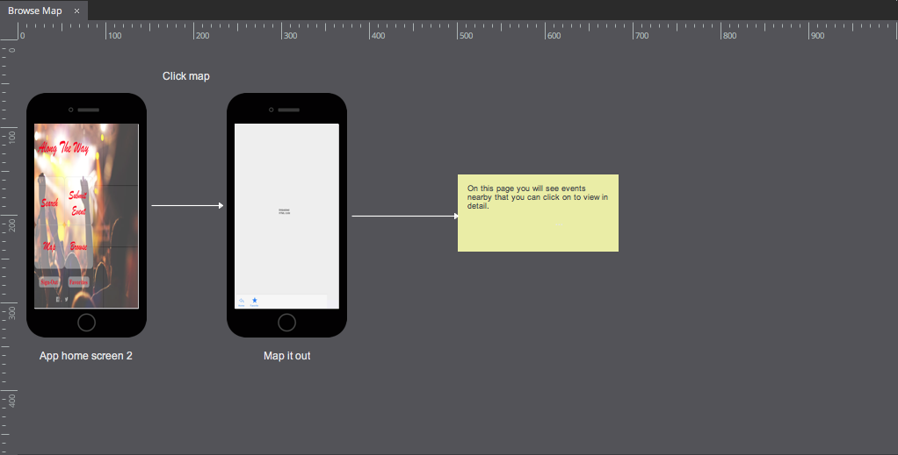
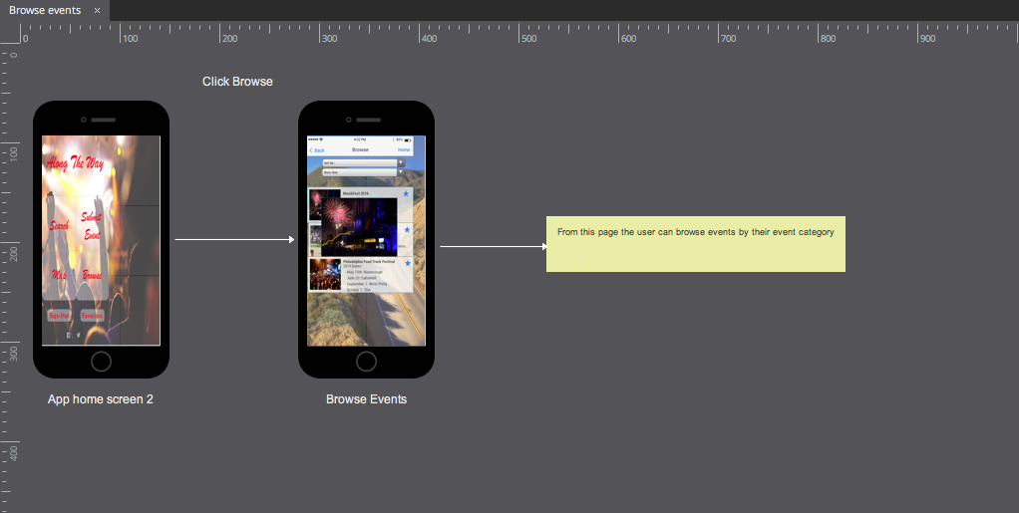
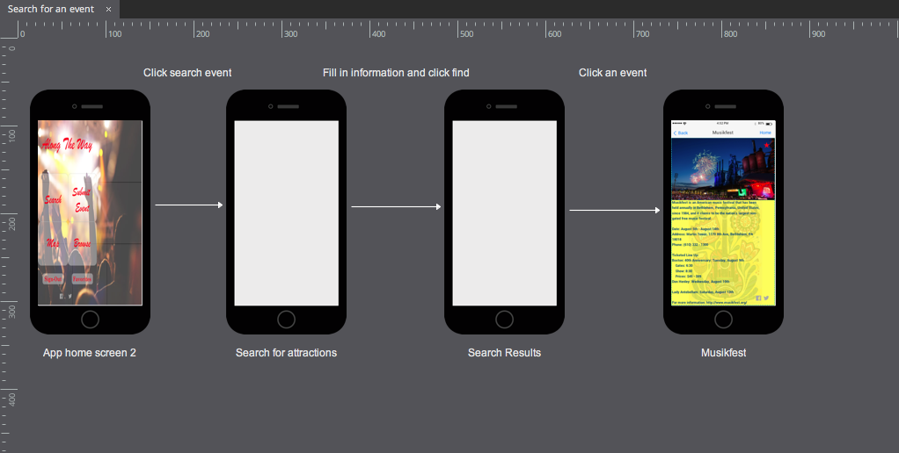
Process model overview
Search for an event

Slide 4
Process model overview
Browse Events

Slide 5
Process model overview
Browse Map

Slide 6
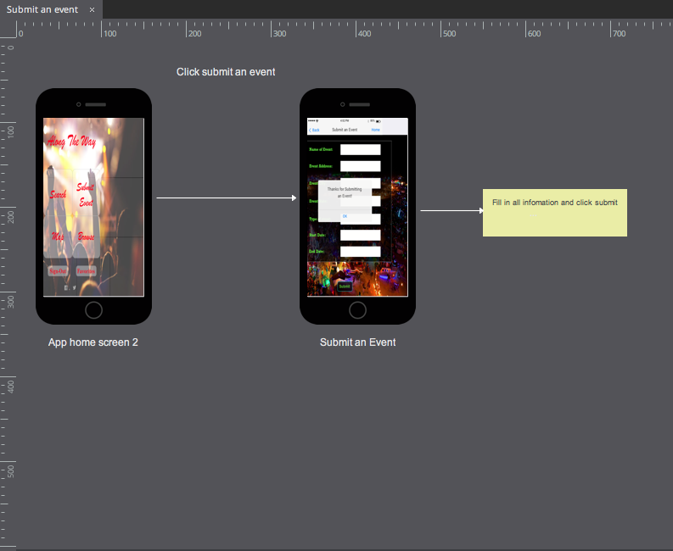
Process model overview
Submit an event

Slide 7
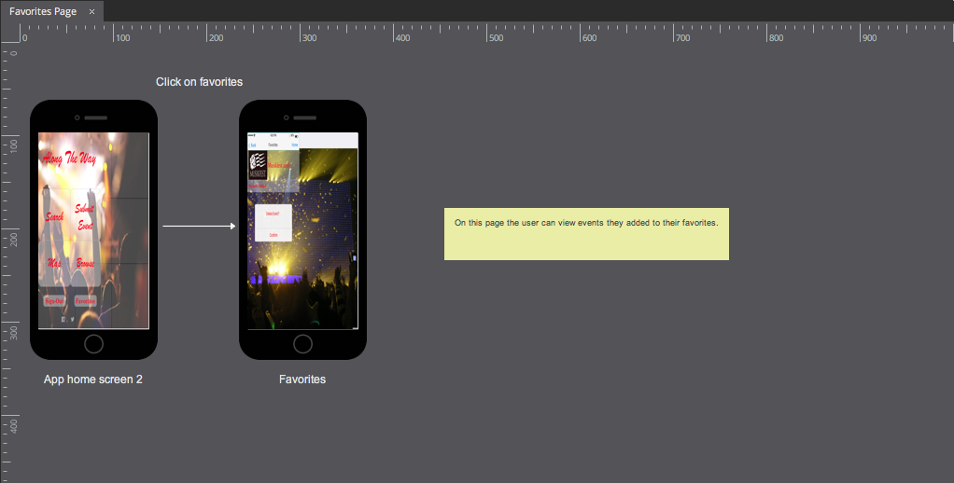
Process model overview
Favorites Page

