Slide 1
Schedulize
Visualize your Schedule.
A scheduling platform for early stage service based businesses.
Alisa Islam, Jacob Andrews, Shane Fowler, Shuyue Ding

Slide 2
Early-Stage Service Based Businesses
Entrepreneurs need to focus on scaling their business. Not repetitive scheduling.
Currently, early service businesses are wasting hours scheduling with clients.
Notes:
Problem..
Early stage businesses that provide services have a lot to do. They have to provide their service, grow their business, market their products, schedule time effectively with clients. It’s a lot. Schedulize

Slide 3
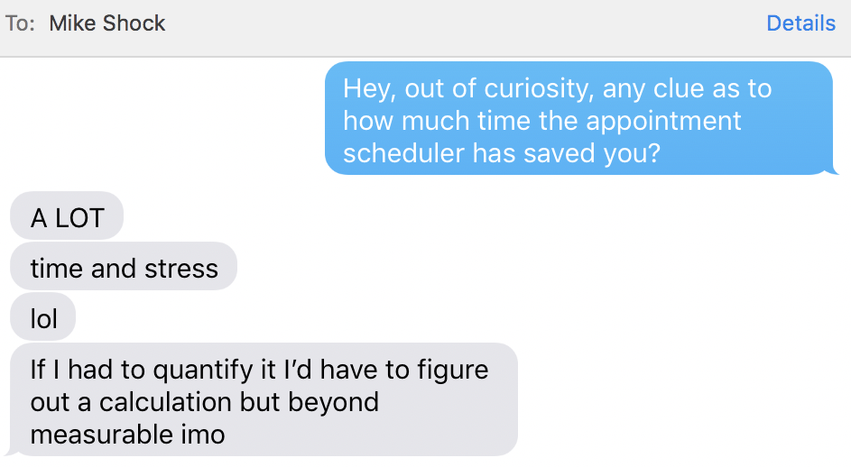
Schedulize.
A client facing solution to solve the monotonous back and forth with clients.
An online service to allow your clients to directly schedule an appointment for your schedule.
Maximize your time with Schedulize.
Michael Shockley, current user of Schedulize:
Visualize your Schedule.
Integrate directly to your website.

Slide 4
Competitive Analysis : Pricing Model
Sole Provider (Monthly) | $30 | $35 | $30 | $0
Unlimited Providers (Monthly) | $120 | N/A | $90 | $75
Booksy
Style Seat
Sqaureup

Slide 5
Competitive Analysis :
Features & Advantages
Price Point
Focus on early business stage / local businesses into scalable platform
Google Calendar Integration
Able to view previous client appointments
Simple Integration & Low Maintenance Costs
Notes:
Style Seat Doesnt have google calender integration
Square Up & Booksy - Cannot see previous appointments made by clients
Booksy Doesnt have website integration

Slide 6
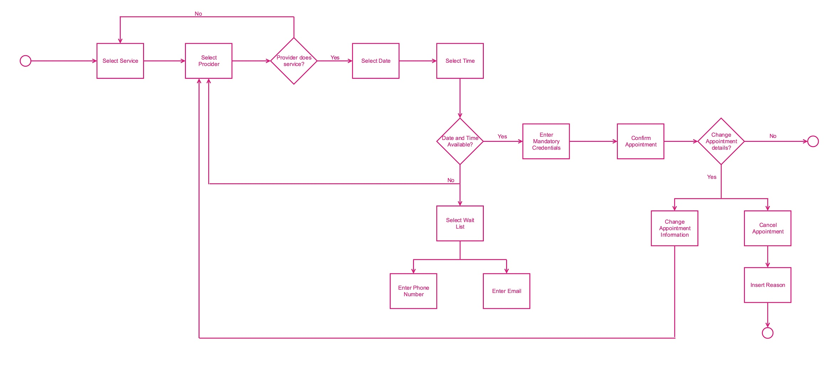
Process Diagram

Slide 7
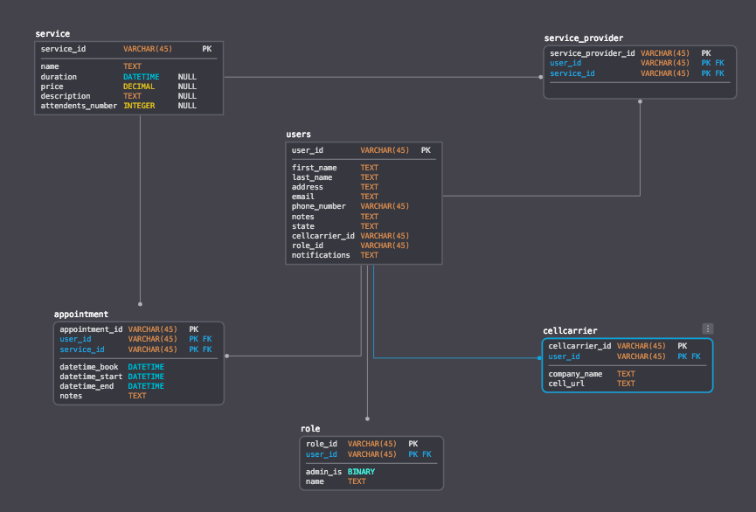
Data Model

Slide 8
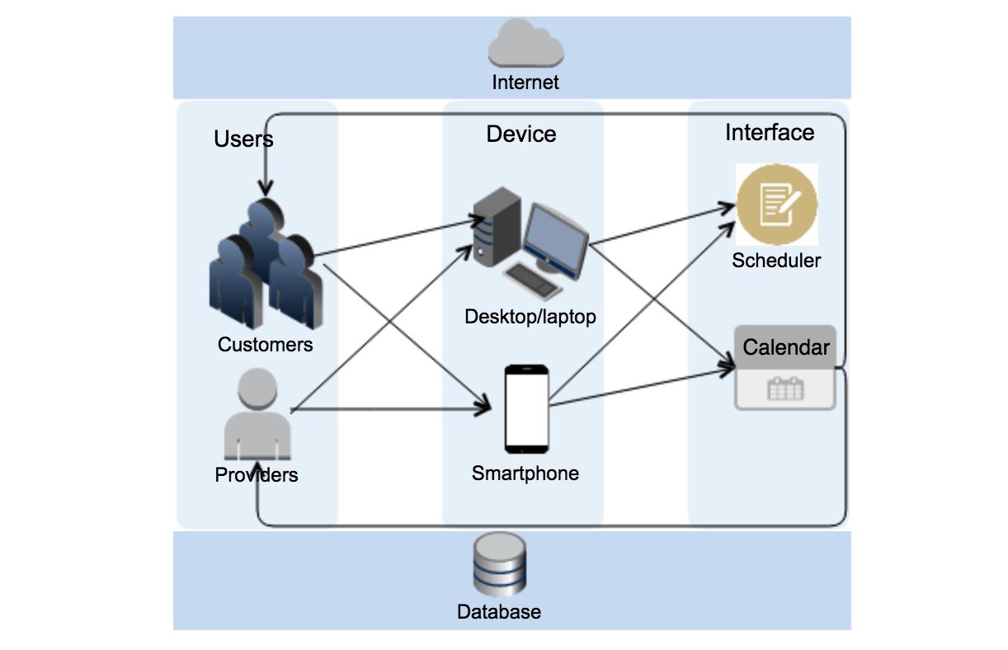
Enterprise Architecture

Slide 9
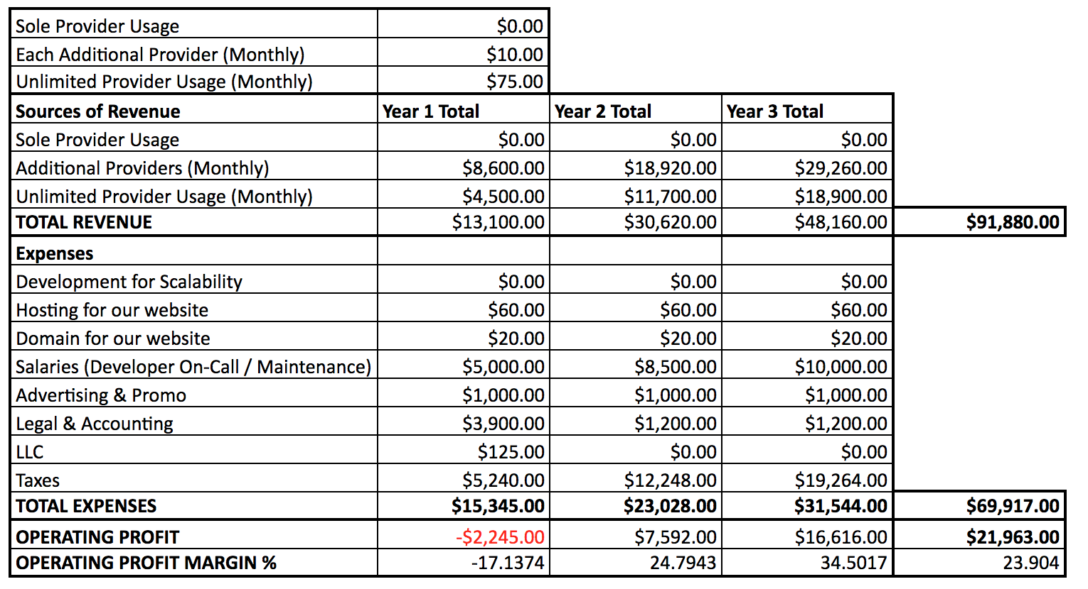
Financials
Notes:
Third Year Operating profit margin is 34%

Slide 10
Appendix

Slide 11
Implementation Plan

