Slide 1
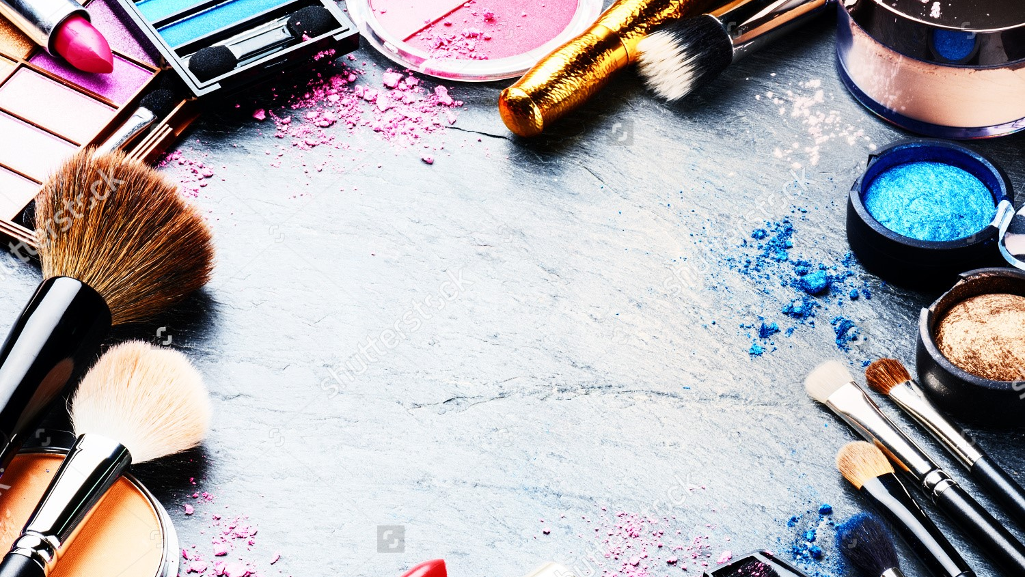
POUNDCAKE
JURGEN ALIAJ , ANTHONY WONG , AJAH PURYEAR , AMY NJUGUNA, TYLER SKEETERS

Slide 2
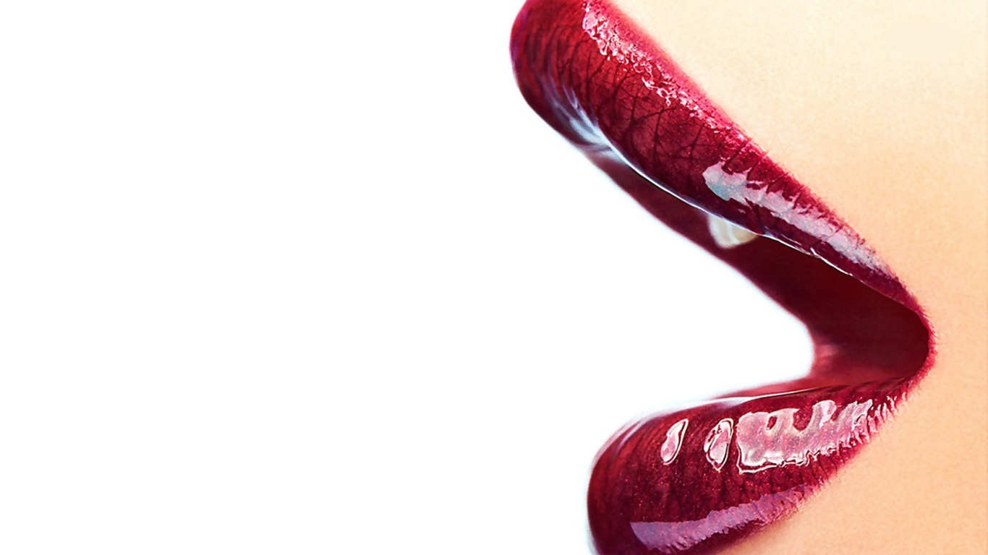
BIG IDEAS
User Friendly
Simplicity
Accessibility

Slide 3
WANTS
Shopping Process
Account Management
Cake Club Subscription
Newsletter Subscription
Product Display

Slide 4
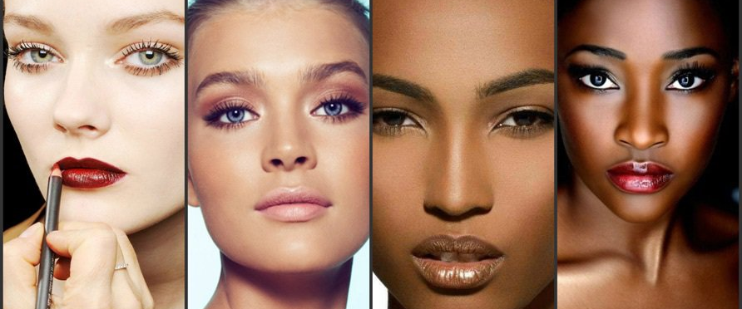
STAKEHOLDERS

Slide 5
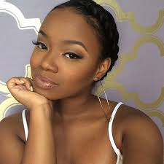
Ashley Brown
Age: 18
Occupation: Youtuber
Location: New York, New York
Income: $10,000/year
Education: Still in High School
Hobbies: Hanging with friends, perfecting makeup, recording makeup tutorials
“I want a product that makes me feel confident in my skin”

Slide 6
Naomi Johnson
Age: 25
Occupation: Retail Manager
Location: Langhorne, PA
Marital status: In a relationship
Children: Son
Income: $55,000/year
Education: High School diploma
Hobbies: Painting, girls night
“I need something that is long lasting because I don’t have time to keep reapplying”

Slide 7
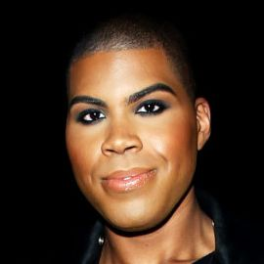
Antonio Smith
Age: 24
Occupation: HR recruiter
Location: Northern Liberties
Income:$65,000
Education: Bachelor’s Degrees
Hobbies: Travel to Poconos once a month
Want to use a brand that will match his skin tone and also agree with Pound Cake’s views about the LGBTQ+
“The products offered by the current industry does not appeal to me. I'm always looking for a provider to not only match my skin tone but represent ME!”

Slide 9
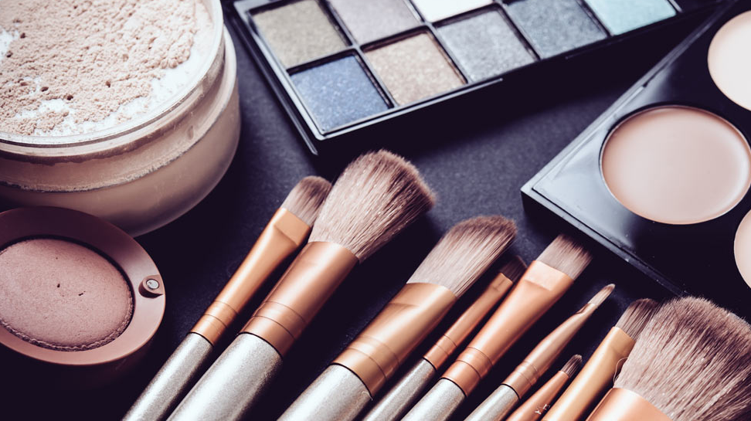
IMPLEMENTATION
WordPress
Web Hosting
Web Developer
Designer
Analytics

Slide 10
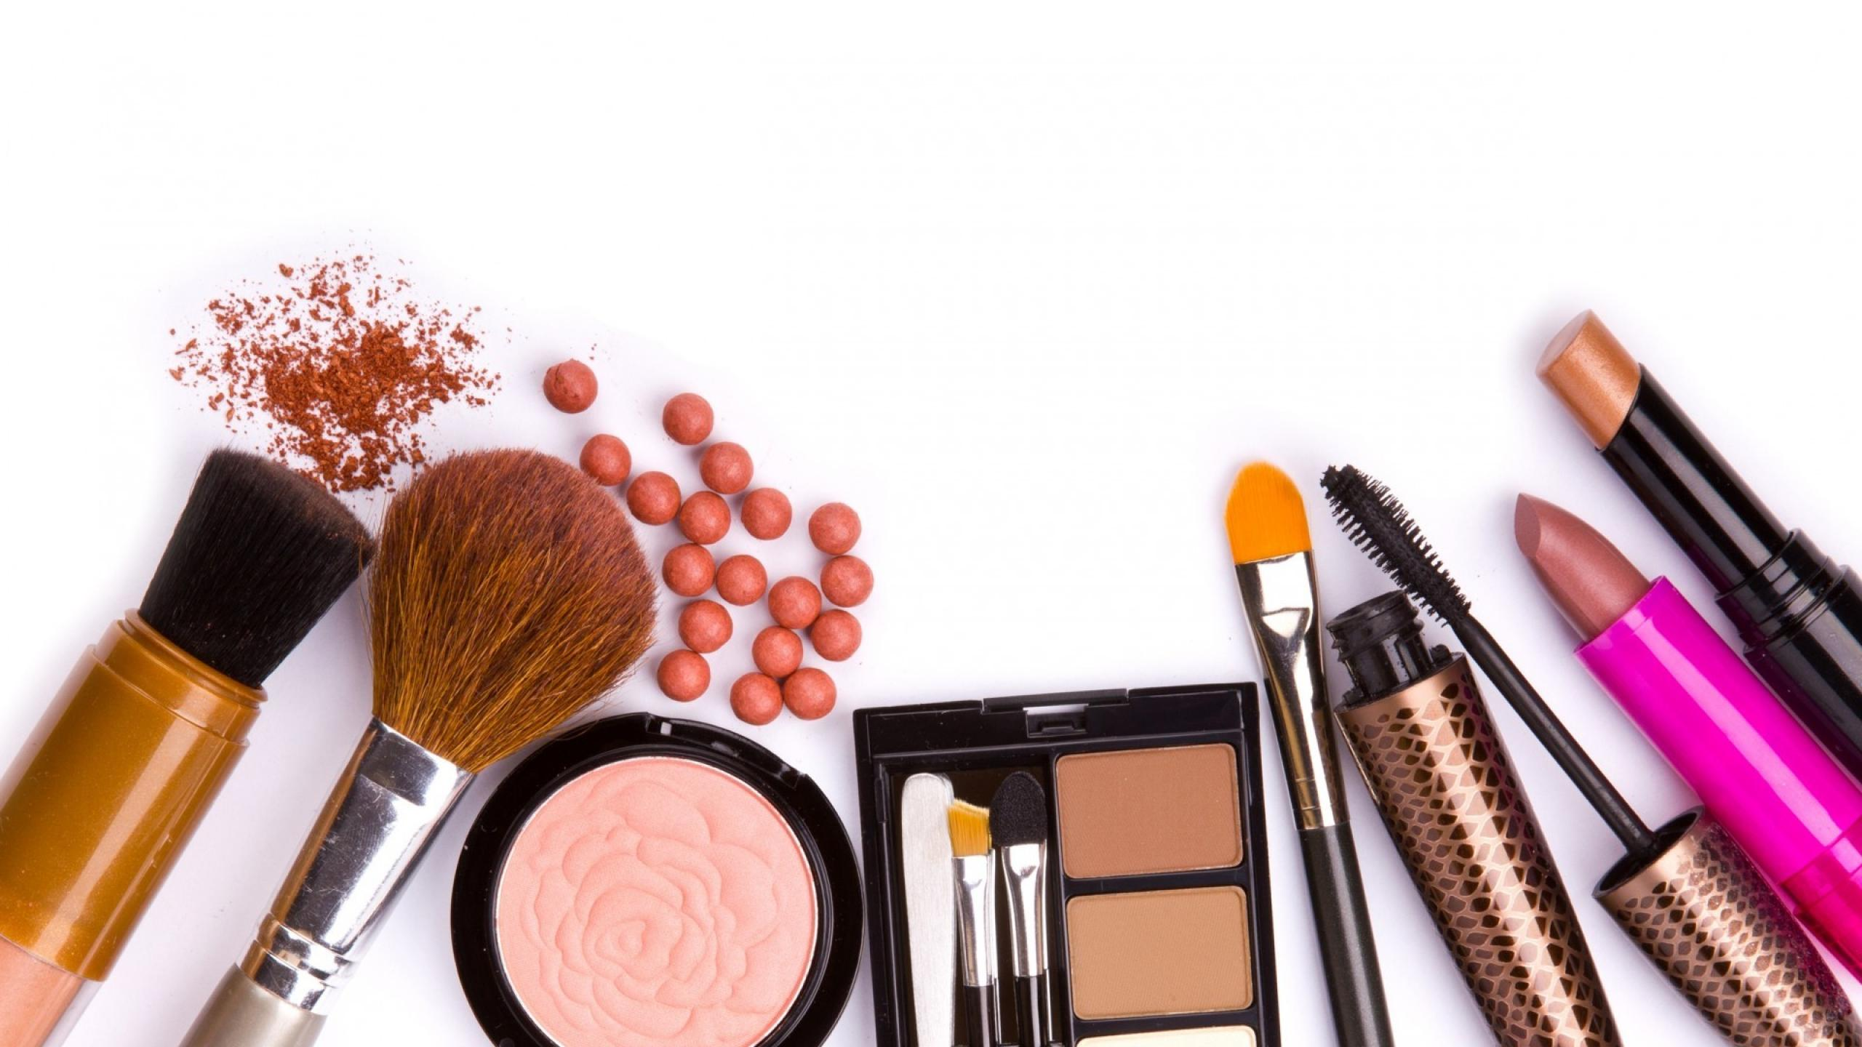
THANK YOU QUESTIONS?

