Slide 1
fox mis 3545: Data driven Business intelligence
Christian Wenner, David Rivera, Sam McAdoo, Ibby Al-Froukh

Slide 2
What is the problem?
Most common job classification for MIS graduates is Business/Systems Analyst at 35%
FOX MIS Required Courses
Enterprise IT Architecture
Data Analytics
Only Business Analyst Class
SOLUTION:
Data-Centric Application Development
Digital Design and Innovation
Lead Global Digital Projects
Information Systems Integration
Add 2nd Business Analyst Class
Utilizes skills learned in previous 4 courses
Data Driven Business Intelligence
Notes:
What is the problem you are trying to solve?
After graduation, a majority of Fox’s MIS students become Business Analysts (BA’s) for consulting firms. In MIS 3504, we support a real client and act as a BA the entire semester. Other than that semester, we get little consulting experience.

Slide 3
How will it work?
Students
Students will be assigned into groups
Each group will be assigned a separate project from company
Companies
IBIT members
Temple-affiliated programs
Projects
Projects focused more on finding a solution, not building the solution
Produce deliverables based on IBIT member’s real business problems
More emphasis towards analyzing processes and requirements
Provide semester-long projects
Divide into roles and utilize skills learned in previous courses
Notes:
Description of the solution – what is it?
Our group wants to form a Temple Business Analyst Club, and support local businesses or other Temple affiliated groups. The club will work on small IT related projects, like recreating a company’s webpage, or increasing their online presence. The club will offer students more consulting experience to further their education here at Temple University.
How does it work? (use the materials from the project charter)
Students will be assigned a project to complete by the end of the semester. Students may be assigned multiple partners or work solo, depending on the size of the project. The student will be required to meet with the client either virtually or in person to analyze the client’s requirements and report progress on the project.

Slide 4
Strategic importance
Additional Business Analyst Class
Business Analyst Experience
New Skills
LEVEL UP!
Business Analyst Experience
+5
In Data Analysis
+3
In Real-world
Experience
+2
Added to your
Personal network
The more Business Analyst experience MIS students receive, the more skills they will acquire.
Notes:
Why is it important?
The more experience students have in business analyst, the better prepared they will be for interviews and in their future jobs. This class will be a great experience to further enhance the student’s education here at FOX MIS.

Slide 5
Department impact
1
Students gain more experience and skill
Graduates have more confidence and knowledge to perform their job
Better prepared graduates will reflect on FOX MIS
Recruiters will look more to FOX MIS
FOX MIS increases it’s popularity
More students will want to join FOX MIS
Notes:
Why should we care? (use the materials from the project charter)
More experience will lead to better prepared graduates. FOX MIS students can enter business environment with greater confidence and knowledge to perform their job. This will reflect the education they received at Temple University and increase FOX MIS’s reputation as an excellent school. In return, recruiters will recognize FOX MIS as a main source for consultants and increase its popularity.

Slide 6
Competitive analysis and market
Market
Universities
Competitors
MIS programs at other universities
Companies
IBIT Members
Temple-affiliated programs
Business Schools

Slide 7
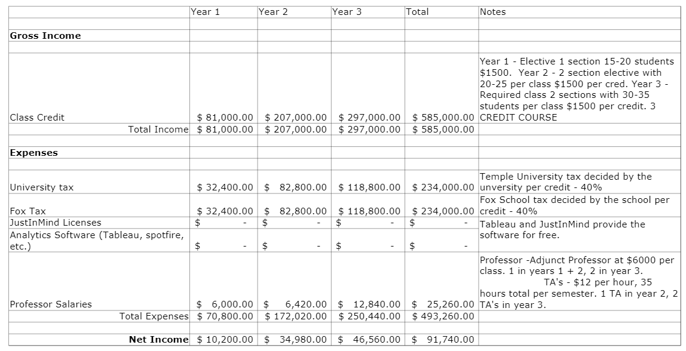
Income and Expenses
Labor Costs

Slide 8
Implementation plan
Submit class request to FOX
Use test course
as an elective
Is course
popular &
beneficial?
Make 3445
a
required course
Create course structure
YES
Evaluate class
- - - -
NO
- - - - - - - -
- - - - - - - - - -
- - - - - - - - - - - - - - - - - - - - - - -
Restructure
Course
Notes:
What steps do you need to take to put your solution into operation?
How did you get here? (MIS 3535)

Slide 9
THANK YOU!
QUESTIONs?

Slide 10
Index: a) Workflow diagram
MIS STUDENT COURSE PATH
 | Fall Junior | Spring Junior | Fall Senior | Spring Senior
Classes | Data Analytics | Data-Centric Application Development | Lead Global Digital Projects | Information Systems Integration
 | Enterprise IT Architecture | Digital Design and Innovation | Business Analyst Class
Client Requests Project
Client
Webpage
Database
Lands on Homepage
Clicks on Clients Page
Requests Project
Registered
Client?
Yes
Fill Request Form
Submit Form
No
Register as a Client
Receives Form

Slide 11
b) Database diagram
Students
TU_id
First Name
Last Name
Year
>
Company
Company_id
Company Name
Password
Case_id
Contact Email
Contact Phone #
First Name
Last Name
Project
Project_id
Description
Company_id
TU_id
CRN
>
>
Class
CRN
Section
Professor_id
Days
Time
JIM_id
# of students
location
Professor
Professor_id
First Name
Last Name
JIM Access
JIM_id
TU_id
# of seats
Expiration
Licensing Costs
>

Slide 12
C) Systems architecture overview
Software
Student
Browser
Tableau
Application
or
3545
Website
Software
Professor
Browser
FOX MIS SERVER
& DATABASE
JIM
Application
Company
Browser

