Slide 1
Hibachi & Asian Bistro
5th Floor Analytics Consultants:
Brittany Bardo
Jamie Clarke
Kevin Quinn Jr.
Jordan Scott
Jie Yeung

Slide 2
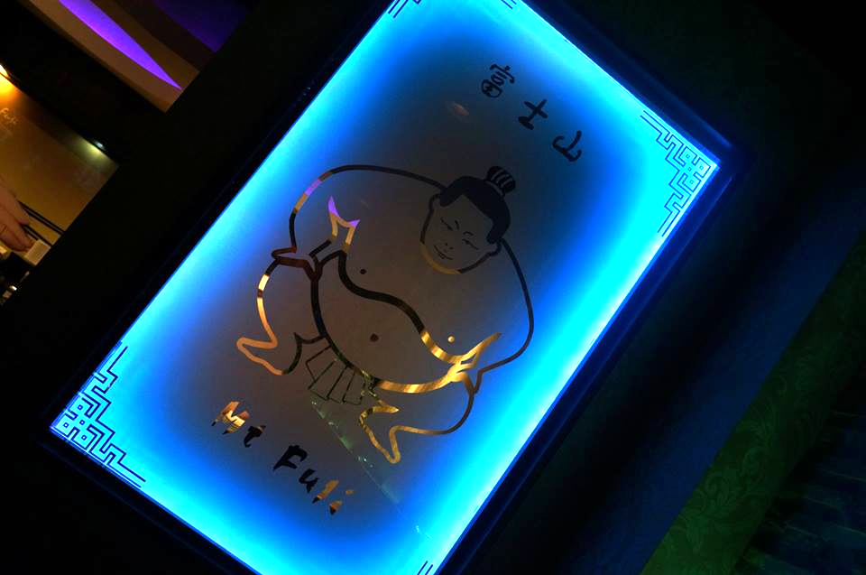
CLIENT BACKGROUND
Mt. Fuji Asian Bistro → family owned small restaurant chain in Pennsylvania
3 locations - Newtown, Ardmore, and Southampton
First restaurant opened in 2001, their newest expansion in Ardmore was in 2013
Target market is higher income adults ages 21-60
Decent digital marketing presence → Websites for Southampton and Newtown → Facebook page → Yelp
Missing website for Ardmore location
Mt. Fuji Asian Bistro → family owned small restaurant chain in Pennsylvania
3 locations - Newtown, Ardmore, and Southampton
First restaurant opened in 2001, their newest expansion in Ardmore was in 2013
Target market is higher income adults ages 21-60
Decent digital marketing presence → Websites for Southampton and Newtown → Facebook page → Yelp
Missing website for Ardmore location

Slide 3
PREVIOUS DIGITAL PRESENCE
Social Media Platforms:
No Twitter
No Pinterest
No Instagram
Existing Facebook → decent following but inconsistent posts and very little activity → 3 locations=complicated for FB
Website:
- Boring colors & website design - Navigation menu hard to navigate - Couldn’t disable background music - No website menu for Ardmore location - No social media icons

Slide 4
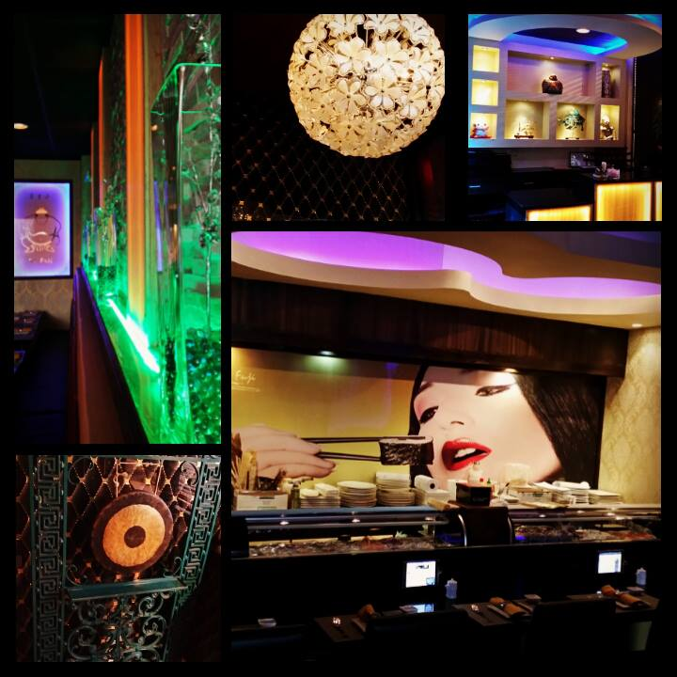
OVERVIEW &
OBJECTIVES
Completely Redesign Website
Created entirely new page for Ardmore Location
Increase website traffic and brand awareness through Google Adwords Campaign
Increase sales and customer base through Living Social Campaign
Improve and manage existing Facebook page
Create Instagram, Pinterest, and Twitter accounts to improve social media presence
Notes:
3 locations - complicated for FaceBook. Need an overview slide as what was done.

Slide 5
GOOGLE ADWORDS: OBJECTIVES
Launch one successful Google AdWords Campaign
Increase brand awareness for Mt. Fuji
Implement cost effective strategy → budget of $25.00
Increase sales
Promote and drive traffic to the new Ardmore, PA, website
Improve Search Engine Optimization for Mt. Fuji
Notes:
Explain reason well. add a slide explaining if objectives were met.

Slide 6
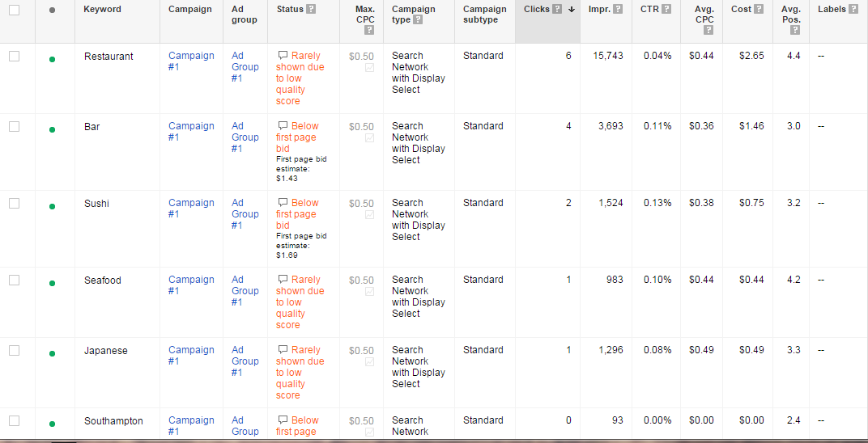
GOOGLE ADWORDS: CAMPAIGN
Notes:
Explain low quality score for website. Hard to see.

Slide 7
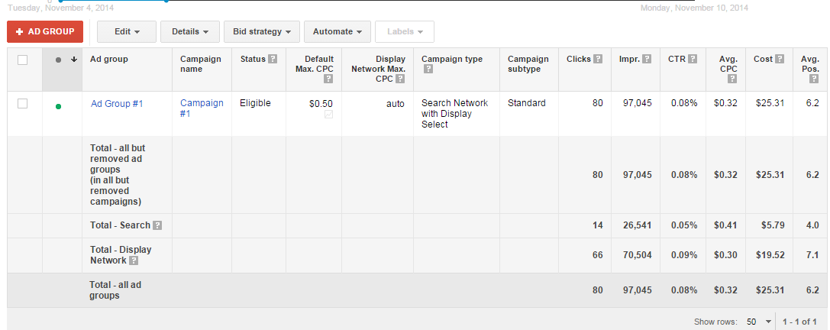
GOOGLE ADWORDS: METRICS
Notes:
needs to be reformed.

Slide 8
GOOGLE ADWORDS: CONCLUSION
Geo-targeted the greater Philadelphia area within a 15 mile radius.
Ardmore, PA website was not launched
Resulted in a low quality score from Google
OBJECTIVES
Increase awareness for Mt. Fuji ✔
People found out about new Ardmore location
Promote and drive traffic to Ardmore website ✘
The Ardmore website was down, however 97,000 impressions promoted the new location
Improve SEO for Mt. Fuji ✔
Over 97,000 impressions

Slide 9
WEBSITE: OBJECTIVES
Completely redesign website to make more visually appealing and functional for customers
Add page for new Ardmore Location
Link social media pages to website via icons
Create an easier to use navigation menu
Delete music from page
Decreases Bounce Rate
Update restaurant menu and contact information pages
Optimize website for mobile devices
Notes:
explain on a slide: high bounce rate and Music. Explain on a slide what was done and then compare to website objectives

Slide 10
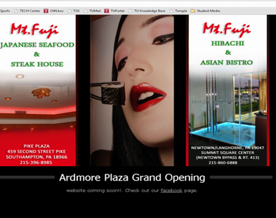
WEBSITE: BEFORE
♫♪♫♪♫♩♬♫

Slide 11
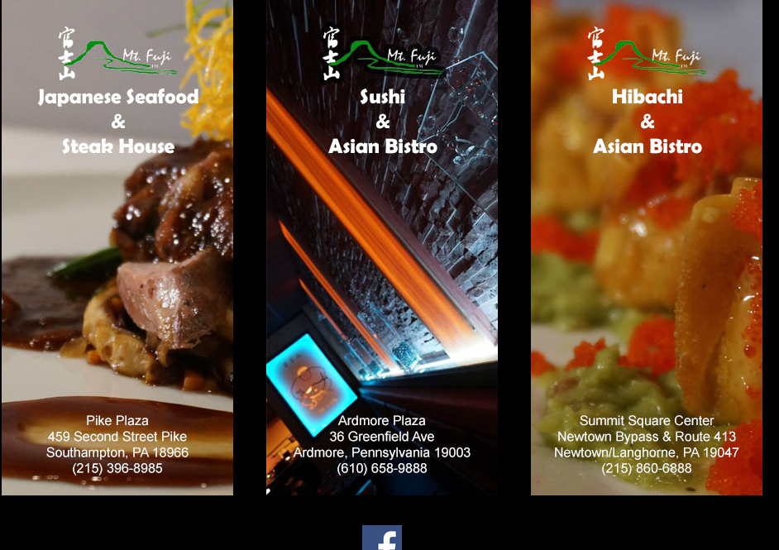
WEBSITE: AFTER

Slide 12
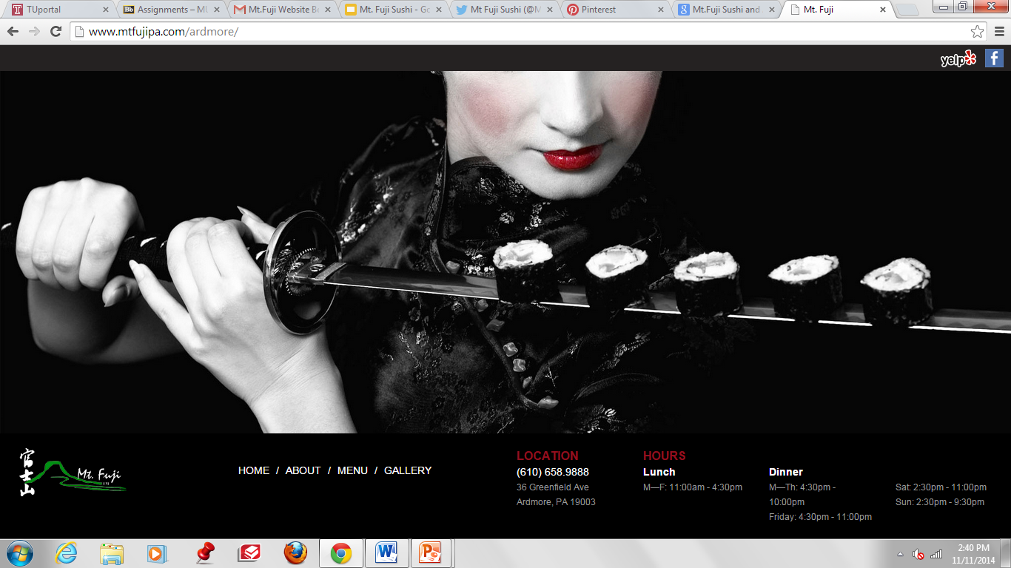
WEBSITE: NEW ARDMORE LOCATION

Slide 13
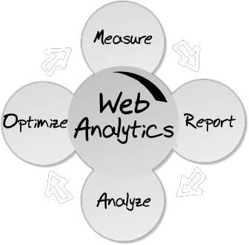
ANALYTICS: OBJECTIVES
To gain a better understanding of the Mt. Fuji customer based on the website metrics
No focus on analytics prior to consulting project implementation
Figure out what to do to increase website traffic & optimize for results
Analyze which pages had the most hits and which pages needed to be improved or fixed
Notes:
great potential for brand building. Date of website implementation and adwords? were these analytics a result of the living social campaign? Explain

Slide 14
ANALYTICS: RESULTS
From September 1 - November 11
Total Visits: 9,311
Unique Visitors: 6,862
Page Hits: 206,127
Average Time on Page: 2.6 minutes

Slide 15
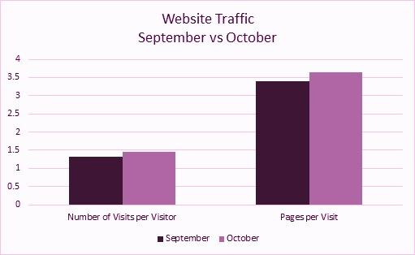
ANALYTICS: WEBSITE TRAFFIC
14% Increase
24% Increase

Slide 16
ANALYTICS: CONCLUSION
Over 8,370 of the website visits were a result of the LivingSocial Campaign
Gained a better understanding of the weak pages and which pages customers spent most time on
After the website redesign, saw an improvement in website views and reduction in bounce rate
By launching the Google Adwords & LivingSocial campaigns right after the new website creation, there was an increase in website traffic directly from these campaign sources

Slide 17
LIVINGSOCIAL: OBJECTIVES
Increase sales
Drive in new customers
Drive traffic to new website
Increase Brand Awareness

Slide 18
LIVINGSOCIAL: CAMPAIGN
496
Vouchers sold
244
Vouchers redeemed
$7,725.00
Gross sales amount

Slide 19
LIVINGSOCIAL: RESULTS
Benefits
Demographics
902 emails opened
8, 370 Website Visits
513 deal page views

Slide 20
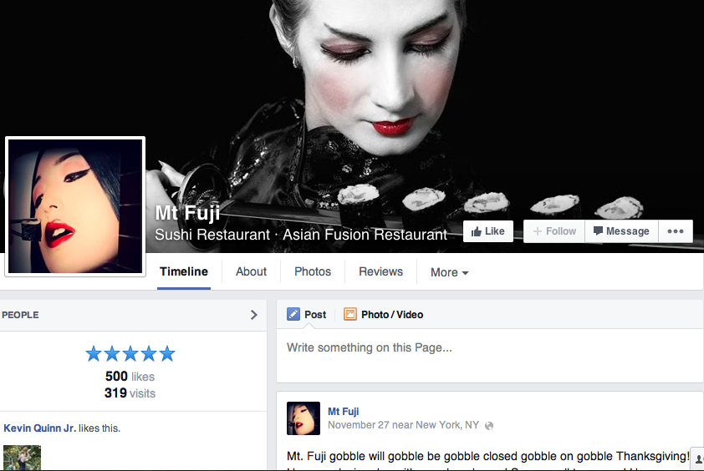
OTHER DIGITAL PLATFORMS- Facebook
Updated
Current relative posts
Reached 500 ‘Like’ benchmark
Appeals to younger and middle age markets

Slide 21
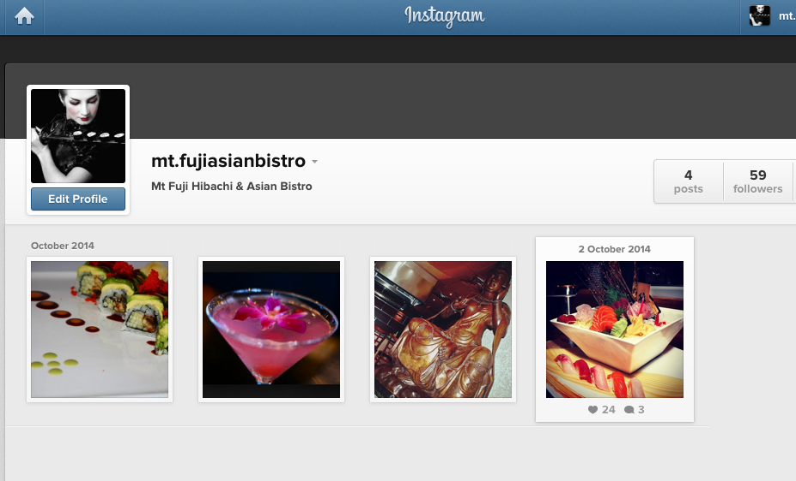
OTHER DIGITAL PLATFORMS- Instagram
Created 10/2
Gained 59 followers
Visually appealing
Attracts younger market of “Foodies”

Slide 22
RECOMMENDATIONS FOR THE FUTURE
Continuance of Instagram, Pinterest, & Yelp
Reevaluate useful digital platforms-> deter focus from Twitter and Foursquare
Utilize active Facebook page and attempt to make consistent and engaging posts
Continuance of Living Social campaign to attract and retain new customers based on success from first campaign
Launch additional Google Adwords campaigns with different keywords to drive more traffic to the website, improve SEO, and increase brand awareness

