Slide 1
BookzBrotherz
Mobile application and website to buy and sell books
Notes:
Main project deck of 12 slides or less that includes:
Problem – what is the problem you are trying to solve? Why is it important? Why should we care? (use the materials from the project charter)
Solution – description of the solution – what is it? how does it work? (use the materials from the project charter)
Competitive analysis and market – who are the competitors? which market does it fit in? who are the clients? (use the disruption innovation material)
Data and process model overview – what is the data model of the solution? What is the process model (MIS 2502 and MIS 3504)
Systems architecture overview – what is the overall architecture? (MIS 2501)
Basic financials for years 1, 2, and 3 including income (sales and other sources) and expenses (marketing, salaries, computing, servers, etc). (use the template)
Implementation plan – what steps do you need to take to put your solution into operation? How did you get here? (MIS 3535)
Appendix
Project charter
Detailed data model
Detailed process model
Detailed systems architecture
All relevant screen prints from the prototype
Project website
As described above.
Prototype demonstration in class. (MIS 3504)

Slide 2
Team Members
Bridgette Weirich
Piya Mewa
Dave Gubitosa
Troy Gillespie
Karan Patel
Project Manager
Business Analyst
Web Developer
IT Architect
App Developer

Slide 3
Book Buying and Selling Application Questionnaire
Conducted four question survey
Shared through social media
115 Total responses

Slide 4
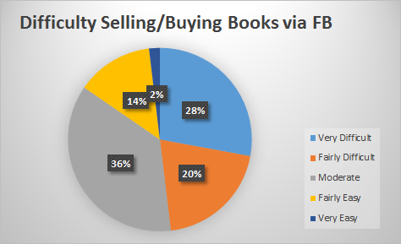
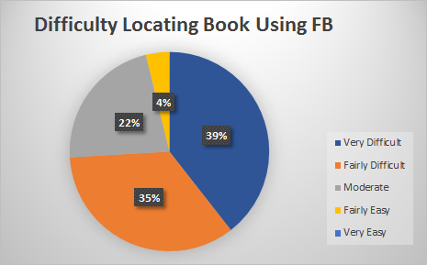
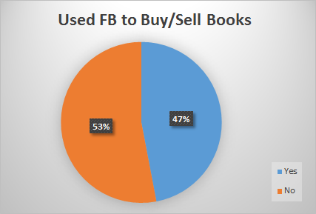
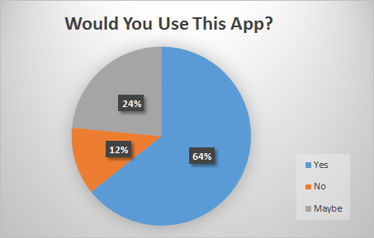

Slide 5
Problem
The Temple University Facebook group is flooded with hundreds of posts from students, trying to sell and buy textbooks. Very few students are successful in filtering through the Facebook posts to find the correct book and price.
Students can sell back books but get very little cash back compared to original purchase price.

Slide 6
Solution
Create an phone application to improve the process and efficiency of buying and selling textbooks among students.
Students will be able to search books available on application by:
School
Major
Course
Professor
Book condition

Slide 7
Competitive Analysis
Market: Sustaining or Low End
Clients:
Customers who use similar products or services
College students
Age 17-30+
Notes:
Sustaining: Who will use: Customers who use similar products or services (college students 17-30+)
Sustaining: Type of New Technology Innovation: a new kind of product or service / a mix of other innovations
New Innovation Cost: Either: Sustaining: Easier and more efficient than existing book applications
Low-end: Cheaper alternative
Sustaining: The above compares to existing similar products/services: slightly or somewhat better
Sustaining: will be used where existing products or services are used
Sustaining and Low-end: Where will the innovation be used: where existing similar products/services used

Slide 8
Business Case
BookzBrotherz will act as a matchmaker for buyer and sellers of books.
Application will be available through the Apple App Store and Android Market.
Will use website to advertise and direct to phone application.
To browse, there will be no fee. Available books will be shown, information will be blurred.

Slide 9
Business Case (continued)
Membership:
To view buyer and seller information, one must become a member by paying a $5/year membership fee.
To sell, sellers must become a member for a $5.00/year basic membership fee.
$7.00/year fee for Premium membership
No ads
Access to seller reviews
Will generate revenue through membership fees and in-app advertising.

Slide 10
Basic Financials
 | Year 1 | Year 2 | Year 3
Gross Income
Subscription - $5 or $7 per year | 3750 | 7500 | 20000
Other income sources (Advertising) | 6500 | 13000 | 28000
Total Income | 10250 | 20500 | 48000
Expenses
Sales, marketing & advertising | 3000 | 3000 | 5000
Salaries, wages & taxes | 25000 | 15000 | 17500
Hosting & other services | 250 | 375 | 600
Other expenses
Total Expenses | 28250 | 18375 | 23100
Net Income | -18000 | 2125 | 24900
Notes:
600 users year 1
1200 year 2
Over doubles year 3

Slide 11
Salary Breakdown
Job description | Hourly Rate | Estimated Hours
General developers | 15 | 500
Mobile application developers | 17 | 500
Project Manager | 25 | 300
Notes:
https://www.quora.com/Outsourcing-What-is-the-general-hourly-billing-rate-of-the-offshore-IT-companies-in-India-for-project-manager-business-analyst-technical-architect-team-lead-and-developer
Source^

Slide 12
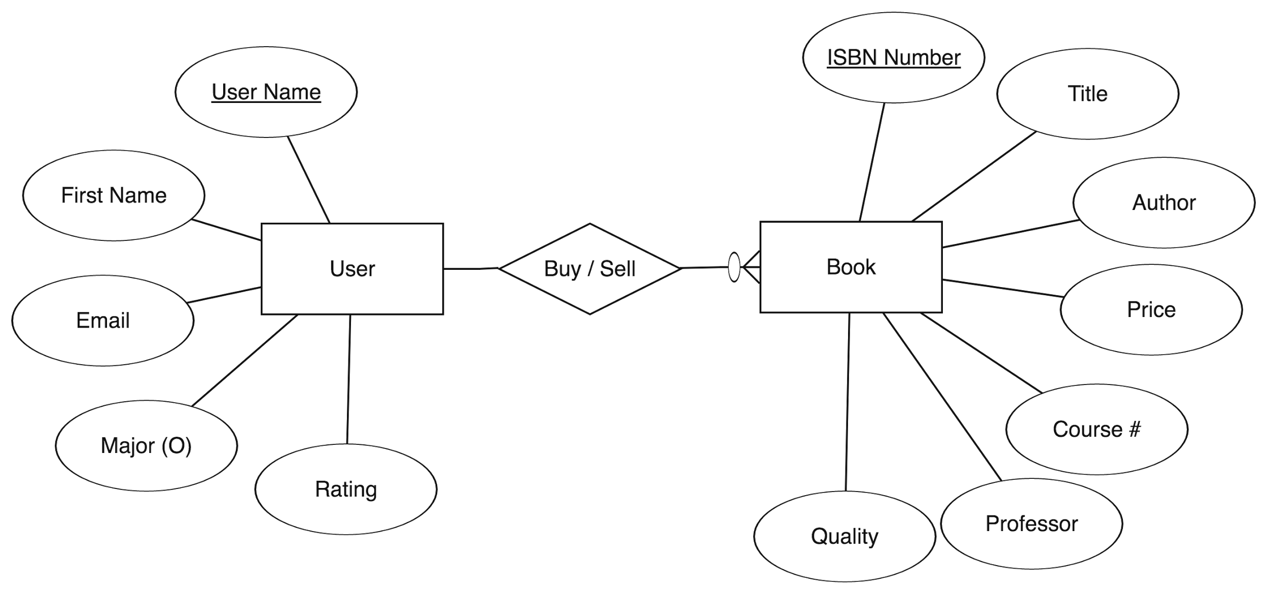
Data Model
User Attributes: Collected when user becomes a member
Book Attributes: Collected when user creates book listing and when user is searching for a book to purchase

Slide 13
Process Model

Slide 14
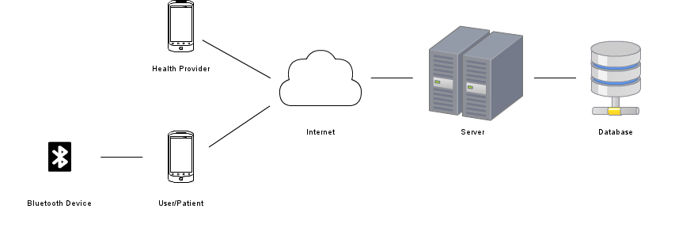
Systems Architecture
Mobile Device

Slide 15
Implementation Plan
Future
Notes:
Analysis: understand business needs and processing requirements
Define business problem and scope
Produce detailed project schedule
Confirm project feasibility
Economic, organizational, technical, resource, and schedule
Staff the project (resource management)
Launch project à official announcement
Gather information to learn problem domain
Define system requirements
Build prototypes for discovery of requirements
Prioritize requirements
Generate and evaluate alternatives
Review recommendations with management
Design: define solution system based on requirements and analysis decisions
Design and integrate the network
Design the application architecture
Design the user interfaces
Design the system interfaces
Design and integrate the database
Prototype for design details
Design and integrate system controls
Implement: construction, testing, user training, and installation of new system
Construct software components
Verify and test
Convert data
Train users and document the system
Install the system
Future state: Introduce the product to the market and promote it heavy,
Will continue to work on maintenance issues on monthly basis
Using user feedback and more research, will be able to enhance the product and put out newer versions

Slide 16
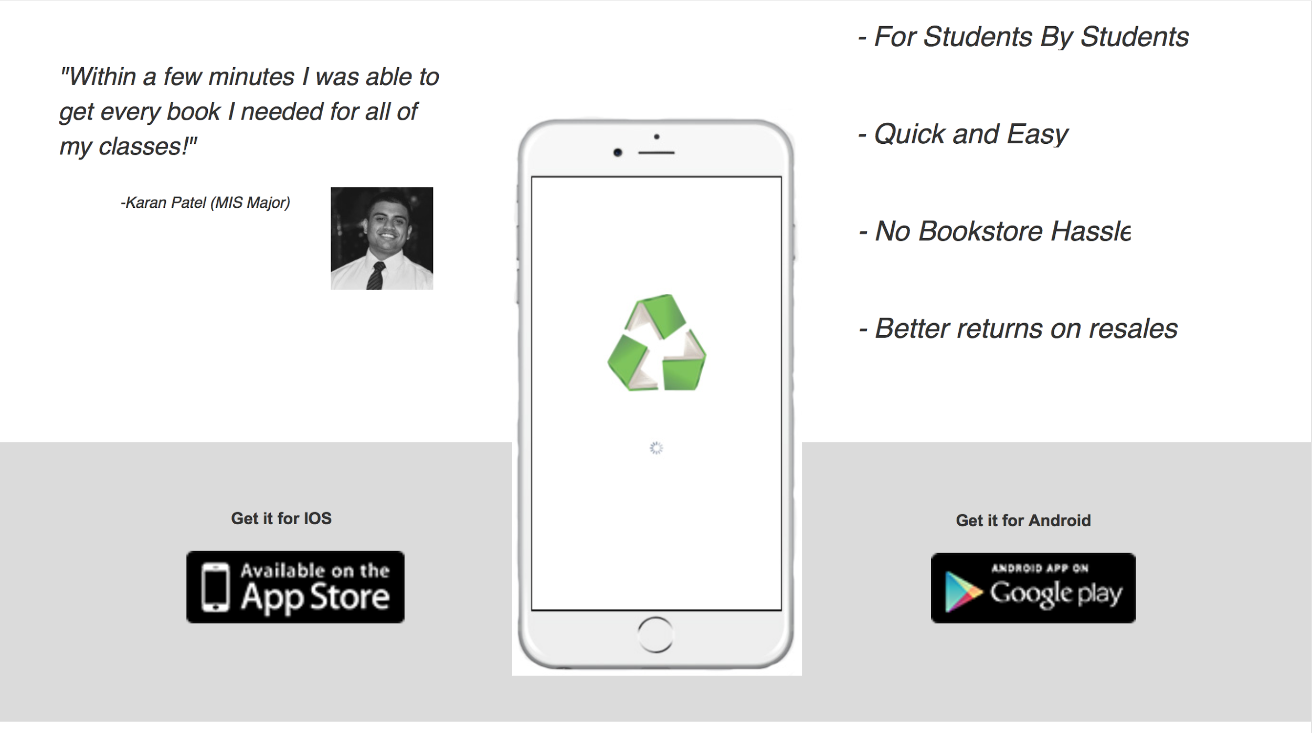

Slide 17
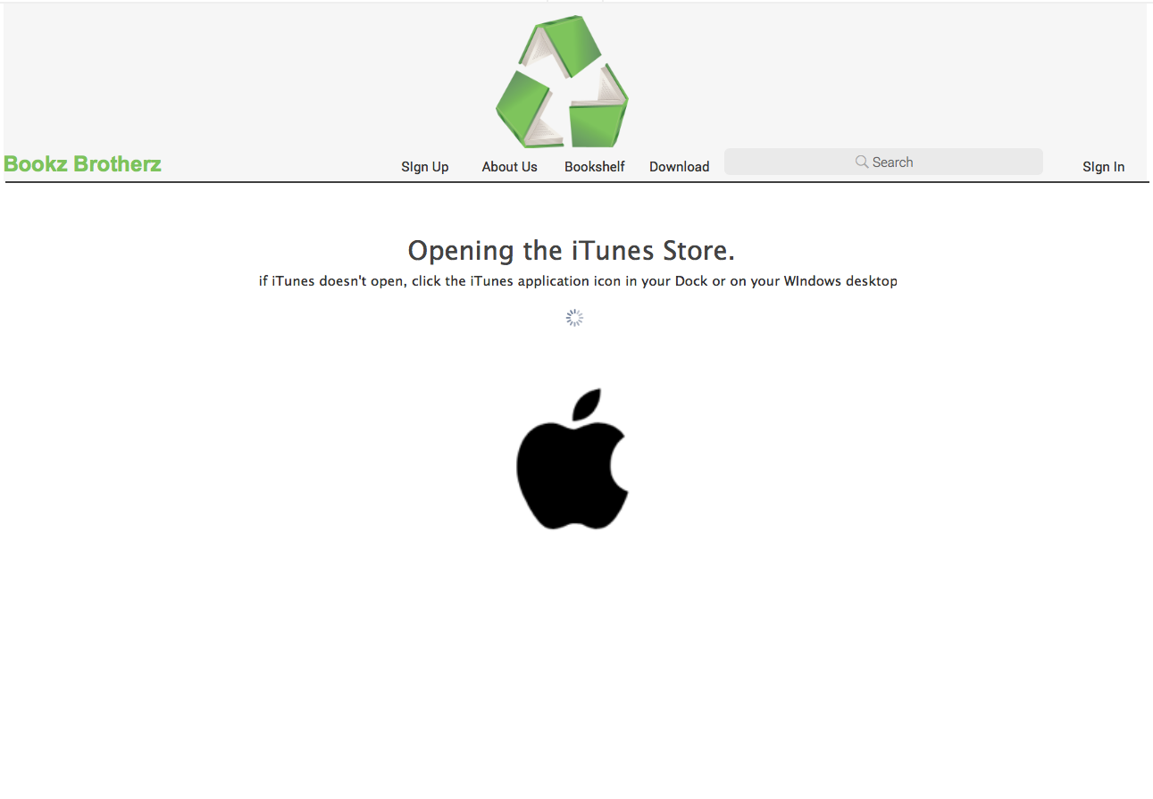

Slide 18
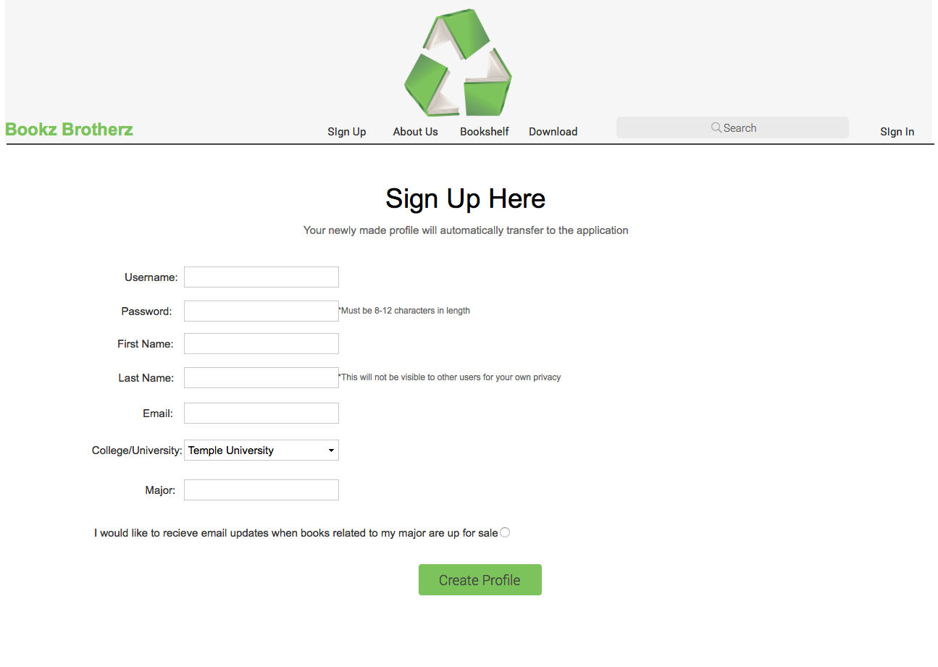

Slide 19
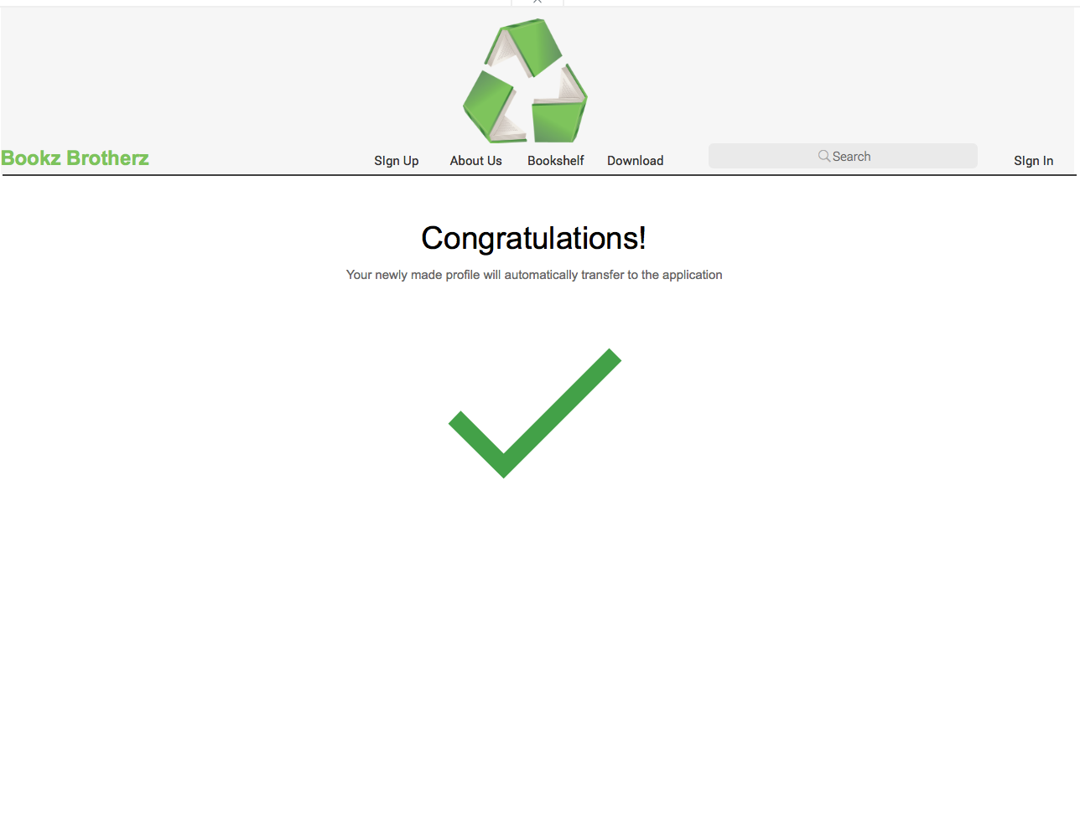

Slide 20
Review
Would you recommend this application?

