Slide 1
OwlNest
Christian Wims, Scott Winter, Jason Randolph, Shay Elmalhi, Chuzhuang Jiang

Slide 2
The Problem
Temple is a big organization with almost 40,000 students, more than 300,000 Alumni and over 500 organizations.
Most students go through their college career missing opportunities to make connections, be part of clubs and organizations that could have helped them grow professionally and personally, and take full advantage of what college has to offer. All because of lack of organized information!
We thought an effort for organization and easy access to information and connectivity was critical, So we thought of a solution ...
Notes:
With hundreds of on-campus clubs and organizations providing wonderful opportunities, a large alumni network, and thousands of fellow students, knowing where to find and filter information is a challenge.

Slide 3
A Social Media app for Temple University

Slide 4
The solution: OwlNest
The app will allow for:
Temple students and Alumni to connect with each other based off their profile information. The information that will be needed when you create an account are your Full Name, Graduation Date, Major, Courses Taken/Taking, Temple Organizations involved in, and Temple Activities involved in.
Students to search for organizations
Students to message each other: ask questions, ask for advice etc.
Organizations to post about events and information.
When your account is created, you will then be able to find other students/Alumni by either searching for a student’s name or by searching for the other profile information. And search for organizations as well.
Notes:
When you find a student, you can choose to connect with them. If the student accepts your connection, then that student will become a part of your network. When a student becomes a part of your network, you will be allowed to message them. For example, if you were interested in joining a Temple organization, you can search that organization on the temple app and find people who are in the organization. Then you can connect with students from the organization and message those students to ask questions and get information about that organization.

Slide 5
Competitive Analysis and Market
The target Clients: Temple Students, Alumni, Staff, and Organizations.
Competitors | Linkedin | Facebook | Instagram | Snapchat
Competitive Advantage | Connect job seekers and prospective employers. | Engagement. The individuals and businesses using this app are able to engage with people personally or with ads that create business. | Specialized app that focused on photo-sharing, location sharing, and community | Firstly, it allowed them to send messages, in photos and writing, away from the eyes of parents and teachers which auto deletes.
OwlNest | Alumni Network Organizations posting Jobs ✅ | Students engage with each other and with Alumni ✅ | Photo sharing and posts ✅ | Private settings ✅

Slide 6
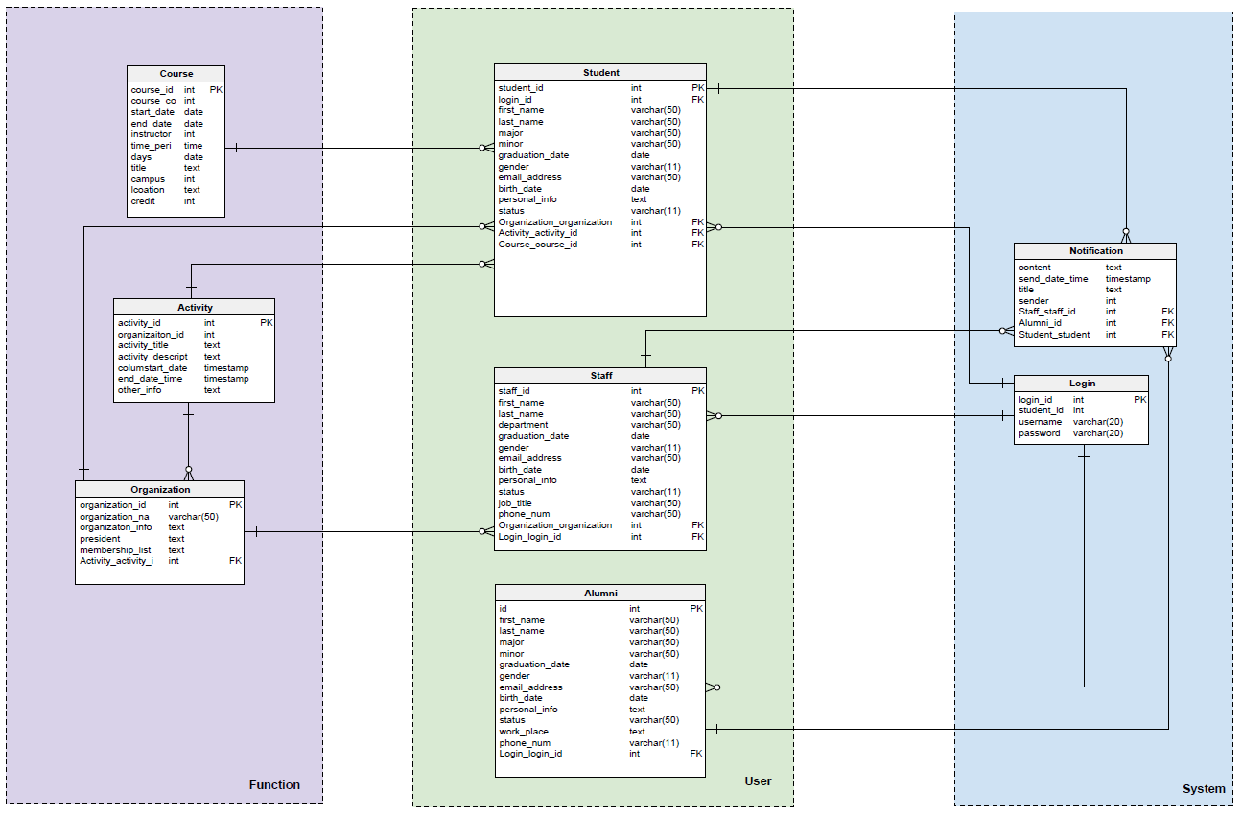
Data Model Overview

Slide 7
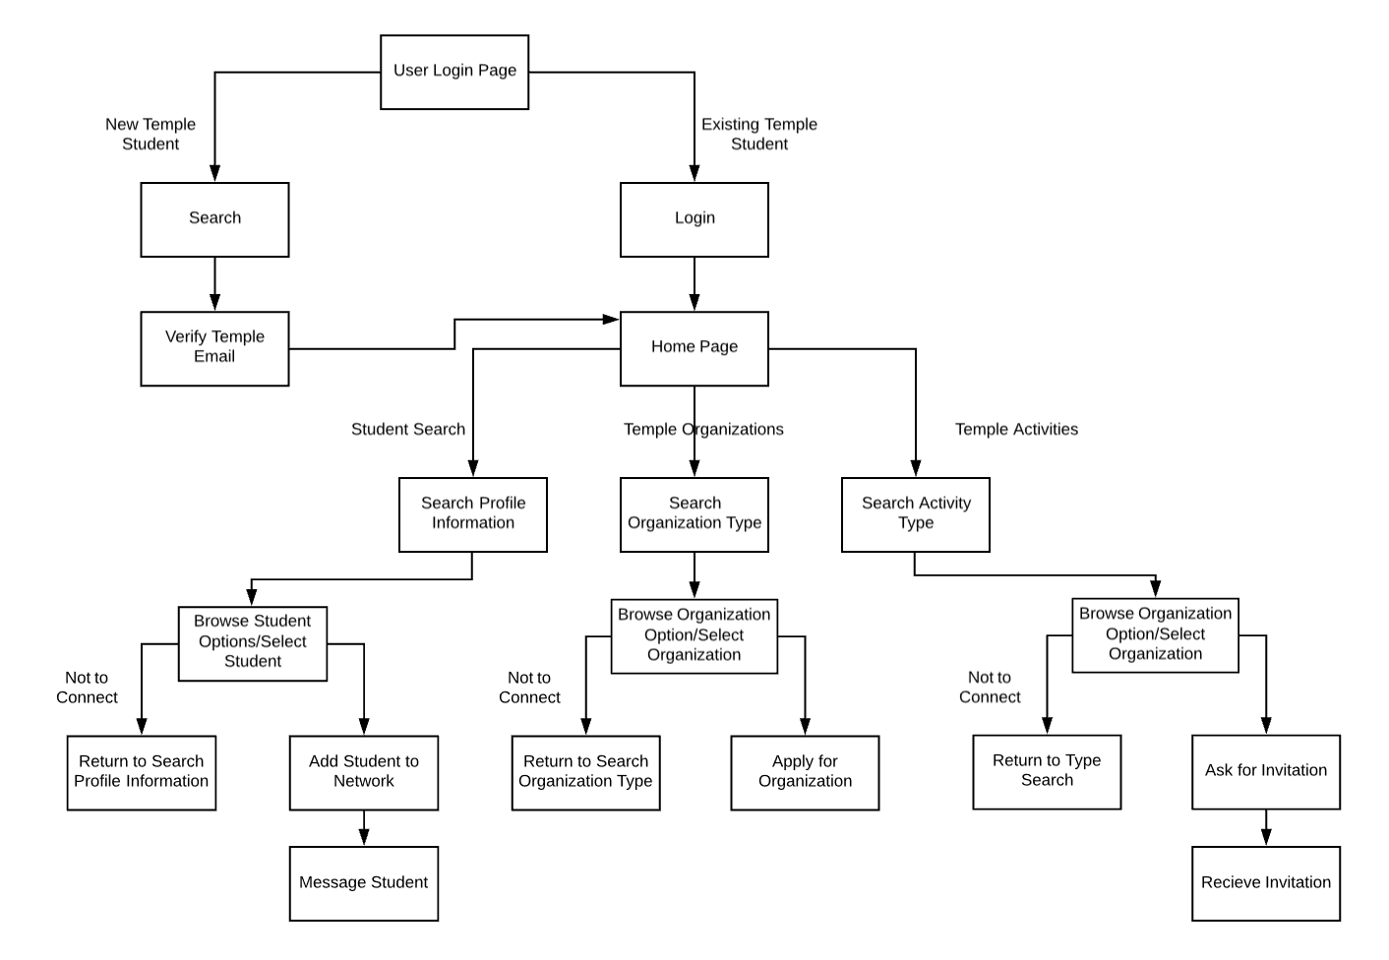
Process Model Overview

Slide 8
System Architecture Overview
User
Server
Website
Manager Browser
Web server
MySQL Database
User Browser
Load Balancer

Slide 9
Basic Financials
OwlNest 3-Year Financial Analysis
Costs | Year 1 | Year 2 | Year 3 | Total
App Development | $150,000 | $0 | $0 | $150,000
Cloud Service Setup Cost | $60,000 | $0 | $0 | $60,000
Developers | $120,000 | $0 | $0 | $120,000
Cloud Service Maintenance Cost | $25,000 | $25,000 | $25,000 | $75,000
Total Costs | $355,000 | $25,000 | $25,000 | $405,000
Benefits
Income (Ads) | $100,000 | $150,000 | $200,000 | $450,000
Total Benefits | $100,000 | $150,000 | $200,000 | $450,000

Slide 10
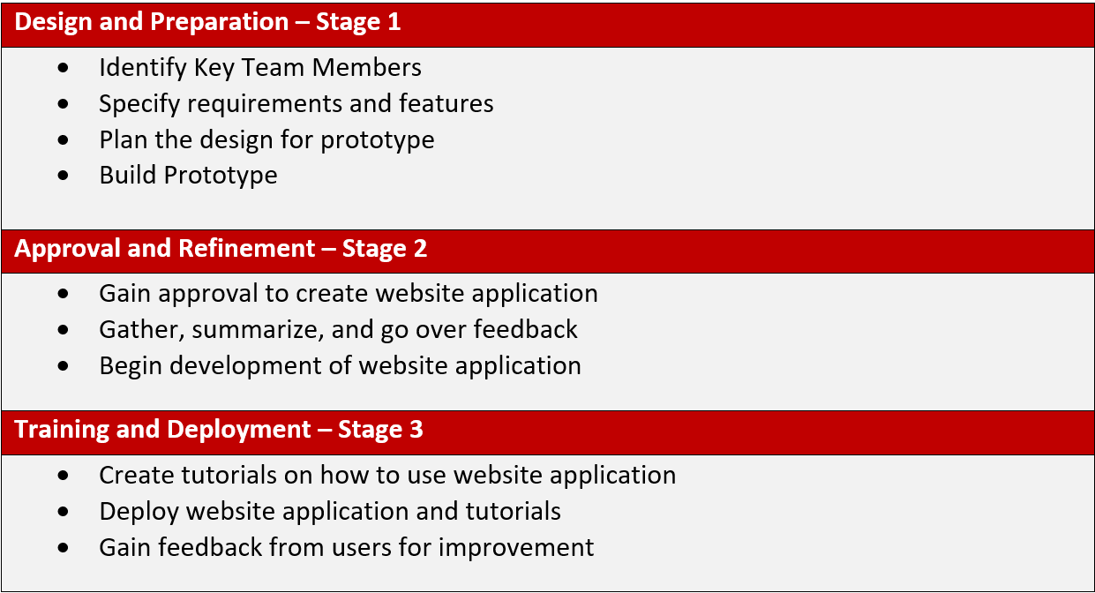
Implementation Plan

Slide 11
Prototype URL
Owlnest_Prototype

Slide 12
Appendix:
Project charter
Detailed budget spreadsheet
Detailed data model
Detailed process model
Detailed systems architecture diagram

Slide 13
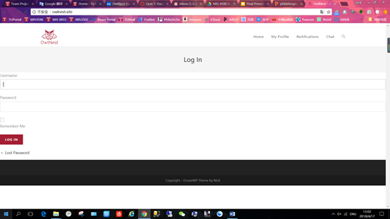
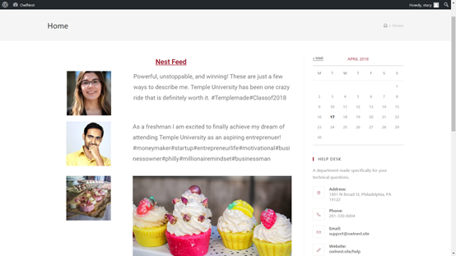
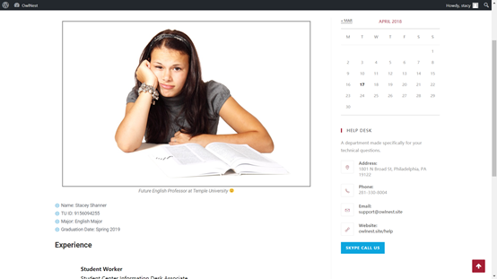
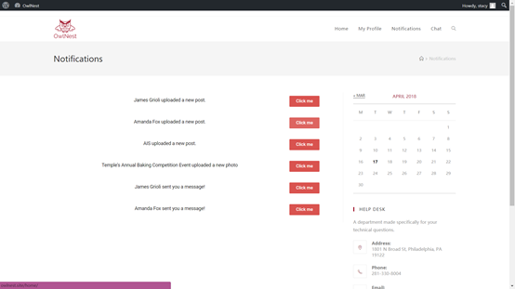
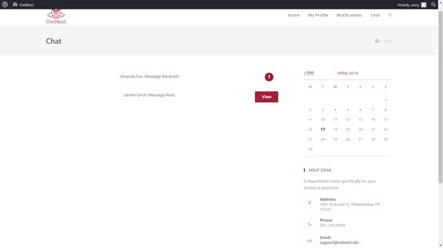
Appendix:

Slide 14
Questions?

