Slide 1
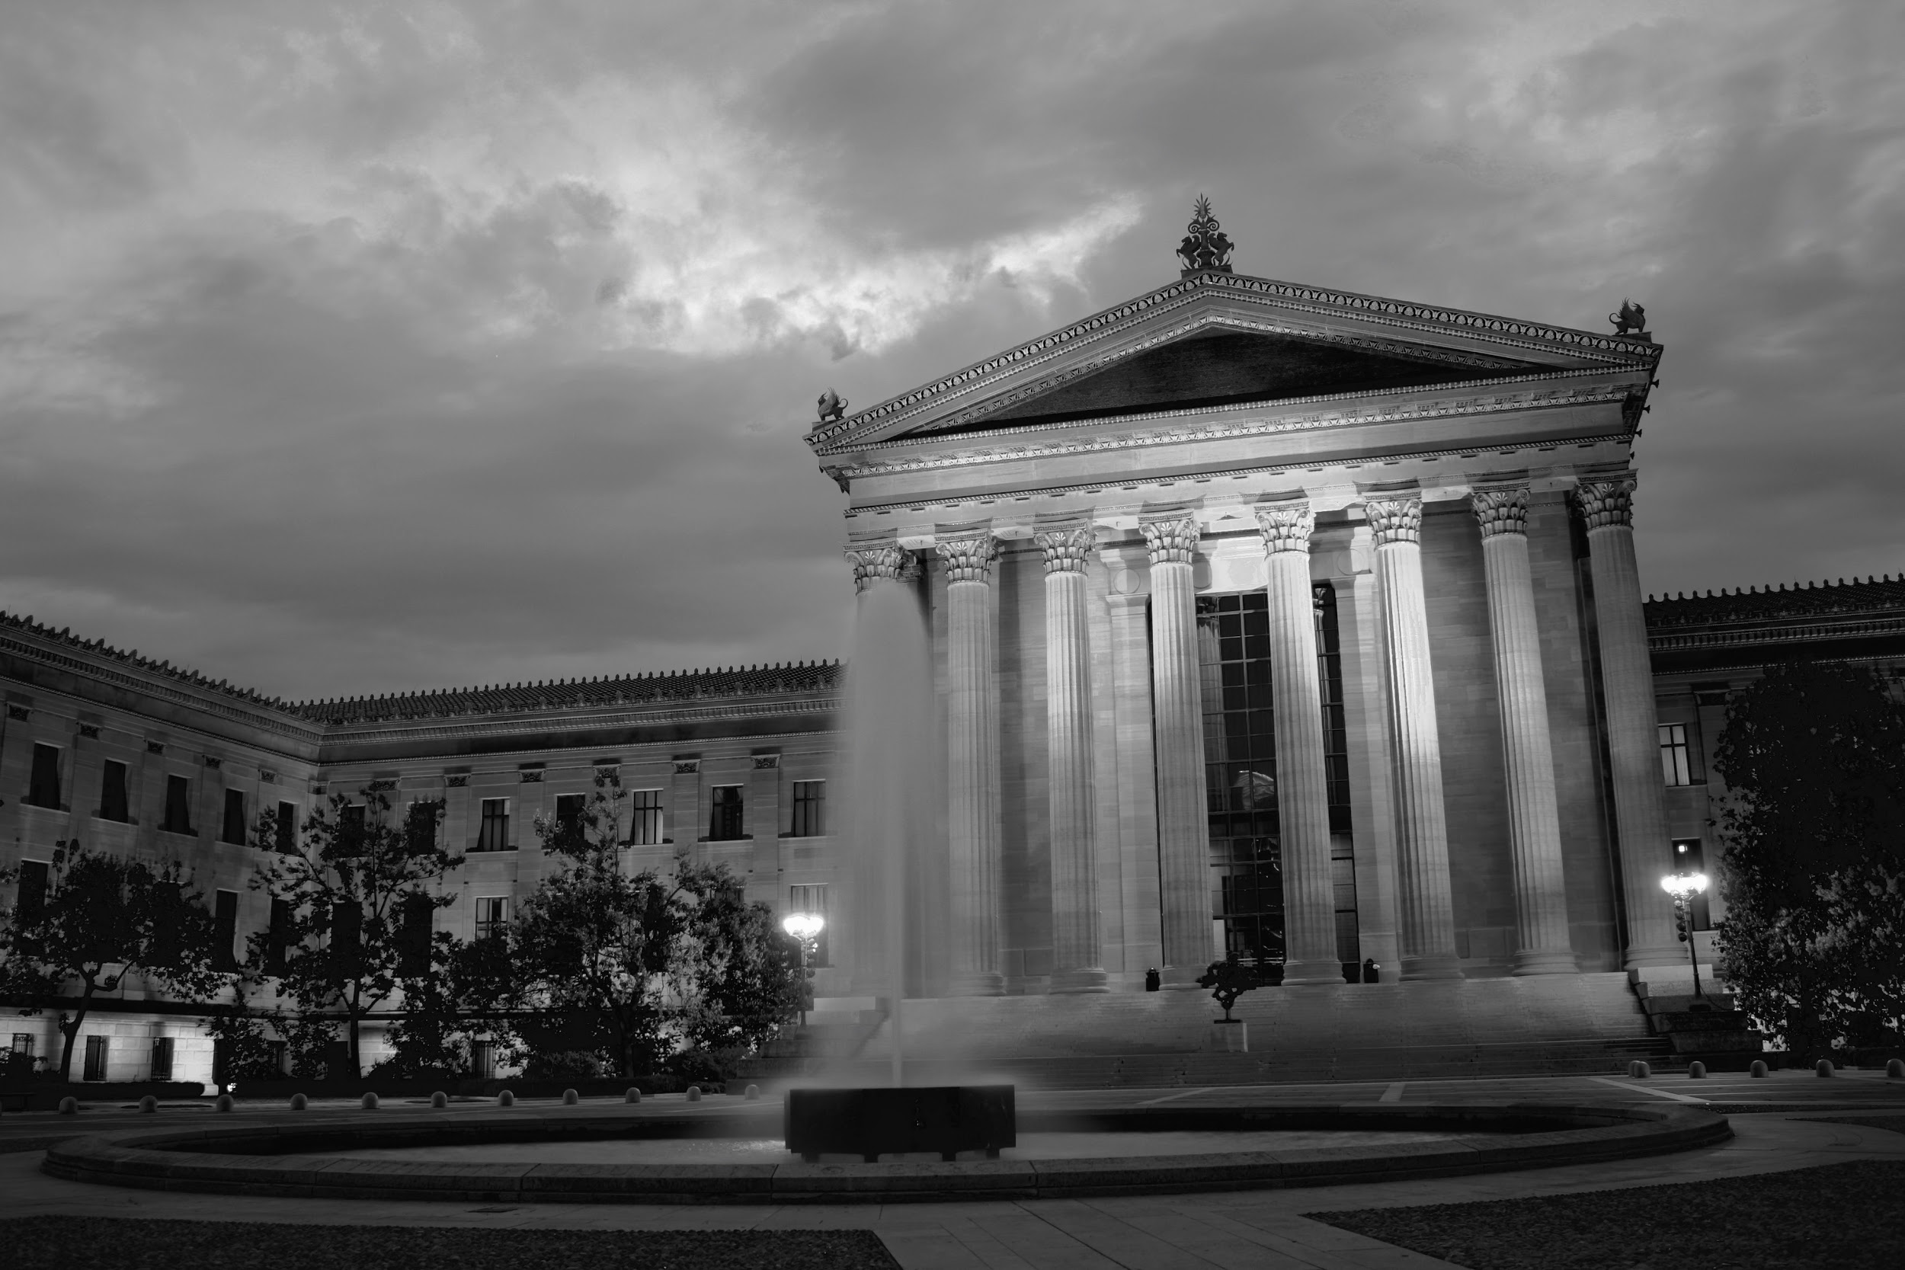
Registration Process
Team B:
Business Analysts:
Connor Gawlik, Jacky Wong, Louis-Gerard Lazarre, Michael Burroughs, Sung Kim
Project Managers:
David Yastremsky & Nodir Zakhidov

Slide 2
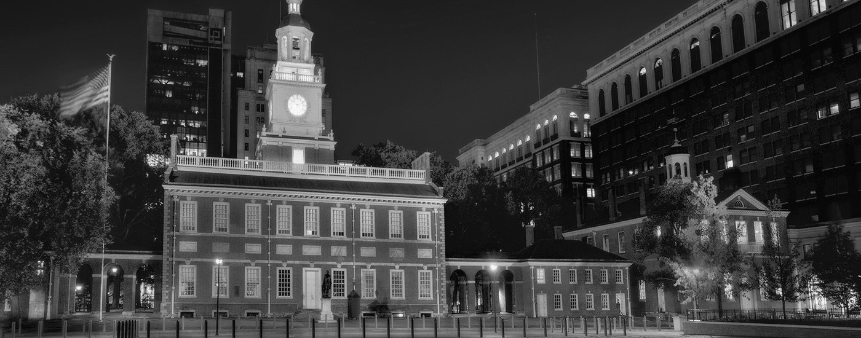
Current Process:
Limited
Disjointed
Ineffective
Current Solution:
Connect with a more diverse group
A streamlined process
Simplistic, effective approach

Slide 3
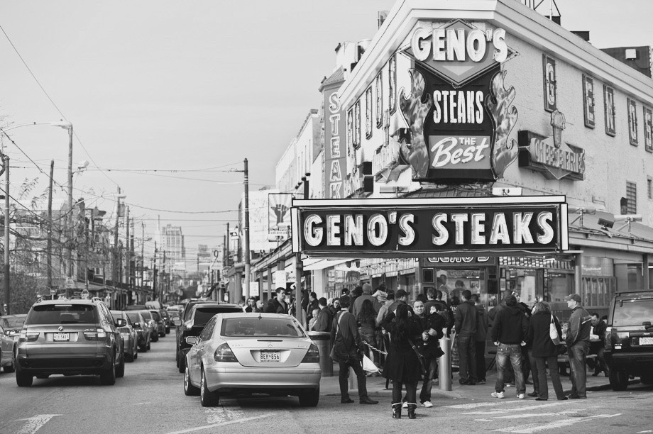
Provide BeHeardPhilly with a:
Seamless Effective Wide-Reach
Registration Process

Slide 4
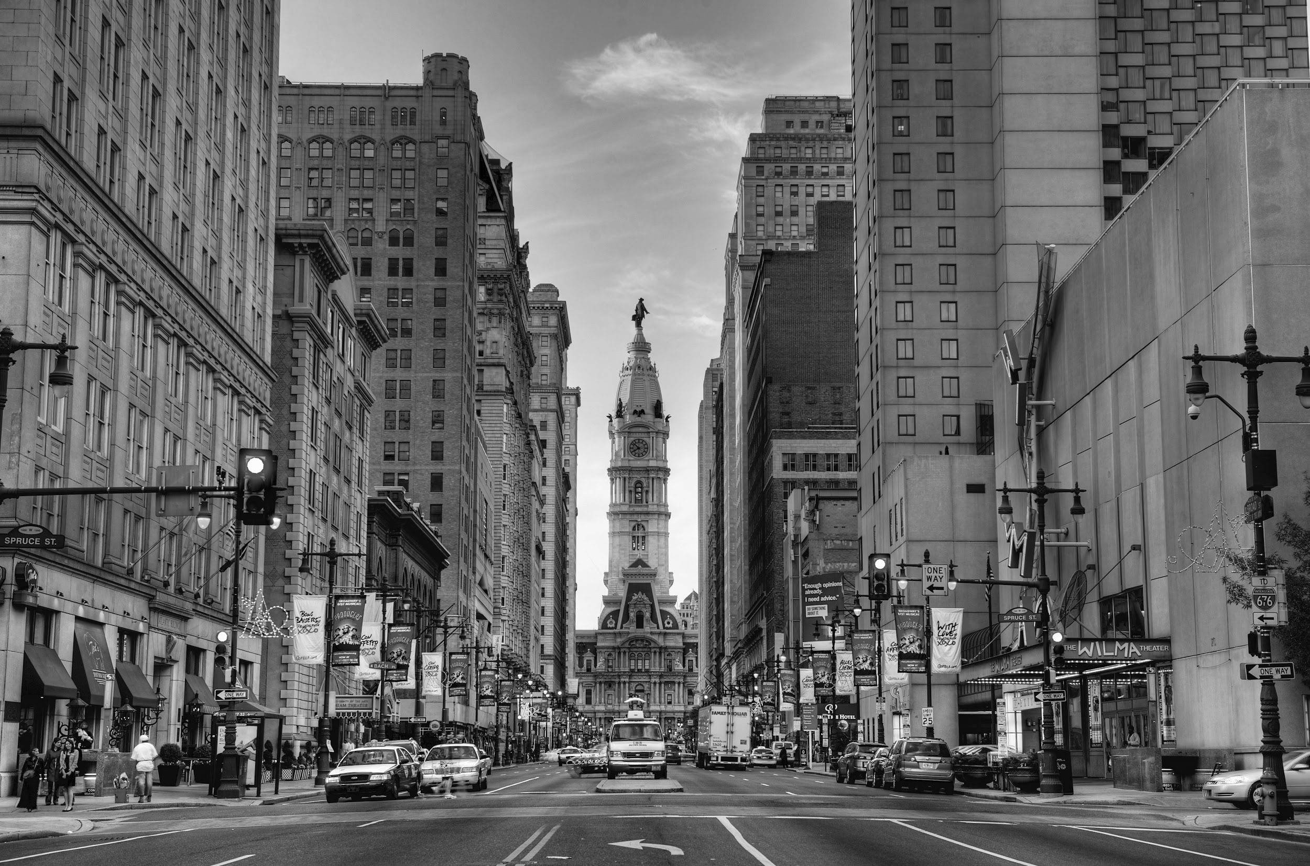
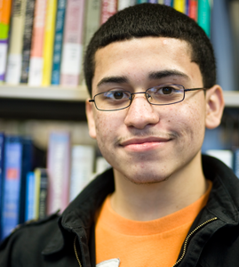
Young Adult - John Snyder
Age: 20
Occupation: Full-time college student
Location: Philadelphia - Temple University
Education: High School Diploma
“I’m not from here but want to feel apart of the city, even though I am just going to college, I want my voice heard!”

Slide 5
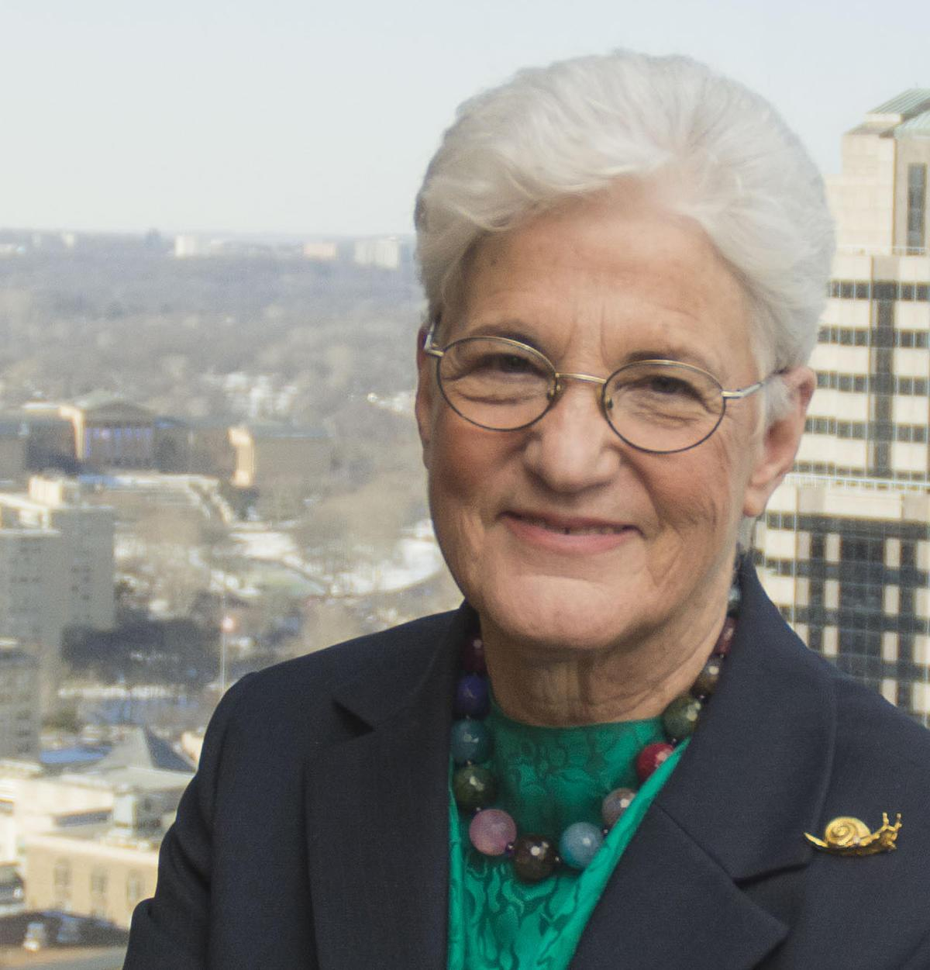
Senior Citizen - Erica Barner
Age: 63
Occupation: Retired Citizen
Location: South Philadelphia
Education: Graduate Degree
“I love Philadelphia. However, I have no way to voice my opinion on current events and hot topics in the city.”

Slide 6
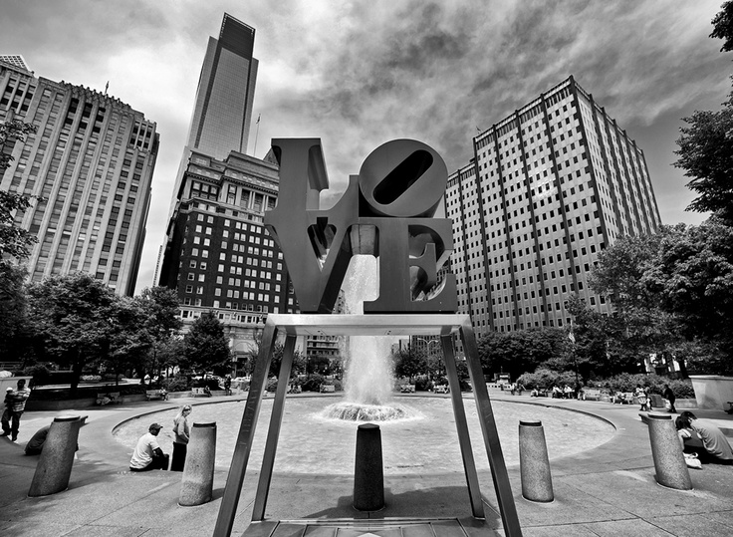
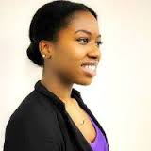
Employee - Jocelyn Hasting
Occupation: Program Coordinator
Location: Philadelphia
“The Street Team is the most effective way of signing people up.”

Slide 7
Benefits:
Improved registration process
Increase sign-ups
Attract a more diverse panel
Strategic Street Team deployment
Streamline data flow

