Slide 1
An analysis of the nfl runningback
Connor Gawlik

Slide 2
Scenario
Many questions surrounding the importance of the running back in todays NFL. Questions have began to surface regarding to:
  Do running backs careers begin to drop off after a certain number of years? Or do they just continue to produce consistently?
  Experts are beginning to say that it is now a passing league (when teams pass the ball more than running the ball on offense)
  Normally and historically teams will only use one primary running back. However, a new trend is emerging in the NFL. Teams are beginning to use two primary running backs. Is this true and does it work?

Slide 3
My data
The data which I am getting my information from is
  http://www.pro-football-reference.com
  http://www.nfl.com
  http://spotrac.com
  The key elements of the data which I am looking at consists of offensive stats, more specifically I plan on measuring the productivity of running backs.

Slide 4
Yards/Attempt
In this image I compare the top four running backs in the league last year and how their average yards per game has changed as the player has gotten older.
As the data represents, according to this small sample, most running backs seem to peek around the age of 26.
While the drop off after 26 may not be extreme, there is still a decline in production.

Slide 5
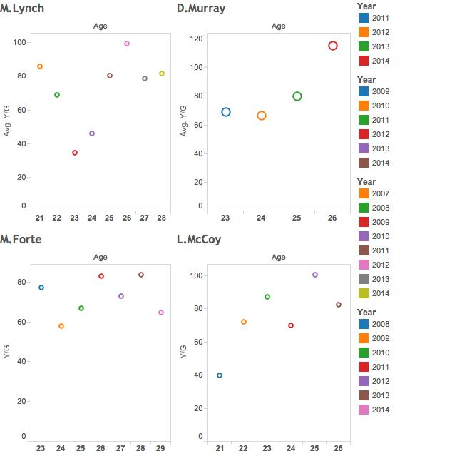

Slide 6
Falling (monetary) value
Next I will be analyzing the wins per team by how much they pay their running backs.
This visual shows that all but one of the 12 win teams pay over $10 million, and the one exception is only paying about $10.1 million.
The trend line illustrated shows that teams that pay less for their running backs tend to win more game than teams that pay more money for their running backs.

Slide 7
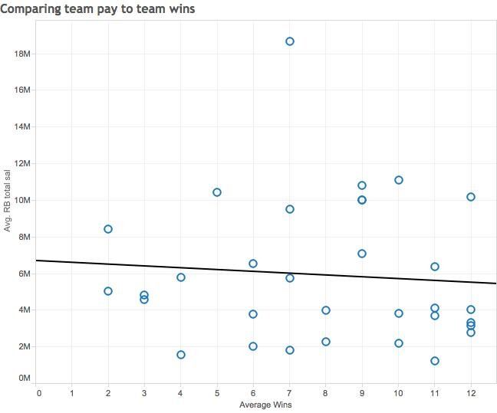

Slide 8
The importance of two backs
Having two primary running backs is becoming more and more of a trend in the NFL.
Two running backs allows for rushing attempts to be split helping running backs last longer and having more productive careers.
This visual shows that the top 5 teams (12 wins) in the NFL last year all used more than 1 runningback to share the rushing attempts.
This also shows that those teams all averaged more than 4 yards per rushing attempt.

Slide 9
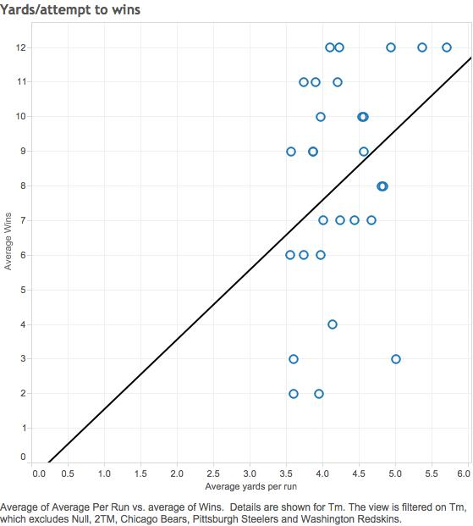

Slide 10
Conclusion
In conclusion, I have shown that running backs tend to improve over the first few years of their career until the age of 26 when they start to suffer from a drop off in production.
In addition, I have show that teams that pay less for their running backs tend to win more games than teams that pay more.
Finally, I have shown the production of running backs when they share carriers and that teams who use more than one running back tend to win more games.

