Slide 1
COURSE CATCHER
Business Proposition
Michael Biffen, Jane Kraus, John Kumpf, & Justin Teyssier

Slide 2
Value Proposition
A comprehensive academic solution combining degree auditing and academic planning for students and faculty.
Interactive & easy to understand audits
Collaborative planning
Increase graduation & retention rates
Improve University efficiency
Notes:
Interactive & easy to understand audits
Many tools (like DARS) are fairly difficult to understand
Course Catcher combines auditing with planning module to provide a student with their suggested “Path”
Collaborative planning
Advisors prepare suggested Paths and monitor student progress
Students can modify their Path while remaining confident they’re meeting academic requirements
Ensures accountability for both students and advisors
Increase graduation & retention rates
Enables students to choose courses & professors that align with their learning style
Keeps them on pace to Fly in 4
Improve university efficiency
Understand real course demand
Improve facility and faculty utilization
Satisfy student needs/wants

Slide 3
Competitive Analysis
Competitors |  | Section Scheduler | Colleague® Student Planning by Ellucian
Overview | Tool used by students to optimize schedule and register for selected classes. | Solution for University faculty to determine when and where to schedule specific course sections. | Tool used by students and advisors to plan and schedule required courses.
Strengths | Automatically builds student schedules based on preferred classes and section/student availability | Maximizes classroom space and class enrollment. Helps manage distribution of classroom resources. | Utilizes pre-loaded degree plans to help students plan classes. Integrated Registration allows for automatic course scheduling.
Weaknesses | “Optimizes” schedule only for University. No guarantee of preferred classes. No consideration of differing sections and professors. | Only focuses on University’s class planning. Has no impact on students scheduling and registration. | Limited focus on individual sections or professors. No sufficient student-advisor communication methods.
Notes:
WHERE COURSE CATCHER DIFFERS:
No researched competitor integrated course and professor reviews. None of them even considered students’ professor or section preferences.

Slide 4
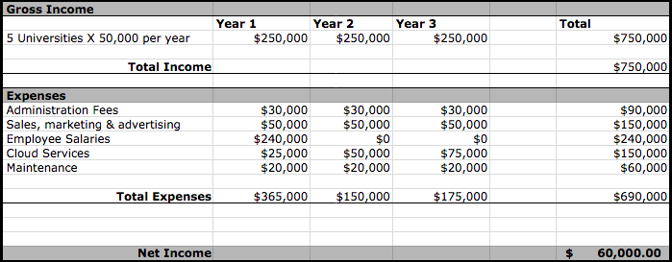
Financial Analysis

Slide 5
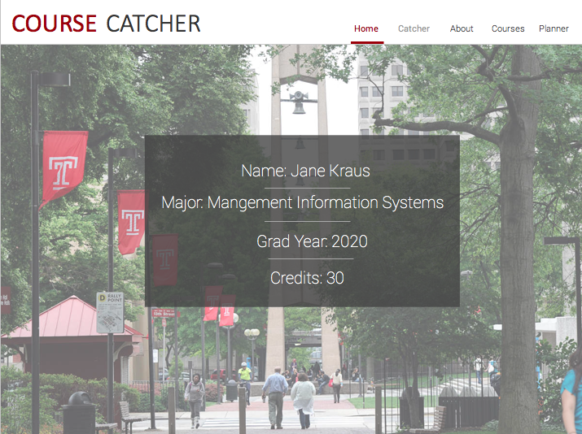
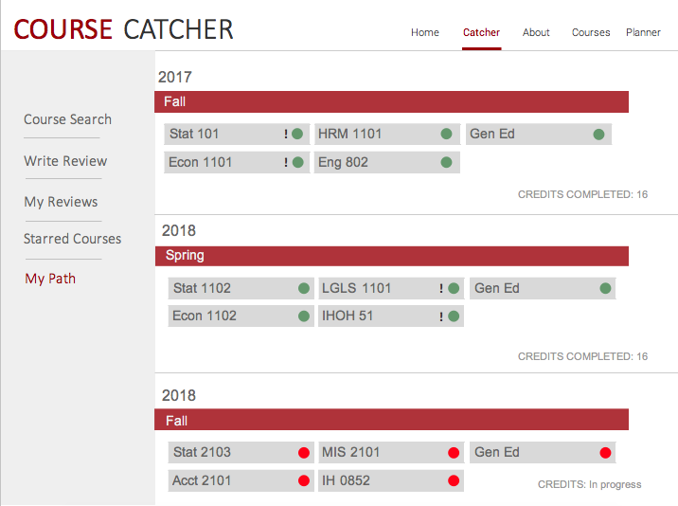
Prototype
Home page
User’s Academic Path

Slide 6
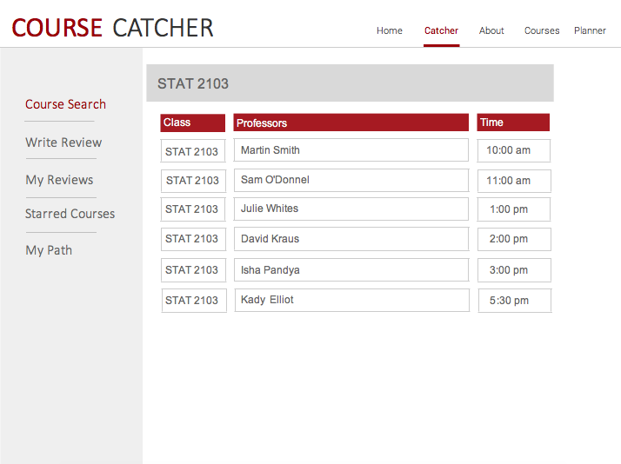
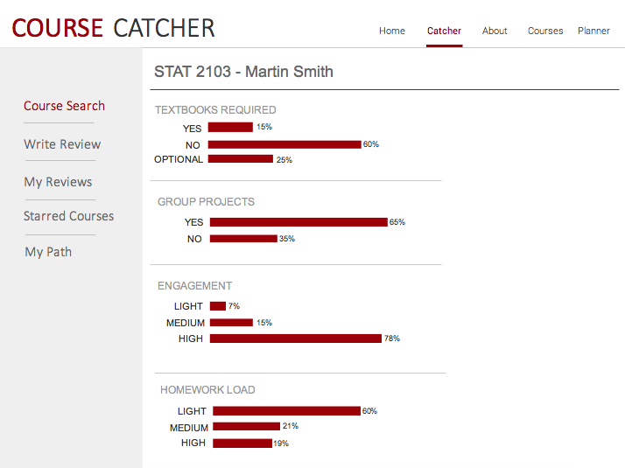
Prototype
Specific Course Search
Course Info

Slide 7
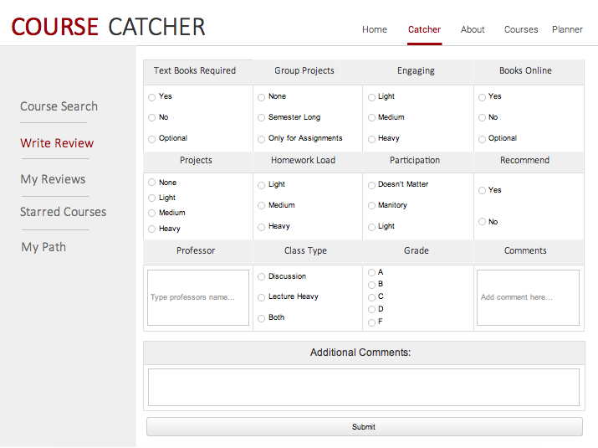
Prototype
Review a Course

