Slide 1
Student-First Course Discovery Tool
Course Search
Darpan Patel, Quy Le, Kevin Diem, Michael Black

Slide 2
The Problem
Current course search tools assume students know what they want
Too many courses
to manually search
No way to discover courses
Counterintuitive

Slide 3
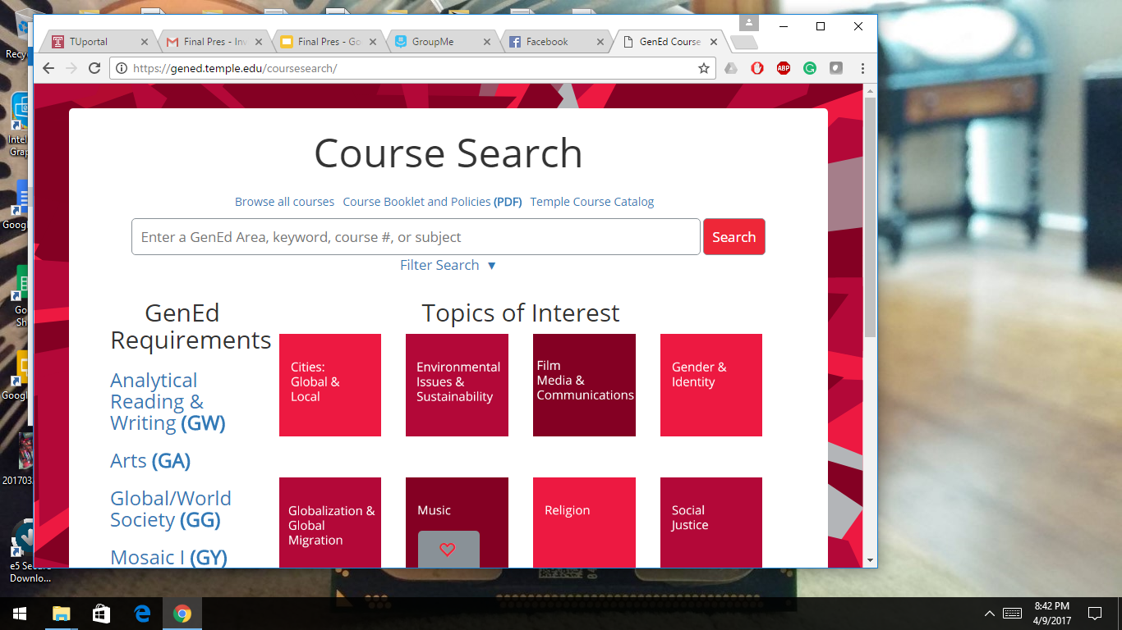
The Solution
Interactive Search Bar
Topics of Interests
Easy to use Interface
Notes:
Intelligently groups courses by interest
Robust search with filters and keywords
Save your favorites in the interface and as PDF

Slide 4
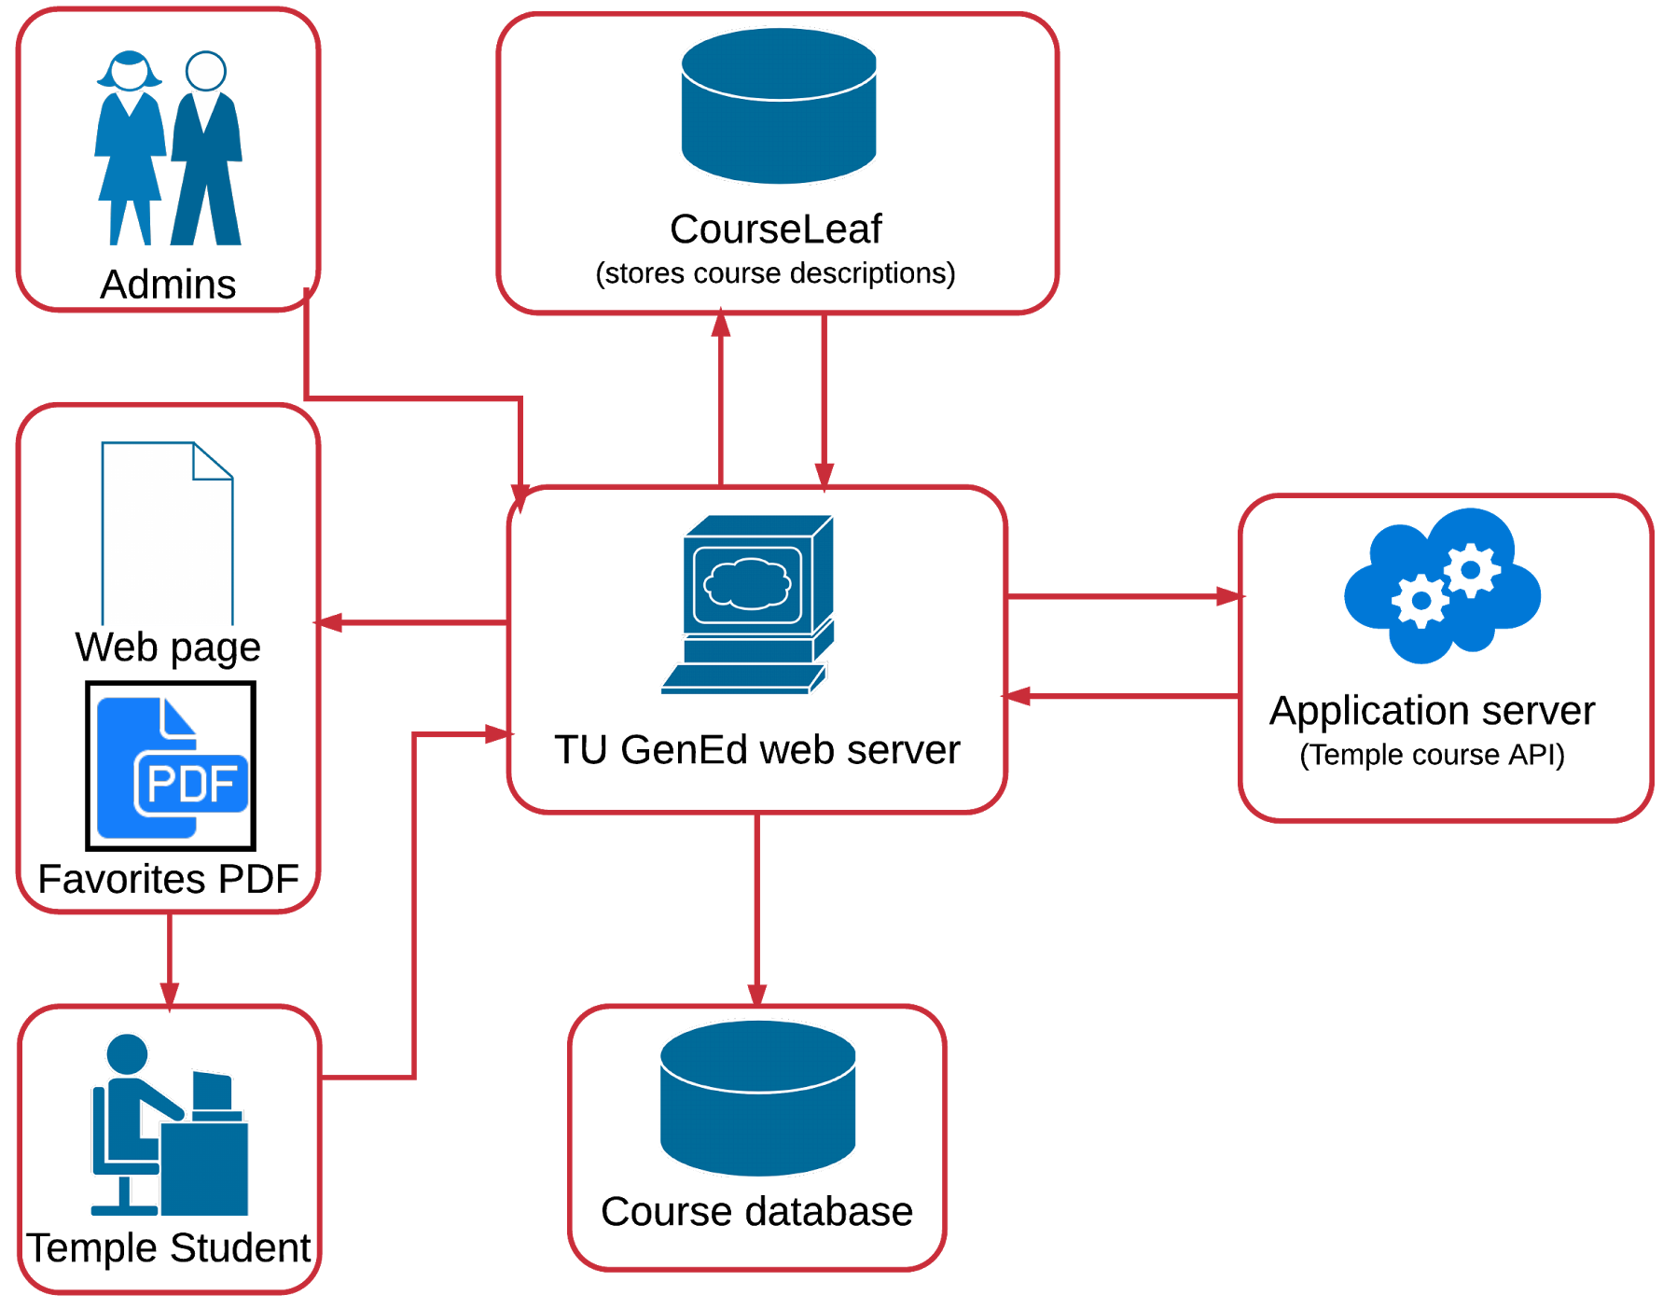
Enterprise IT Architecture
Notes:
List and analyze the enterprise architecture and systems impact of the solution – what it will mean for other systems? – what will you need from other systems?
It was important to consider the load our application would place on Temple’s systems, including existing ones like CourseLeaf
Questions: Is CourseLeaf queried every time someone loads CourseSearch?

Slide 5
Focus Group
Led discussion with 10 students about existing course search options, then Course Search
Implemented student suggestions
Source: pixabay.com, CC0 Public Domain
Notes:
Implemented suggestion: Favorites storage, honors courses
Potential future feature: Integrated weekly schedule overview

Slide 6
Demo
Notes:
Pick one element of the app to show off, there may not be time for more
USE A PERSONA, does not need to be a life story or extremely detailed

Slide 7
Current Market
Student Information Systems
Consist of 14 components
(Colleague, Banner)
Our falls under Course Search
Thayer, Terri-Lynn B. Market Guide for Higher Education Student Information Systems Gartner, 2017. Gartner. Web. 8 April 2017.
Notes:
Q:who are the competitors? which market does it fit in? who are the clients?
Some examples of major leaders in Student Information Systems are ellucian, JenzaBar, and Oracle.
Based on Gartner’s Market Guide, Student Information Systems are made up of the following 14 parts. Ours falls under Course Catalog.

Slide 8
Competitive Analysis
Performance
Measure
Different
Performance
Measure
Cloud Based Systems: JenzaBar JX, Oracle Student Cloud, Apar eLite SIS
Sustaining Innovation
Course Search
Student first thinking
Low cost business model
Lower profit margin tier for incumbents
Addressing over-served customers
Low-end Disruption
Time
New Market Disruption
Time
For Who? – Higher Education CIOs who want to get their institution ahead
Notes:
Q: who are the competitors? which market does it fit in? who are the clients? Cont’d.
Currently the market leaders are working on moving from on-premise to cloud based solutions, which falls under sustaining innovation.
Our strategy is to bring in CourseSearch in from the low-end. Our Low-Cost business strategy will give us an advantage in better profit margins (they have higher costs & can’t charge as low as us).
The idea is the major leaders have no reason to move to a lower-tier profit margin (relative to themselves) and continue to perform in their higher bracket.
We continue in the low-end while improving our product until we meet market expectations but at a lower cost margin than the incumbents.

Slide 9
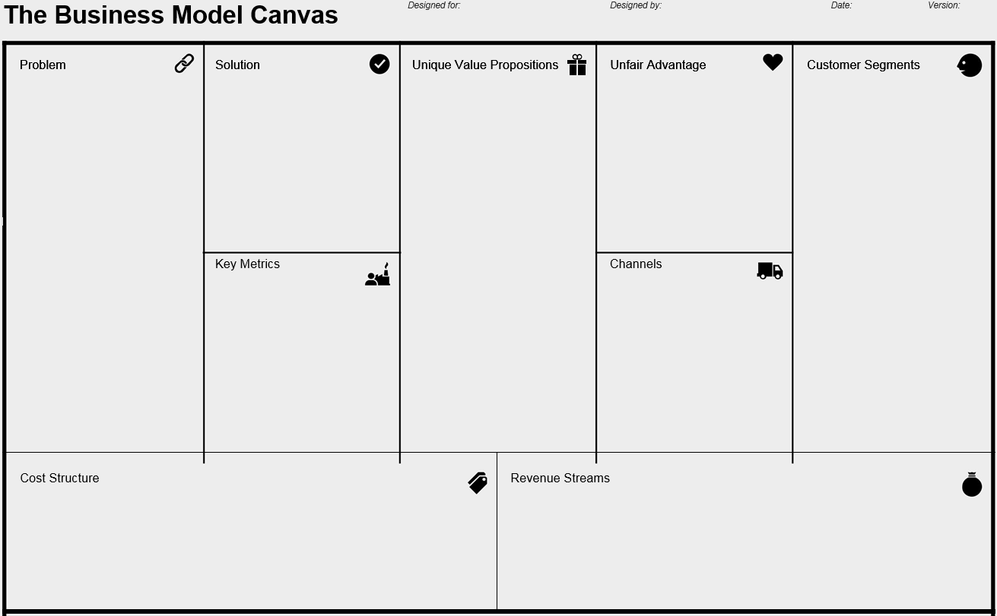
The Business Model Canvas
Problem
Solution
Unique Value Proposition
Unfair Advantage
Customer Segments
Low barriers to entry
Low customer awareness
Limited product capabilities
First to market
Simplistic Product
Low-cost business strategy
No unfair advantage
General Education Departments
Individual colleges within larger Universities
Improved 'customer' satisfaction and educated decision making in the GenEd course search process.
Key Metrics
Channels
Conversion Rates
Number of Searches
Usability
Calling General Education departments
Cost Structure
Revenue Streams
Number of sales
#of Degree Granting Universities
Conversion rate
Customer Awareness
Marketing costs
Salary Costs based on Net Revenue
Notes:
Increase Font Sizes

Slide 10
Financials
Year 1
Year 2
Year 3
$117,500
$235,000
$352,500
# of Sales x Price
Sales, Marketing, Etc.
$10,575
$21,550
$31,725
$106,925
$213,450
$320,775
Net Income
Average Sales Price
Avg. Conversion Rate
($50,000 + $200,00)/2 * 4,700 * 5% * .4%
# of Degree
Granting Universities
Customer Awareness
(Goal 20/4700)
Sales, Marketing, Etc. Costs: 9% of Revenue
Notes:
Q:Basic financials for years 1, 2, and 3 including income (sales and other sources) and expenses (marketing, salaries, computing, servers, etc). (use the template)
Revenue is generated through sales. Our price ranges from $10,000 to $2,500 depending on negotiations and customization.
$10,000 is based on the current costs for Temple’s booklet system. $2,500 is our absolute minimum.
We averaged it out to $6,250. It’s then multiplied by the total possible customers in the country, 4,700. The average conversion rate for software as a service is 7%. We hope to reach at least the universities in the Philadelphia area, which is 20 out of the 4,700 total possible. This is .40% of the total potential customer base. We hope to increase by this number each year as well.
Our only costs are marketing which typically is 9% of a firm’s revenue. It can be as low as 2% for smaller firms, such as ourselves.
Infrastructure is paid by the buyer, whether it is on-premise or cloud. Considering our solution requires little customization, we do not require additional developers. Salary costs are the remainder of net revenue.

Slide 11
Why Course Search?
According to Gartner, Higher-Education CIOs are looking for...
Support for Analytics
Modular Systems
Less Expensive & Less Disruptive Implementations
Delivering Education in a Student-Centric Manner
Thayer, Terri-Lynn B. Market Guide for Higher Education Student Information Systems Gartner, 2017. Gartner. Web. 8 April 2017.

Slide 12
Thank you!
Any questions?
Darpan Patel, Quy Le, Kevin Diem, Michael Black

