Slide 1
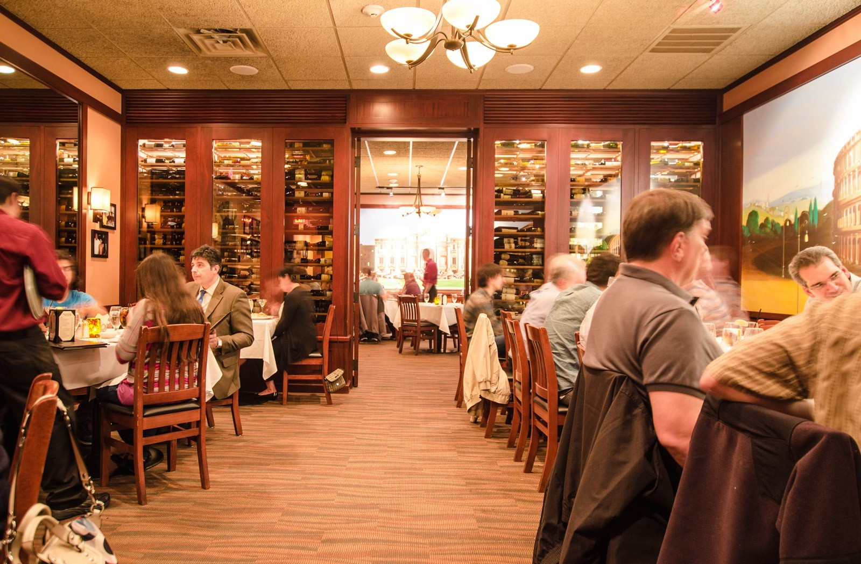
Dibs
Ajah Puryear, Parth Patel, Jose Gil, Noah Fulkroad, and Malik Donald.

Slide 2
Inspiration & Problem
Without Dibs
With Dibs
Notes:
Ajhia
Our inspiration came from Maliks(point to him) significant other who is a chef (pause)… And engaged us to bring digital innovation to the reservations and the overall dinning experience of customers.
(Ask audience) Raise you hand if you have ever had bad dining experience.
Disappointed with the quality or look of food.
The timing of food… getting it late
Not knowing the menu
And Dibs was born… to help solve/alleviate those problems..
Now ill hand it over to parth to tell you more about dibs
Dibs can solve this…

Slide 3
Who are we?
Value Added
An innovative and cost-effective avenue for restaurants to better manage their tables.
Customers receive a facilitated experience from reserving, ordering, and then even paying.
Holistic Service
Social Network Driven
Make reservations at their favorite restaurants.
Browse the menu and pre-order their food.
Provide their preference for the type of service they receive.
The platform integrates with social media feeds of our customers and showcases restaurant activities of their friends.
Notes:
Parth

Slide 4
Competitive Analysis
App Capabilities | Yelp | Nowait | OpenTable | Dibs
Search for restaurants, make reservations and view customer reviews | ✓ | ✓ | ✓ | ✓
Join a waitlist | ✓ | ✓ | ✖ | ✓
Pick your seating when making a reservation | ✖ | ✖ | ✖ | ✓
Place order when making a reservation | ✖ | ✖ | ✖ | ✓
Integrates with social media feed of customers | ✖ | ✖ | ✖ | ✓
Notes:
Jose

Slide 5
Marketing Strategy
Paid Advertisements
Search Ads
In-Store
Optimize Social Media
Target: Millennials/Gen-Z
Ages: 18-38
Notes:
Jose

Slide 6
How will we generate revenue?
Service subscription: $150/location/month
Reservation fee: $0.95/reservation
Ad Revenue: $50/location/month
Notes:
Noah

Slide 7
Dibs Prototype
Notes:
Malik

Slide 8
Systems Architecture
Notes:
Parth

Slide 9
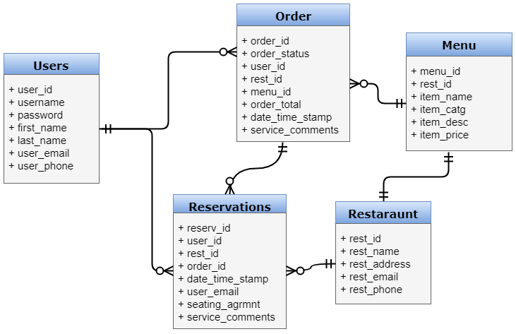
Data Model
High Level - Relational Data Model
Notes:
Partn

Slide 10
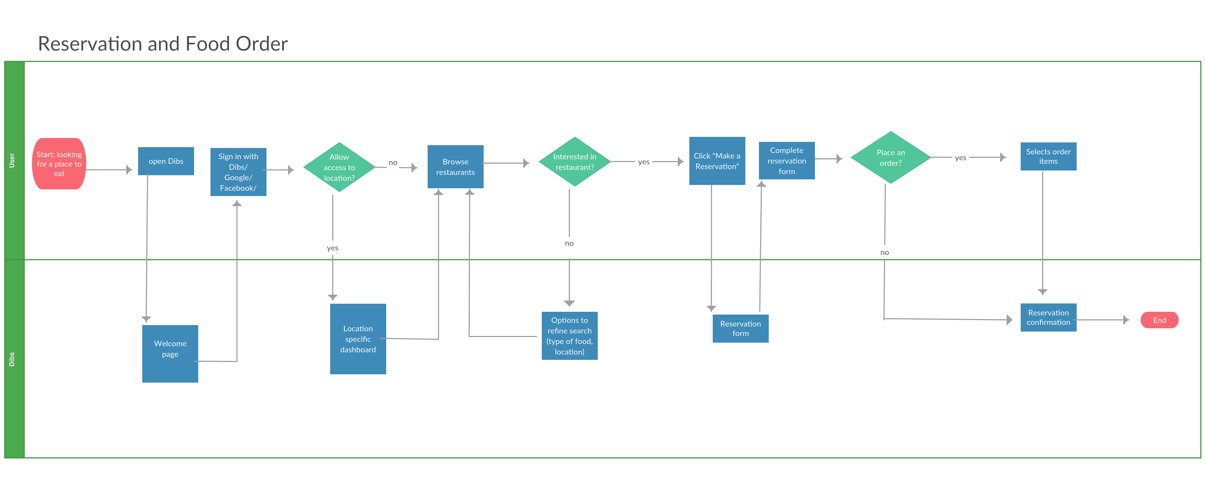
Process Model
Notes:
Noah

Slide 11
Financial Outlook
Notes:
Noah

Slide 12
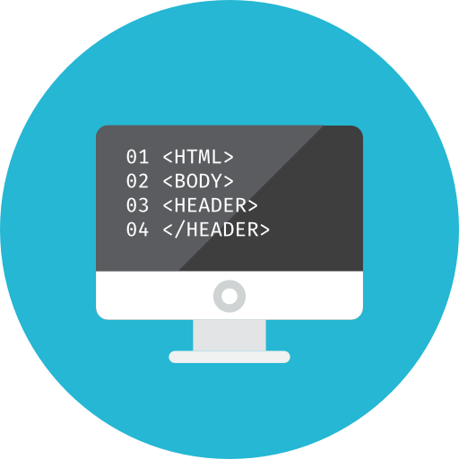
Implementation
Design and develop
User testing
4-6 MONTHS
1 MONTH
1-3 MONTHs
Analysis, research & plan
Maintenance and support
CONTINUOUS PROCESS

Slide 13
Questions?

Slide 14
Appendix

Slide 15
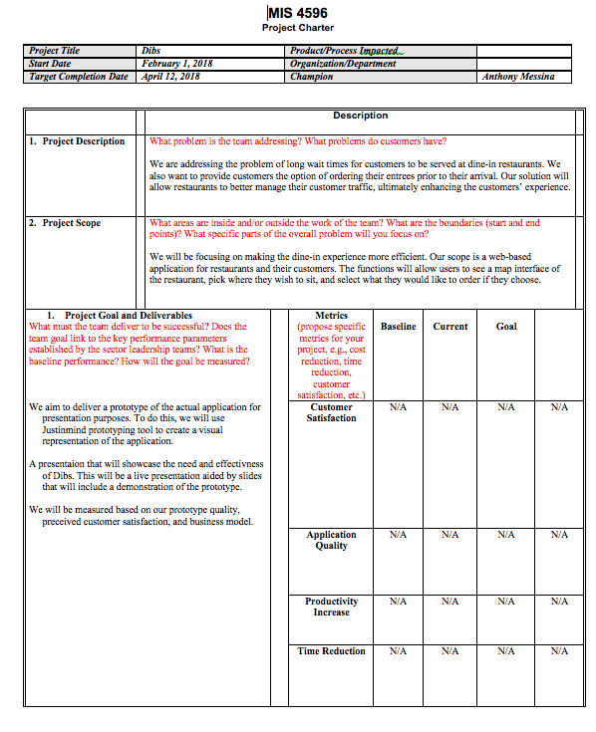
Project charter

Slide 16
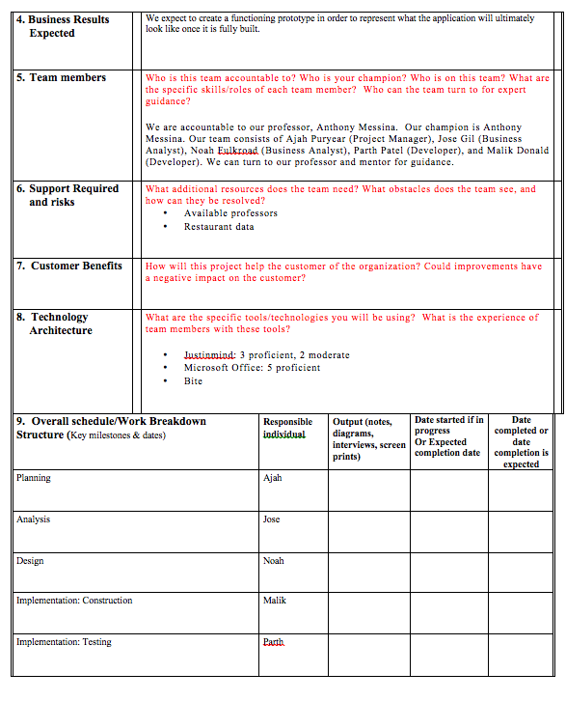
Project charter

Slide 17
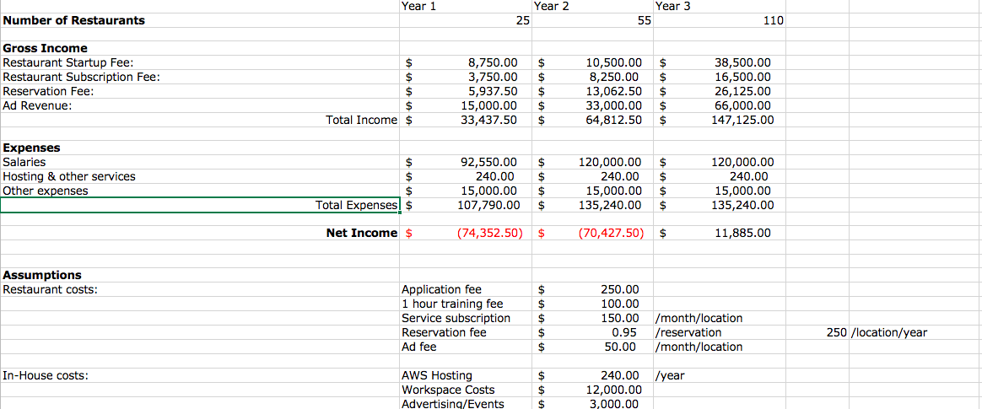
Financial Analysis

Slide 18
Assumptions
Restaurant Costs:
Dibs Costs:

Slide 19
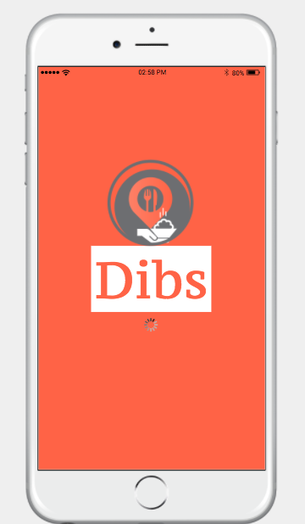
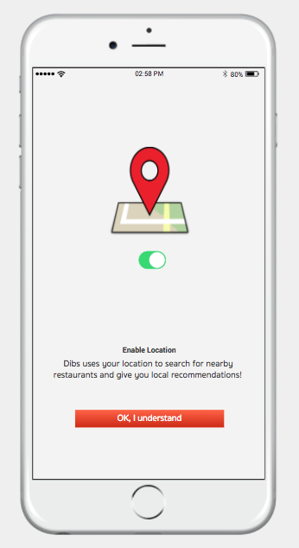
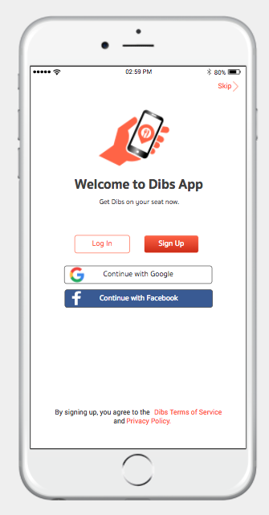

Slide 20
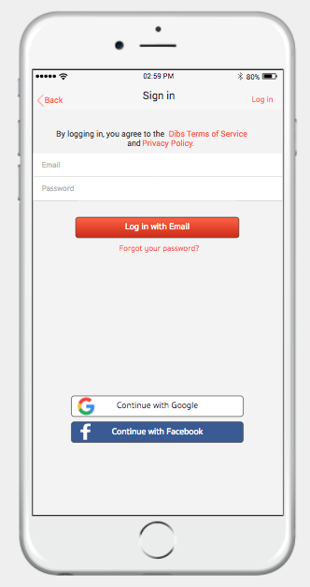
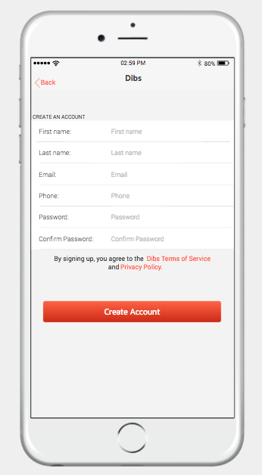
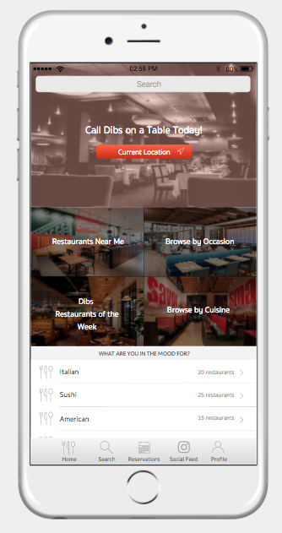

Slide 21
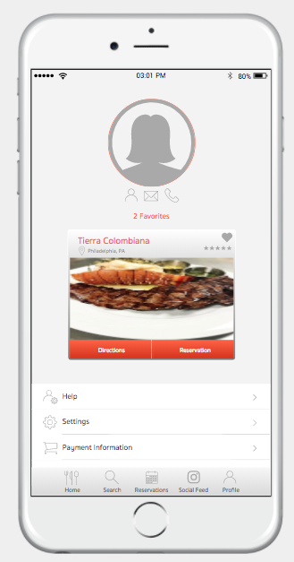
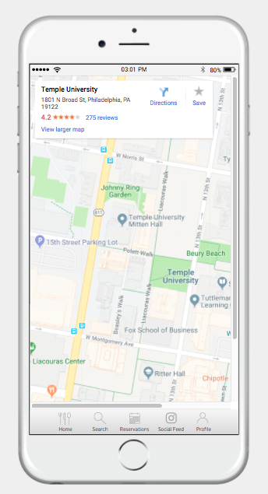
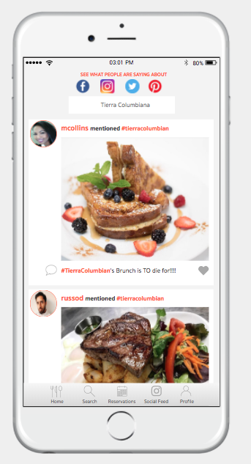

Slide 22
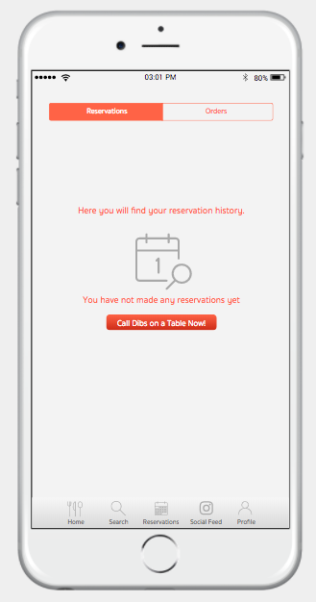
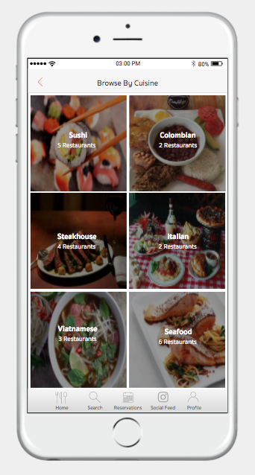
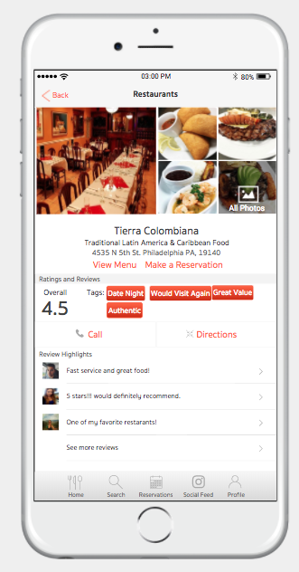

Slide 23
