Slide 1
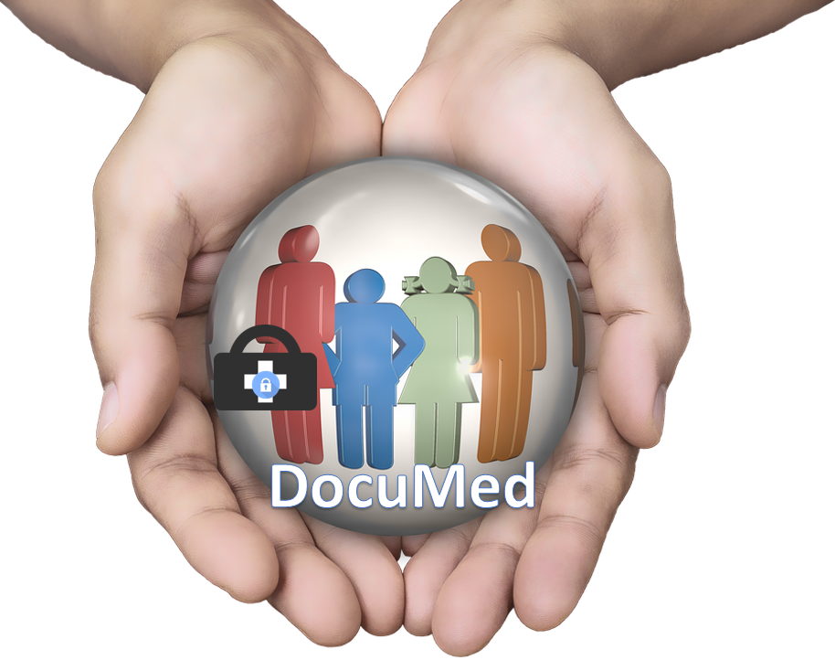
DocuMed
Alan Kim
George J Raymond
Jeremy A. John
Johnathan Holland
Notes:
It's all about you?-->

Slide 2
Industry Issues
Documentation Redundancy and Accuracy​
Patient Engagement​
Errors
86% mistakes is made from administration, which led to 400,000 death a year
83% said they should have full access to their electronic records
Roughly $250 billion consists of administrative costs yearly

Slide 3
Solution
DocuMed
Real-time updated medical information
Reducing redundant administrative costs across the healthcare value chain
Allow transparency between patients and doctors
Notes:
What is the value that we are giving>
The patient care ecosystem
Eliminate redundant administrative costs throughout the healthcare value chain
Mobile Application
HIPAA compliant (data is living in the block chain
Access to test results
Medical records are available at all times
Patient scheduling
Notifications on medication use (alarm/notification)
Medical bill
Procedure notification
Block Chain
Single patient file
patient data is always up-to-date
Prescriptions are singular( where patient cannot go to different hospitals to get a prescription)
Medical Conditions will be all in one place
Procedures will be all in one place
No lost patient data
Single patient file will prevent additional tests from other hospitals
System cross-references/verifies new data entries (blood type from being A to O)

Slide 4
Medical entities don’t have integrated access to valuable real-time data
Doctor
Payer
Patient
Specialist
Pharmacy
Labs
Hospital
Notes:
Information silos→loss of data
→change the blue block on the left side
Focus on the solutions from the first 3 slide

Slide 5
Prototype
Notes:
Pick a different screenshots
Count on scrrenshot crashing

Slide 6
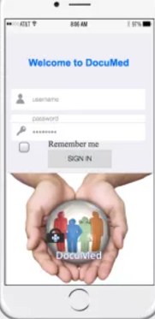
Patient
Primary Care
Pharmacy
Hospital
Payer
Verified
Verified
Verified
Verified
Date | Time | Patient_ID | Hash | Entity | Location | Transaction Details | Confirm
04.11.2017 | 8:00 | #1234 | #SH1234 | Hospital_ID | #4655 | Patient Admitted | Patient_ID
04.11.2017 | 8:07 | #1234 | #SH1235 | Nurse_ID | #4655 | Registered Patient | Patient_ID
04.11.2017 | 8:21 | #1234 | #SH1236 | Nurse_ID | #4655 | Vitals: Status | Patient_ID
04.11.2017 | 8:21 | #1234 | #SH1237 | Nurse_ID | #4655 | Vitals: Heart Rate Updated | Patient_ID
04.11.2017 | 8:33 | #1234 | #SH1238 | Doctor_ID | #4655 | Request Lab:Blood Test | Patient_ID
04.11.2017 | 8:47 | #1234 | #SH1239 | Nurse_ID | #4655 | Perform Lab: Blood Test | Patient_ID
04.11.2017 | 9:04 | #1234 | #SH1240 | Doctor_ID | #4655 | Diagnosis Treatment:Cleared | Patient_ID
04.11.2017 | 9:07 | #9876 | #SH1241 | Pharm_ID | #2343 | Pharm Prescription | Waiting
04.11.2017 | 9:21 | #1234 | #SH1242 | Hospital_ID | #4655 | Discharged: Cleared | Patient_ID
Verified
Notes:
Assumed entities already manage their own databases.
Each access point is unique. There is not one gate keeper. Access points are encrypted.
A Blockchain is a tamper proof, shared digital ledger that records transactions. (Permanently records history, Time Stamped).
All Patient information will be record throughout life time.
Smart Contracts allow patient-Entity relationships associating medical records with viewing permissions and data retrieval instructions on external databases.
On Blockchain- Hash of the records, a machine to machine verification occurs outside the block to validate the information before writing to the ledger. Unique hash for every transaction.
With DocuMed each entity that has a Private key&Public key can view the Patients records.

Slide 7
Competitive Analysis
 | DocuMed | Epic
Measure Performance
Patient Actively Engaged
Procedure Confirmation
Trusted System Integration
Doesn’t require redundant data storage
Real-time Data Retrieval
Notes:
Currently, Temple Health, Penn Medicine, Jefferson Hospital are hosted and support by Epic.
54% of these Hospitals patients are maintained on Epics software. *Epic Website.
DocuMed allows Patients to rate medical experience. Epic provides transcribes information documented by doctor, hospital and specialist. Inconsistency.
DocuMed the Patient is engaged in their medical treatment, gains an understanding, is included in the decisions
DocuMed the Patient will confirm each medical transaction after the doctor, hospital and/or specialist performs the task.
The blockchain provides a trusted location for information to be retrieved and not transferred.
The Patient does not have to retake test, redo registration, list medication or transcribe medical condition.

Slide 8
 | Year 1 | Year 2 | Year 3 | Year 4 | Year 5
Application Development: Maintenance: | 800,000 | 50,000 | 50,000 | 50,000 | 50,000
Infrastructure Hosting: Server: Database: Networking equipment: Maintenance: | 50,000 50,000 500,000 10,000 | 50,000 56,000 | 50,000 57,000 | 50,000 58,000 | 50,000 59,000
Total Cost | 1,410,000 | 156,000 | 157,000 | 158,000 | 159,000
Financials
Notes:
Develop the application with an initial cost at 800,000 with maintenance costs after year one
The blockchain will be hosted by IBM
The database will hold the hashes that will connect the other entities databases together
3rd party vendor to maintain the system

Slide 9
Implementation
Blockchain
Application
Patients
Connect the Database
Connect the Application
Connect the Users
Notes:
This is an example of how Temple Hospital will be integrated
Integrate Temple Hospital's database in order for the hash to verify the information to write code into the blockchain.
Then connect the application with the blockchain so its features can be enabled.
Finally notify patients of the new application, so they may start using all of its features.

Slide 10
Solution
DocuMed
Real-time updated medical information
Reducing redundant administrative costs across the healthcare value chain
Allow transparency between patients and doctors
Notes:
What is the value that we are giving>
The patient care ecosystem
Eliminate redundant administrative costs throughout the healthcare value chain
Mobile Application
HIPAA compliant (data is living in the block chain
Access to test results
Medical records are available at all times
Patient scheduling
Notifications on medication use (alarm/notification)
Medical bill
Procedure notification
Block Chain
Single patient file
patient data is always up-to-date
Prescriptions are singular( where patient cannot go to different hospitals to get a prescription)
Medical Conditions will be all in one place
Procedures will be all in one place
No lost patient data
Single patient file will prevent additional tests from other hospitals
System cross-references/verifies new data entries (blood type from being A to O)

Slide 11
Questions?

Slide 12
Appendix

Slide 13
Sources
https://getreferralmd.com/2016/08/30-healthcare-statistics-keep-hospital-executives-night/
http://www.commonwealthfund.org/publications/in-the-literature/2014/sep/hospital-administrative-costs
https://www.oecd.org/els/health-systems/Tackling-Wasteful-Spending-on-Health-Highlights-revised.pdf

Slide 14
Application Benefits
Payer
Performance Matrix
Primary Care
Patient History
Hospital
Real Time Records
PATIENT
Specialist
Transparency
Pharmacy
Source of Truth
Notes:
Payer-Measuring Performance for each Hospital, Specialist and Primary Care
Primary Care- Accurate historical patient history.
Hospital Records- Real Time Records
Specialist- Transparency-Providing Medical facilities updated findings
Pharmacy- Accurate Medication –Source of Truth
Patient- The patient is now center of their medical experience. And becomes an active participant by being coming engaged.

Slide 15
Patients can leave reviews of doctors which insurance companies can use (correct diagnosis, correct drug prescription, drug cost, drug effectiveness, and side effects)
Add gym memberships to application where it will track gym attendance when scanned
Reduction in lost referrals which is 46%
110 million information security breaches in 2015
17,000 patient records are breached today
Multiple points of encryption to prevent breaches

Slide 16
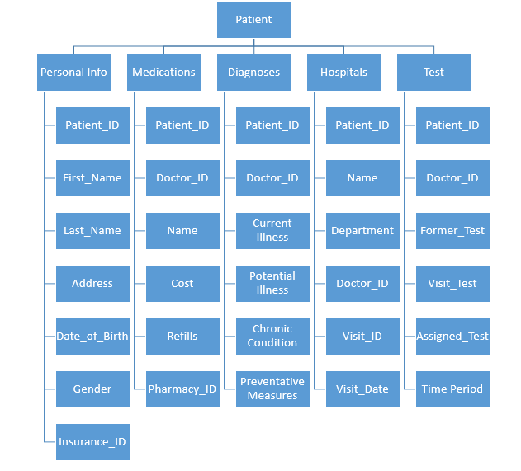
DocuMed Model

Slide 17
Health Tracking Benefits
Become a healthier YOU!
Track health indicators
Track gym member participation to get premium discounts

Slide 18
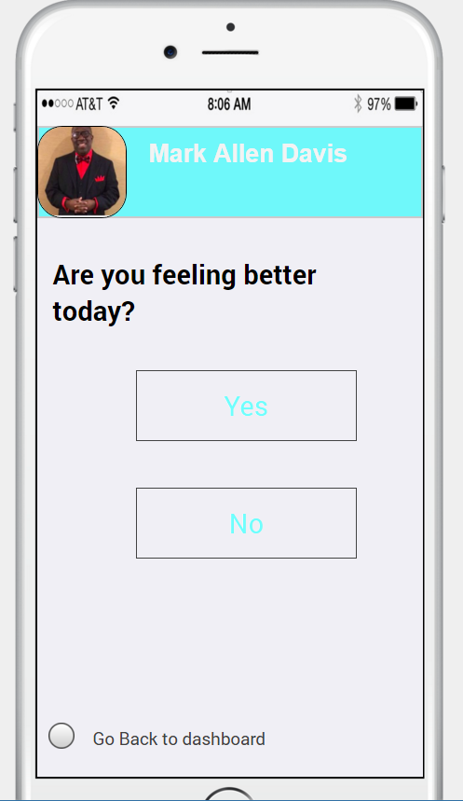
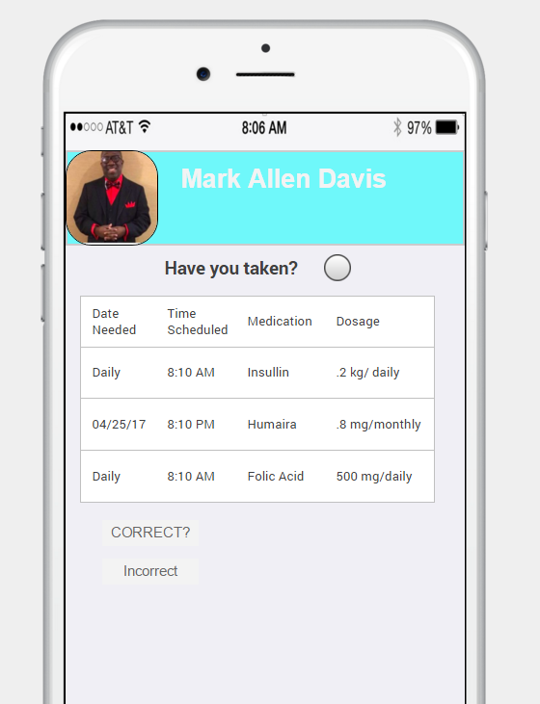
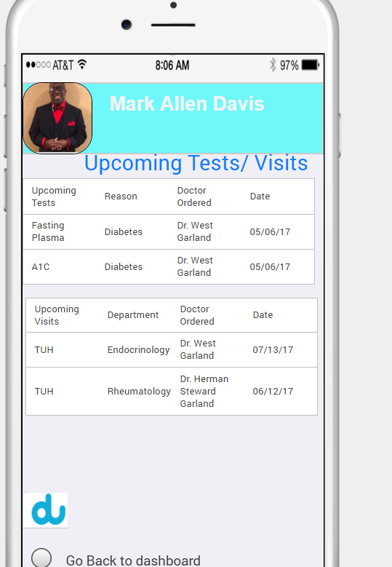

Slide 19
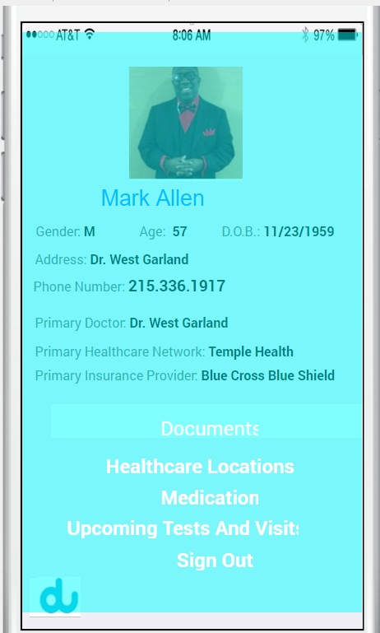

Slide 20
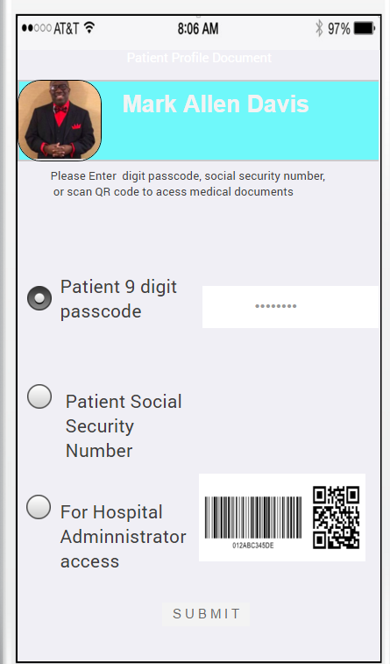
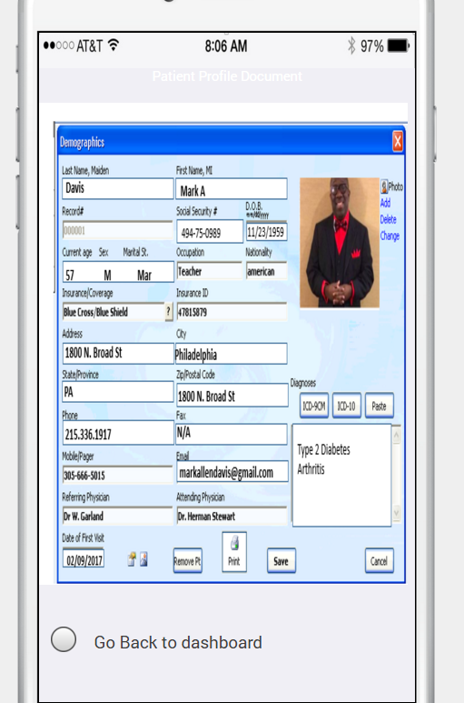

Slide 21
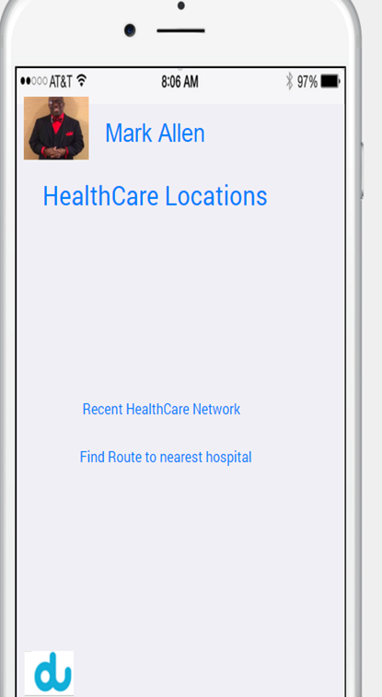
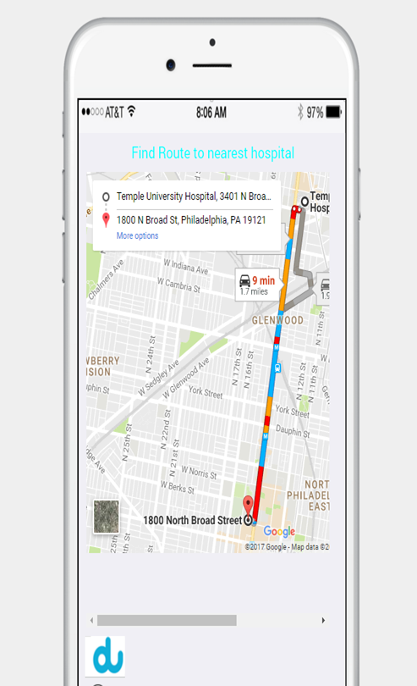
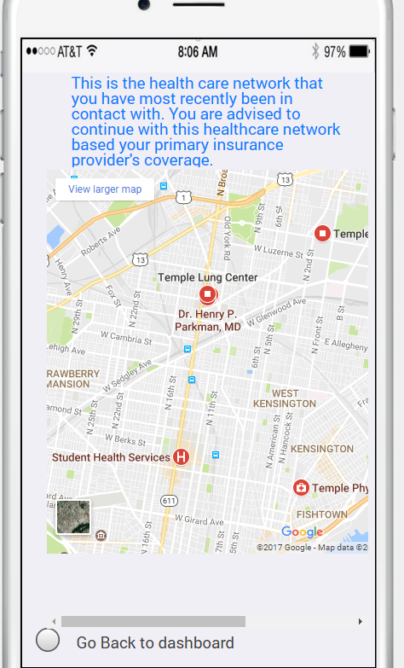

Slide 22
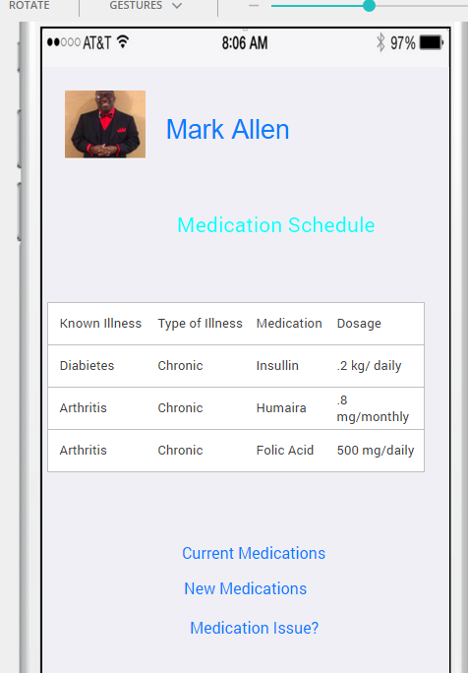

Slide 23
Have you ever struggled to go get answers to your medical information, only to find yourself left in the dark ?

