Slide 1
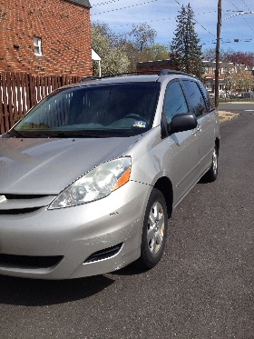
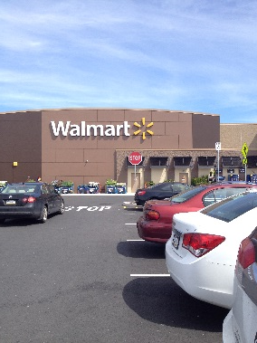
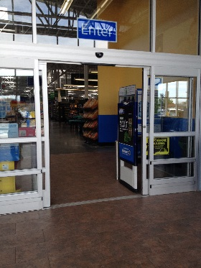
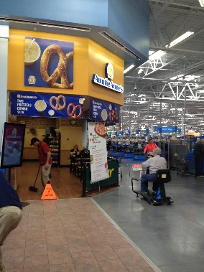
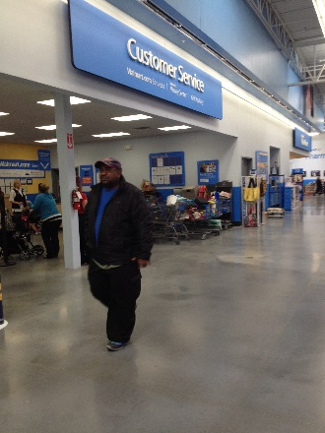
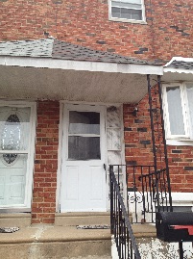
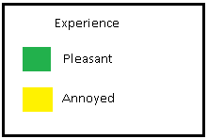
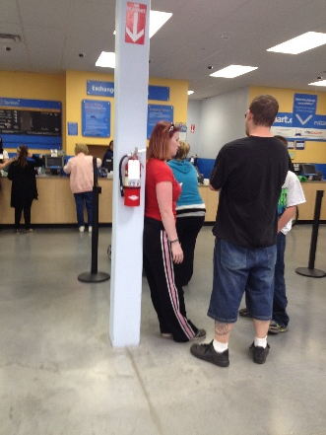
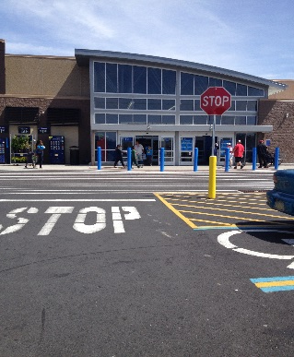
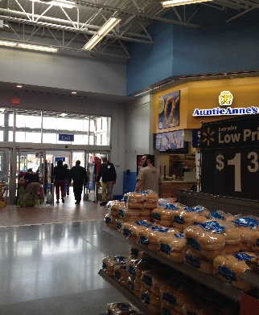
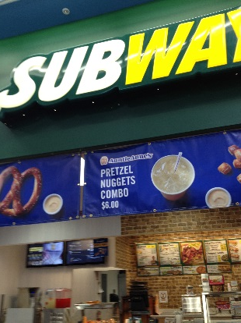
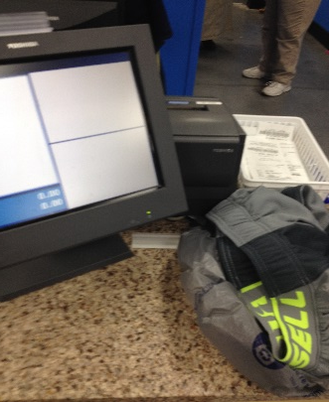
8min
2min
3 min
2:00P.M on a Sunday I got into my car to go to an nearby Wal-Mart to return an purchased item
2:08P.M I got to Wal-Mart parking Lot it was crowded with cars
2:10P.M I enter into Wal-Mart Store
At the entrance/exit I saw an Auntie Ann for people to sit and eat. It was somewhat crowded
2:13P.M. It took me 3mins to find the Customer Service since there wasn’t any signs at entrance
2:30 I arrived back home
Mapping Sequence
8
min
1 min
1 min
3 min
4 min
2:20 I got to back into my car and left the parking lot to go back home
2:21 I exit out of Wal-Mart and there is a worker that checks purchased items.
2:20 While I was walking to the exit there was another food distributor for customers near the exit
2:17pm I got to the register and started the return process, the worker was very pleasant and efficient in the process, only took 2min. Got full cash back for my purchase
2:13p.m. Started waiting in line. There was not many people in the line and there is 3 register open.

Slide 2
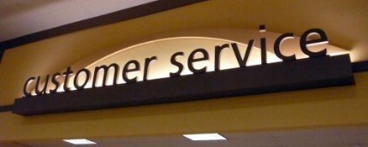
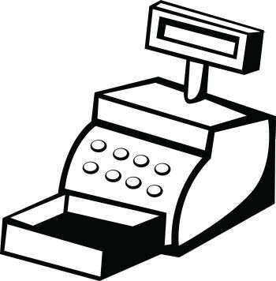
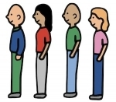
v
Storyboard
Sunday Afternoon…
1
It was sunny warm day, I left my house at 2:00pm to return the shorts I bought that didn’t fit from a nearby Wal-Mart
2
3
4
I drove to store and It was pretty crowded. The parking lot was packed with cars and I saw lots of people walking in and out of the store.
Once I got into the store there wasn’t any signs to point me where the customer service is, so I was confuse to where to go.
I walk around aimlessly until I find a big customer service sign. It was near the entrance/exit, but the fact that there wasn’t a sign to show me at the beginning somewhat annoyed me.
10
At 2:30pm I got back home and thought, it didn’t took long to of got my item returned. It only took 30 min!
8
7
6
5
9
I got to the register and it was a young gentlemen that was helping me with my return. It did not took him more than 2 min until he finish the return process and gave me the receipt to sign. He was very nice during this process and told me to have a nice day at the end. At this point I was not annoyed at all since the returned process went so smoothly and did not took long at all.
I started walking to the exit. While I was walking to the exit I passed by some fast food restaurant, one of them is Auntie Aunt. I was tempted to buy one since I love Auntie Aunt’s pretzels but I didn’t. I saw that there was a lot of people there, mostly family buying their kid pretzels or snacks.
I than finally exit out of the store. At the exit I saw that there is a worker, an older gentleman, that checks purchase item just incase of theft or any confusion with their purchase. He didn’t check me or ask for my receipt since I haven’t bought anything.
I walk up to the customer service. Once, I got to the customer service, there wasn’t a long line. There was only about four people waiting in line. One couple and, two other younger people.
I saw that there are three register open that was helping customer with their return. It did not took long until I was next in line for my return.

