Slide 1
Tea Worldwide
Group 6: Sean Carpenter, Rich Henne, Ed Shen, Tennyson Coleman

Slide 2
Overview
Big Idea
Process
Key
Insights
Product

Slide 3
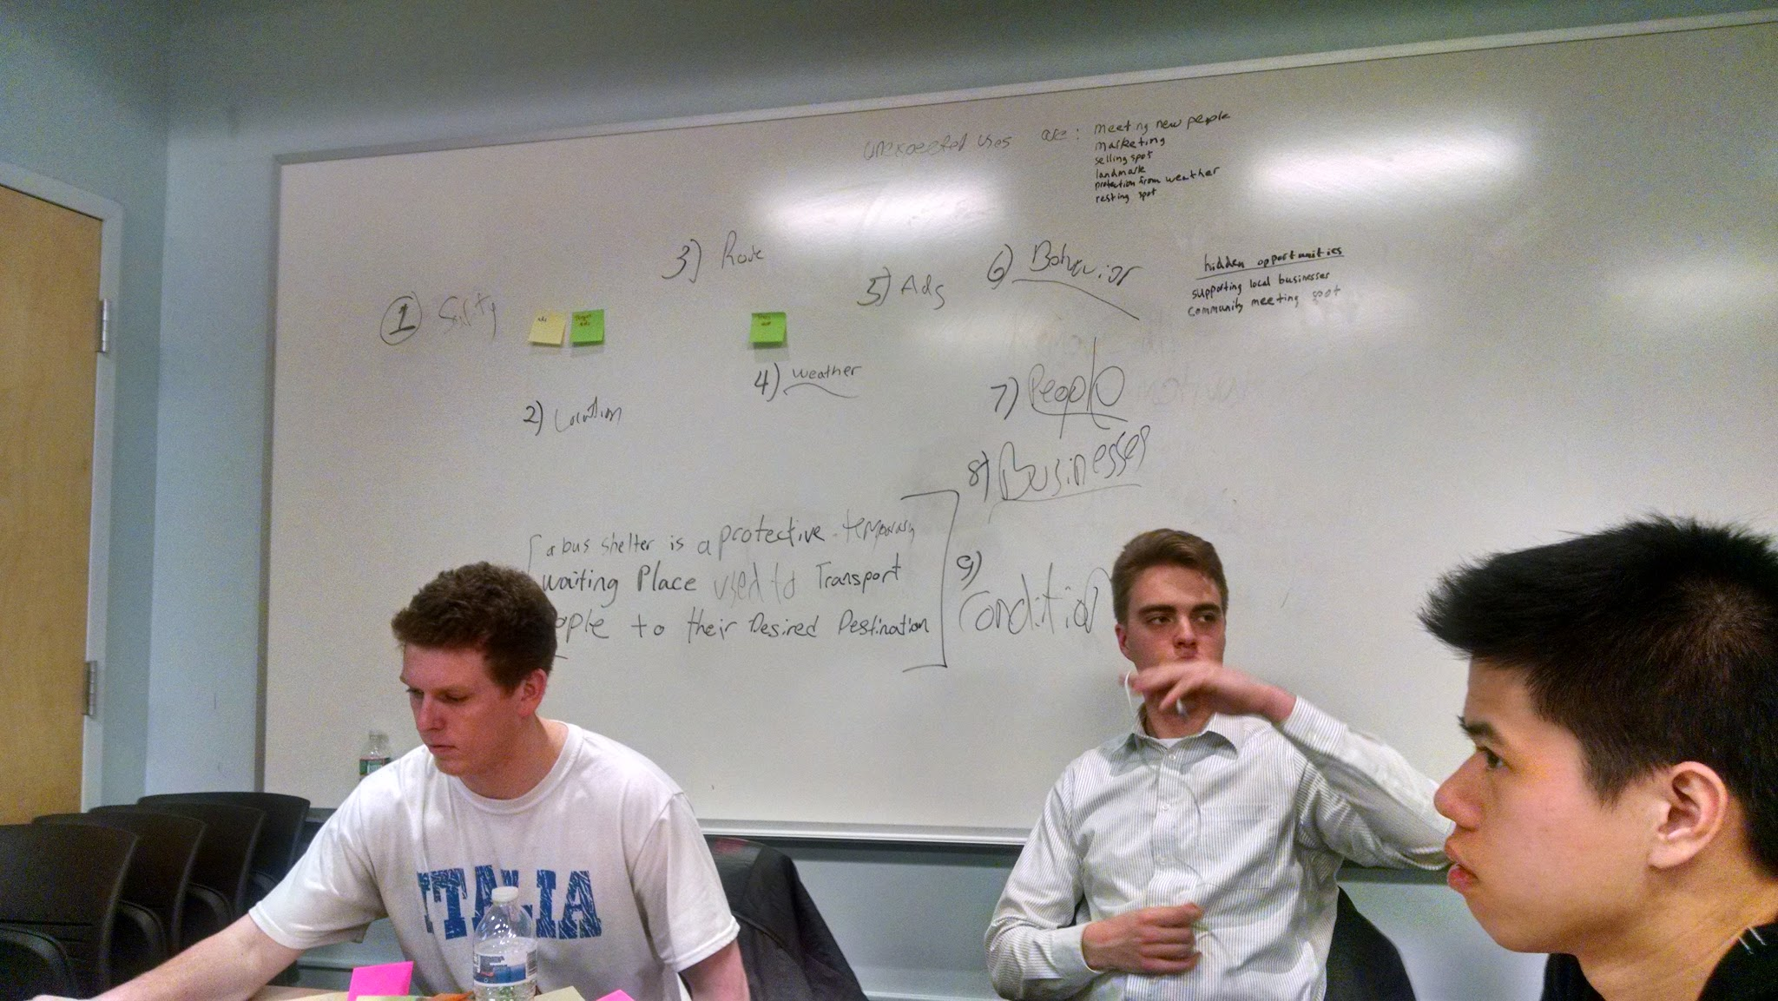
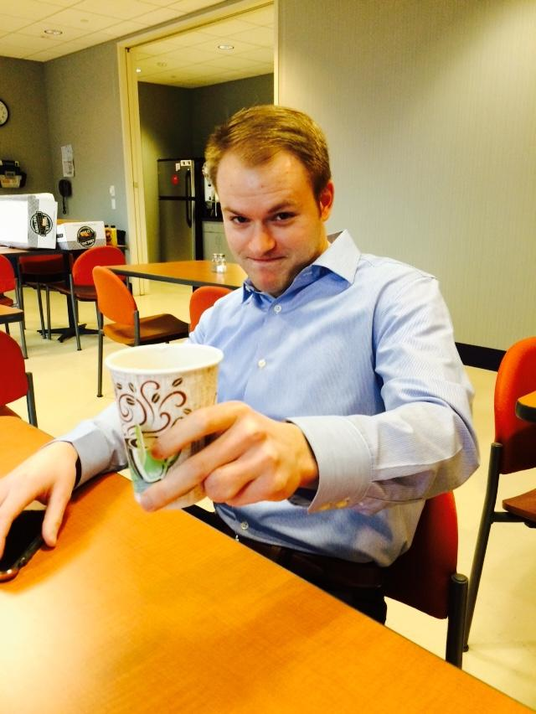
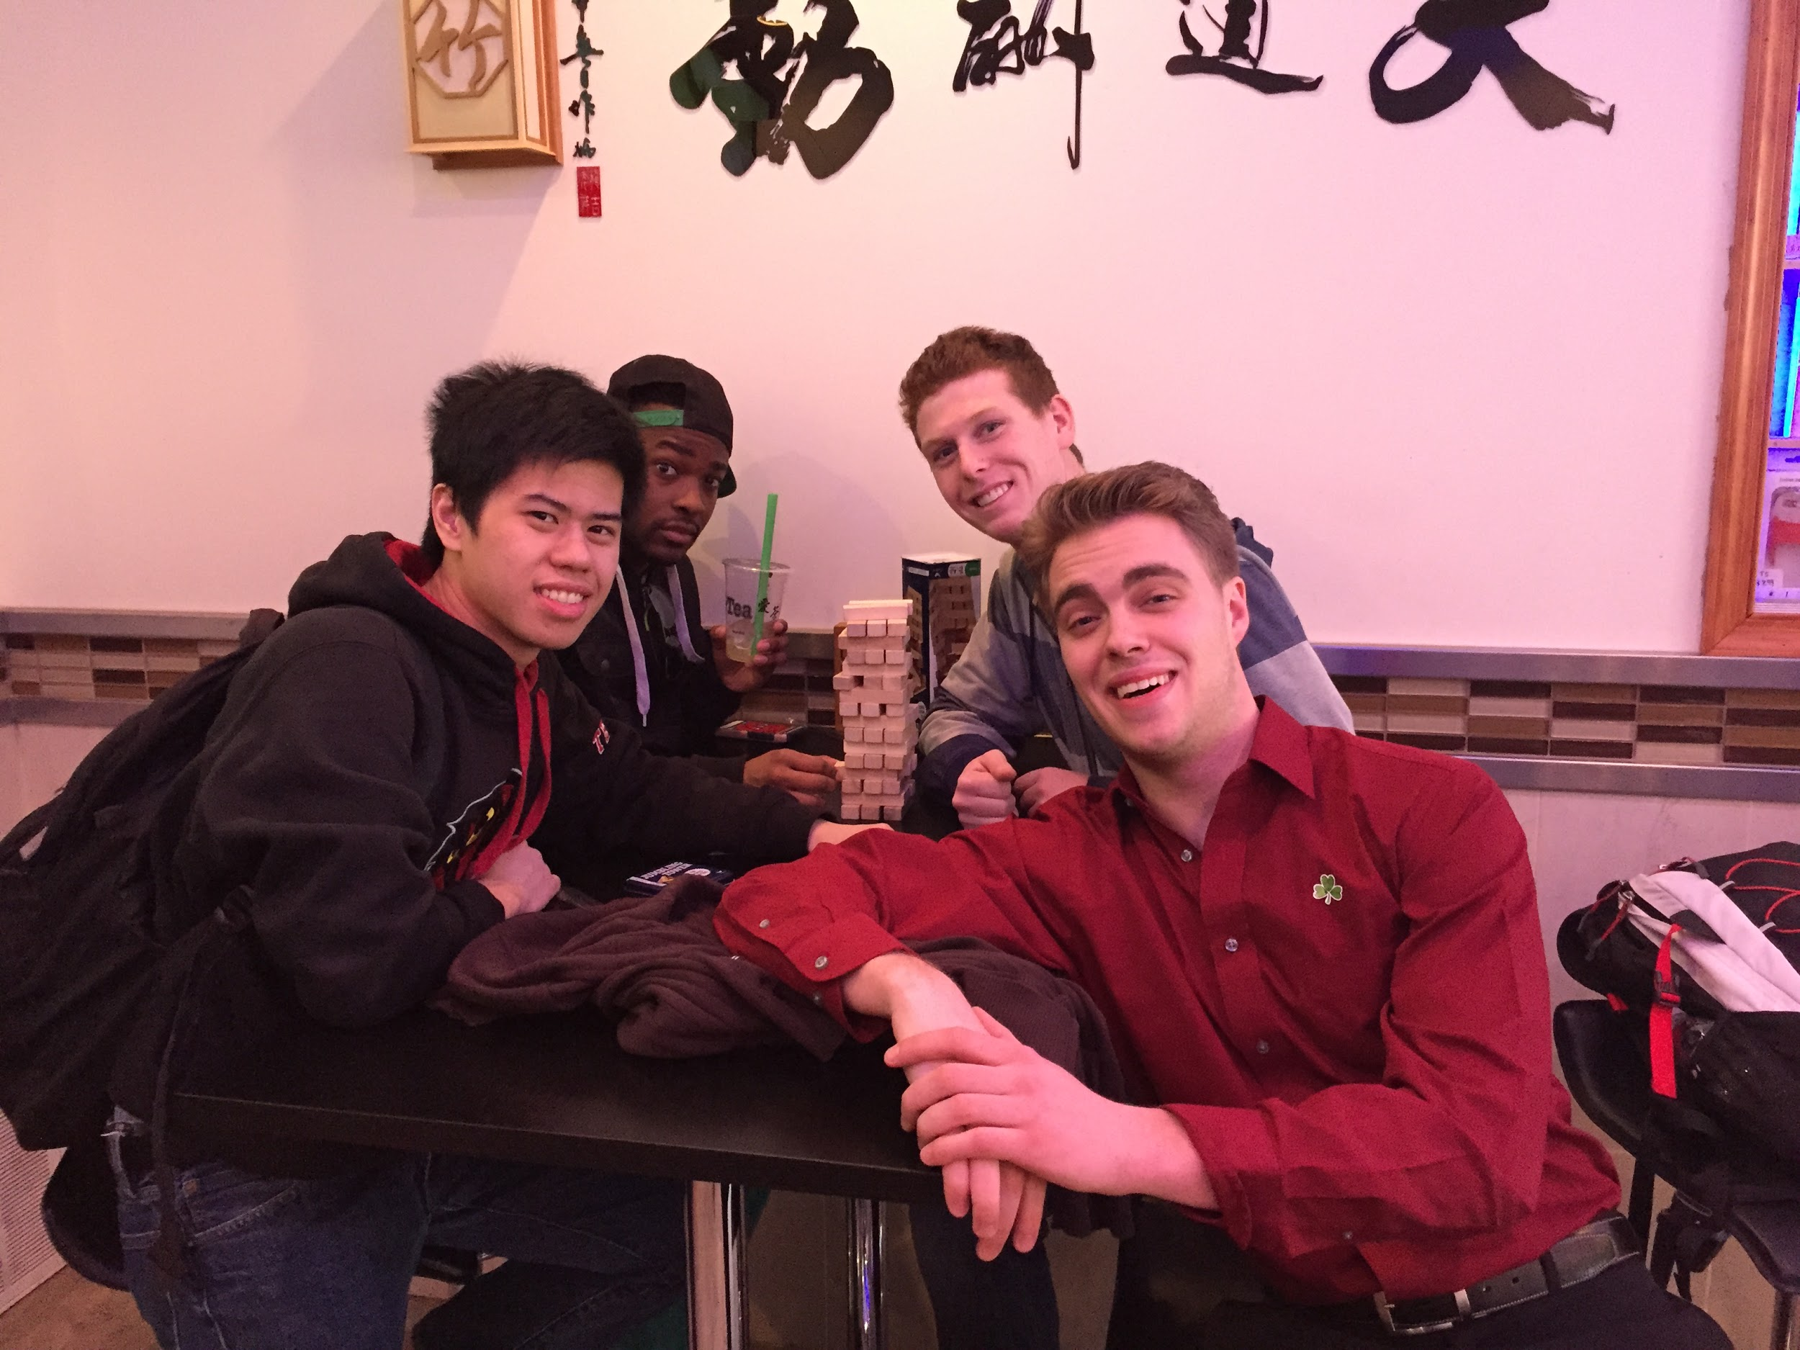
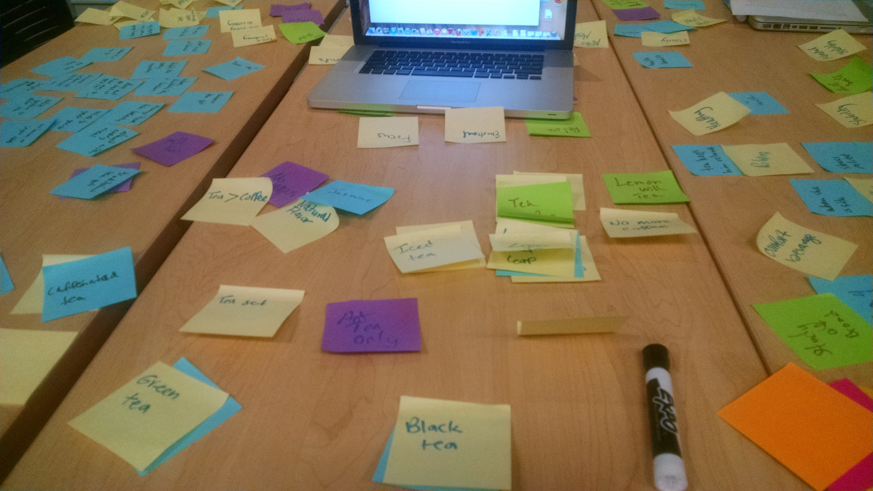
Process
Tea research
Interviews
Each team member researched a country's tea culture and presented their findings. (Russian, Japanese, Chinese, and American).
Then each team member interviewed at least one person who drinks tea and presented to the group.
Experience
Brainstorming/Solution
The team took a trip to I-Tea, a local tea shop located on Spring Garden. Tea shop had traditional Chinese artwork and games for customers to play with.
The team then went through multiple brainstorming sessions and came to a final solution.

Slide 4
Big Idea
Process
Key
Insights
Product

Slide 5
Key Insights From the Process
1
Cultures vary from person to person on a global scale and are extremely differentiated
2
Technology has the capability to connect everyone world wide in real time in order to share ideas, experiences, and form meaningful relationships
3
Creating a network of people combining their mutual love of a product to create a bond over sharing their differences

Slide 6
Big Idea
Process
Key
Insights
Product

Slide 7
Product
Problem Statement How can we connect people around the world from different cultural backgrounds through tea?
Unmet Needs Currently no outlet for people to bond and share their experiences about tea, limited by geographical locations
Solution Our tea app connects users globally to allow them to form meaningful relationships and bond over tea.
Affected Stakeholders
Tea drinkers, non-tea drinkers, tea shops, tea enthusiasts

Slide 8
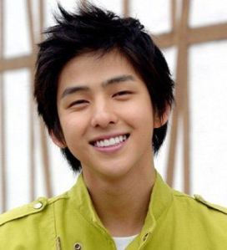
Personas
Jennifer Silvestri
30 year old who lives in Philadelphia
Married and is expecting a child
Drinks tea because it calms her down during her mood swings.
“I wonder who else enjoys drinking green tea as much as I do”
Unmet need: My husband doesn't like tea so I need to be able to share my experiences with other people
Nick Nuss
20 year old who lives in Hong Kong
Student studying International Business
Drinks tea because he believes it promotes a long term healthy lifestyle.
“How can I combine tea and technology to benefit businesses and society”
Unmet need: Wants to be able to build a business around tea-sharing experiences

Slide 9
Big Idea
Process
Key
Insights
Product

Slide 10
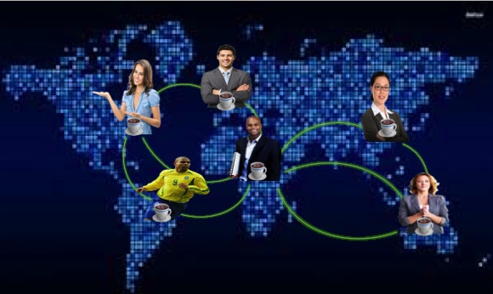
Solution: CULTURALLY CONNECTING
Our solution will create a universal application that allows individual to connect, bond, and share their tea cultural moments with anyone in the world. This application will work on any mobile and tablet device, allowing easy access from anywhere and anytime of the day.

Slide 11
BIG IDEA
Security
Sharing
Our big idea is a tea app that connects users from around the world in real time allowing them to communicate, bond and share experiences to build relationships
Connectivity
Revenues
Education
Bonding
Health
Communication

Slide 12
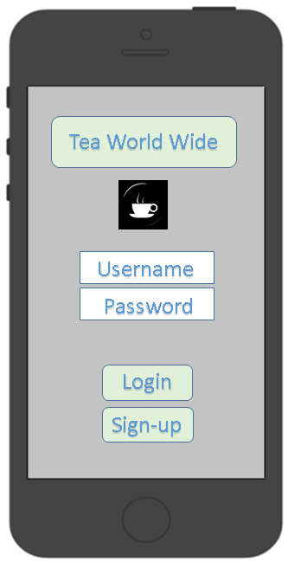
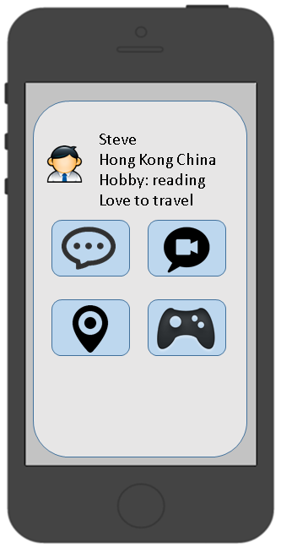

Slide 13
