Slide 1
Nick Hockley, Alex Savon, Dan Matronia

Slide 2
The Fitness Industry Today
Lack of Motivation
73% of People Give Up On Their New Years Resolution
Costly
Over-Crowded
Annual Gym Membership Costs: $696
Annual Trainer Overhead Costs: $4800-$7200
46% of people reported gyms being over crowded

Slide 3
FindYourFit
A mobile based application creating a new market for trainers and trainees to connect
Safety
Higher Profitability
Personalization

Slide 4
Higher Profitability
Trainer
No Gym Overhead Costs
Lower Marketing Costs
Location
Trainee
No Annual Gym Memberships
No Guest Fees
Location
Notes:
Trainer
Gym Overhead Cost Average $4800-$7200
Marketing Costs-No Longer does a trainer have to put in the time/effort to market their services
Traveling Costs-Trainee’s Will Be in the General Vicinity of the Trainer which will mitigate traveling expenses
Trainee
No More Gym Membership Costs, including sign up fees and contract breaking fees
No More Gym Guest Fees If Traveling
Location-No more driving to a gym that may not be in your are

Slide 5
Personalization
Based around 3 key features:
Geo-Location
Workout Menu
Effort Level

Slide 6
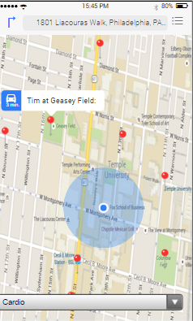
Geo-Location Feature
Nearby Trainers
Geo-location detection
Advanced Search Options

Slide 7
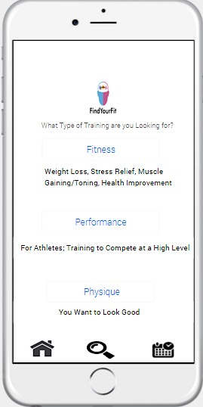
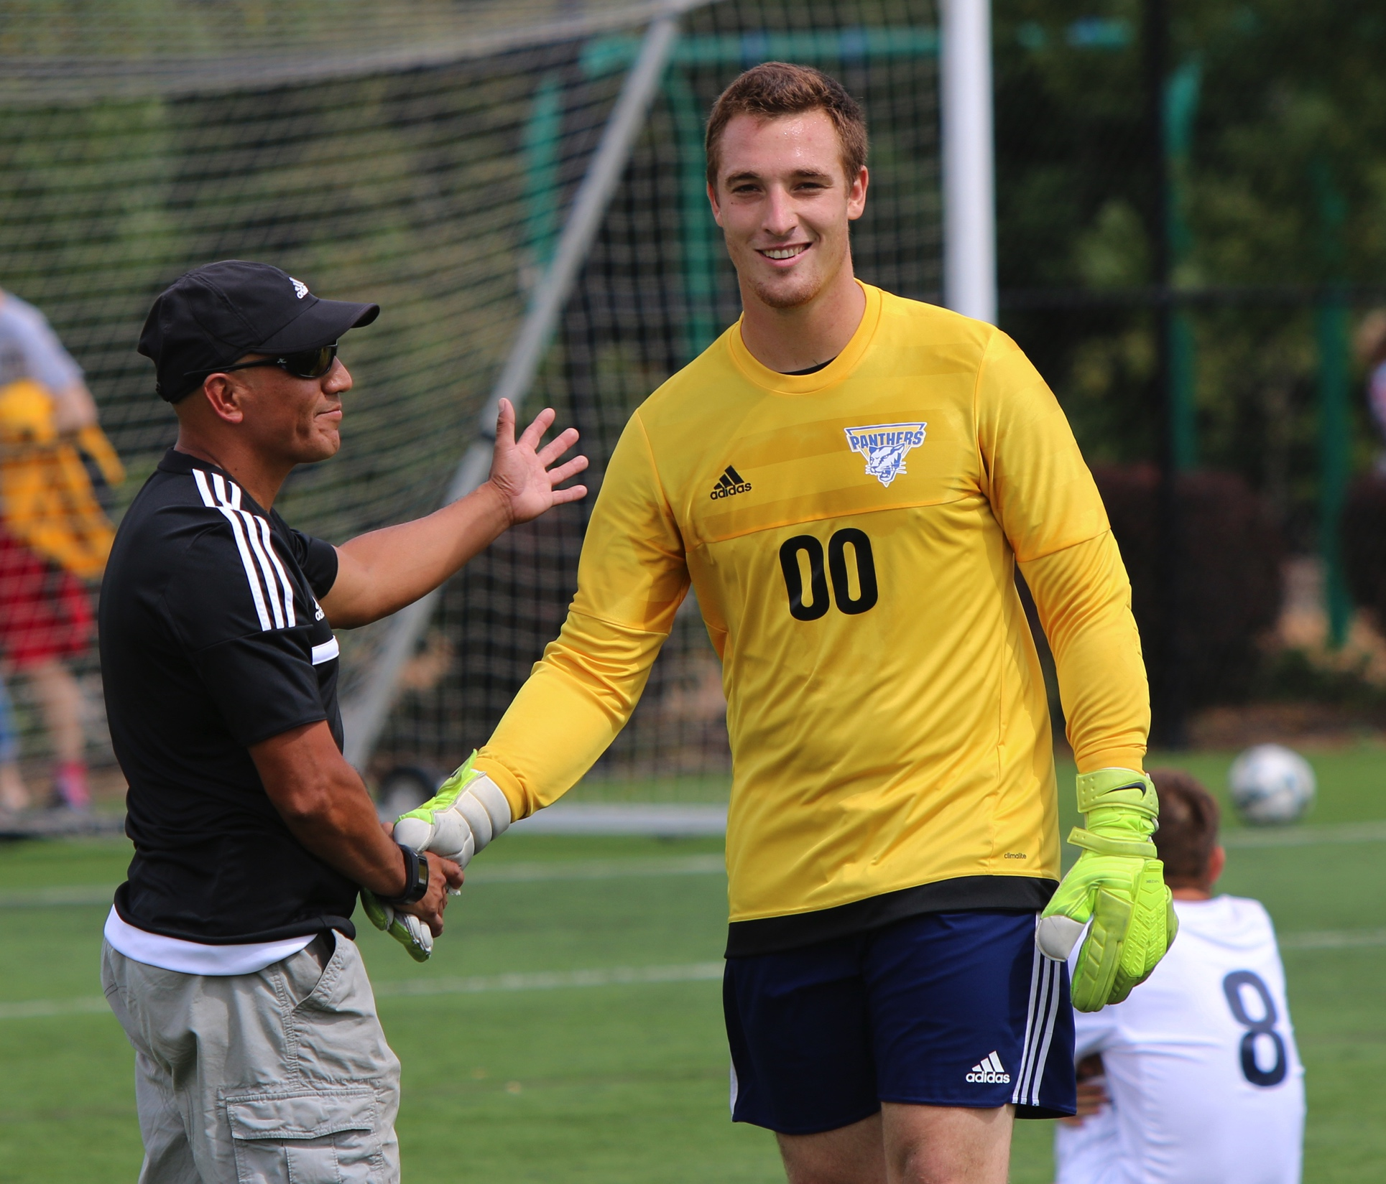
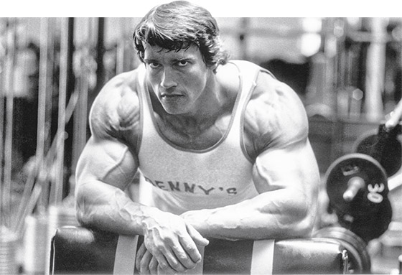
Workout Menu
Recreational Bodybuilder Looking For A Way To Change His Lifting Routine
Soccer Mom Looking For A Little Bit Of Everything In Her Workout
College Intramural Soccer Player Looking To Improve His Play On The Field

Slide 8
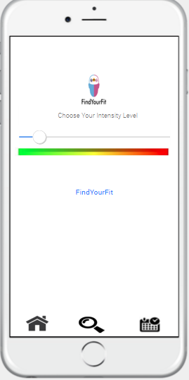
Effort Level
Feeling Tired Or Sore?/Maybe Just Starting Out
If Your Ready For A Challenge
Keep It Moderately Paced

Slide 9
Safety
Trainers Are All Background Checked
Trainers Must Have One Of Three Accreditations:
ACSM
NSCA
ACE
Trainers Are All Rated on the Application
Ensures Users Have A Voice on their Trainers

Slide 10
The Fitness Industry Revisited
Greater Motivation From Personalized Workouts
Higher Profitability
Lack of Motivation
73% of People Give Up On Their New Years Resolution
Costly
Over-Crowded
Avoid
Overcrowded Gyms
46% of people reported gyms being over crowded
Annual Gym Membership Costs: $696

Slide 11
The “Plan”
Personal Trainers and Trainees are offered incentives
How Do We Keep Our Customers?
Application Development and Testing
The Beginning
Application is featured at various fitness expos
The Sell
Deals With Various Personal Trainer Associations
Further Our Market
Notes:
The Sell-Application is featured at fitness expos to target the first market we would like to tap-fitness minded enthusiasts
The furthering of our market will include us going to personal training accreditation sites and creating deals with them where we use their certifications to “certify” our trainers this may drive more people towards their accreditation; as well as, they will feature us as a viable alternative to gyms for new fitness trainers looking for certification.
How Do We Keep Our Customers-Personal Trainer Deals-One Transaction Each Week For 10 Consecutive Weeks Will Result in A Reduced Percentage Cut taken out of the fee for training.
Trainees-Every 10th Consecutive Week They Workout with 4 or more days they will receive a free workout; wherever/whenever they please

Slide 12
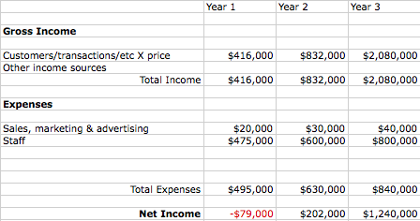
How Do We Make Money?
Notes:
Pricing Scheme 20% of Each Transaction
Each Hour Session = 40$
First Year:
Goal: 1000 Full Transactions Per Week. We will primarily be directing our expenses towards staff: software team, marketing team, and management team. The sales marketing and advertising will be primarily focused towards marketing at fitness expos to target are first potential market base. Currently There are 289,000 Trainers In The U.S. We are in the third most highly populated states for personal trainers with over 1400 trainers. We only need a 100 of them to perform 10 transactions a week to realize our goals in the first year
Second Year: Goal Is To Double Number Of Transaction to 2000 Per Week. We hope to achieve this goal through a expanded staff; as well as, greater presence at fitness related events. This is the first year we turn a profit from the word of mouth of our application; as well as, greater marketing potential.
Third Year: Goal is to achieve 5,000 Transactions Per Week. We once again expand our staff; however, this time much greater; as well as, a larger marketing budget geared to greatly expanding our base not only to fitness expos, but also web based advertising to the general public as well as relationships with national personal trainer associations.
Why Is HR Costs So High: Average Marketing Manger, Average Software Developer, and Average Project Manager Costs. We also account for teams going to various expos. We wish to be hyper aggressive to ensure we get into the fitness industry quickly and aggressively.

