Slide 1

Gamer Connect
Kyle Domsohn, Andrew Fiss, Elijah Jamison, Tyler Urquhart

Slide 2
Market Overview
In 2016 the number of gamers worldwide has reached 1.8 billion
63% of U.S. households are home to at least 1 person who plays video games regularly (3+hours per week)
54% of the most frequent gamers play video games with others
E-sports is estimated to earn $1.5 billion in revenue by 2020
1.8 Billion Users
63% of U.S. Households
54% of audience
$1.5 Billion
Notes:
http://essentialfacts.theesa.com/Essential-Facts-2016.pdf

Slide 3
Problem
How to find a similarly skilled team?
Many online games are not very fun when playing with/against people above or below skill level
No easy and efficient way to connect with other players of similar skill
Too easy or too hard = bad experience and frustration

Slide 4

Gamer Connect Overview
Competitive
Gamer Connect is a platform that allows gamers to connect and compete
Matching system will match players with other similarly skilled players
Tournament system will provide a playground for teams new and old to compete in paid contests
Free tournaments will be available to users as well
Gamer Connect
Social

Slide 5
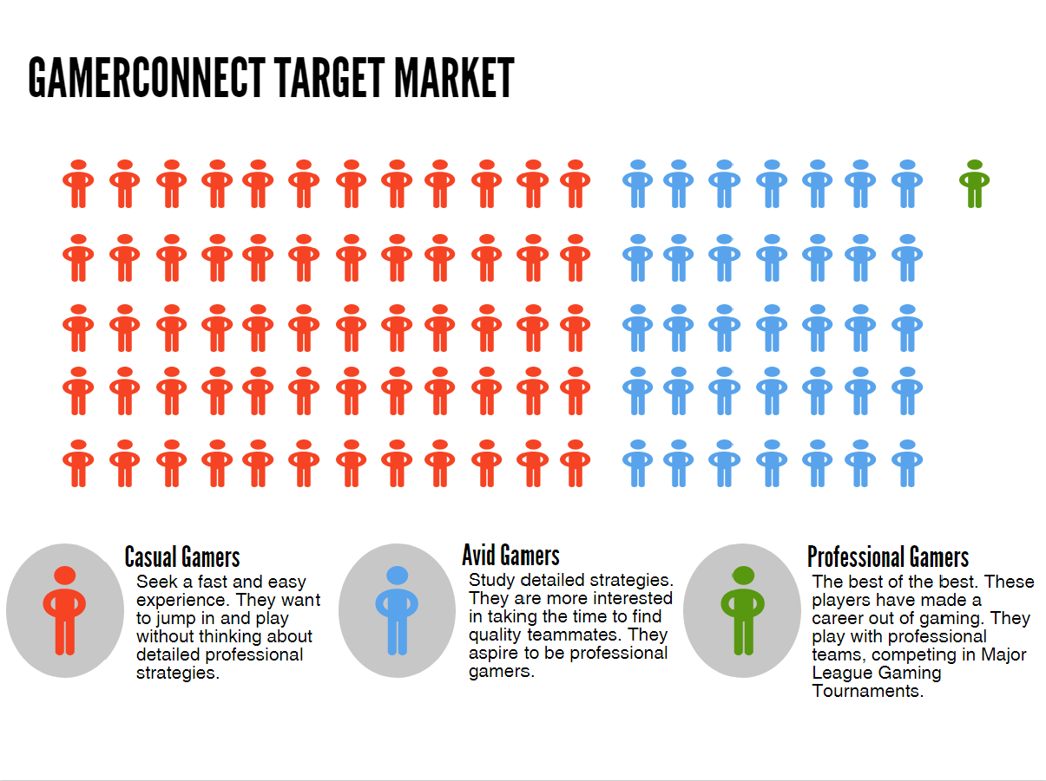
Notes:
Two Major Segments - Competitive and Casual Gamers
eSports interest
Looking for social interaction
Looking for other gamers using current platform (PC, Xbox, PlayStation, Nintendo)
Willing to participate in tournaments or try recommended games

Slide 6

Persona
Anthony Mendoza
Avid Gamer
Game: Overwatch

Slide 7
Prototype Demonstration

Slide 8
Financial Analysis
Tournament Income = # of total tournaments × $5 buy in × # of players
Tournament payout = # of total tournaments × average payout

Slide 9




Competitive Analysis
 | Team Matching | Dynamic Team Matching | Tournaments | Social Media
Reddit
GamerLink

Slide 10





Systems Architecture
API Input

Slide 12
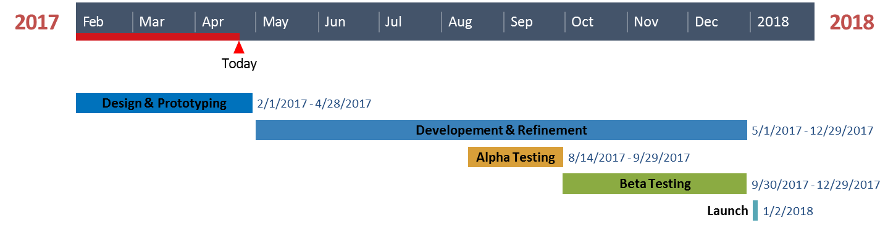
Implementation Plan

Slide 13
THANKS!
Any questions?

