Slide 1
Participation
Team E
Business Analysts:
Matthew Maling
Katie Margraf
George Raymond
Weiming He
Liwei Yi
Project Managers:
Ryan Pace
Kim Eastlake

Slide 2
The Big Idea
Providing channels for distributing information about survey member outcome
Creating Account Management Tools for Member

Slide 3
What are the Problems?
Problems:
Objectives:
Insufficient account management tools
Unable to edit account information
Easier way to track member involvement
User friendly platform
Ability to edit personal information
Ability to see survey results

Slide 4
What Should We Do?
Needs:
Opportunities:
Keep members actively participating
Member dashboard
Track survey participation
Channels for distributing survey results
Offer an rewards program
Create a personal profile with the ability to edit information
Event Page
Have a page to see survey results

Slide 5
Update.
Participate.
Be Heard.

Slide 6
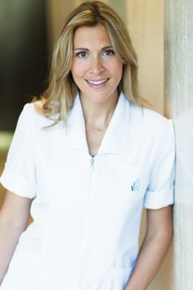
Ellen
“I hope we have better public transportation here in Philadelphia. The government needs to do something.”
Age:35
Occupation: Nurse at Jefferson Hospital
Graduated from Drexel University
Hobbies: Gardening, Spending time with her family.

Slide 7
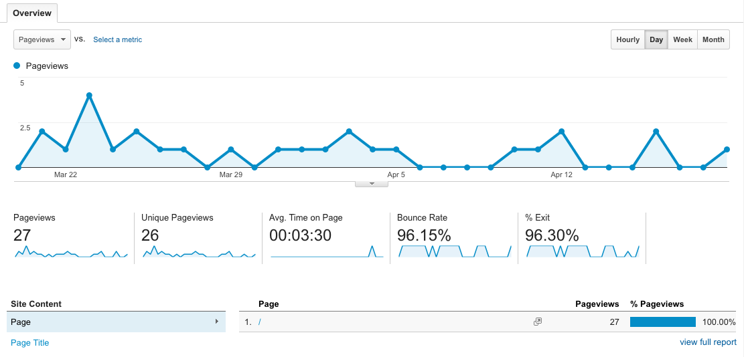

Slide 8
Business Case
Benefits:
Increase member participation
Increase Be Heard Philly awareness
All-in-one Platform
Resources Needed:
A way for members to know about the platform
Actively update/manage content
Member to constantly update their profile

Slide 9
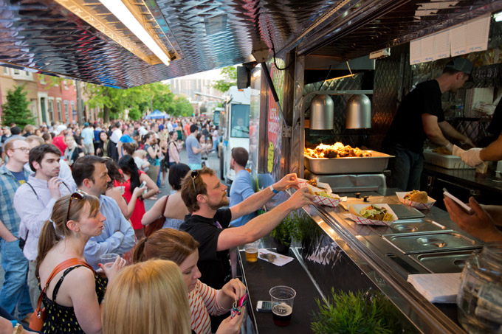
Summary
Creating Account Management Tools for Member
Providing channels for distributing information about survey participation outcome
Transforming BHP
Into the First Municipal
Research Panel

Slide 10
THANK YOU!
Team E
Business Analysts:
Matthew Maling
Katie Margraf
George Raymond
Weiming He
Liwei Yi
Project Managers:
Ryan Pace
Kim Eastlake

