Slide 1
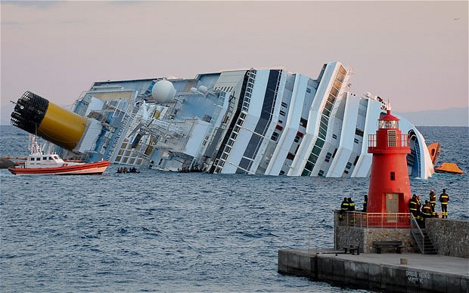
Carnival’s crisis management of the costa concordia disaster

Slide 2
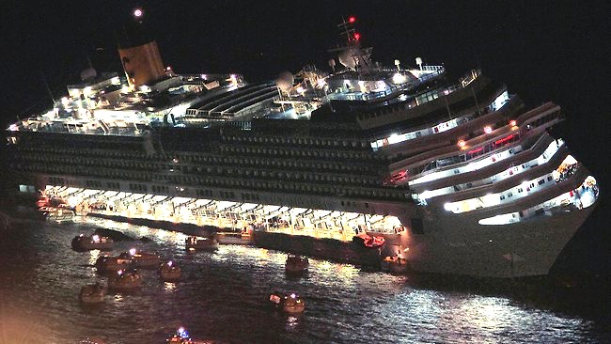
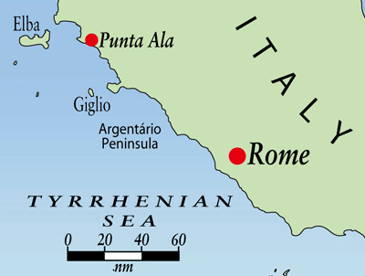
What Happened
January 13, 2012
Sailing along the cost of
the island Giglio
3,206 passengers and 1,023 crew onboard
Hit a rocky outcrop
Crew and captain responded poorly
30 people died and 2 remain missing

Slide 3
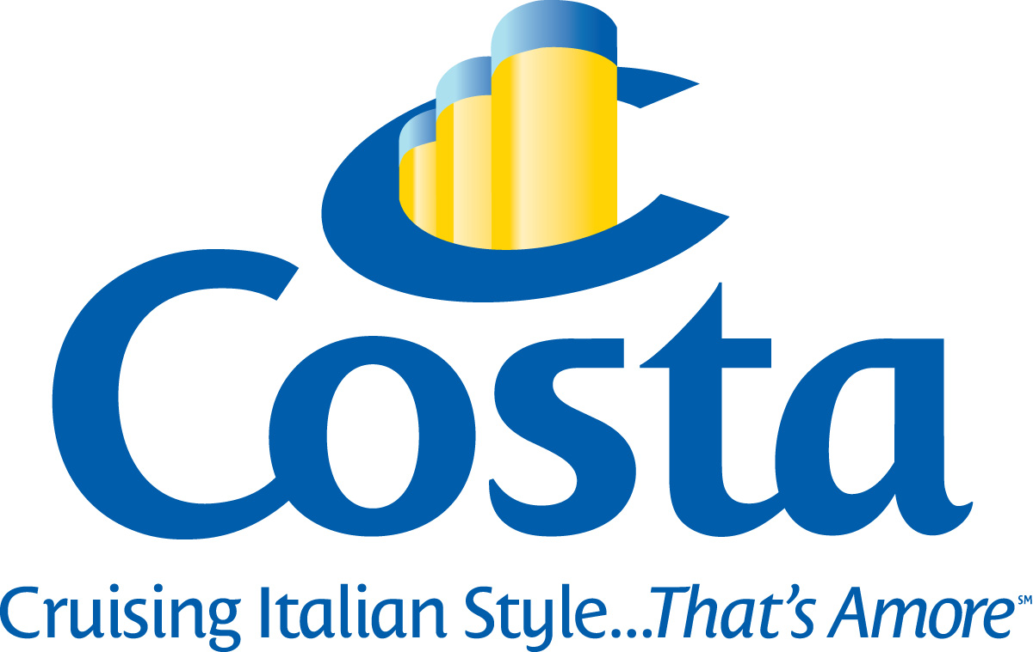
Costa’s Immediate Action
The Costa company commented within hours after accident
Posted updates on their website
Costa Cruises offered compensation to passengers
They held two press conferences

Slide 4
Carnival’s CEO’s Response
Mickey Arison
Tweet
No in person statement or press
conference
Official statement expressing condolence
– 4 days late
Sent executive to visit shipwreck scene

Slide 5
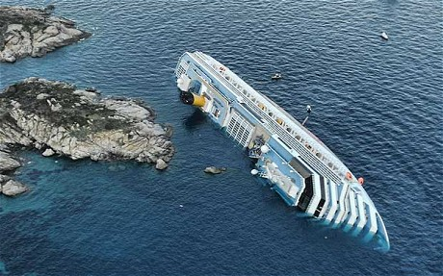
Carnival’s Response
Originally offered 30% coupon
Later offered complete compensation package
Executives seemed uninvolved

Slide 6
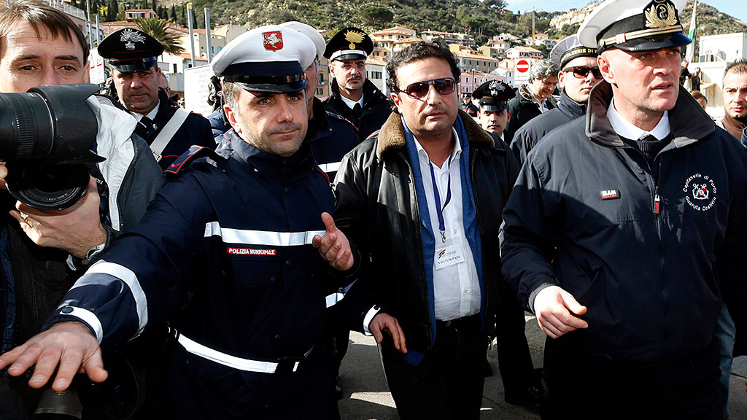
The Captain
The captain admitted to mistake
His crisis response was poor
Sentenced to 16 years in prison
Companies did not pay his
legal fees

Slide 7
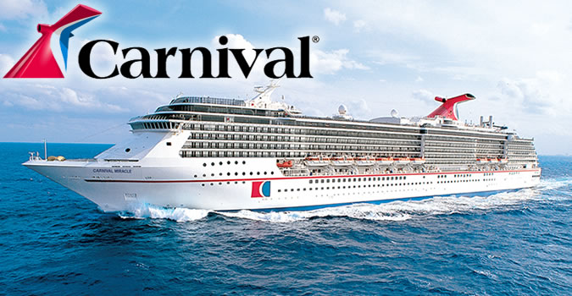
Long-Run
Shares fell 14%
Net profit decreased for the year
Stricter safety regulations for entire industry
No great long-term effects

Slide 8
Takeaways
Be united as a company
CEO should be at the forefront of crisis management
Appear sympathetic and understanding

Slide 9
Work Cited
Bhasin, K. (2012, January 24). Carnival Is Failing Spectacularly In The Handling Of Its Costa Concordia Crisis. Retrieved October 12, 2015.
Booton, J. (2012, January 27). Carnival Fails Crisis 101 in Costa Response. Retrieved October 12, 2015.
Coombs, T. (2007). Crisis Management and Communications. Retrieved October 1, 2015.
Costa Concordia: What happened. (2015, February 10). Retrieved October 10, 2015.
Coulter, A. (Ed.). (2013, January 8). Long-Term Impact From the Costa Concordia Cruise Disaster. Retrieved October 13, 2015.
Gaines-Ross, L. (2010). Reputation Warfare. Spotlight.
Walker, J. (2012, January 22). Cruise Crisis Management FAIL - How Carnival is Ruining its Reputation Following the Costa Concordia Disaster. Retrieved October 12, 2015.

