Slide 1
No Guess Rx
CRAIG KESTECHER, TERRY HURST, CHRIS HUMMEL, AND ANSH CHAUDARY

Slide 2
Development
Solution with an application (Iphone & android)
Source cheap prescription drugs
Take into account insurance carrier
Data sourced from users
Notes:
Transactional data. Other systems: IOS/Android, coding and design applications

Slide 3
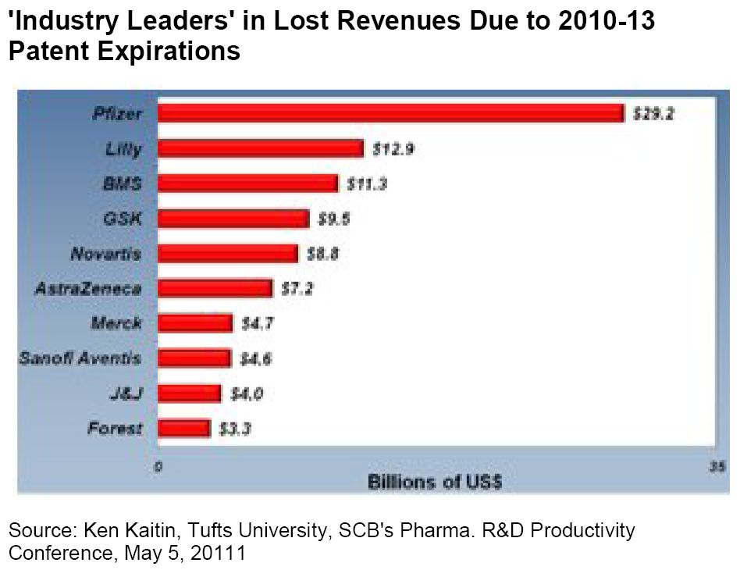

Slide 5
Business Case
Eliminate guesswork
Which pharmacy location
Know price of drugs
Receiving best deal
Buy from a specific company
Greenstone → Pfizer Generic
Information flow
Competition

Slide 6
Key Ideas
Easy to use application
Save consumers money

