Slide 1
Ashley Lombardo, Steve Scanlon, Jack Portnoy, Peter Hwang

Slide 2
Problem
Lack of transparency between law enforcement and society
Current solutions lack benefits for law enforcement
"This is not a problem just of Ferguson, Missouri. This is a national problem.”
- President Obama
Notes:
Talk about current events that have to do with police brutality and how it affects society
longer court processes
Talk about how we interviewed cops and how they didn’t like body cameras because it didn’t benefit them

Slide 3
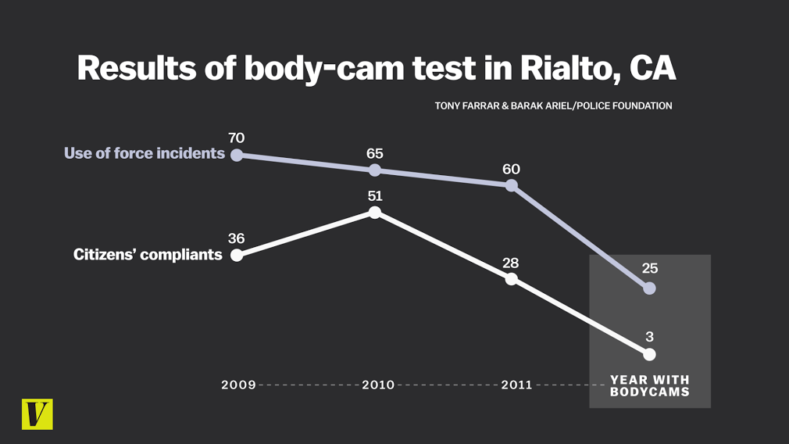
STATISTICS
Notes:
There is clear evidence of the effectiveness of body cameras. For example, in Rialto California, the use of force incidents decreased by 45 when body cameras were implemented and citizens’ complaints decreased by 33 when body cameras were implemented in 2012.

Slide 4
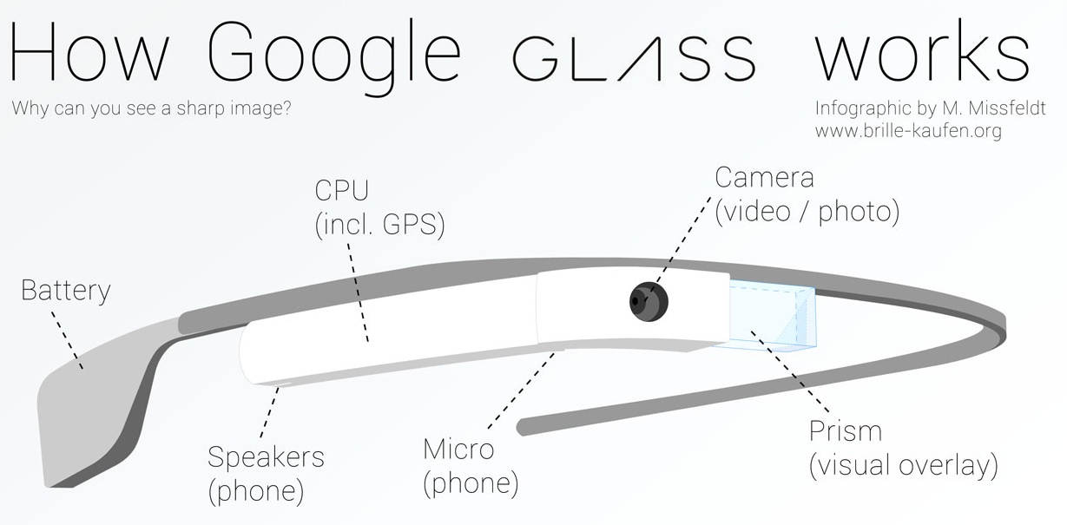
Solution - Google Glass
Utilizing Google Glass
Live streaming capability
Facial recognition
GPS
Bluetooth
Notes:
Google glass has all the technology necessary
Better than body camera because it livestreams back to the dispatcher and the dispatcher is then able watch over the officer
Facial recognition will help protect police officers during traffic stops
GPS system will help locate officer if something ever happened to them
Wireless for safety reasons
Google Glass Application
Live-streaming/recording of what officers see
Two-way communication with dispatcher

Slide 5
Got Your Back Prototype
https://www.justinmind.com/usernote/tests/19900868/19900877/19900879/index.html

Slide 6
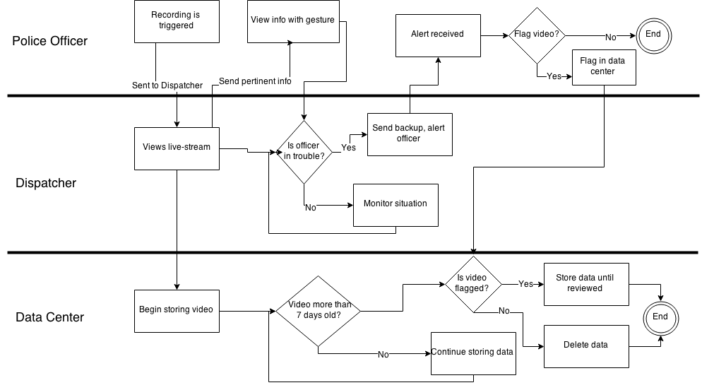
Process Model – How it works
Notes:
Briefly go over the process

Slide 7
Benefits
Law Enforcement
Society
Accountability of citizens
Lower court fees
Increase safety
Increase officer productivity and effectiveness
Accountability of police officers
Lower taxes
Decrease police brutality
Transparency
Good morale
Less court time
Notes:
https://publicservice.asu.edu/sites/default/files/ppd_spi_feb_20_2015_final.pdf

Slide 8
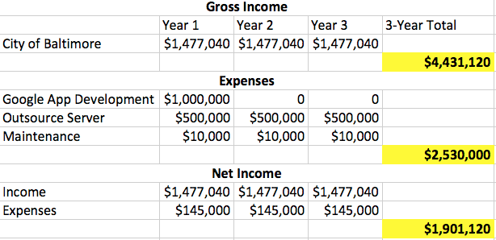
Business case

Slide 9
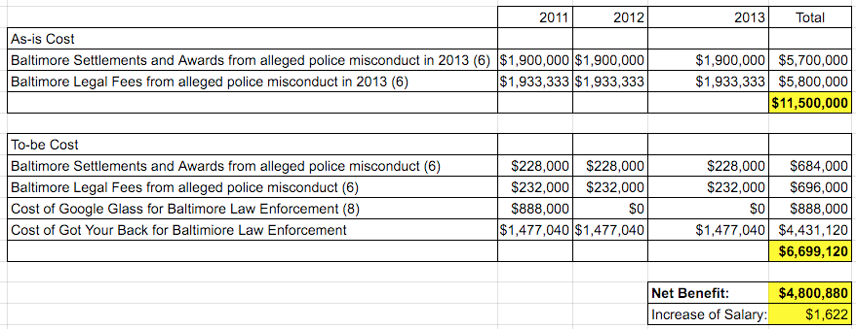
Cost Benefits
“...citizen complaints declined by 88 percent.” - Vox
Notes:
Talk about how the net benefit could lower taxes, increase police salaries, increase budget for safety equipment, etc.
Est. we could reduce Baltimore settlements/awards and legal fees by 80% based on how 92% reduction with dash cameras
vox.com stating that police precincts using body cameras saw a 88% decrease in the number of citizen complaints
There are clear cost benefits for implementing Got Your Back
Source 6 (http://www.baltimoresun.com/news/maryland/bs-md-settlement-confidentiallity-20141227-story.html#page=1)
Source 7 (http://www.vox.com/2014/9/17/6113045/police-worn-body-cameras-explained)
Source 8 (http://www.huffingtonpost.com/2014/05/14/google-glass-price_n_5322986.html)

Slide 10
Competitive Analysis
Got Your Back
Traditional Body Cameras
New Market
Dynamic
Two-way communication
Back up capabilities
GPS
Facial recognition
POV
Growing Market
Static
No two-way communication
Battery life
No head rotation
Notes:
New market – nothing exactly like this out there so they need to create the market and
Dynamic – it allows connection between the police officers and the dispatcher – which also creates transparency to society
The two way connection - allows police officers to have another set of eyes, they are able to speak to each other about the situation and make the best possible situations
Back up capabilities – as the video is streaming, the dispatcher is also able to see what is going on and pin point and flag certain parts of the video
GPS, facial recognition – capabilities that come with the google glass itself that you cannot get with traditional body cameras
POV – police turns head

Slide 11
Risks
Resources
Privacy
Trigger/End
Public Access
Battery
Connectivity
Notes:
Resources – will all police departments be able to afford the google glass and this technology
- Especially ones without funding
Privacy – on both sides
For society - going into homes
For cops – recording depending on what they are doing when they aren’t attending to a call
Trigger/end – need to work closely with the police departments to decide when the streaming/recording will begin and end
When it comes to the start of the call, getting out of a car, etc.
Public access – does society get access to these footage? What would the conditions be? Does this cause any problems?
Battery – the current google glass model doesn’t have a good battery life
But there are options to extend - portable batteries, car chargers
Connectivity – need wifi/cellular network when it comes to the connection between the dispatcher and officer
- Still can record video

Slide 12
Implementation Strategy
Plan
Final Application
Deploy
Monitor
Design
2 Months
4 Months
9 Months
Continuous
6 Months

Slide 13
Questions ?

Slide 14
Appendix

Slide 15
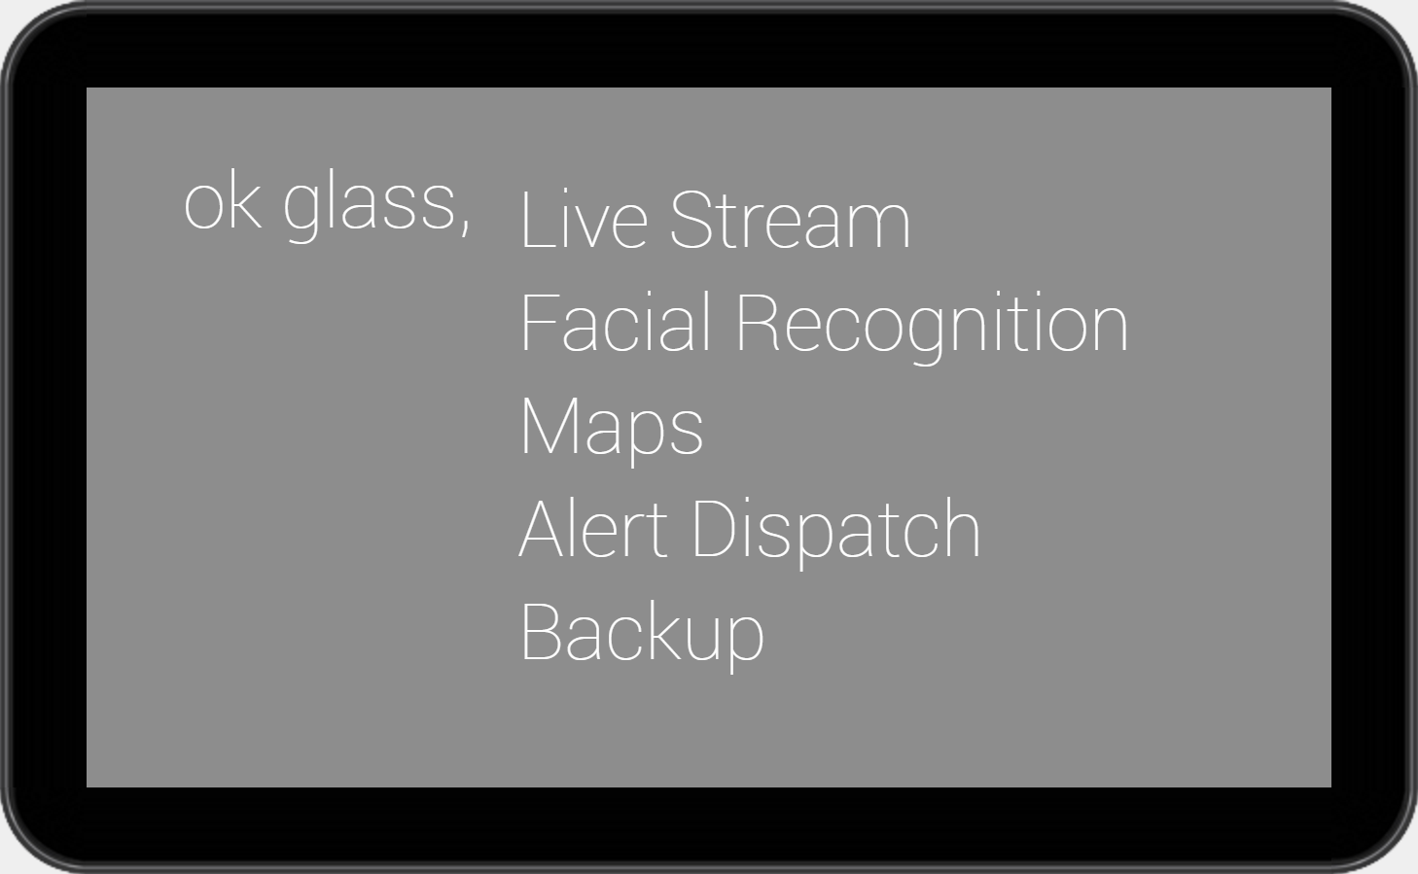
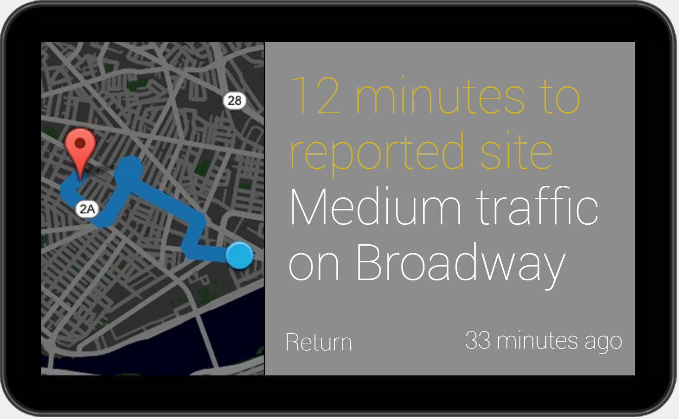
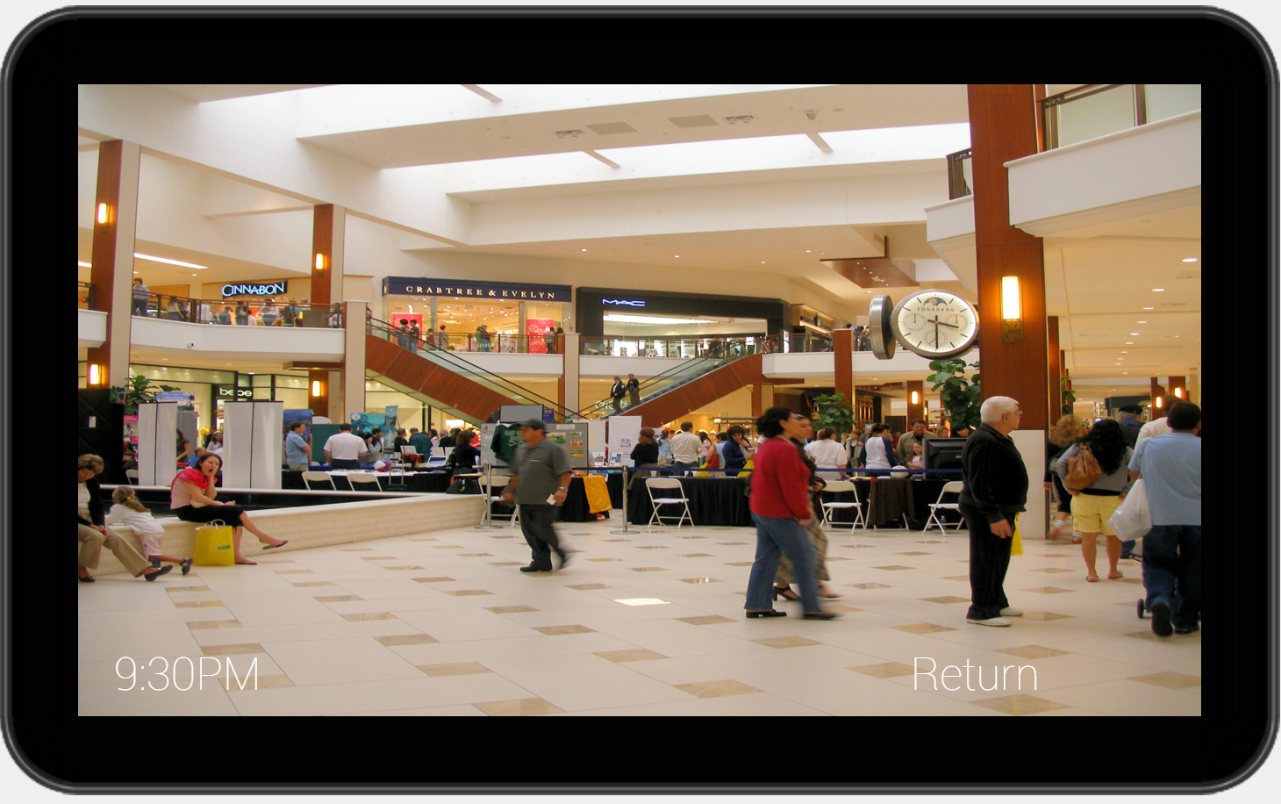
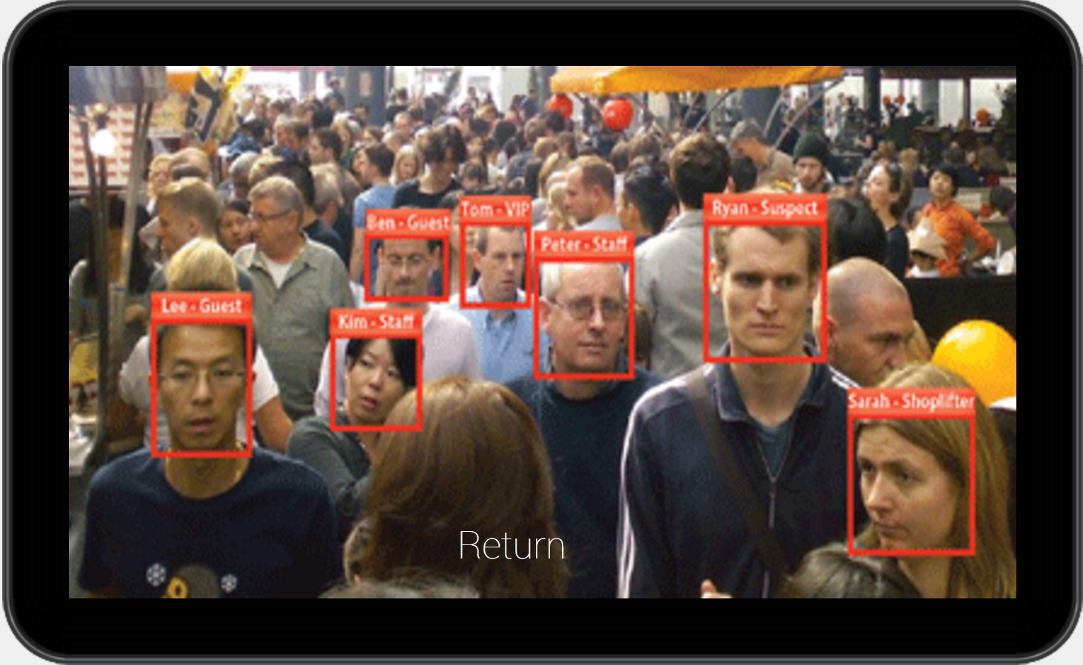
Prototype Screenshots

Slide 16
Porter’s 5 Forces
Bargaining Power of Suppliers
High
Google Glass - only technology like this out there
Google has the power to control price and how our technology is implemented with the Glass
Threat of Substitutes
High
Body cameras and radios
Most police departments already have them
Rivalry between Competitors
Low
Emerging market
Nothing like this yet
Threat of Potential Entrants
Medium
Expertise needed, this market does not exist but can be copied
Will need to start with own idea
Bargaining Power of Buyers
Medium
Police department and government
Potential product to increase safety and transparency

Slide 17
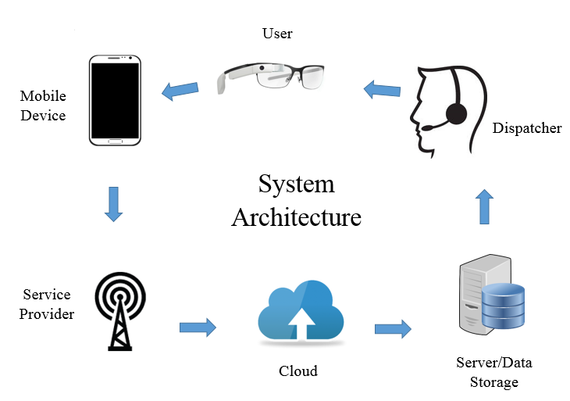
System Architecture

