Slide 1
Group Up
CONNOR GAWLIK, EVAN CHIAO, MIKE DENNIS & KIN LEE
Mentor: SATBIR BEDI

Slide 2
Issue at stake
Difficult finding like minded peers
Larger classes can be isolating and intimidating
Many students lack experience with groups
Lack of collaboration tools
Increase Collaborative Learning → Improved Student Performance
Notes:
Universities don’t provide or have lackluster tools to encourage meeting in a free purely collaborative environment

Slide 3
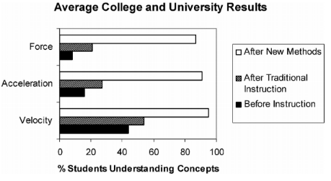
Case Study
“With respect to academic achievement, the lowest of the three studies cited would move a student from the 50th to the 70th percentile on an exam.”

Slide 4
Solution = Group Up!
Provides the means for students to meet
Matches unknown students who are like minded
Creates study groups which improves collaboration
Develops a network of peers to draw on
Adapts any needs for different requests
Notes:
Easily adaptable depending on the need of the university.

Slide 5
Competitors & Market Analysis
Features | Quizlet | Study Blue | Koofers | Course Hero | GroupUp
Material Sharing
Quizzes Questions
Tutors Interaction
Recruiters Interaction
Matching Feature
Meet up Study
Targeted Market
High Schools Low graduation rates College & Universities Students in First and Second years GenEd classes Commuter Schools
Notes:
Quizlet
Self learning tool with flashcards
Collaborative share of school content and questions
Course Hero
Storage of abundant study resources
Contact tutors for help and study
Share own study materials for other users
Study Blue
Learning platform with uploaded study materials
Study with practice quizzes and later materials
Koofers
Practice exams as study materials
Ranking in professor ratings
Tool with job search available

Slide 6
Melissa Oak
Melissa is a Junior at Temple
Melissa’s Calculus class has 250 students and she doesn’t know anyone
Melissa want’s to create a study group for Calculus

Slide 7
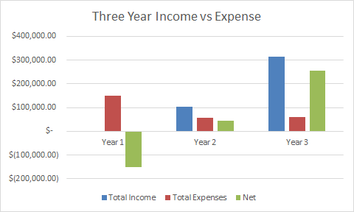
Financials
Net income for year 3: $149,900
Labor Cost for Initial Development
Mobile App Developer: $40,500
Project Manager: $36,000
Unit Tester: $4,400
Data Architect: $36,000
Reference: http://www.payscale.com

Slide 8
Implementation plan
Year one goal: 10,000 users
Approach Temple University as first customer
Built to purpose versions
Year two goal: Two universities with licenses
Year three goal: Six universities with licenses
Improve base application with additional phases

Slide 9
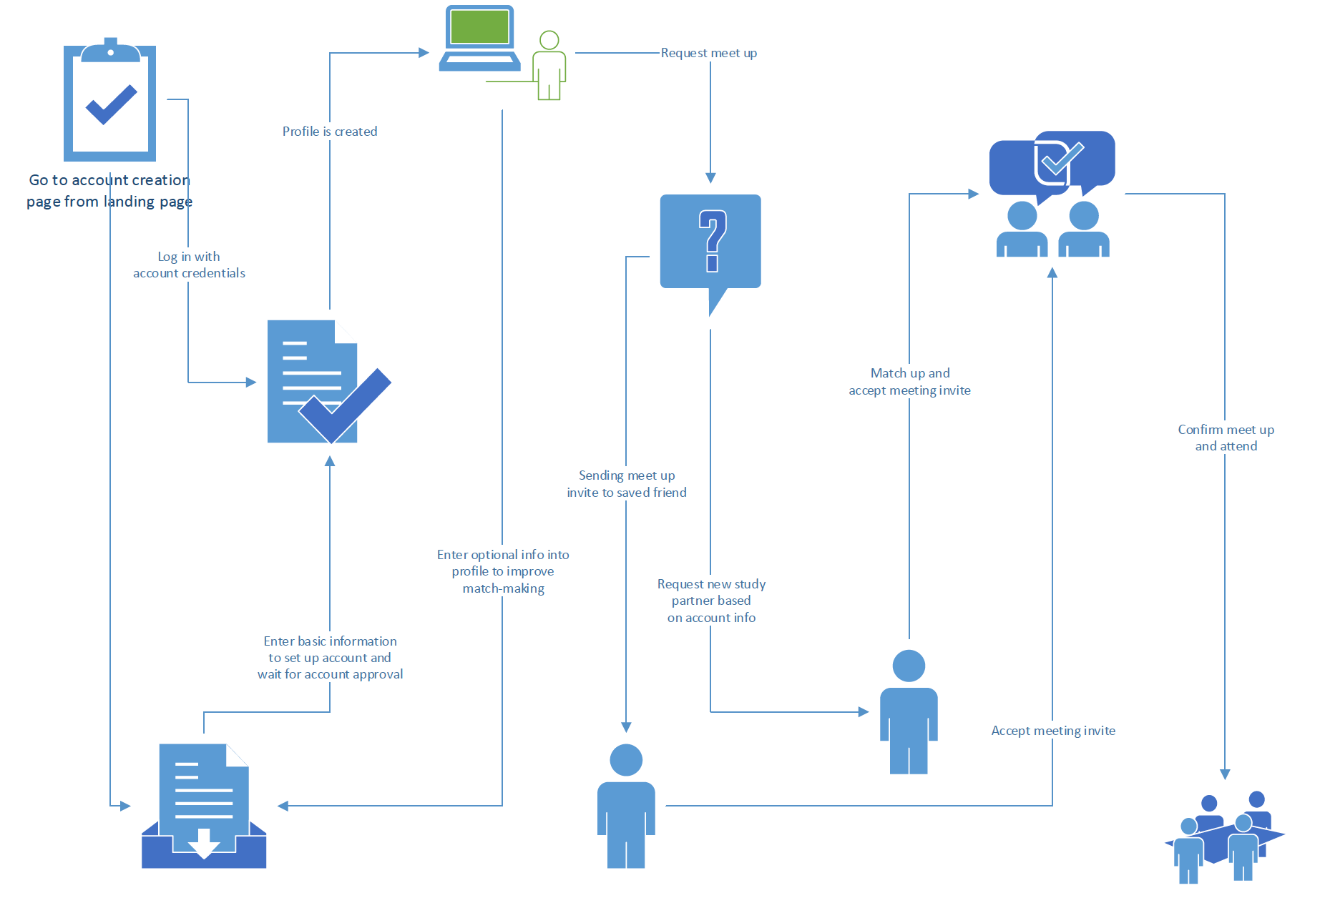
Process Model

Slide 10
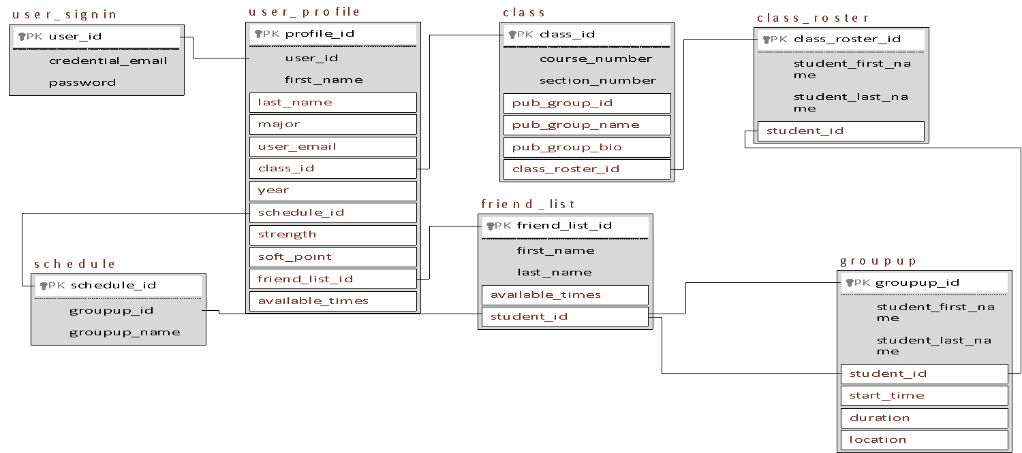
Data Model

Slide 11
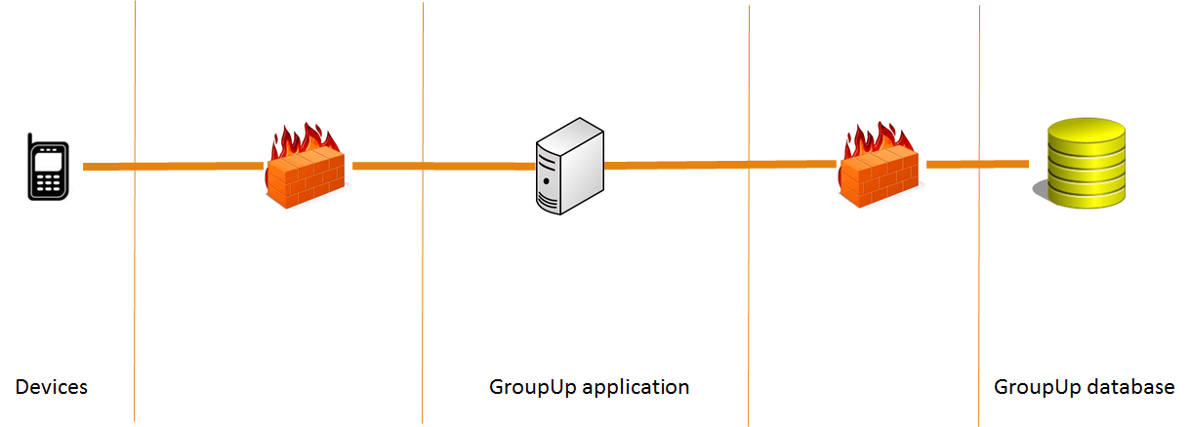
System architecture
Notes:
Scalability— easy and flexible to change in size
Performance— load balance any tier and minimum network utilization
Availability— simple architecture have less faults and available most of the time

