Slide 1
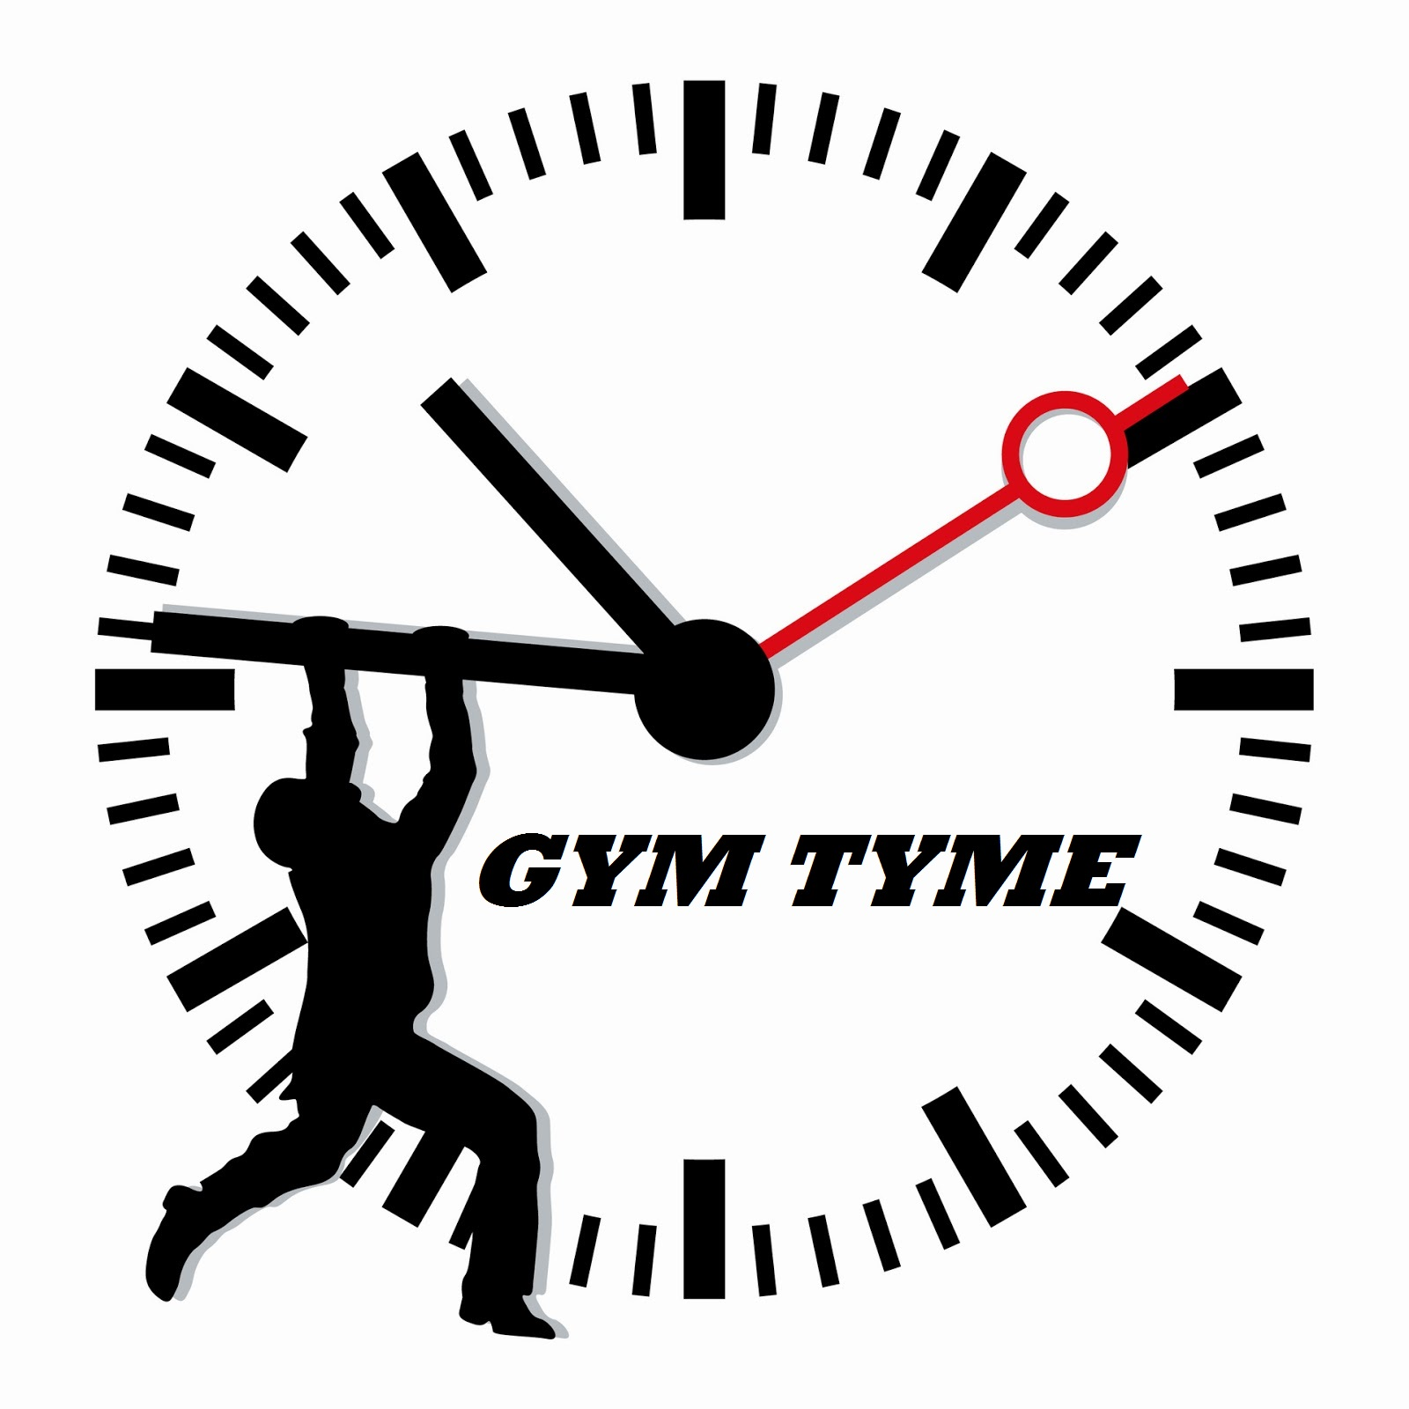
Kyle Fogarty, Rachel Jarlsberg, Julie Bin, Andrew Melville

Slide 2
Current Situation
Crowded gym frustration forums often complain about crowded gyms and suggest remedies, yet gyms do not address problem at hand
Gym membership owner visits gym on average: 2 times / week
Average monthly cost of gym membership: $58
Amount of gym membership money that goes to waste from under utilization: $39
67% of people with gym memberships never use them

Slide 3
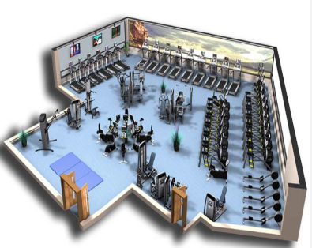
Problem
Peak Times = Overcrowded
Importance
Relevance
Opportunity exists to enter the market
Decreasing customer retention rates
Wait time is too high
Notes:
The problem that we’re addressing is the wait time at gyms especially during peak times where they become overcrowded. From our own experiences we know how frustrating this can be, especially when you plan your workouts out in advance, even down to which machines you’re going to use. And overall this problem can affect customer retention rates if members become frustrated too often and decide to take their membership elsewhere.
What we’re proposing is not only going to benefit gym members but also the management teams at gyms, and through research we’ve found that the opportunity does exist to enter the market.

Slide 4
GymTyme
Real-time tracker of gym activity and usage
RFID Bracelets & Readers
New Gyms, Gyms Opening New Facilities
Notes:
So our solution is GymTyme which is a mobile app that tracks gym activity in real-time. And it accomplishes this through the use of thermal cameras and RFID bracelets and readers that are located in each area of the gym.
We’ll be targeting new gyms so the RFID bracelet will essentially be their membership card and just like a normal card they’ll be designed in such a way that you can hook them onto your key chain so you don’t lose them. They also only cost about $.20 to make when you buy them in bulk so the gym isn’t going to take a major hit if some of their members lose the bracelet.
So basically members will swipe in at different areas and they information will be sent to the app so other people can see the capacity of certain areas throughout the gym. And for the actual gym this benefits them by showing them peak times for certain machines and which machines they need more of or can get rid of.

Slide 5
Target Markets
Golds Gym
Serious Weight Lifters
Planet Fitness
LA Fitness
Newtown Athletic Club
Family Friendly – For All Ages
The Gym For Everyone
Weight, Machines, Classes, Sauna, Spa, Pool, Courts
Weights, Machines
Weight Lifters, Fitness Gurus
Weight, Machines, Salon, Water Park, Classes, Dining Areas
Weights, Machines, Tanning Beds
Notes:
Essentially there are 4 different markets in the fitness industry that we can potentially target. You have the serious weight lifters who frequent gyms like Golds Gym which is more of a high end gym they have a bunch of locations and it’s $30 a month.
Then you have gyms like Planet Fitness who monthly membership fee is a third of Golds. And they really focus on the judgment free zone and that anyone can come to their gym. From people who haven’t worked out a day in their life to people who work out twice per day.
LA is closely related to Golds in that they target more weight lifters and people who are serious about working out. But they offer more exclusive services like saunas, a bunch of different fitness classes, basketball courts, and even a pool. Again it’s about $30 per month but they also charge a $99 inititation fee.
And then finally you have more family friendly fitness centers like the Newtown Athletic Club. It costs $60 per month and that’s because they have a bunch of different services. Not only can you workout but they have different food services, a small water park outside and they even have a spa and salon.

Slide 6
Competitors
Workout Trainer
Provides free workout
Targeted to fulfilling fitness goals
JEFIT
Focused on Strength training and body building
Personal trainer/workout tracker
Skorkit
Workouts with no equipment
Strives on being the simplest way to work out
Nike+
Utilizes Nike wristband to track training activity
Equipment automatically inputs data
Notes:
Workout Trainer:
- designed to stay fit with simple workouts
JEFIT:
- Focused on hard core lifters
Skorkit:
-Easy fast and simple workouts
Nike+:
-High tech product uses nike wristband to automatically input data

Slide 7
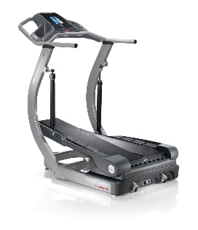
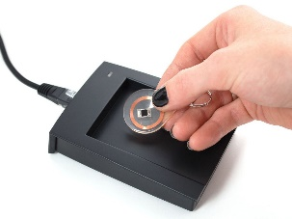
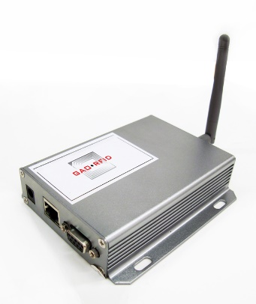
Behind the Scenes

Slide 8
3 Year Financial Plan
 | Year 1 | Year 2 | Year 3
Gross Income
Gym Monthly Fee $500/month [10 gyms] | $60,000.00 | $120,000.00 | $180,000.00
Total Income | $60,000.00 | $180,000.00 | $360,000.00
Expenses
General Developer [150 hours] | $6,000.00 | $0.00 | $0.00
Mobile Application Developer [150 hours] | $5,700.00 | $0.00 | $0.00
Marketing/Advertising | $5,000.00 | $5,000.00 | $5,000.00
Sales Rep [200 hours/year] | $4,200.00 | $2,100.00 | $2,100.00
Amazon Web Services [hosting] | $30.00 | $30.00 | $30.00
Other expenses:
Installment of RFID [$1000 per gym] | $10,000.00 | $10,000.00 | $10,000.00
RFID Bracelets [$250 per 1000] | $2,500.00 | $2,500.00 | $2,500.00
RFID Card Reader [$36/each; 80/gym] | $28,800.00 | $28,800.00 | $28,800.00
Maintenance/Repair | $1,000.00 | $1,500.00 | $2,000.00
Total Expenses | $63,230.00 | $49,930.00 | $50,430.00
Net Income | -$3,230.00 | $130,070.00 | $309,570.00
Accumulated Net Income | $436,410.00
Amazon Web Services Costs:
$30 for first terabyte
$29.50 for next 49 terabytes
$29 for next 450 terabytes

Slide 9
Implementation Plan
Design & Preparation
1. Survey Gym
Refinement & Iteration
1. App features & Infrastructure
Test & Deployment
1. Integration testing
2. Gym Blueprint
3. Technical Specifications
2. Software Development
3. Finalize Application
2. App Deployment
3. Data Collection & Analysis

Slide 10
Moving Forward
Phase 1
1. Focus on Gym users
Phase 2
1. Focus on Gym Management
2. Provide data of usage frequency for equipment
2. Capacity of overall gym and specific machines

Slide 11
Thank You

Slide 12
Appendix

Slide 13
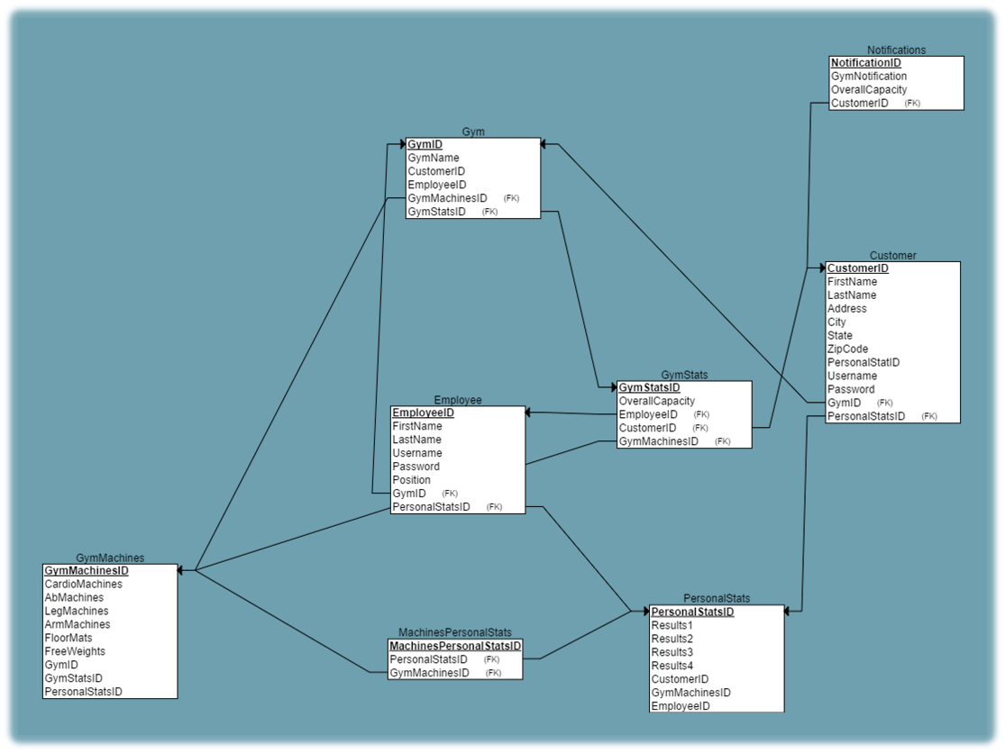
Data Model

Slide 14
Process Model
Gym User
Check capacity
Equipment usage
Scan into section
Scan out of section
Check personal activity/stats

Slide 15
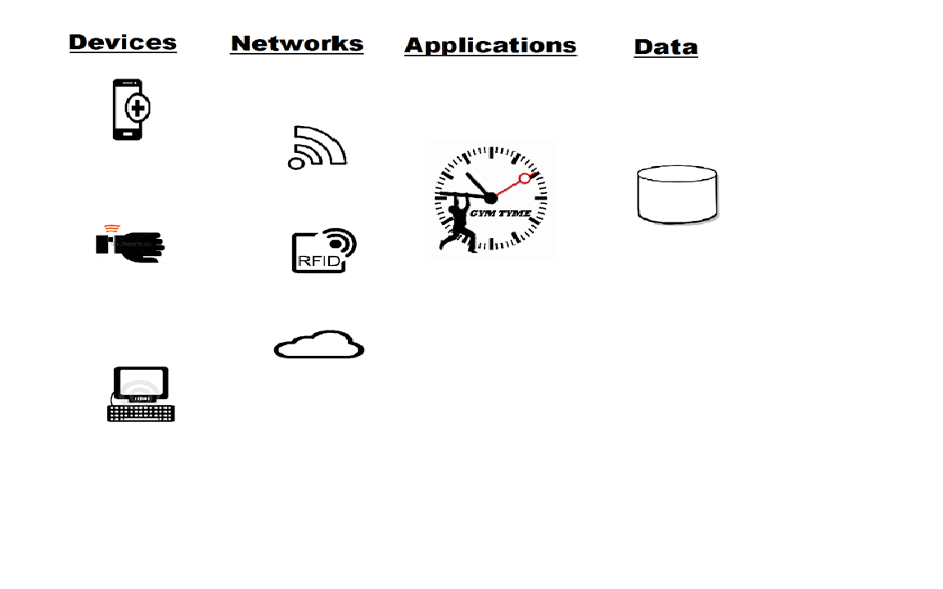
Systems Architecture

