Slide 1
Odd Job Auction
Elizabeth Gulla, Richard Sitek, Chau Tran, Pushpinder Multani
Notes:
Introduce problem
Liz

Slide 2
Problem
$392B/year of home services occur through antiquated platforms
Labor-intensive jobs are difficult to automate
Home services are expensive
Experienced & reliable tradesmen charge high rates
Notes:
“Collectively, less than two percent of the $400 billion home services market goes through online and mobile platforms like HomeJoy and RedBeacon today.” (source: http://pando.com/2013/12/23/housecall-the-uber-for-all-your-home-services-raises-1-5m-from-e-ventures/)
Little to no development on the automation of labor-intensive functions via the use of technology
Master tradesmen are pricy and starting a trade business immediately after school is expensive
Limited accessibility for reliable tradesmen (ratings through app)
Liz

Slide 3
Our Solution: Odd Job Auction
Auction-style home services networking platform
Available on all major operating systems
No posting fees
No hidden fees
Flat monthly fee for contractors
Flat rate for first contact with new client
Notes:
Screenshot of app, introduce app
Available on ios, google play, and windows
No posting fees for contractor’s customers to post potential jobs
Liz

Slide 4
Competition
Feedback system
Many contractors to choose from
1.25 Stars – Consumer Affairs
1.5 Stars – Consumer Affairs
Company takeovers
Employed by HomeAdvisor
Not employed by Handy
Takes on consumer risk
Handles all transactions
Notes:
Rick

Slide 5
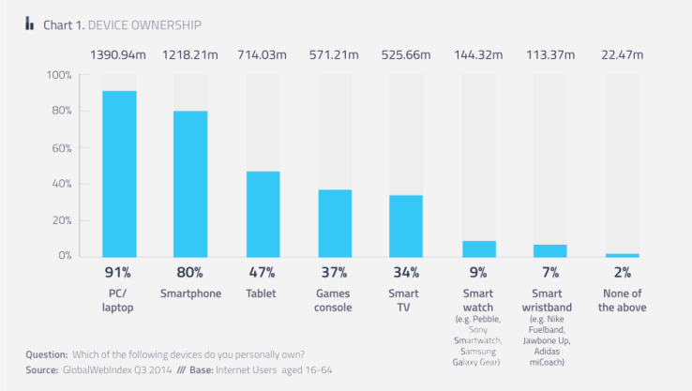
Differentiation
Provides unmatched value
Low costs to service providers
$10/month service fee
$20/connection
We don’t handle the transactions
First app of its kind in this market
Notes:
low cost to consumers through auction-style bids placed on behalf of apprentice tradesmen
First app of it’s kind in the Greater Philadelphia area
(source of chart: http://techcrunch.com/2015/01/12/80-of-all-online-adults-now-own-a-smartphone-less-than-10-use-wearables/)
Rick
Make graph bigger.

Slide 6
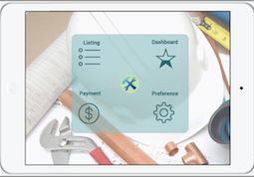
Architecture
Database:
Tradesmen credit card
Database:
Jobs Posting
User Input
Tradesmen’s Response
Notes:
Add credit card companies

Slide 7
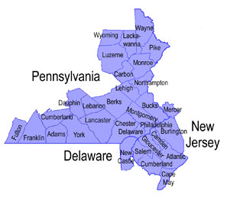
Implementation Plan
Set Up Data Analytics
Publish
Marketing
Create blog
Paper ads
Banner ads
Get Press
Review Data
Notes:
Set up marketing data analytics
Get press (contact blog authors, newspapers, magazines, etc.)
Market app to review sites and blogs to publicize the announcement of our app (create blog, create product video, get press, manually recruit customers, email distribution list)
Publish app via apple app store and google play store
Review data collected (discuss reviews and improvements we can make)
Pushpinder
Plan needs to include timeline and geographic limits/rollouts

Slide 8
Financial Plan
(in thousands) | Year 1 | Year 2 | Year 3
Revenue | $85 | $260 | $510
Expenses | $55 | $15 | $20
Net Income | $30 | $240 | $490
Accumulated Income | $30 | $270 | $760
Notes:
Revenue includes subscription revenue from tradesmen, “won bid” revenue ($20 charged for each bid that a tradesman has won), and ad revenue
100 subscribers for 1st year, 300 for 2nd , 600 for 3rd
Each subscriber will have at least 3 job per month
Expenses include app development for the first year, app maintenance for years 2 and 3, and ad fees
Chau
Round off. No decimals, round up if there is a decimal

Slide 9
Notes:
Chau

Slide 10
Questions?

