Slide 1
Search Engine Optimization Internship
Hung Dau
Spring 2018

Slide 2
Fox Run Brands
Founded in 1962 by a British entrepreneur
A leading supplier in the consumer goods industry.
Supplying many kitchen products to thousands of retailers in the US.
Headquarter in Ivyland, PA and has other locations in Philadelphia, Canada, and China

Slide 3
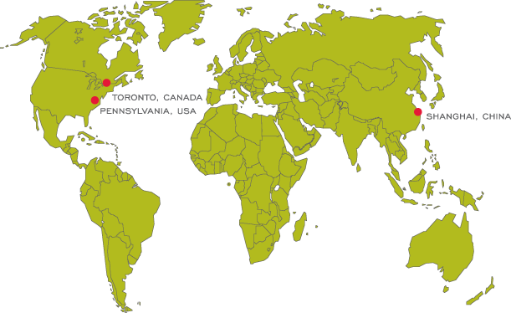
The Basic Model of The Company
Create the main revenue from supplying products to retailers.
Also sell thousand of products on different e-commerce websites including Amazon, Walmart, etc.
The most significant assets of the firm are people, factories, and products.

Slide 4
My team within the firm
E-commerce department
Developing and managing selling products on E-commerce sites, Amazon, Walmart, etc.
Launching different marketing strategy to help promoting the firm’s brand and products.
Researching on different market that the firm can invest in.

Slide 5
My roles as an SEO intern
Working to increase the ranking of company’s products on Amazon’s SERP.
Identifying and implementing effective SEO strategies on Amazon.
Creating and managing Amazon PPC ads.
Researching on keywords to maximize the products’ potentiality.
Extracting and analyzing data of products on Amazon.
Reporting the data weekly to the manager.

Slide 6
How does my experience relate to my coursework?
MKTG 3508 – Digital Marketing
Experiencing real-life perspective about Search Engine Optimization.
Applying knowledge of digital marketing and Search Engine Marketing.
Researching and collecting effective keywords.

Slide 7
How does my experience relate to my coursework?
MIS2101 – Data Analytics
Extracting and analyzing data.
Reporting.
Creating charts for better analysis.
Utilizing Excel and Tableau skills.

Slide 8
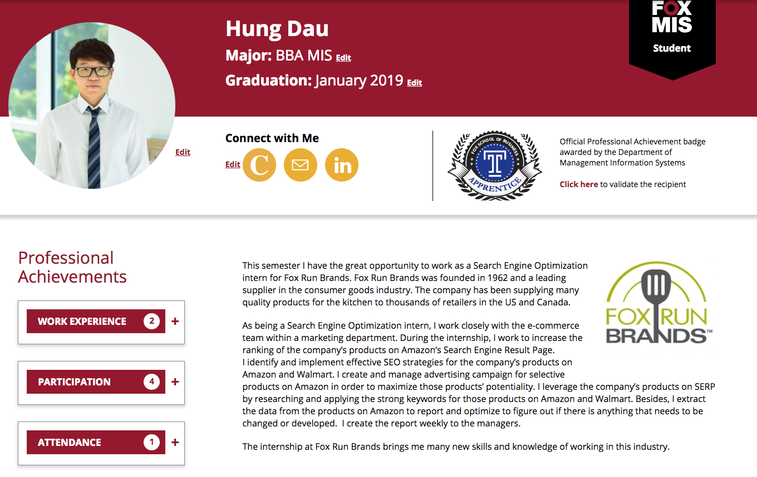
My E-Portfolio
http://community.mis.temple.edu/hungdau/seo-internship-spring-2018/

