Slide 1

“Delivering fresh products within the palm of your hands.”
-----
Lamar Dixon, Darryl Jones, Nicholas Stamboolian, Ryan Trapp, and Celynna Zoleta

Slide 2
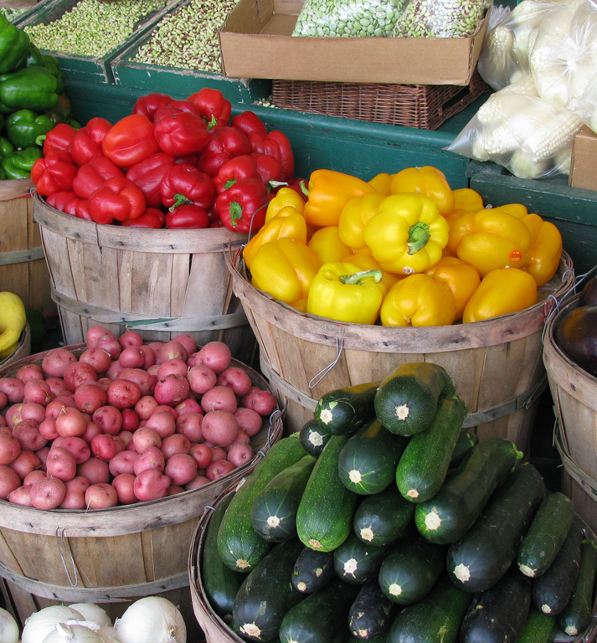
Problem
Farms offer fresh products without the worry of pesticides. They sell their products at their farms or local farmer's market, but they are not making enough sales.
There are individuals who would like fresh products, but have to deal with grocery store items and pesticides because these markets are too far away or are open once a week during summer and spring seasons.
Local food at U.S. farmers' markets are slowing.
A January report from the U.S. Department of Agriculture shows that while more farmers are selling directly to consumers, local food sales at farmers markets, farm stands and through community supported agriculture have lost some momentum.
Notes:
Recommendations from scuff:
-Include reasons to why both the customer AND farmer should be interested in our product.
-Sets up the story for the prototype

Slide 3
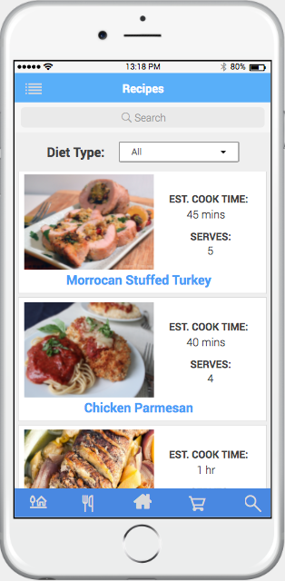
Solution
Mobile application that directly links farmers to consumers
Easy access to fresh grocery items that can be ordered and delivered to your home.
Offers recipes made from fresh farm ingredients.

Slide 4
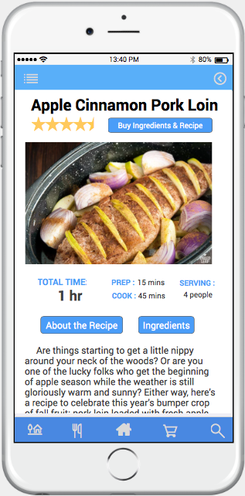
Product Key Features
Recipe and Ingredients added to cart with one click of a button
Shop for individual fresh grocery items from farmers with the use of the application
Look up different farms within the area

Slide 5
How does it work?
Customer
Farmer
Application
Driver
Places an order
Receives order
Accepts
Request
Prepares
Items
Items ready for pickup
Notify
Company
Receives request
Notifies farmer
Receives notification
Requests driver
Accepts
Delivery
Picks up items
Delivers
products

Slide 6

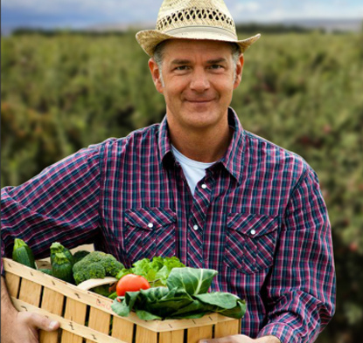
Users
Sarah Gilbert
23 year old recent college graduate working her first full time job
Jack Williams
Farm Owner who works on his farm with his family
“Organic food is so expensive, and I have no time to grocery shop. Searching for recipes for all the ingredients I order doesn’t help”
“I wish my fresh produce received more sales!
It’s sad knowing my products will just be injected with pesticides.”

Slide 7
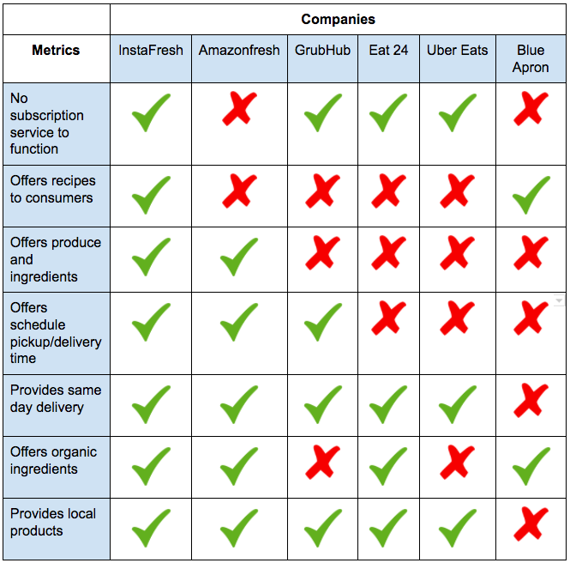
Our Market
In total, U.S. online grocery sales amounted to about 7 billion U.S. dollars in 2015. As of 2016, 5 percent of U.S. consumers preferred shopping for groceries online.
*http://foodtechconnect.com/2015/08/18/global-online-grocery-grows-80-billion-by-2018-syndy/
What Clients Want
More convenient way to buying food
Want larger product offering
Sell more produce and ingredients
Cut shelving and perishable cost
Notes:
Who are the competitors?
Which market does it fit in?
Who are the clients?
Use the disruption innovation material
What market do we fit in?
-InstaFresh is a new company in the online grocery market which focuses on a new sustaining app that allows consumers to order organic produce and ingredients from their local farms to their dinner table.
Who are our clients?
-Our clients not only consist of all consumers who grocery shop online but also farmers as we provide a platform for them to to sell their produce to customers thus allowing farmers to gain loyal customers and guaranteed sales.
Who are the competitors?
-AmazonFresh, Blue Apron, Uber Eats, GrubHub, Eat 24. Our competitors are sites that provide consumers a way to have meals or food/produce be delivered to them.

Slide 8
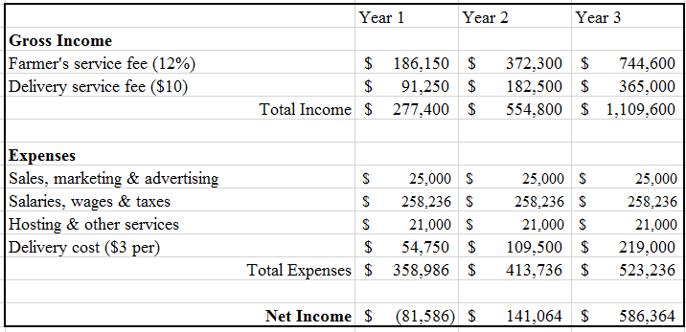
How much will it cost?
InstaFresh estimates 50 active daily users

Slide 9
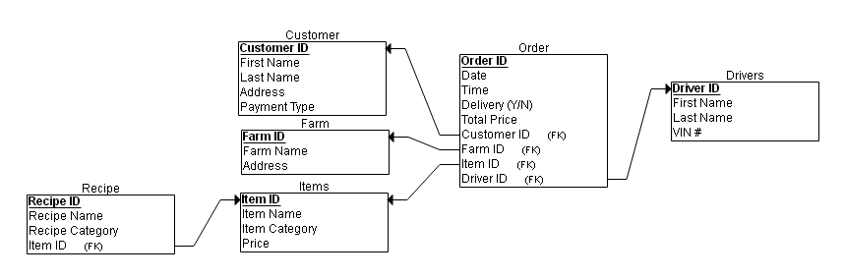
Data Model

Slide 10
Systems Architecture

Slide 11
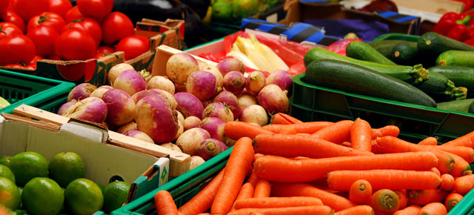
Implementation Plan
Focus on developing application
Logistics: contact local Philadelphia farmers
Hire delivery drivers
Start locally around Philadelphia, Work our way out

Slide 12
Questions?

