Slide 1
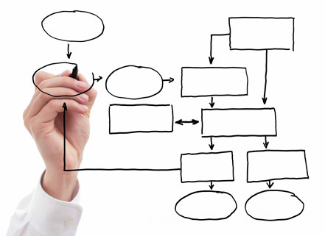
MIS 5121: Business Process, ERP Systems & Controls Real World Control Failures: By: ____________

Slide 2
Control Failure: Skimming
Background:
Control Failures:
Results:
What Could / Should those in Authority Have Done Different?:
Reference:
_____ Fraud: Link
Notes:
Notes:

