Slide 1
Bernie Madoff Scandal

Slide 2
Background
Bernard L. Madoff Investment Securities LLC founded in 1960 by Bernard Madoff
Bernard L. Madoff Investment Securities LLC operates as a securities broker in the United States and internationally.
As of December 15, 2008, Bernard L. Madoff Investment Securities LLC is in liquidation.

Slide 3
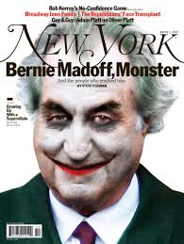
Scandal
Scandal:
Madoff chose rich Country Clubs to find rich investors
Madoff promised a consistent 10% profit every year on investment and fulfilled his promise
Claimed he achieved this consistency by using a "collar" method to limit gains and losses
Timeline of the scandal:
1983: Madoff is elected to the NASD council for four years
2000: SEC begins investigation to determine if it is a fraud; no evidence found
2000: Madoff faces liquidation and decides to give $173 mil 2 months in advance
2008: Madoff confesses about his fraud
Notes:
Example: When a client gave Madoff $1,000,000. Madoff returned 10% of it, i.e. $100,00 every year for the next 10 years.
After 10 years, he had given the investor all of his money ($1,000,000) back. In the 11th year, he had no more cash to make the yearly payment. When the client would ask for his $1,000,000; Madoff admitted that it no longer existed. Essentially, it was a ponzi scheme that made no profit inspite lasting for 10 years. Madoff kept adding more and more investors to be sustainable and cover his company cost as well. The new investor's cash was used to pay back the old investor. Every investor's 10% gain was another investor's 10% loss.

Slide 4
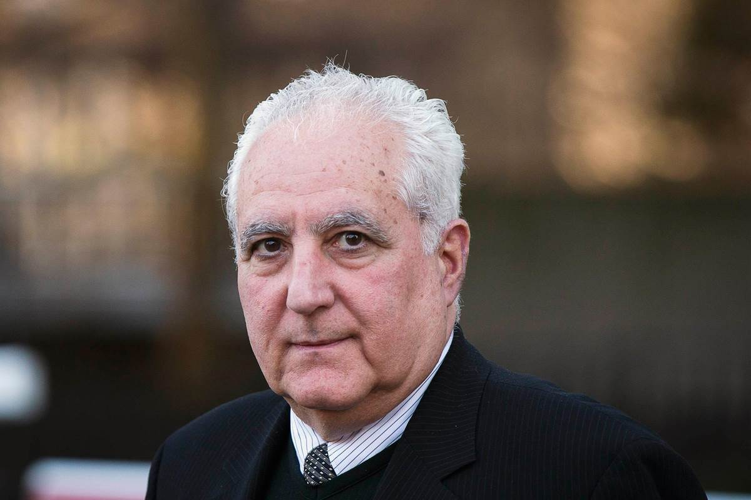
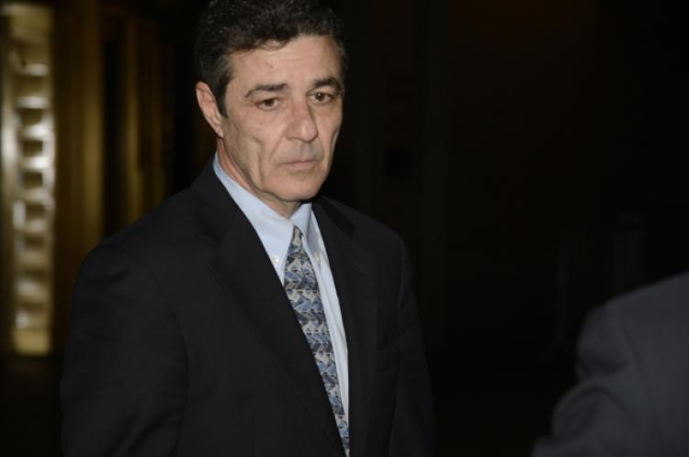
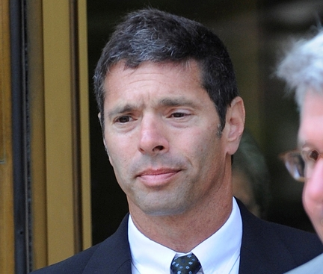
Other Key Players
Daniel Bonwentre
Director of Operations
Worked for Madoff for 30 years
Helped perpetuate the fraud by falsifying accounting records
Frank Di Pascali Jr.
CFO and Madoff's right-hand man
Worked on the scheme for 20 years
David Friehling
Madoff's outside accountant and firm's auditor
Pleaded guilty to various charges including Securities fraud.

Slide 5
Consequences
Madoff has been serving a 150 year prison sentence on 11 counts of fraud
Celebrities like Kevin Bacon, Stevin Spielberg, Larry King lost 24 million approx.
People lost millions; some even lost their entire life savings
Bernard Madoff Investment Securities LLC is in the process of liquidation
The most devastative effect = people’s trust in investments
Notes:
The most devastative effect of this scandal was that on people's trust in investments. If people stop investing in the businesses and the government that would be worst case scenario for the economy.

Slide 6
Control Failures
GAAP violations
Violation of Conservatism principle of GAAP
Violation Full Disclosure principle of GAAP
Violation of Revenue Recognition principle of GAAP
Friehling conducted an audit but failed to documented his findings and conclusions as required under GAAS
Whistle Blowers like MarkoPolos alerted the SEC in 2001, but no action was taken.
“I gift wrapped and delivered them the largest Ponzi scheme in the history and they couldn't bother to conduct a thorough and proper investigation.“
Friehling signed off on a report to the SEC indicating that Madoff's firm had $1.09 billion in assets and $425 in liabilities; phony figures.
Friehling reviewed internal controls at Madoff and regularly distributed annual audit reports to Madoff's customers; all these statements were materially false.
Madoff sat on the SEC committee and his family members served on other regulatory panels, these connections may have played a role as well.
Notes:
Violation of Conservatism principle of GAAP:
The accounting for the company wasn't fair not was it reasonable and hence company violated the conservatism principle of GAAP
The books and reports were changed to make the business look profitable.
Full Disclosure Principle:
The company didn't include complete information, which would affect income statements as the books were cooked. The company failed to accurately reveal that they weren't profitable.
Violation of Revenue Recognition principle of GAAP as the revenue wasn't recorded as it was earned.
“Friehling also failed to test internal controls as required under GAAP and GAAS standards. For example, Friehling did not take any steps to test internal controls over areas such as BLMIS’ redemption of client funds, the payment of invoices for corporate expenses, or the purchase of securities by BLMIS on behalf of its clients.” - Accountant for Bernard L. Madoff Investment Securities, LLC Charged with Fraud Stemming from Accounting Violations

Slide 7
Controls that should be in place
SEC making sure that they don't just miss incidents like Madoff but also the banking irregularities that brought down markets in 2008
The SEC should have proactively engaged in checking the firm of its funds
Organizations being audited by one of the Big four auditing firms. In Madoff's case, Madoff had essentially "bought" Friehling’s license for two decades and committed the fraud; Friehling was from a smaller auditing firm.
Need solid reforms to prevent such frauds and to ensure that current administration at the SEC doesn't turn a blind eye to such mischief in the market.
If the above important controls have been followed then the controls that will in result work are:
Examine a bank account through which billions of dollars of Madoff's client funds flowed
Audits to be conducted independently and audit reports are assessed by the board
Verify liabilities related to client accounts
Review material sources of revenue, including commissions

Slide 8
Sources
http://content.time.com/time/business/article/0,8599,1867092,00.html
http://www.fraud-magazine.com/article.aspx?id=4294977160
http://blogs.reuters.com/great-debate/2009/01/06/why-did-the-sec-fail-to-spot-the-madoff-case/
https://archives.fbi.gov/archives/newyork/press-releases/2009/nyfo031809.htm
http://www.wsj.com/articles/SB123491638561904323
http://www.journalofaccountancy.com/news/2009/mar/20091553.html
http://www.accountingweb.com/aa/standards/madoffs-accountant-when-is-an-auditor-not-an-auditor

