Slide 1
Mirant Corp Fraud Case
A control failure instance

Slide 2
Mirant Corp
Southern Energy Inc. (NYSE: SOE), a global independent power producer and energy marketing and risk management company, becomes Mirant in 2001
Mirant was listed in the New York Stock Exchange and the share value reached its highest at $47 in 2001
Mirant, a spinoff of Southern Co., and its subsidiaries employed around 7,000 people

Slide 3
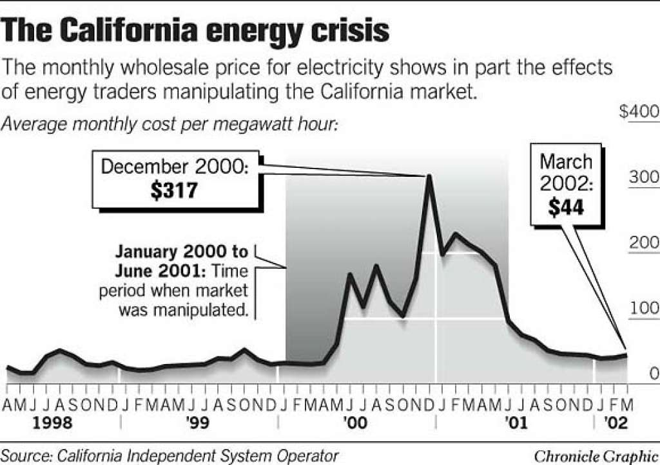
The Scandal
In June 2001, a Senate committee suspects Mirant to be involved in price manipulation and for not turning over documents requested for the probe
Claimed that Mirant defrauded shareholders and violated federal securities laws
Manipulated utility prices and inflated stock
Over the period of two years Mirant overstated earnings by total of $188 million, $159 million in 2001 and $29million in 2002 , and reported a $2.4 billion loss for 2002
Suspicion that Mirant employees were forced to delete certain specified files concerning Mirant's activities in California’s energy crises

Slide 4
Consequences
Thousands of investors lost money as stock price collapsed
Had to terminate several power plant developments
Failure to find additional financing, Mirant would have been forced into bankruptcy
Removal from several markets
The stock went down 90 percent from its peak value of $47 in May 21, 2001
Mirant had to sell assets, close offices
Distrust from global investors
Delay in publishing financial statements for coming quarters

Slide 5
Control Failure
Improper understanding of costs of long term projects
Mismanaged corporate governance
Improper accounting practices
$85 million overstatement of a gas inventory asset, a $100 million overstatement of an accounts payable liability and a potential $68 million overstatement of an accounts receivable asset
Improper and mismanaged reconciliation methods used to verify asset accounts and liability accounts
Published falsified financial statements
Improper controls and monitoring in finance division
Improper monitoring and neglect by internal and external audit teams
Improper risk management and risk disclosure

Slide 6
What controls must be in place
External oversight for management decisions
Third party committee to investigate past book keeping practices
Segregation of duties to allow no conflict of interest in creation of transactions and control and monitoring of transactions
Reconciliation of accounting books, accounts and balances
Periodic check of accounting books and review
Highlighting unacceptable business practices
Integrity of audit function and clear audit reports must be maintained

Slide 7
Conclusion
Mirant Corp. has prevailed in a six-year legal battle to clear the company of allegations
Shareholder plaintiffs repeatedly failed to show how Mirant had broken federal laws
However, the conclusion was that accounting practices and internal controls failed
Either intentional or unintentional, the internal control failure caused losses to the company and its share holders
Streamlining internal controls and following best audit practices is extremely necessary

