Slide 1
CONTROL FAILURE
Satyam scandal

Slide 2
BACKGROUND
Satyam Computer Services Limited was an Indian IT services company based in Hyderabad and was established in 1987, and was the 4th fastest growing IT company in India.
Satyam had 53,000 employees and 9% market share along with $2.1 Billion in revenue.
Satyam was listed in New York Stock, National Stock exchange and Mumbai stock exchange
The company offers consulting and information technology services including software development, system maintenance and packaged software integration.

Slide 3
The scam and people involved
The Satyam scam occurred in 2009 when founder and chairman of Satyam Computers, B. Ramalinga Raju made the confession of having tampered with the accounts of the company and was found guilty in an accounting scam worth Rs. 7000 crore($1.1 billion)
Ten people who were judged guilty in the Satyam case along with their designations are as follows:
Names | Designations
Ramalinga Raju | Chairman and Founder of Satyam Computers
B. Rama Raju | Former MD of Satyam Computers
Vadlamani Srinivas | Former Chief Financial Officer
Subramani Gopalakrishnan and T Srinivas | Former PriceWaterhouseCooper auditors
B Suryanarayana Raju, G. Ramakrishna, D. Venkatpathi Raju and Ch Srisailam | Former Employees
V.S. Prabhakar Gupta | Former Internal Chief Auditor

Slide 4
FRAUD
Raju has maintained records of Satyam accounts and minutes of meeting since the year 2002. He stored record of accounts for the latest year-2008 to 2009 on a computer server called My Home Hub.
Alongside, he created fake invoices and bills using software applications such as Ontime.
Details of accounts from 2002 to 2009 were stored at two IP addresses.
A secret program was planted using source code of official invoice management system through the User ID Super User with the capability to hide or show the invoice in the system.
Close to 356 investment firms were allegedly used to divert funds from Satyam Computers
The companies used to conduct transactions with Satyam Computers through inter-corporate investments.
The money raised through this fraudulent practices was used for purchasing several thousand acres of land in Andhra Pradesh for capitalizing on the booming real estate market.
Facts had to be manipulated to display healthy profits for the company and every effort made to bridge the gulf between actual and manipulated accounts failed.
Satyam tried to cash out INR 7800 crore through the sale of Maytas Infrastructure and Maytas Properties, which was the last unsuccessful attempt made to recover the money and it failed.

Slide 5
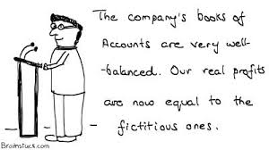
CONTROL FAILURES
Satyam scam is essentially a scam which highlights the role played by corporate misgovernance and fraudulent auditing practices in connivance with CAs and auditors.
Company also fudged its accounts to other stakeholders including the board, stock exchanges, regulators and investors.
The Satyam scam is an accounting fraud while sought to manipulate the markets and other stakeholders through lies about the financial well being of the company.
Fundamental facts such as revenues, interest liabilities, and cash balances had been inflated beyond actual levels to show the company in good light.
External auditors who had to prevent fraud by promoters are questionable in this case.
The actual number of employees was 40,000 and not 53,000 as reported. Mr Raju had been allegedly withdrawing ₹200 million (US$3 million) every month for paying these 13,000 non-existent employees

Slide 6
CONSEQUENCES
The founder of Satyam was arrested two days after he admitted to falsifying the firm's accounts. Ramalinga Raju was charged with several offences, including criminal conspiracy, breach of trust, and forgery
Shares of Satyam fell from US$29.10 in 2008 to US$1.80 in March 2009
Satyam was also removed from the Nifty and the Sensex
The Institute of Chartered Accountants of India (ICAI) has imposed a life-time ban on four auditors — S Gopalakrishna, Talluri Srinivas, V Srinivasa and VS Prabhakara Rao — involved in the Satyam Computers accounting fraud.
Many companies terminated its engagement with the company.
Mahindra bought Satyam for Rs 58 per share and formed Mahindra Satyam and was subsequently merged with Tech Mahindra on 24th June 2013

Slide 7
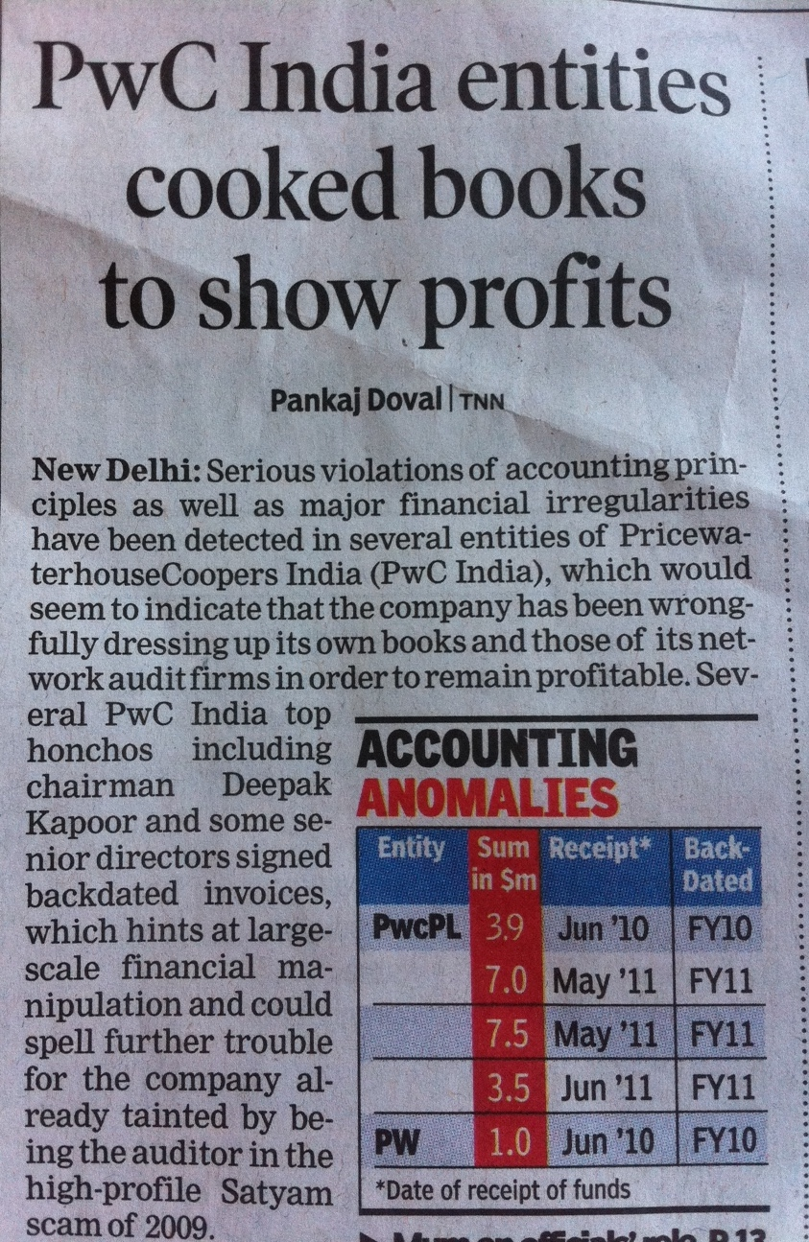
IMPACT on external auditors
PriceWaterCoopers affiliates served as independent auditors of Satyam Computer Services when the report of scandal in the account books of Satyam Computer Services broke. The Indian arm of PwC was fined $6 million by the SEC (US Securities and Exchange Commission) for not following the code of conduct and auditing standards in the performance of its duties related to the auditing of the accounts of Satyam Computer Services.[

Slide 8
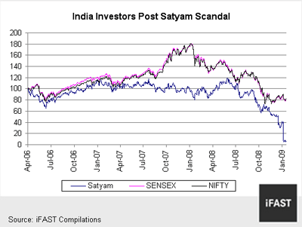
IMPACT on people
Jobs of 50000 employees were at risk.
GDP fell by 0.4%
Country’s booming economy was at risk.
Indian Stock market fell dramatically
India’s reputation was a risk.

Slide 9
What could have been done to prevent the scandal?
In this case, the fraud done by group of people in power and who thought that they could cover up the scam. By placing the following controls in the organization, would have detected the fraud in the beginning stages and not resulted in scandal reducing the impact.
By proper segregation of duties. Transaction entry, processing and completion should be performed by different group of people and no one should have complete authorization to make changes in the Ledger without approvals.
By reconciliation methods to check the account balances.
By ensuring that the audits are done independently and reports of internal and external audits are assessed and checked by the board.
Corporate governance need to be stronger and having transparency as a culture throughout the organization.

Slide 10
REFERENCES
http://www.careerride.com/view.aspx?id=20900
https://en.wikipedia.org/wiki/Satyam_scandal

Slide 11
THANK YOU

