Slide 1
MIS 5121 Business Process, ERP Systems and Controls
Real World Control Failures: Toshiba Corporation
By: Sean Walsh

Slide 2
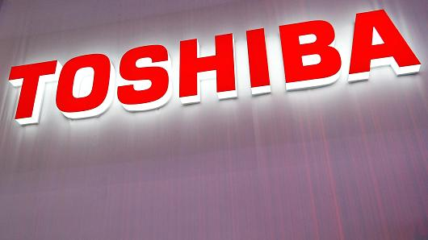
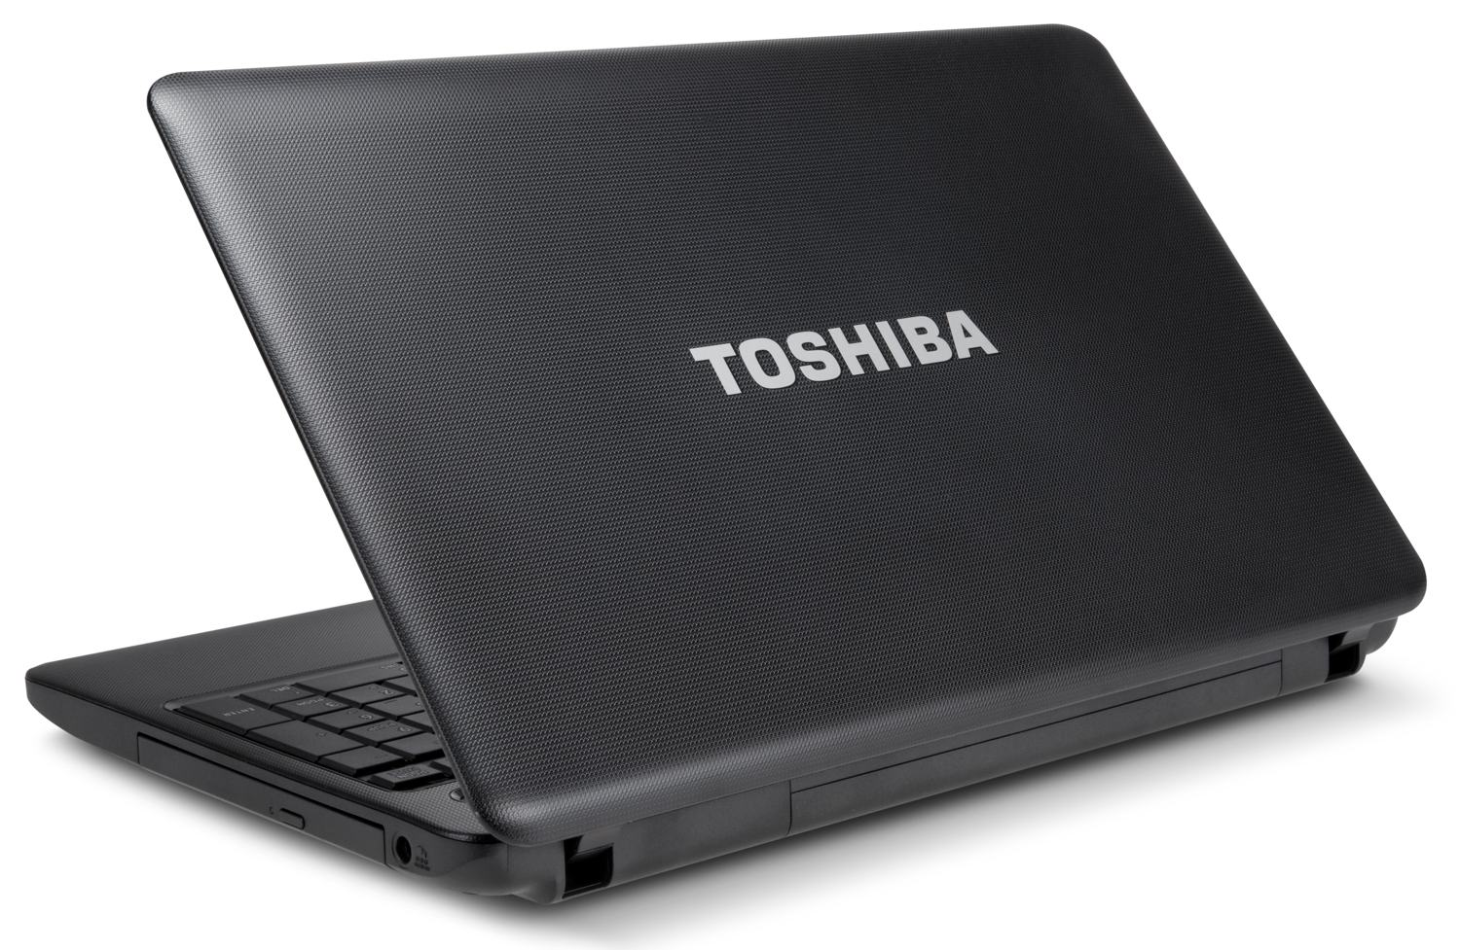
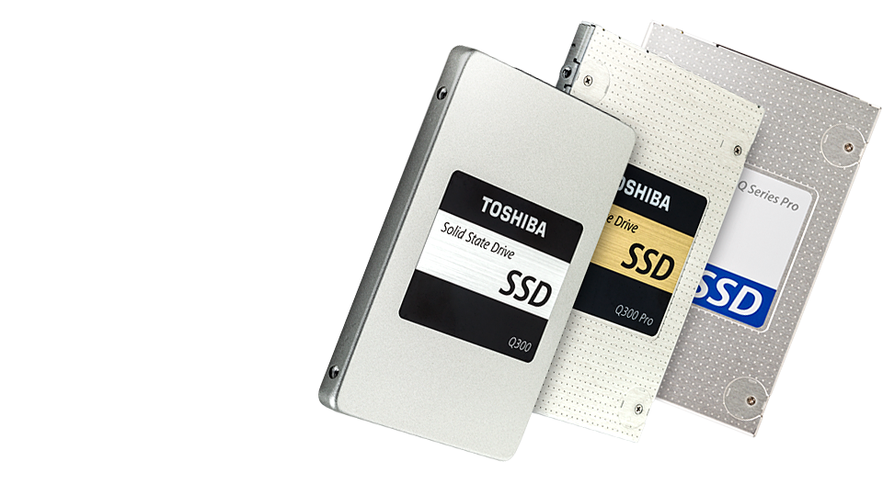
Background of Toshiba Corporation
Founded in Japan in 1938
Became a major manufacturer of heavy electrical equipment post WWII
Developed into a conglomerate over the later half of the 20th century

Slide 3
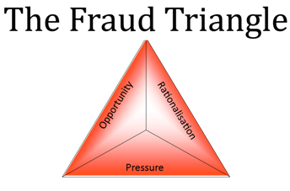
Control Failures: 2008 - 2014
Intense Sales Targets handed down from management to Visual Products business line.
Visual Products overstated profits instituting a “carryover” in accounting.
Accounting department failed to provide checks-and-balances to business lines.
Internal Audit acted as a consultation service to business lines instead of an auditing service.
Audit committee was not independent or knowledgeable in finance and accounting.

Slide 4
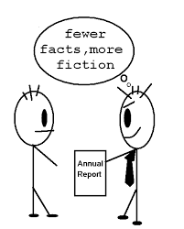
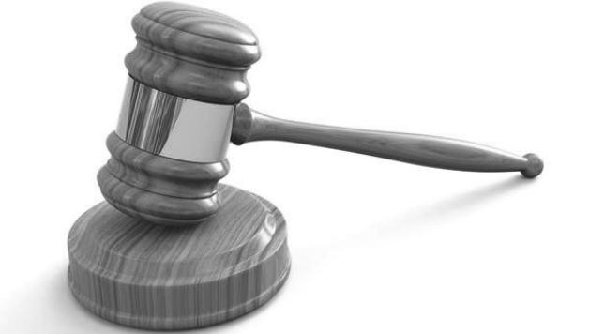
Results from Toshiba’s Accounting Fraud
Earnings overstated by at least $1.9B over period in question.
CEO Hisao Tanaka stepped down.
Fined $60M by Japanese Government.
E&Y’s Japanese Auditing firm under investigation for its complicity.
New lawsuits have been filed from foreign investors.

Slide 5
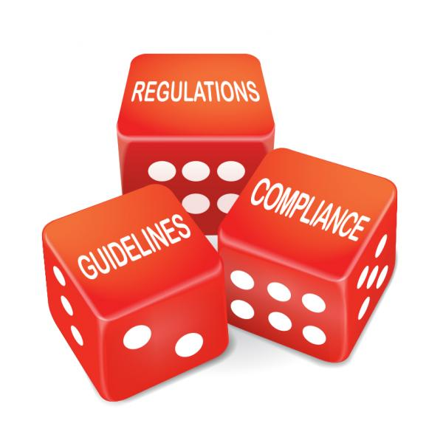
What could have been done differently?
Created a corporate culture of integrity over loyalty.
Enforced policy for audit department to act as an audit function.
Appointed knowledgeable personnel to Audit Committee.
Enforced Audit Committee independence.
Stronger whistleblower policy awareness and function.

Slide 6
Sources:
http://www.wsj.com/articles/toshiba-accounting-scandal-draws-record-fine-from-regulators-1449472485
http://www.business-standard.com/article/opinion/toshiba-a-case-of-internal-audit-failure-115080900760_1.html
http://fortune.com/2015/07/21/toshiba-just-lost-its-ceo-to-a-huge-accounting-scandal/
http://www.wsj.com/articles/toshiba-ceo-felled-by-accounting-scandal-1437468537
http://www.investopedia.com/articles/investing/081315/toshibas-accounting-scandal-how-it-happened.asp
http://www.ethicsboard.org/system/files/meetings/files/Agenda_Item_F-2_-_Toshiba_Accounting_Scandal_0.pdf
http://www.toshiba.co.jp/about/ir/en/news/20150725_1.pdf
https://www.bloomberg.com/news/articles/2015-12-07/toshiba-said-to-face-biggest-fine-by-japan-s-financial-regulator

