Slide 1
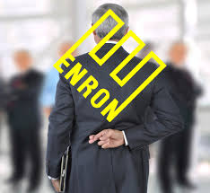
Enron
Control Failure
Notes:
Hello every one,
Today I am going to share the real control failure of Enron.

Slide 2
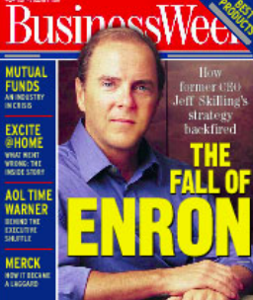
Company Background
Enron was established in 1985 by Kenneth Lay and Jeffrey Skilling.
The Enron company was the 7th largest corporation in America.
It was named “America’s most innovative company”
One of the largest companies to produce electricity, natural gases,and other communication initiatives
Notes:
Enron was established in 1985 by Kenneth Lay and Jeffery Skilling. Enron company was the 7th largest corporation in America. It was named “America’s most innovative company. One of the largest companies to produce electricity, natural gases, and other communication initiatives.

Slide 3
What happened?
Enron's complex financial statements were confusing to shareholders and analysts.
Fooled everyone into thinking Enron were making tons of money.
Lied about profits
Concealed debts so they did not show up on accounts
Notes:
Enron's complex financial statements were confusing to shareholders and analysts. In addition, its complex business model and unethical practices required that the company use accounting limitations to misrepresent earnings and modify the balance sheet to indicate favorable performance.

Slide 4
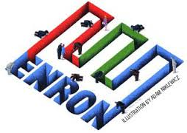
Control Failure
Ethnicity of management: Top official at Enron abused their power and privileges.
Auditor independence: The accounting firm, Arthur Anderson, not only provides auditing services but also consulting services to Enron.
Employee collusion. Many Enron employees worked for Arthur Anderson before.
Notes:
Directors failed to detect and stop accounting fraud.
Top official at Enron abused their power and privileges.
Ineffective internal and external auditing
The accounting firm, Arthur Anderson, not only provides auditing services but also consulting services to Enron.
Employee collusion. Many Enron employees worked for Arthur Anderson before.

Slide 5
Results
Investor lost about 60 billion dollars
4500 employees lost their jobs
People’s trust in the American economic system was destroyed
Banks were suspected of collusion
The rules for company financial reporting were drastically sharpened: SOX Act
Notes:
Investor lost about 60 billion dollars
4500 employees lost their jobs
Citizen’s trust in the American economic system was destroyed
Banks were suspected of collusion
The rules for company financial reporting were drastically sharpened: SOX Act

Slide 6
What should do
Hire a new CEO who commits ethical leadership.
Auditor independence should be maintained to make sure auditors can objectively access whether the accounting department telling the truth about finances.
Hire another accounting firm such as KPMG, E&Y, Deloitte, or PwC to run through the books one more time before submitting financial information to the IRS.
Notes:
Hiring a new CEO commit ethical leadership.
Auditor independence should be maintained to make sure auditors can objectively access whether the accounting department telling the truth about finances.
Hire another accounting firm such as KPMG, E&Y, Deloitte, or PwC to run through the books one more time before submitting financial information to the IRS.

Slide 7
Reference
http://www.global-ethic-now.de/gen-eng/0d_weltethos-und-wirtschaft/0d-01-globale-wirtschaft/0d-01-203-enron-folgen.php
http://www.wsj.com/articles/SB1011565452932132000
https://en.wikipedia.org/wiki/Auditor_independench
http://www.journalofleadershiped.org/attachments/article/30/JOLE_2_1_Johnson.pdf

