Slide 1
Ball State University
Control Failure: Fraud
November 28, 2016
Said OUEDRAOGO

Slide 2
Background
Ball State University (BSU)
Muncie, Indiana
Established in 1918
Public coeducational research university
Endowment $192,694,012
Students 21,998

Slide 3
Control Failure
Gale Prizevoits former investment director
Invested $13.5 M in highly risky mortgage bonds obligations (2008 and 2010) under Seth Beoku Betts and George Montolo advices
Altered records and conducted university business on her private email account
Seth Beoku Betts spent the investment money on luxury cars and real estate

Slide 4
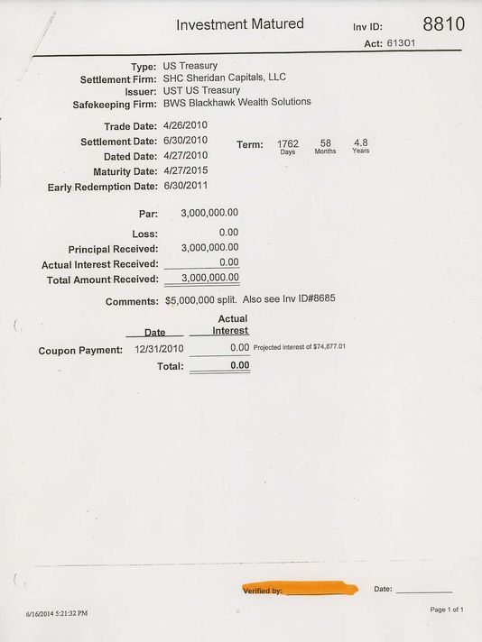

Slide 5
Control Failure
Interest rate of 5.04727% on a purported $3 million US Treasury investment ⇒ In general interest rate with more than 3 digits after the decimal point is atypical
Maturity date of Aug. 27, 2036 on a supposed Fannie Mae investment⇒ University policy limits investment to terms of 5 years
Documents was initialed by Prizevoits, and self-signed
Secretly signed contracts to avoid detection by superiors and auditors

Slide 6
Results
Gale fired for dishonesty, deceit, incompetence, neglect of duty, gross misconduct and willful disobedience of BSU’s investment policy.
Financial lost
$13.3 million investment lost
Only received $1.5 million in restitution
$2.9 million loss in FY 2011
Reputation lost
Seth Beoku Betts pleaded guilty in federal court to securities fraud, and George Montolio pleaded guilty to wire fraud

Slide 7
What Could/Should those in Authority Have Done Different?
Should have been a Compliance Committee to look at the investment strategy and policy and review the investment portfolio regularly
Consultation of external financial advisors
Broker pre-approved list
Segregation of duty. The person who initiated the investment should not be the only one approving the investment
Internal Auditors should have looked closely those investments

Slide 8
Reference
http://www.ibj.com/articles/48321-ball-state-fraud-involved-failed-internal-controls
http://www.ballstatedaily.com/article/2016/02/news-fraud
http://wane.com/2016/08/05/prosecutor-no-charges-in-ball-state-investment-scandal/
http://www.indystar.com/story/news/education/2014/06/25/ball-state-university-records-deception-lack-due-dilligence-muncie-fraudulent-investments-gale-prizevoits/11348489/
http://college.usatoday.com/2016/08/12/prosecutor-closes-book-on-ball-state-university-investment-scam/

