Slide 1
Target corporation - Canada
MIS 5121- Real Life Control Failure Project
By Alexandra Adje

Slide 2
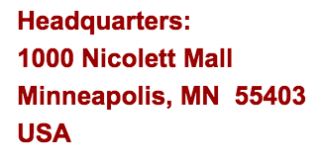
Company background
Upscale discount retailer providing high-quality, on-trend merchandise at attractive prices in clean and spacious stores since 1962 an online at Target.com since 1999.
Second largest general merchandise retailer in America
Second quarter 2016 sales: $16.2 billion
1,802 stores in the US, 341000 team members worldwide
$4 million/week raised for community giving
2011: Target bought 189 Zellers store in Canada, planning to turn 125-135 into Target stores
2013: largest ever single-year of store openings with 124 stores in Canada
2015: Cyber Fusion Center opening

Slide 3
Canadian expansion- Control failures
Attempted to roll out an ERP system with no experience
Failure to test the Point of Sale (POS) system before implementing
Failure to properly train employees on how to use technology tools
Inaccurate metrics due to business analysts having excessive control authority
Supply Chain Management failure
Overfilled distribution centers
Empty in store shelves
Incorrect products, incorrect quantities→ delay in supply chain
Lack of communication between warehouse and supply chain software
Inaccurate data in SAP

Slide 4
Some illustrations of Target unprepared expansion on the canadian market

Slide 5
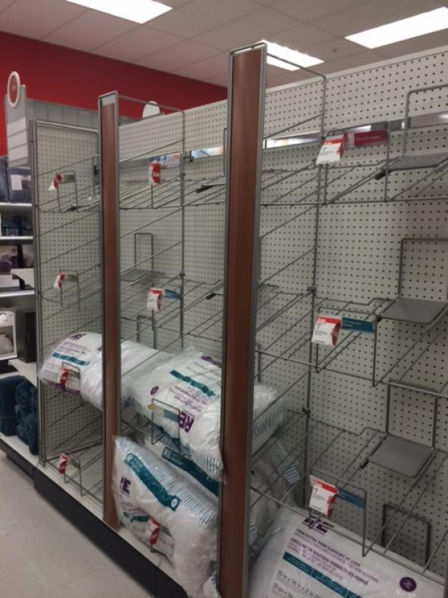
You probably get the idea

Slide 6
It was bad….

Slide 7
Results
Delay in supply chain
Empty shelves in the first week
Loss of reputation
Unsatisfied customers
Jan 2015: exit Canada closing 133 stores
Stock price dropped from $73.50 to $56.61
Total net loss of over $2 billion
2016 : Investors filed lawsuit against target over failed canadian expansion

Slide 8
What could/should those in authority have done differently?
Not rush the real estate deal with Zellers
Set project to test and review the different systems
Take time to train the employees to ensure correct use of new software system like SAP
Install automated accuracy checking controls to prevent human error especially when entering data
Segregate duties in a way that prevent business analysts to have access to certain features like being able to turn off auto-replenishment system

Slide 9
references
http://fortune.com/2015/01/15/target-canada-fail/
http://www.itbusiness.ca/news/4-it-lessons-learned-from-target-canadas-failure-as-documented-by-canadian-business/64199
https://consumerist.com/2016/01/22/9-things-we-learned-about-the-downfall-of-target-canada/
http://www.itbusiness.ca/news/4-it-lessons-learned-from-target-canadas-failure-as-documented-by-canadian-business/64199
http://www.theglobeandmail.com/report-on-business/missing-the-mark-5-reasons-why-target-failed-in-canad/article22459819/
https://www.linkedin.com/pulse/target-canada-international-failure-james-jack
http://www.macleans.ca/economy/economicanalysis/off-target-how-a-u-s-retail-giant-misread-the-canadian-market/

