Slide 1
The Volkswagen emissions scandal
MIS 5121:
Real World Control Failures
Tiesha Christian

Slide 2
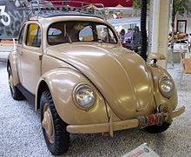
Volkswagen
Volkswagen is a German automaker founded on January 4th 1937
Volkswagen is known as the people's car
Volkswagen has factories in many parts of the world. Such as Mexico, USA, Slovakia.

Slide 3
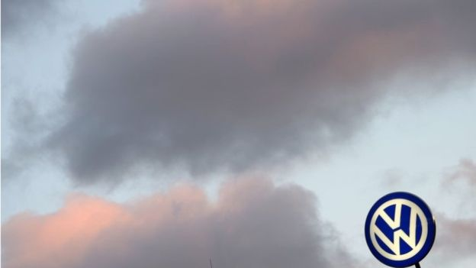
The Volkswagen Scandal
The Environmental Protection Agency (EPA) found that many VW cars being sold in America has a "defeat" device or software.
In diesel engines that could detect when they were being tested, changing the performance accordingly to enhance results.
VW has admitted to cheating emissions test in the US

Slide 4
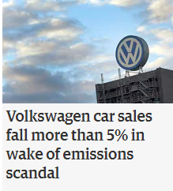
The Volkswagen Scandal
Volkswagen reached a $1.2b settlement with the US dealers over the emissions scandal
James Robert Liang, 62 pleaded guilty in federal court in Detroit to a single charge of trying to defraud the United States and violate the Clean Air Act
It was shared with the public that Top Level Executives were not involved physically. However, misconduct was tolerated
Control Failure: Lack of Governance over production

Slide 5
Results
After compromising 11 million vehicles in worldwide
VW has decided to pay for their wrong doing
Several lawsuits
VW headquarter offices are raided by authorities
VW offers each affected customer $500 which cost the company a total of $250m
Volkswagen will pay $10 Billion to any customer affected owner
$2.7 Billion for environmental cleanup
$2 Billion to promote

Slide 6
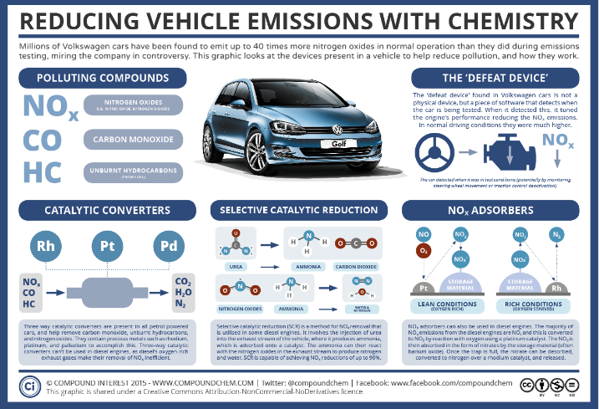
What could/should leadership done differently
Segregation of duties to avoid the risk of fraud and vulnerabilities.
Stronger internal controls to help mitigate fraud.

Slide 7
Resources
http://www.bbc.com/news/business-34324772
http://www.latimes.com/business/la-fi-volkswagen-settlement-20161001-snap-story.html
Wikipedia
https://www.theguardian.com/business/2015/dec/10/volkswagen-emissions-scandal-systematic-failures-hans-dieter-potsch
http://www.cnn.com/videos/cnnmoney/2016/06/28/cnnmoney-volkswagen-emissions-scandal-timeline.cnn

