Slide 1
Real World Control Failure: PTC Inc.
Vu Do
Dec 5, 2016

Slide 2
Background
Parametric Technology Corp (PTC Inc.)
Incorporated in 1985 outside of Boston, MA
Headquarter in Needham, MA
Computer Software Company
CEO – James E. Heppelmann

Slide 3
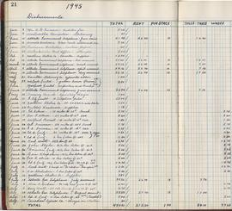
What Happen
Two China subsidiaries of PTC Inc. violated the Foreign Corrupt Practice Act - Feb 16, 2016
PT (Shanghai) Software Co. Ltd. and PT (Hong Kong) Limited.
Books and Record violations
From 2006-2011, recorded improper travel, gifts, & entertainment, it total nearly $1.5million.
Recorded bribes on their books & records.
Disguised it as legitimate commissions & business expenses.
Rolled up into the Corporate Parent’s books & records.

Slide 4
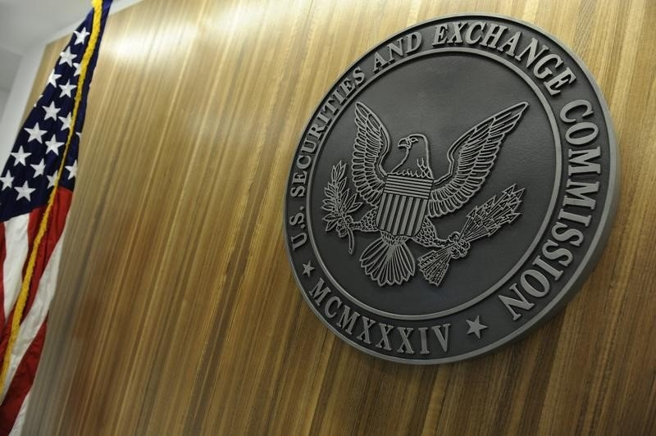
Penalty
Agreed to:
Pay $14,540,000 to Department of Justice (DOJ)
Profit disgorgement of $11,858,000 to the SEC
Prejudgment Interest of $1,764,000 to the SEC
SEC settled the case with an internal administrative order
No court
Total cost of damage : $28,162,000

Slide 5
Control Failures
Internal control failures in place or lack of
China was expected to have the same internal controls that the United States offices had.
Measures was not in place to ensure that internal controls instate where applied to locations out of state.
Commission was decided after sale had concluded.
Control weakness – allowed one corporate employee to oversea the approval process.

Slide 6
What Could Have Been Done Differently
PTC Inc. should have establish internal controls suitable for out of state subsidiaries of the company and not assume that they would follow the internal controls of in-state offices.
Paid more attention to the numbers being recorded on subsidiaries books that are then being put onto the main books.
Focus on putting the right employees in place to monitor and perform their duty correctly in foreign offices.

Slide 7
Reference Page
https://www.workiva.com/blog/ptc-china-internal-controls-failure
http://www.referenceforbusiness.com/history2/45/Parametric-Technology-Corp.html
http://www.fcpablog.com/blog/2016/2/16/ptc-pays-28-million-to-resolve-china-fcpa-offenses.html
https://www.sec.gov/news/pressrelease/2016-29.html

