Slide 1
MIS 5121: Real World Control Failure - TJX
By: Victoria a. johnson

Slide 2
Background
Founded in 1976, TJX was once considered the largest apparel and home fashions retailer in the US off-price segment.
Ranked #138 in the Fortune 500 rankings for 2006.
Reached $17.4 billion in sales for the year ending January 2007.
Tripled in size to their closest competitor, Ross Stores Inc.
Operated eight independent businesses with 2,400 stores and 125,000 associates.
Sold branded merchandise at 20 and 70 per cent lower than department stores.
Purchased merchandise directly from manufacturers at wholesale prices.

Slide 3
What Happened?
On December 18, 2006, TJX detected the presence of suspicious software, altered computer files and mixed-up data.
TJX brought in security consultants and notified law enforcement officials.
All eight business within the United States, Puerto Rico, Canada and the United Kingdom had been breached.
On February 21, 2007, TJX made a public announcement and acknowledged that their systems were first accessed back in July 2005.
Payment card consumer data was believed to be stolen from their systems which included driver license numbers, identification numbers and in some cases included social security numbers.
It was revealed that the cyber attack lasted for 1.5 years.

Slide 4
How It Happened?
Research concluded that TJX systems had been intruded upon by multiple points of attack.
These multiple points included: encryption, wireless attacks, USB drives stored at in-store kiosks, processing logs, and compliance and auditing practices.
TJX central database in Framington was believed to be the source of the hack which allowed intruders to steal payment card data.

Slide 5
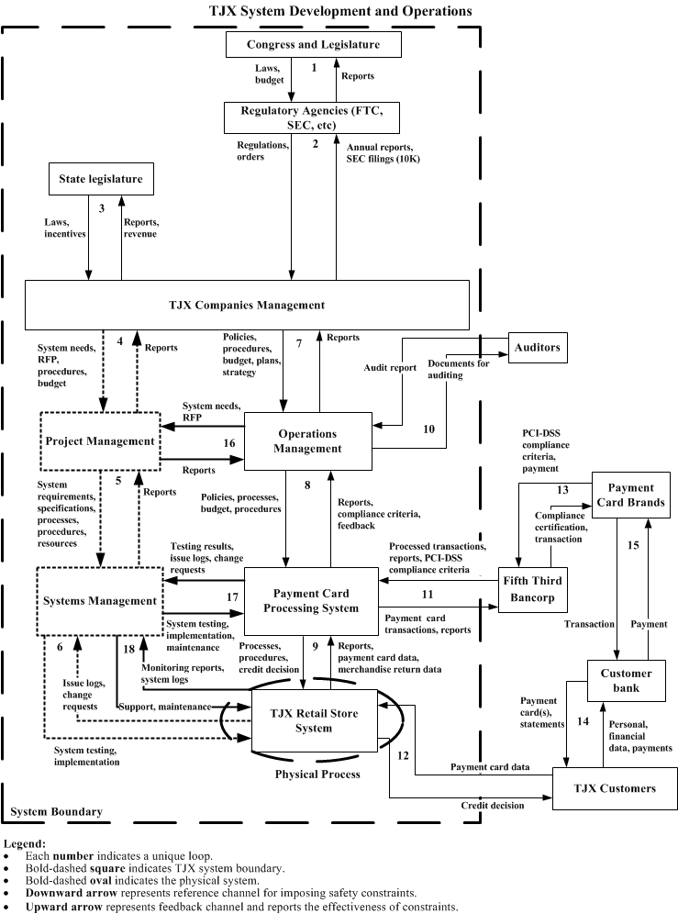
TJX
HIERARCHICAL CONTROL STRUCTURE

Slide 6
How It Happened?
Encryption
Credit cards couldn’t be processed when their numbers were encrypted so the intruders found a way to get the data during the window of processing time before it could be encrypted.
Wireless attack
Intruders focused on handheld (price check) guns and their interactions with database controllers which allowed them to obtain IP addresses.
USB drives at In-store kiosks
The intruders opened the back of the terminals and used USB drives to load software into the terminals.

Slide 7
Control Failures
A failure to segment networks carrying cardholder data from the rest of TJX's network and the storage of prohibited data.
More than 80GB of cardholder data was stolen.
Failure to properly configure its wireless network.
Failure to maintain adequate logs.
Exposed data on nearly 94 million accounts
Failure to employ sufficient measures to detect and prevent unauthorized access to computer networks or to conduct security investigations, such as patching or updating anti-virus software.

Slide 8
Outcomes
A number of class action lawsuits were filed against TJX in US and Canadian courts.
There were claims of negligence and related common-law and/or statutory causes of action stemming from the security intrusion.
TJX violated 9 out of the 12 Payment Card Industry (PCI) data security controls.
The Federal Trade Commission charged TJX with failure to provide reasonable and appropriate security for sensitive consumer information.
The settlement reached requires TJX to implement a comprehensive information security programs and obtain audits by independent third party security professionals every other year for 20 years.
12 months after the breach, TJX disclosed that it spent or set aside $250 million in breach related costs which included fixing the security flaws and settling claims, lawsuits and fines.
Settlements reached included free credit monitoring services for 3 years to consumer whose driver’s license numbers were revealed in the breach, plus cash reimbursements and vouchers.

Slide 9
What Could Have Been Done Differently?
TJX should have established stronger security standards which can include the following:
Not using a decryption key from software vendor.
Employing encryption at all points of transaction.
Regular change keys.
Preventing users from completing certain tasks in the database.
Removing large amounts of sensitive information that have been available in the system for too long.

Slide 10
Sources
http://www.nbcnews.com/id/20979359/ns/technology_and_science-security/t/encryption-faulted-tjx-hacking/
http://www.baselinemag.com/c/a/Business-Intelligence/TJX-Breach-Could-Have-Been-Avoided
http://www.networkworld.com/article/2343505/security/tjx-gets-20-years-of-ftc-scrutiny-for-security-failures.html
http://www.computerworld.com/article/2539588/security0/tjx-violated-nine-of-12-pci-controls-at-time-of-breach--court-filings-say.html
http://money.cnn.com/gallery/technology/security/2013/12/19/biggest-credit-card-hacks/3.html
Security Breach at TJX case, Ivey Management Services

