Slide 1
Module 2 - Systems
MIS5122: Enterprise Architecture for IT Auditors

Slide 2
Agenda
Systems Topics
Central Processing Unit (CPU)
Control Unit
Arithmetic Logic Unit (ALU)
Registers
The System Bus
I/O Basics
Processing Parallelism
Multicore Processing
Scaling up & out
Class Activity
Building our own computer

Slide 3
Case Study – Focus on Systems
Desktops
Servers
Special Purpose Machines NAS Routers

Slide 4
Question?
Is a 2.4 GHz Xeon twice as fast as a 1.2 GHz Pentium III?
Is a 3.4 GHz Xeon twice as fast as a 1.7 GHz Xeon?
Will my program run in half the time on the 3.4 GHz Xeon vs. the 1.7 GHz Xeon?
Notes:
Remember: Speed is determined by many factors? What factors?

Slide 5
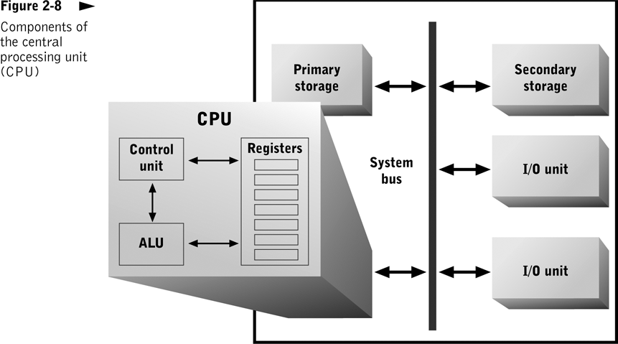
Notes:
Control unit
Moves data and instructions between main memory and registers
Tells the ALU what to do
Arithmetic logic unit (ALU)
Performs computation and comparison operations
All input and output to registers
Set of registers
Storage locations that hold inputs and outputs for the ALU

Slide 6
How a Microprocessor Works

Slide 7
Registers
What are “general-purpose” registers?
What are “special-purpose” registers?
Notes:
General Purpose Registers - Hold data for currently executing program that is needed quickly or frequently
Hold intermediate results and frequently needed data items
Used only by currently executing program
Implemented within the CPU; contents can be read or written quickly
Increasing their number usually decreases program execution time to a point
Special Purpose Registers - Store information about currently executing program and about status of CPU
Track processor and program status
Types
Instruction register
Instruction pointer
Program status word (PSW)
Stores results of comparison operation
Controls conditional branch execution
Indicates actual or potential error conditions

Slide 8
Word Size
What is the “word size” of a machine?
Notes:
Word Size
Number of bits a CPU can process simultaneously
Increasing it usually increases CPU efficiency, up to a point
Other computer components should match or exceed it for optimal performance
CPU components (ALU, registers), bus, RAM, etc.
Implications for system bus design and physical implementation of memory

Slide 9
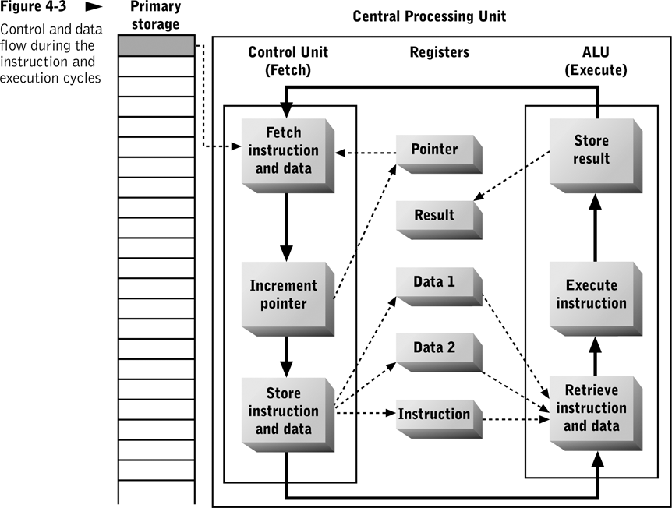

Slide 10
What did you learn?
A(n) _______ is the number of bits processed by the CPU in a single instruction. It also describes the size of a single register.
The address of the next instruction to be fetched by the CPU is held in the _______________.
word
instruction pointer

Slide 11
What did you learn?
PSW
In many CPUs, a register called the _____ stores condition codes, including those representing processing errors and the results of comparison operations.

Slide 12
Clock Rate
What is the “clock rate” of a machine?
How is it typically measured?
What is the CPU cycle time?
What are “wait states”?
Notes:
Typically measured in thousands of MHz (1000 MHz = 1 GHz)
CPU cycle time – inverse of clock rate
Can typically fetch and execute simple instruction in 1 cycle
Rate of actual or average instruction execution is measured in MIPS or MFLOPS
Wait state
Waiting to access memory
Waiting to access I/O devices

Slide 13
What did you learn?
The _________ time of a processor is 1 divided by the clock rate (in Hz).
One ______ is one cycle per second.
cycle time
hertz

Slide 14
Question?
In your own words, what does Moore’s law have to do with making CPUs faster?

Slide 15
The Physical CPU
Electrical device implemented as silicon-based microprocessor
Contains millions of switches, which perform basic processing functions
Physical implementation of switches and circuits

Slide 16
Why binary?
What is the “decimal” system and why do we use it?
How would we count if we had four fingers on each hand?
Binary is just another numbering system, no better or worse than decimal
Use binary numbers to represent numeric values
Use binary numbers to represent characters
Favorite saying
“There are 10 types of people in this world, those who understand binary and those who don’t”
It’s cheap and easy to make circuits that deal with two and only two voltages
High voltage represents a 1
Low voltage represents a 0

Slide 17
Switches and Gates
What are “switches” and “gates”?
Notes:
Basic building blocks of computer processing circuits
Electronic switches
Control electrical current flow in a circuit
Implemented as transistors
Gates
An interconnection of switches
A circuit that can perform a processing function on an individual binary electrical signal, or bit

Slide 18
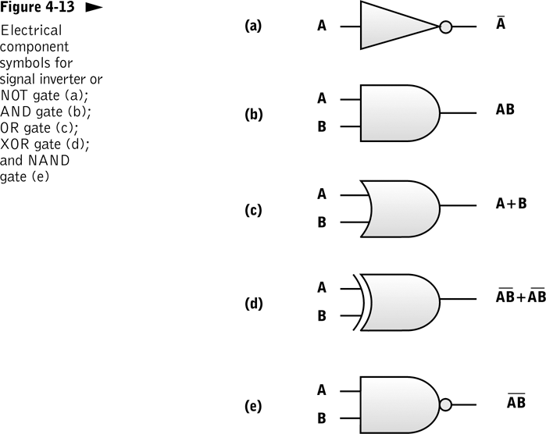
Not
And
Or
XOr
NAnd

Slide 19
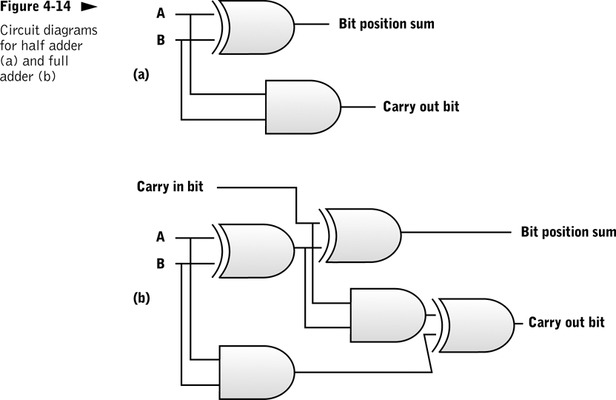
A | B | Carry | Sum
0 | 0 | 0 | 0
1 | 0 | 0 | 1
0 | 1 | 0 | 1
1 | 1 | 1 | 0
XOr
And
XOr
XOr
And
XOr
And

Slide 20
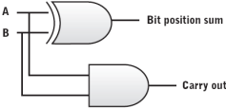
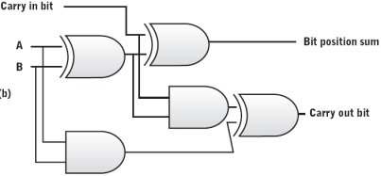
Look at the physical length of the circuit and we’re only adding a pair of 6 bit numbers. How long would the circuit be if we were multiplying a pair of 32 bit numbers or 64 bit numbers?

Slide 21
Electrical Properties Affect speed and reliability of CPU
Conductivity | Ability of an element to enable electron flow
Resistance | Loss of electrical power that occurs within a conductor
Heat | Negative effects of heat: Physical damage to conductor Changes to inherent resistance of conductor Dissipate heat with a heat sink
Speed and circuit length | Time required to perform a processing operation is a function of length of circuit and speed of light (approx 186,000 miles per second) Reduce circuit length for faster processing

Slide 22
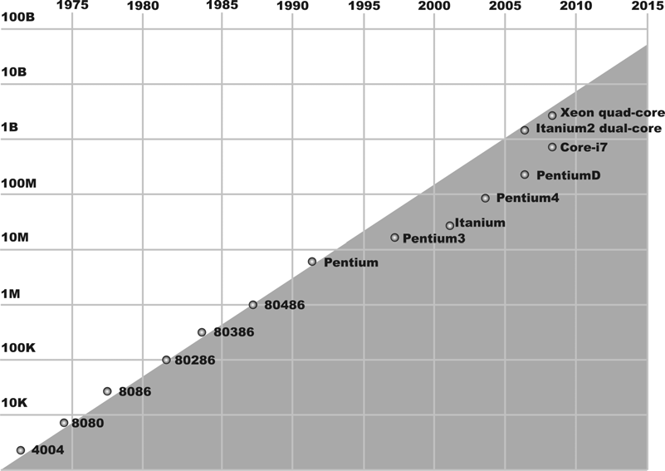
Moore’s Law - Rate of increase in transistor density on microchips doubles every 18-24 months with no increase in unit cost

Slide 23
What did you learn?
___________ predicts that transistor density and processor power will double every two years or less.
Moore’s law

Slide 24
Case Study – The Fastest CPUs?
A few special purpose desktops?
Servers

Slide 25
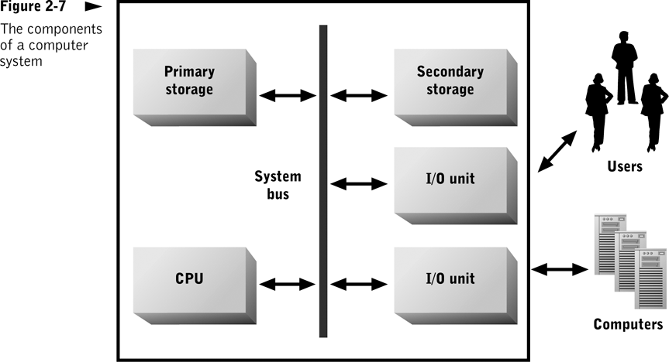
The System Bus
Notes:
System Bus (FSB)
Connects CPU with main memory and peripheral devices
Set of data lines, control lines, and status lines
Data bus
Address bus
Control bus
Bus protocol
Number and use of lines
Procedures for controlling access to the bus

Slide 26
The System Bus

Slide 27
Question?
If I have one system with an 800 MHz bus and another system with a 1.6 GHz bus, will the second system run application twice as fast as the first system?

Slide 28
Register | Value
R1
R2
Address | Data
1000 | 127.34 | Subtotal
1001 | 0.07 | Tax rate
1002 |  | Tax
127.34
Load R1,1000
127.34
1000
Read from RAM
And wait for 1 bus cycle

Slide 29
Register | Value
R1
R2
Address | Data
1000 | 127.34 | Subtotal
1001 | 0.07 | Tax rate
1002 |  | Tax
127.34
Load R2,1001
0.07
0.07
1001
Read from RAM
And wait for 1 bus cycle

Slide 30
Register | Value
R1
R2
Address | Data
1000 | 127.34 | Subtotal
1001 | 0.07 | Tax rate
1002 |  | Tax
127.34
Multiply R1,R2
8.91
0.07
And wait for 1 clock cycle

Slide 31
Register | Value
R1
R2
Address | Data
1000 | 127.34 | Subtotal
1001 | 0.07 | Tax rate
1002 |  | Tax
127.34
Store R2,1002
8.91
8.91
8.91
1002
Store into RAM
And wait for 1 bus cycle

Slide 32
Bus Clock and Data Transfer Rate
What is the “bus clock pulse” and a “bus cycle”?
What do these have to do with “data transfer rate”?
Notes:
Bus clock pulse
Common timing reference for all attached devices
Frequency measured in MHz
Bus cycle
Time interval from one clock pulse to the next
Data transfer rate
Measure of communication capacity
Bus capacity = data transfer unit x clock rate

Slide 33
Case Study – The Fastest FSBs?
A few special purpose desktops?
Servers

Slide 34
What did you learn?
The ___________ is the communication channel that connects all computer system components.
The system bus can be decomposed logically into three sets of transmission lines: the _______bus, the ________ bus, and the ____ bus.
system bus
address
control
data

Slide 35
Question?
What does it mean when I say that a device controller insulates the system from the physical geometry of I/O devices?
How do device controllers insulate the system from the physical geometry of I/O devices?

Slide 36
Logical Access – I/O Ports
What is meant by “logical access” and how do “I/O ports” facilitate logical access?
Notes:
Communication pathway from CPU to/from peripheral device
Usually a memory address that can be read/written by the CPU and a single peripheral device
Also a logical abstraction that enables CPU and bus to interact with each peripheral device as if the device were a storage device with linear address space
Mailbox analogy

Slide 37
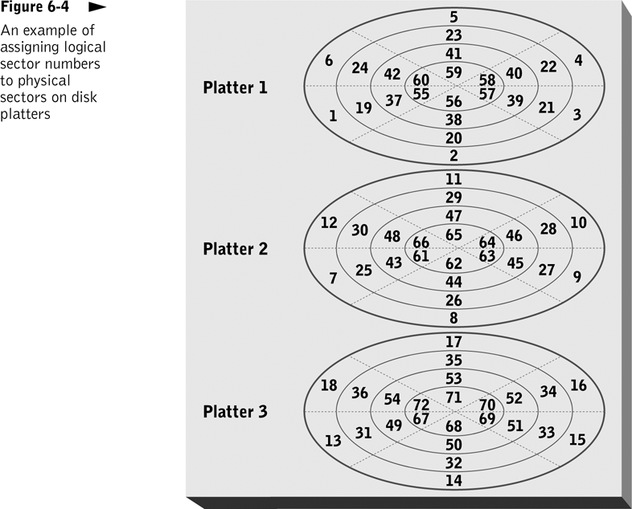
Logical access: The device, or its controller, translates linear sector address into corresponding physical sector location on a specific track and platter.

Slide 38
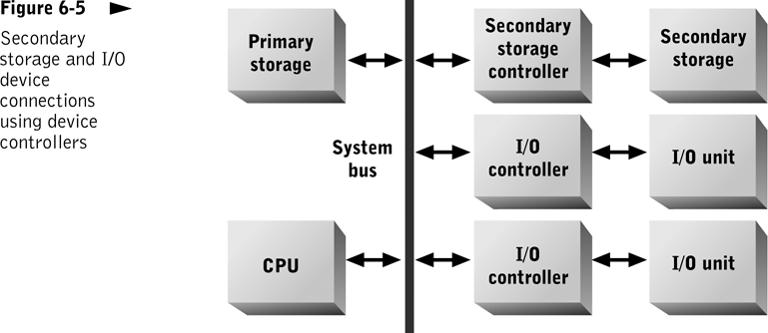
Notes:
Device Controller
Used by secondary storage and I/O devices
Implement the bus interface and access protocols
Translate logical addresses into physical addresses
Enable several devices to share access to a bus connection

Slide 39
What did you learn?
A(n) ________ is a memory address to which the CPU copies data when writing to an I/O or storage device.
The operating system normally views any storage device as a(n) _________________, thus ignoring the device's physical storage organization.
I/O port
Linear address space

Slide 40
What did you learn?
Part of the function of a storage secondary device controller is to translate _______________ into physical addresses.
logical addresses

Slide 41
Question?
What are the big differences between buffers and caches?

Slide 42
Buffers and Caches
What is a “buffer” and what is a “cache”? How are they similar? How are they different?
Notes:
Improve overall computer system performance by employing RAM to overcome mismatches in data transfer rate and data transfer unit size
A buffer is a region of memory used to temporarily hold data while it is being moved from one place to another within a computer.while a cache is a temporary storage area where frequently accessed data can be stored for rapid access.

Slide 43
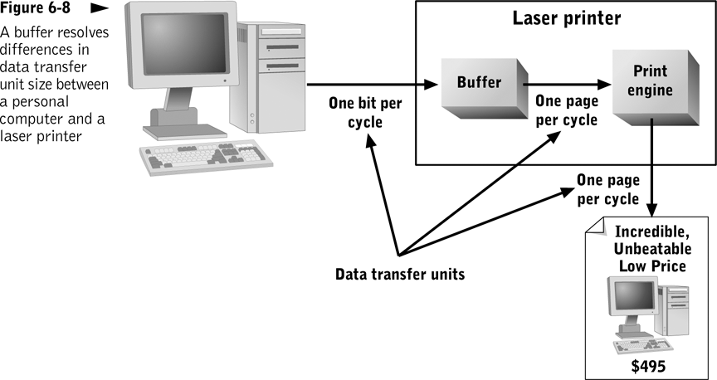
Notes:
Buffer
Mailman/mailbox analogy
Small storage areas (usually DRAM or SRAM) that hold data in transit from one device to another
Use interrupts to enable devices with different data transfer rates and unit sizes to efficiently coordinate data transfer
Buffer overflow

Slide 44
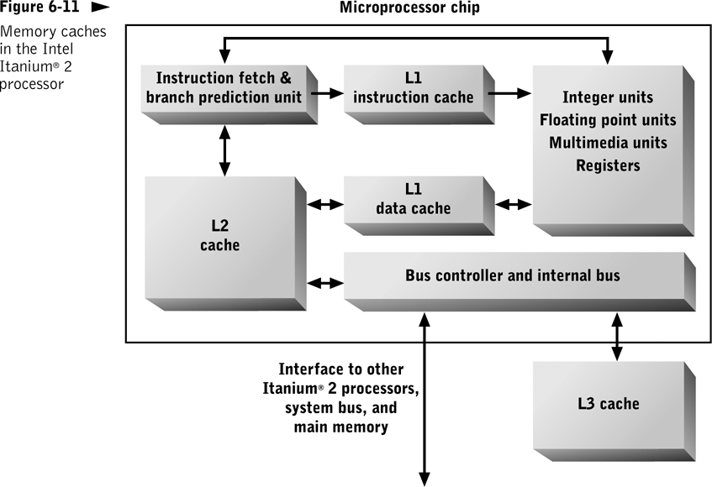
Can limit wait states by using SRAM cached between CPU and SDRAM primary storage:
Level one (L1): within CPU
Level two (L2): on-chip
Level three (L3): off-chip
Intel Itanium® 2 microprocessor uses three levels of primary storage caching.
Notes:
Cache
Differs from buffer:
Data content not automatically removed as used
Used for bidirectional data
Used only for storage device accesses
Usually much larger
Content must be managed intelligently
Achieves performance improvements differently for read and write accesses

Slide 45
Case Study – The Largest Caches?
A few special purpose desktops?
Servers

Slide 46
What did you learn?
A(n) _______ is a small area of memory used to resolve differences in data transfer rate or data transfer unit size.
A(n) ______ is an area of fast memory where data held on a storage device is prefetched in anticipation of future requests for that data.
buffer
cache

Slide 47
What did you learn?
A(n) ____ cache is implemented on the same chip as the CPU and is integrated into the same circuitry as the CPU.
L1

Slide 48
Processing Parallelism
Increases computer system computational capacity; breaks problems into pieces and solves each piece in parallel with separate CPUs
Techniques
Multicore processors
Multi-CPU architecture
Clustering

Slide 49
Question?
What type of system is faster?
A 4-way system with four separate CPUs
A quad-core system

Slide 50
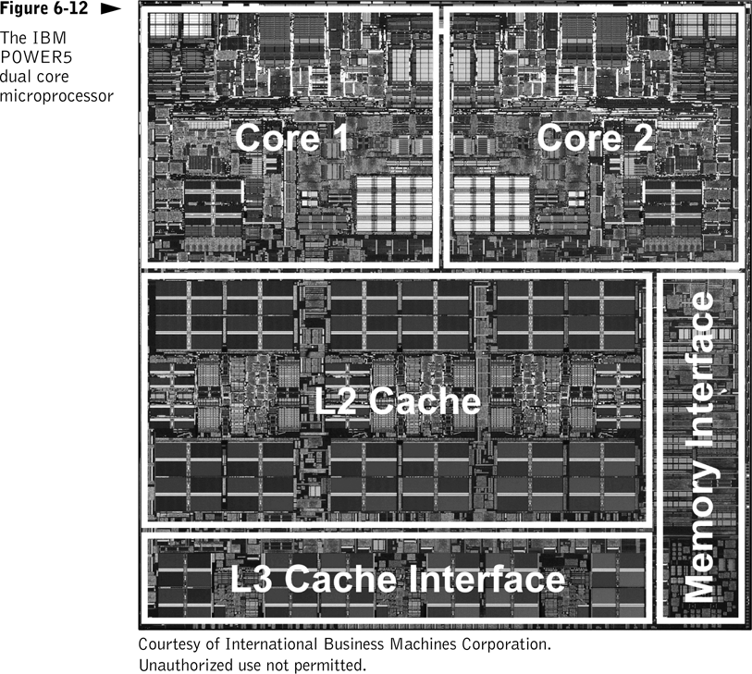
Notes:
Multicore Processors
Include multiple CPUs and shared memory cache in a single microchip
Typically share memory cache, memory interface, and off-chip I/O circuitry among the cores
Reduce total transistor count and cost and provide synergistic benefits

Slide 51
Case Study – Multiple Processors or Multicore Processors?
A few special purpose desktops?
Servers

Slide 52
Multi-CPU Architecture
Employs multiple single or multicore processors sharing main memory and the system bus within a single motherboard or computer system
Common in midrange computers, mainframe computers, and supercomputers
Cost-effective for
Single system that executes many different application programs and services
Workstations

Slide 53
Scaling Up
What is “scaling up”?
Notes:
Increasing processing by using larger and more powerful computers
Used to be most cost-effective
Still cost-effective when maximal computer power is required and flexibility is not as important

Slide 54
Scaling Out
What is “scaling out”?
Notes:
Partitioning processing among multiple systems
Speed of communication networks; diminished relative performance penalty
Economies of scale have lowered costs
Distributed organizational structures emphasize flexibility
Improved software for managing multiprocessor configurations

Slide 55
Computer System Classes
Microcomputer | Meets information processing needs of single user Examples: PCs, network computers
Portable | Meets information processing needs of a single user at a variety of levels Examples: laptop, network, PDA
Midrange computer | Supports many programs and users simultaneously
Mainframe | Handles information processing needs of large number of users and applications Large amounts of data storage and access
Supercomputer | Designed for rapid mathematical computation

Slide 56
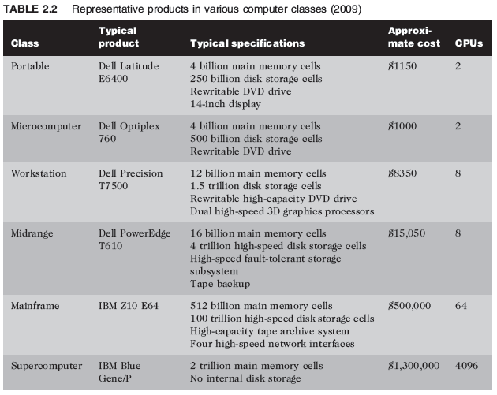
Table 2.2 Representative products in various computer classes (2009)

Slide 57
Multicomputer Configurations
Any organization of multiple computers to support a specific set of services or applications
Common configurations
Cluster
Blade
Grid
Cloud

Slide 58
Cluster
Group of similar or identical computers that cooperate to provide services or execute a common application
Connected by high-speed network
Typically located close to one another
Advantages: scalability and fault tolerance
Disadvantages: complex configuration and administration

Slide 59
Blade
Circuit board that contains most of a server
Same advantages and disadvantages as a cluster, but also:
Concentrate more computing power in less space
Are simpler to modify

Slide 60
Grid
Group of dissimilar computer systems, connected by high-speed network, that cooperate to provide services or execute a common application
Computers may be in separate rooms, buildings, or continents
Computers work cooperatively at some times, independently at others

Slide 61
Cloud
Set of computing resources with two components:
Front-end interfaces
Back-end resources
Specific way of organizing computing resources for maximum availability and accessibility
Minimum complexity in the user or service interface

Slide 62
Case Study – Focus on Systems
Desktops
Servers
Special Purpose Machines NAS Routers

Slide 63
Review
Systems Topics
Central Processing Unit (CPU)
Control Unit
Arithmetic Logic Unit (ALU)
Registers
The System Bus
I/O Basics
Processing Parallelism
Multicore Processing
Scaling up & out

