Slide 1
Module 3 - Storage
MIS5122: Enterprise Architecture for IT Auditors

Slide 2
Agenda
Storage
  Characteristics of Different Types of Storage
  Primary Storage
  Secondary Storage
    Magnetic Tape
    Magnetic Disk
  Storage Safety Nets
  SAN and NAS
  Cache Controllers

Slide 3
Case Study – Focus on Storage
Desktops
Servers
Special Purpose Machines NAS SAN

Slide 4
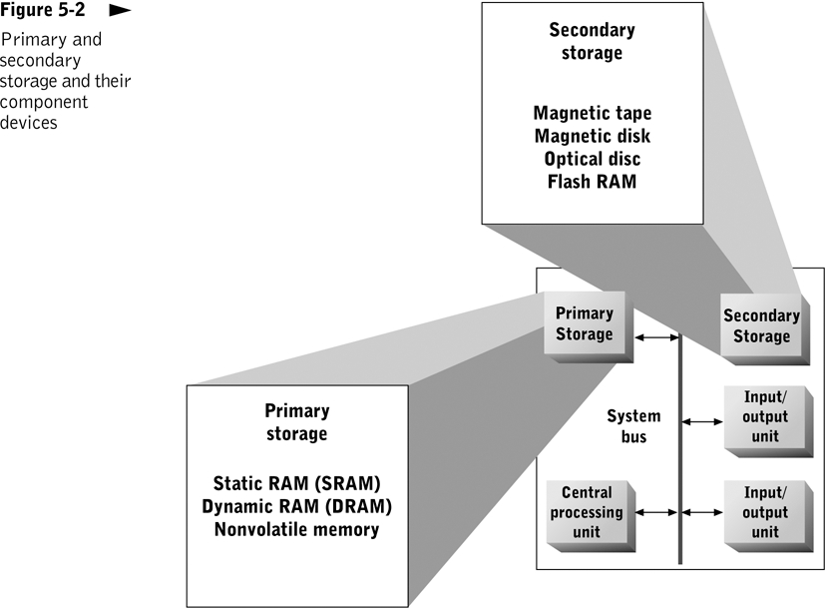
  Provide long-term storage of programs and data
  Support immediate execution of programs
Don’t forget registers and caches!

Slide 5
Question?
Assume that primary storage (i.e. RAM) is 1,000,000 times faster than secondary storage (i.e. disk).
If it took one second to access a byte in RAM, how long would it take to access disk?
Put this in useful units

Slide 6
What are the following characteristics of storage devices?
Speed
Volatility
Access method
Portability
Cost
Capacity
Notes:
Access Methods - Serial (tape) vs. direct access everything else

Slide 7
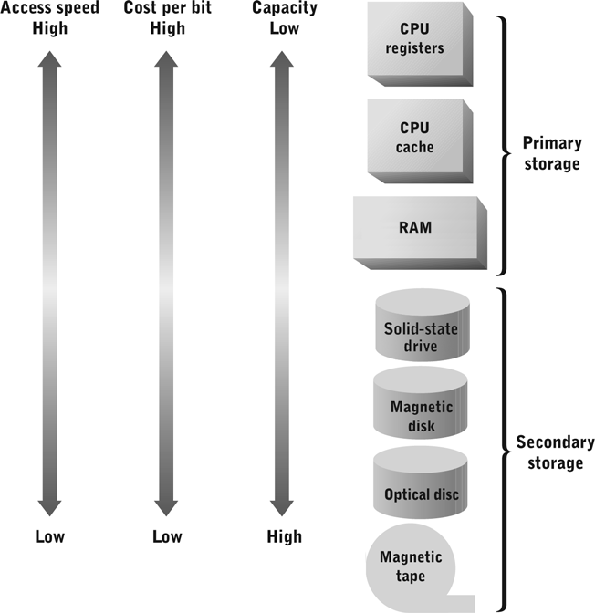
Memory-Storage Hierarchy
Volatile
Non-volatile
Notes:
Speed
Primary storage speed
Typically faster than secondary storage speed by a factor of 1,000,000 or more
Access time expressed in nanoseconds (billionths of a second)
Secondary storage speed
Access time expressed in milliseconds (thousandths of a second)
Remember wait states?
Data transfer rate – how much data moved per unit of time
Access Method
Serial access (linear)
Tape only widely used for of serial storage
Random access (direct access)
Just about everything other than tape
Parallel access (simultaneous)
Can simultaneously access multiple storage locations - RAM

Slide 8
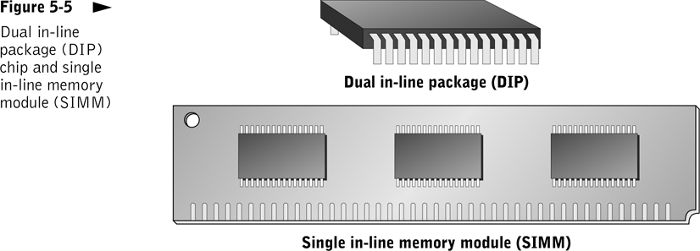
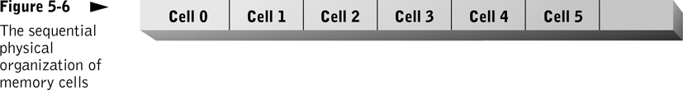
Notes:
Primary Storage (RAM)
Critical performance characteristics - Access speed, Data transfer unit size
Must closely match CPU speed and word size to avoid wait states
Static RAM (SRAM) – Registers, L1/L2/L3 Cache
Built entirely out of transistors
More expensive
Faster (5 nanoseconds – 5 billionths of a second)
Dynamic RAM (DRAM) – Traditional RAM
Uses both transistors and capacitors
Less expensive
Capacitors require refresh and can’t access memory during refresh cycle
Slower (50 nanoseconds – 50 billionths of a second)

Slide 9
Question?
Who has nonvolatile RAM with them right now?
What kind?
Notes:
Random access memory with long-term or permanent data retention
Originally relegated to specialized roles and secondary storage; slower write speeds
Where is the system software for your iPod installed?
Lives through total loss of power, hard, or soft reset
Generations of devices (ROM, EPROM, and EEPROM)
Flash RAM (most common NVM)
Competitive with DRAM in capacity and read performance
Relatively slow write speed
Looks like a drive but is a solid state device
Secure Digital
Compact Flash

Slide 10
What did you learn?
The contents of most forms of RAM are _______, making them unsuitable for long term data storage.
__________ is typically stated in milliseconds for secondary storage devices and nanoseconds for primary storage devices.
volatile
Access time

Slide 11
What did you learn?
_________ storage is slower, cheaper, and non-volatile versus _______ storage which is faster, more expensive and volatile.
Tape drives are __________ devices. Disk drives are random or direct access devices.
Secondary
primary
serial access

Slide 12
What did you learn?
Modern personal computers generally use memory packaged on small standardized circuit boards called _______________.
DIMMs or SIMMs

Slide 13
Question?
In your own words, what is the “duality of magnetism?”

Slide 14
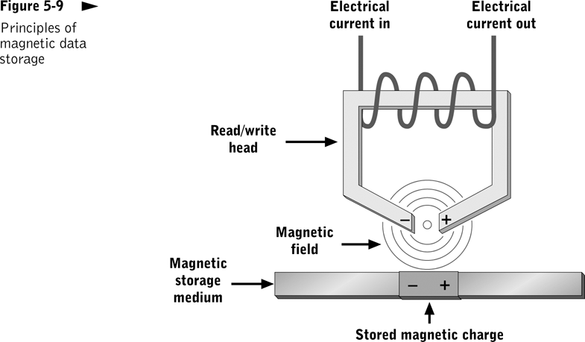
Notes:
Magnetic Storage
Exploits duality of magnetism and electricity
Converts electrical signals into magnetic charges
Captures magnetic charge on a storage medium
Later regenerates electrical current from stored magnetic charge
Polarity of magnetic charge represents bit values zero and one

Slide 15
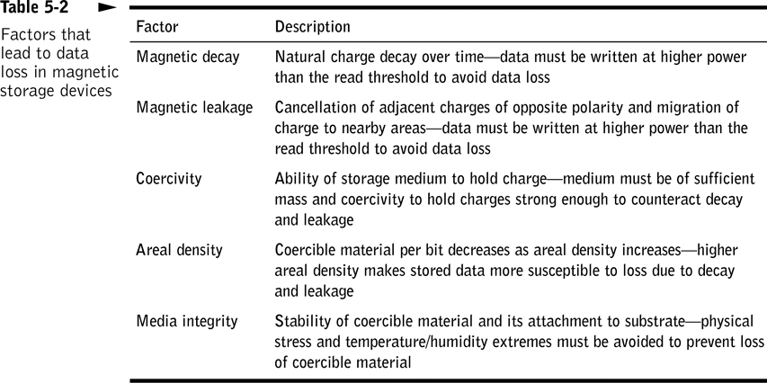

Slide 16
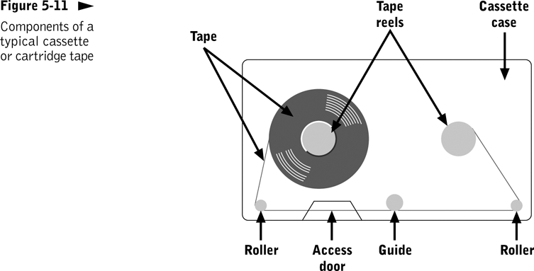
Notes:
Magnetic Tape
Ribbon of plastic with a coercible (usually metallic oxide) surface coating
Mounts in a tape drive for reading and writing
Relatively slow serial access – NOT!
Compounds magnetic leakage; wraps upon itself
Susceptible to stretching, friction, temperature variations
Reliable, dirt cheap, incredible capacity

Slide 17
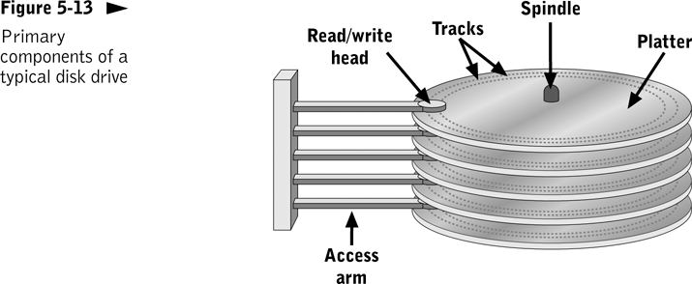
Notes:
Magnetic Disk
Flat, circular platter with metallic coating that is rotated beneath read/write heads
Random access device; read/write head can be moved to any location on the platter
Hard disks and floppy disks
Cost performance leader for general-purpose on-line secondary storage

Slide 18
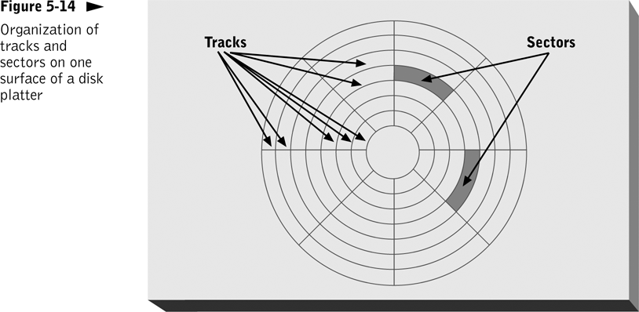

Slide 19
Question?
If I worked for a hard drive manufacturer and my boss told me that our current hard drives were not fast enough, where would I focus my attention to make them faster?
If my boss told me that we needed to improve density, where would I focus my attention?
Can I both make drives faster and improve the density?

Slide 20
Notes:
Magnetic Disk Access Time
Head-to-head switching time
Track-to-track seek time
Rotational delay
Most important performance numbers
Average access time
Sequential access time
Sustained data transfer rate

Slide 21
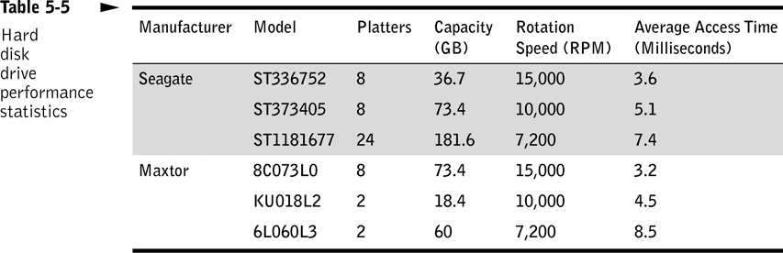

Slide 23
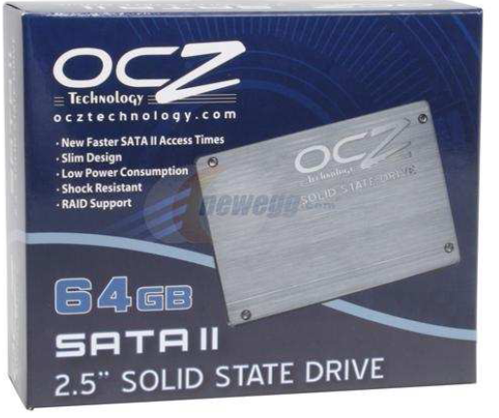
Solid State Drive
$789 for 64 GB
Why are reads so fast?
Are writes that fast?
Why shouldn’t you defrag this device?

Slide 24

Solid State Drive

Slide 25
What did you learn?
The ______________ of a hard disk drive generates or responds to a magnetic field .
Data stored on magnetic media for long periods of time may be lost due to _______________ and _____________.
read/write heads
magnetic leakage
magnetic decay

Slide 26
What did you learn?
A(n) ____________ stores data in magnetically charged areas on a rigid platter.
The three components of average access time for a disk drive are _____________________, ___________________, and _____________.
hard disk drive
head to head switch time
track to track seek time
rotational delay

Slide 27
Fault Tolerance
Methods of securing file content against hardware failure
  File backup/Recovery
  Mirroring
  RAID (Redundant Array of Inexpensive Disks)
  Transaction logging

Slide 28
File Backup
Protects against data loss (file content, directory content, and storage allocation tables)
Store backup copies on a different storage device in a different physical location
  Tape
  Disk
Manual or automatic
Full or incremental
Test restores on a regular basis like your job depends on it!

Slide 29
Question?
If I had six 100 gig volumes and I wanted to mirror my hard drives, how much usable space would I have?
If I wanted to build a RAID-5 array, how much usable space would I have?
What is better, mirroring or RAID-5? Why?
Notes:
If I have a datacenter with 1,000 servers and they each have 5 hard drives, I’ve got 5,000 hard drives.
They’re brown, round, and spinning at thousands of RPM, electromechanical devices break.
Even if the MTBF is measured in years, how often do I lose a hard drive?
What happens if that hard drive is part of my order entry system, my accounting system, or god forbid, my ERP system?

Slide 30
Mirroring
Notes:
All disk write operations are made concurrently to two different storage devices
Provides high degree of protection against data loss with no performance penalty if implemented in hardware
Disadvantages
Cost of redundant disk drives
Higher cost of disk controllers that implement mirroring

Slide 31
RAID
Notes:
RAID
Disk storage technique that improves performance and fault tolerance
All levels except RAID 1 use data striping
Breaks a unit of data into smaller segments and stores them on multiple disks
Multiple levels can be layered to combine their best features (e.g. RAID 10)
Can be implemented in hardware or software

Slide 32
RAID

Slide 33
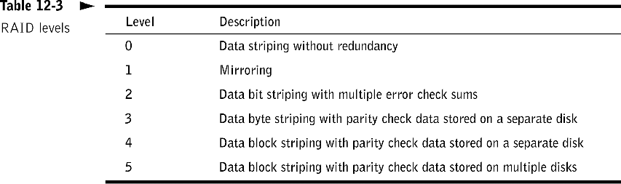

Slide 34
Case Study – Mirroring & RAID-5
Let’s take a look!
Servers
All C-Drives Mirrored
All SQL Logs Mirrored
File/Print & SQL Data RAID-5

Slide 35
What did you learn?
RAID 10 combines disk mirroring and _______ to achieve performance improvement and fault tolerance.
striping

Slide 36
Transaction Logging
Notes:
Transaction Logging
Automatically records all changes to file content and attributes in a separate storage area; also writes them to the file’s I/O buffer
Provides high degree of protection against data loss due to program or hardware failure
Imposes a performance penalty; used only when costs of data loss are high (yeah, right!)

Slide 37
Case Study – Transaction Logging Let’s Take a Look!
SQL Servers

Slide 38
Question?
Which is better, NAS technology or SAN technology? Why?
Notes:
SAN is a dedicated network of storage devices(can include tape drives storages, raid disk arrays etc) all working together to provide an excellent block level storage. While NAS is a single device/server/computing appliance, sharing its own storage over the network

Slide 39
Storage Consolidation
Overcomes inefficiencies of direct-attached storage (DAS) in multiple-server environments
Common approaches
  Storage area network (SAN)
  Network-attached storage (NAS)

Slide 40
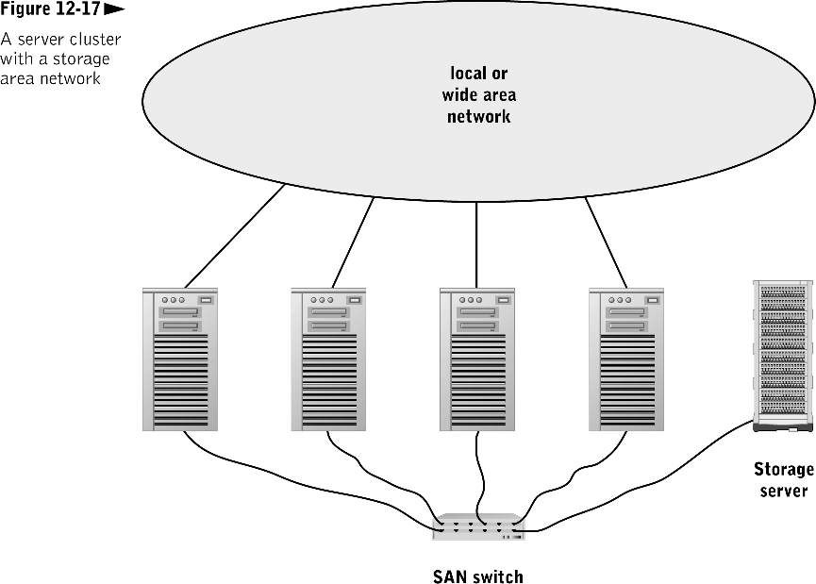

Slide 41
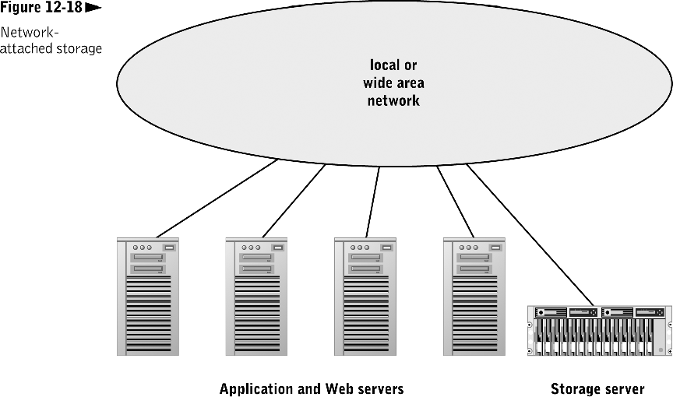

Slide 42
Case Study – Network Attached Storage
NAS

Slide 43
What did you learn?
In a(n) ____, multiple servers share access to the same storage server over a special-purpose network dedicated to low-level storage accesses.
Under ____, a specialized server manages one or more file systems and responds to the file I/O requests sent across a LAN or WAN.
SAN
NAS

Slide 44
Question?
How does a caching disk controller improve read access times?
How does a caching disk controller improve write times?

Slide 45
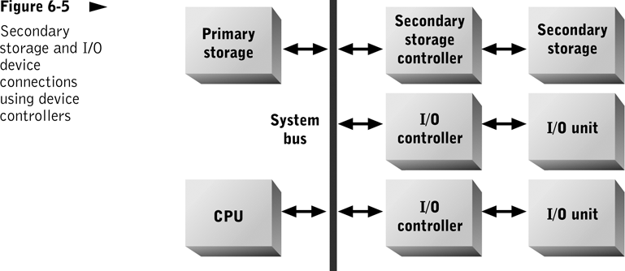
Device Controllers
Notes:
Device Controllers
Used by secondary storage and I/O devices
Implement the bus interface and access protocols
Translate logical addresses into physical addresses
Enable several devices to share access to a bus connection

Slide 46
Cache Controller
Notes:
Cache Controller
Processor that manages cache content
Guesses what data will be requested; loads it from storage device into cache before it is requested
Can be implemented in
A storage device storage controller
Operating system

Slide 47
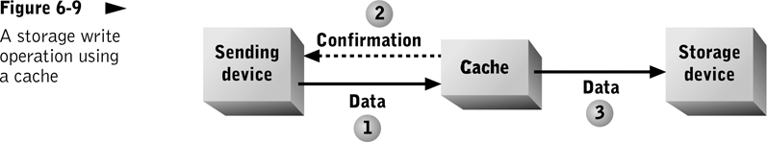
Write access: Sending confirmation (2) before data is written to secondary storage device (3) can improve program performance; program can immediately proceed with other processing tasks.

Slide 48
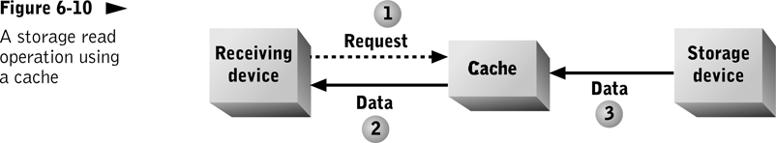
Read accesses are routed to cache (1). If data is already in cache, it is accessed from there (2). If data is not in cache, it must be read from the storage device (3). Performance improvement realized only if requested data is already waiting in cache.

Slide 49
What did you learn?
An access to primary storage that is found within a cache is called a(n) ________.
cache hit

Slide 50
Case Study – Focus on Storage
Desktops
Servers
Special Purpose Machines
NAS
SAN

Slide 51
Review
Storage
  Characteristics of Different Types of Storage
  Primary Storage
  Secondary Storage
    Magnetic Tape
    Magnetic Disk
  Storage Safety Nets
  SAN and NAS
  Cache Controllers

Slide 52
Working with RAID Arrays

Slide 53
Purpose
Get your hands dirty configuring RAID arrays on a Windows 2012 Server
Get more exposure with virtual machine technology
Have fun (in a geeky sort of way)!

Slide 54
Plan
Get into groups
Add 5 GB virtual hard drives to our virtual machines and fire them up
Configure 3 of the drives into a RAID array
Configure the other two into a pair of mirrored drives

Slide 55
One Drive Goes Bad
Shutdown your server
Delete one of the drives in your RAID-5 array
Bring up your systems and check out the state of the volume
See that you can still access the data even through the singe drive has failed
Shutdown your servers

Slide 56
New Drive Added
Add another drive to your server
Fire up your server and we’ll see if we can repair the array
Make sure we can still get to the data after the array has been recovered
Delete the volume and kiss your data goodbye

Slide 57
Mirrored Drives
Can you do it again with mirrored drives?
How much space is available on a mirrored volume?

Slide 58
Questions?
Any questions?
Have fun!

Slide 59
RAID 5 vs. Mirrored Drives
Which one is better?
RAID 5
  Pros?
  Cons?
Mirrored Drives
  Pros?
  Cons?

